Slide 1
Art of the Prehistoric Aegean
Greece
- Minoan, 1900-1450 BC
- Mycenaean, 1600-1200 BC

Slide 2
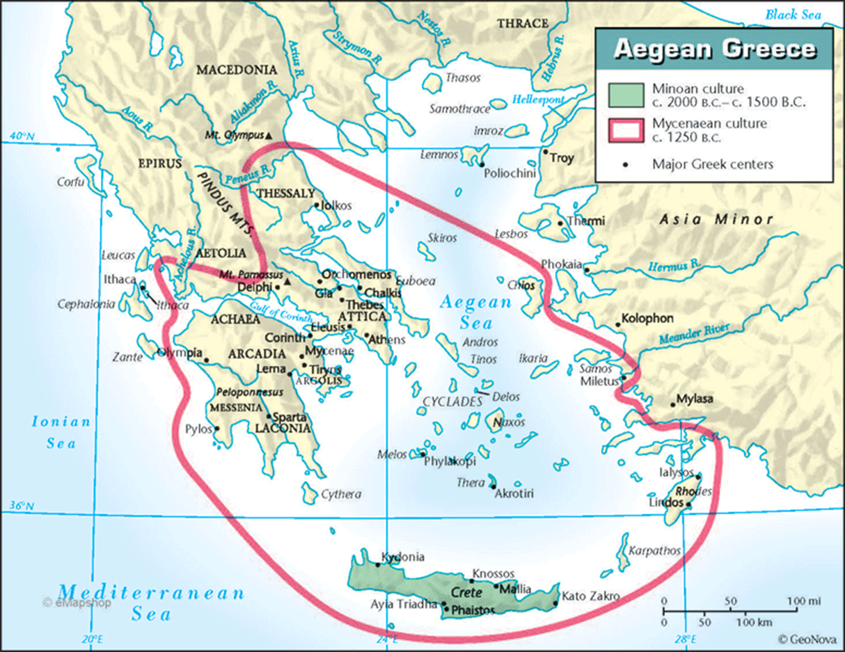
Bronze Age in the Aegean (c. 2600-1100 BCE)
Cyclades- Cyclades islands
Minoans- Thera and Crete
Helladic (Mycenaean) –
mainland Greece

Slide 3
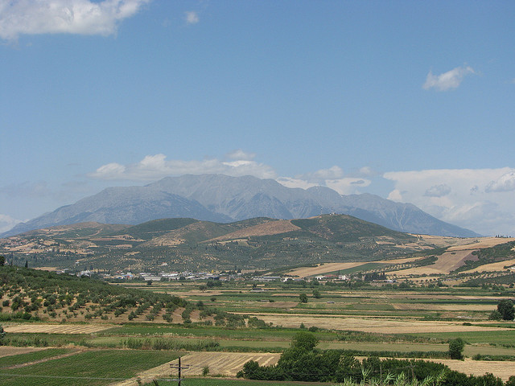


Slide 4
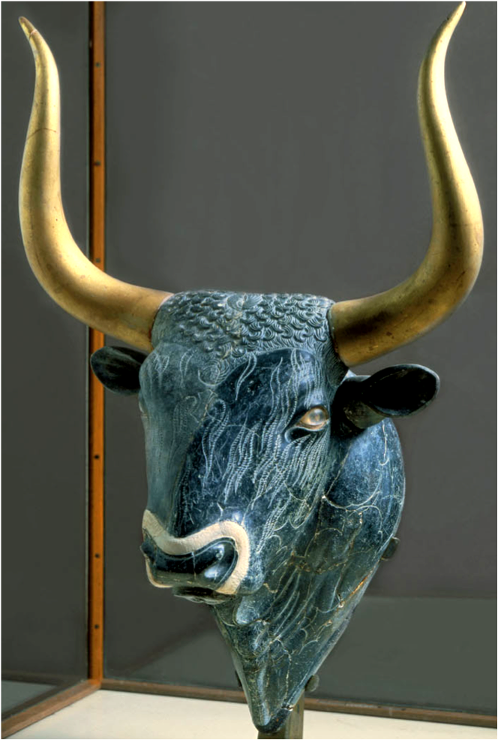
Minoan
Bull’s Head Rhyton, Knossos, Crete. “New Palace” Period. C. 1550-1450 BCE.
Steatite with shell, rock crystal and red jasper, the gilt-wood horns are restorations, height 12”

Slide 5
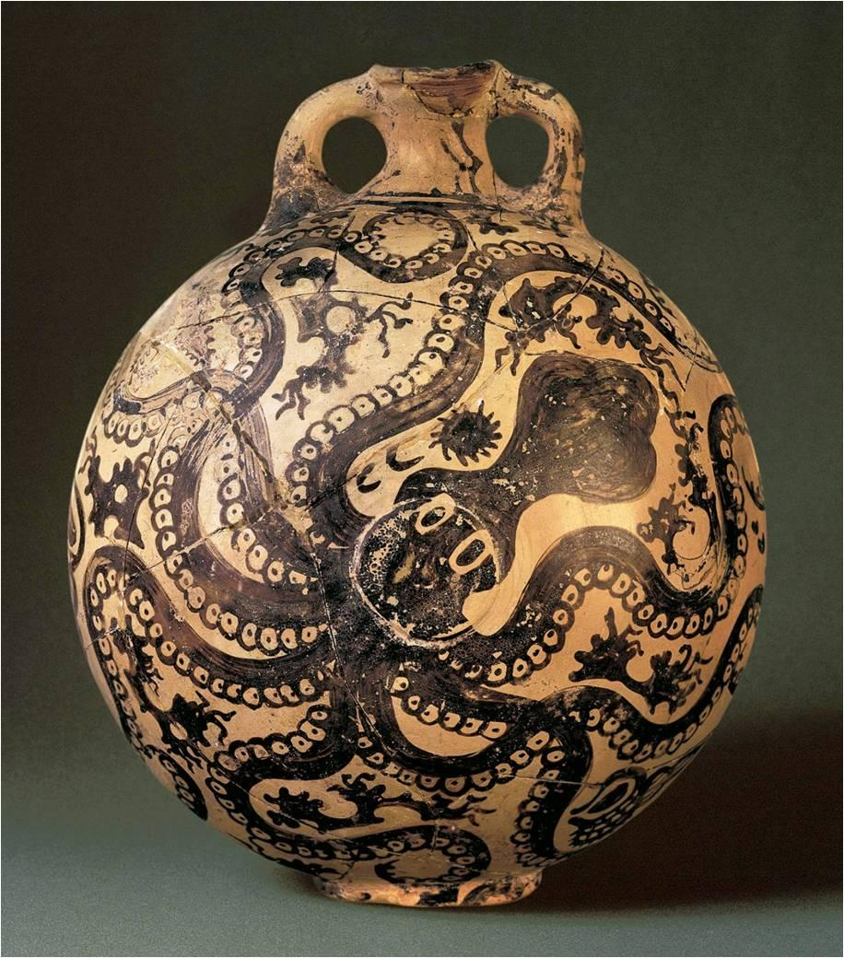
Minoan
Octopus Flask, Palaikastro, Crete. “New Palace” Period,
c. 1500-1450 BCE. Marine style ceramic, height 11”

Slide 6
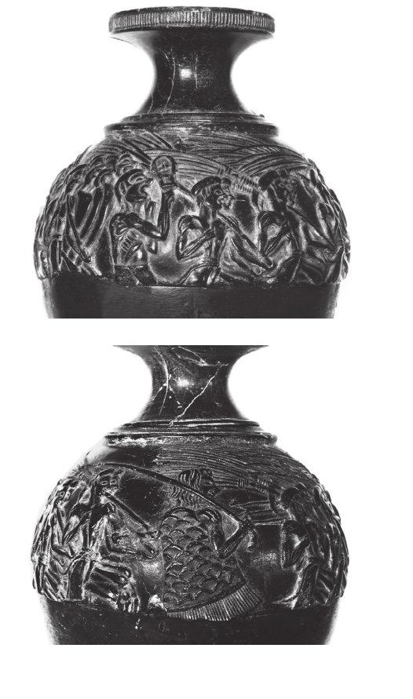
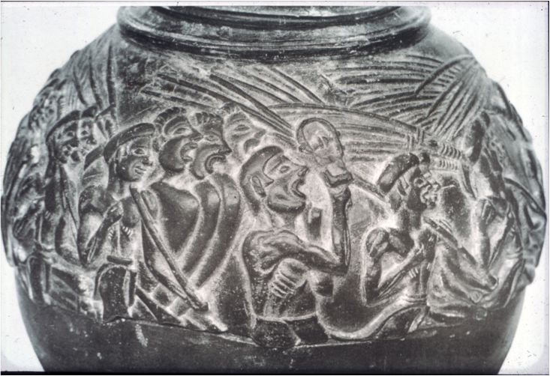
Minoan
Views of the Harvester Rhyton, Hagia Triada, Crete, “New Palace” Period,
C. 1650-1450 BCE. Steatite, diameter 4.5”

