Slide 1
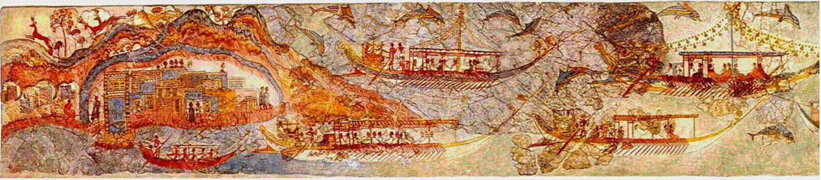
Minoan
“The Flotilla Fresco” from Akrotiri. Room 5 of West House, Akrotiri, Thera.
“New Palace” Period. c. 1650 BCE

Slide 2
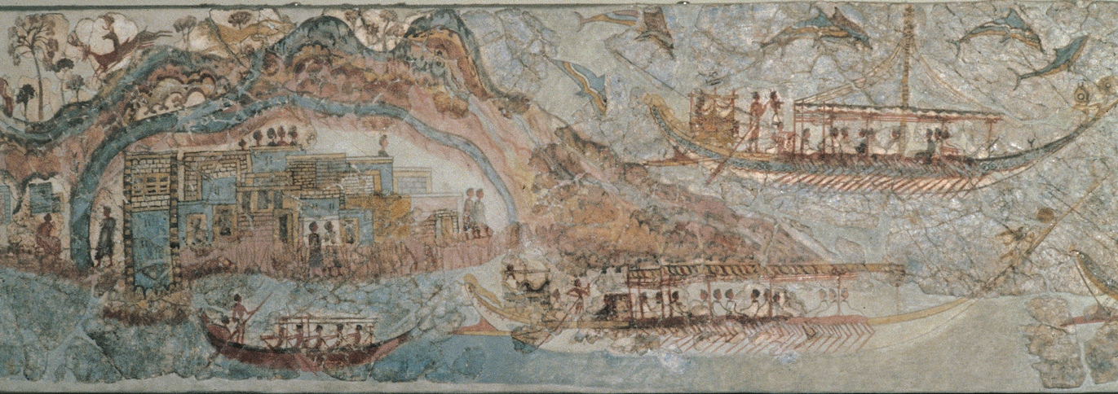

Slide 3
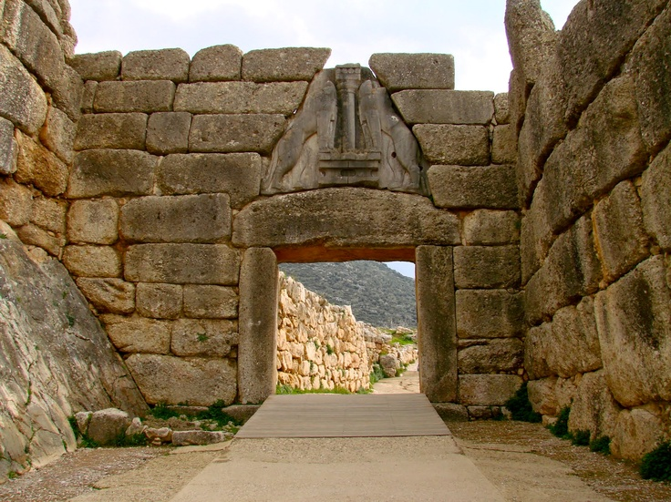
Mycenaean
Lion Gate, Mycenae, as it appears today. c. 1250 BCE.
Limestone Relief, height of sculpture approx. 9’6”

Slide 4
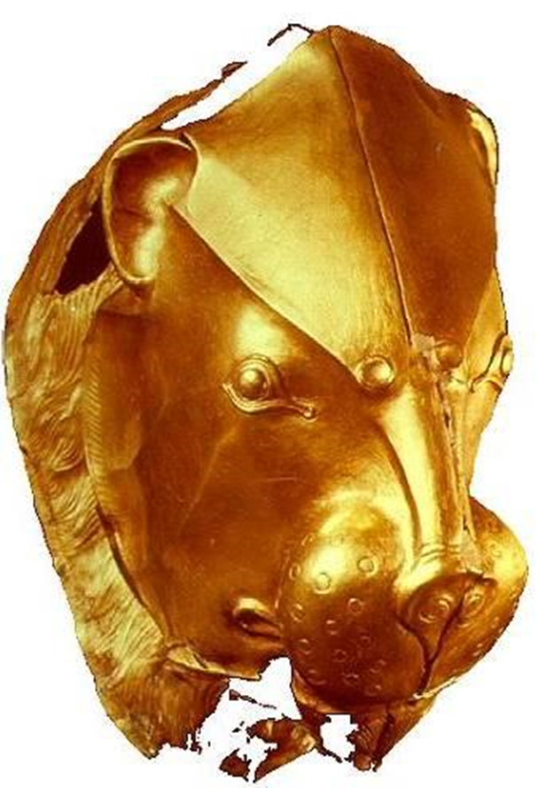
Mycenaean
Golden Lion’s Head Rhyton, from shaft grave iv, Grave circle A, south of Lion Gate Mycenae,
16th century BCE. Athens

Slide 5
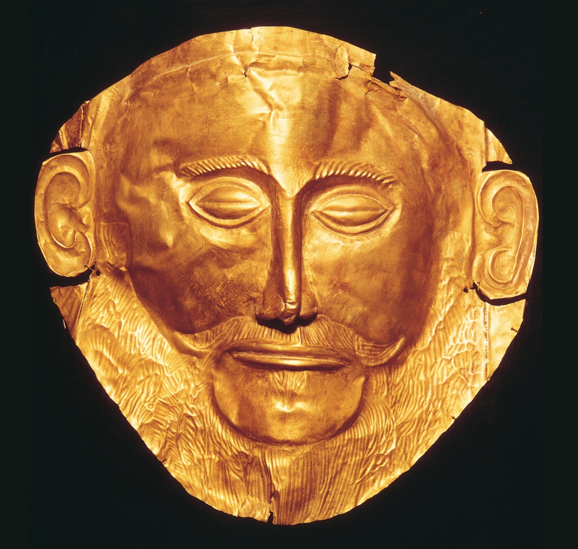
Mycenaean
Funerary mask,
Mycenae, Greece,
ca. 1600–1500 BCE.
Beaten gold, 1’

