Slide 1
Art of Ancient China

Slide 2
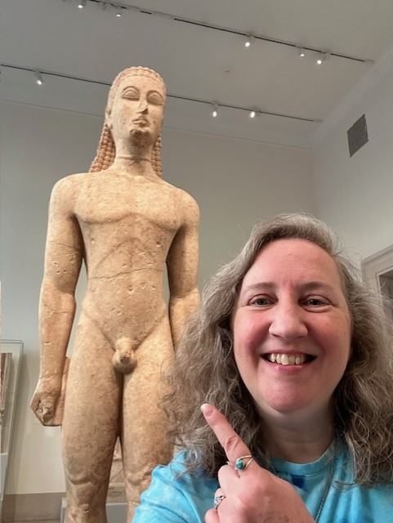
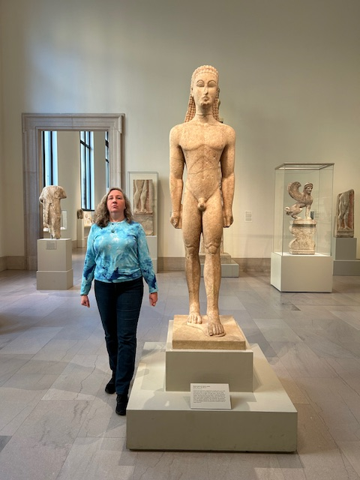

Slide 3
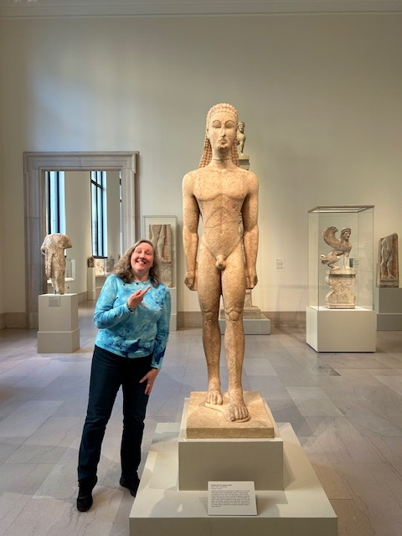

Slide 5
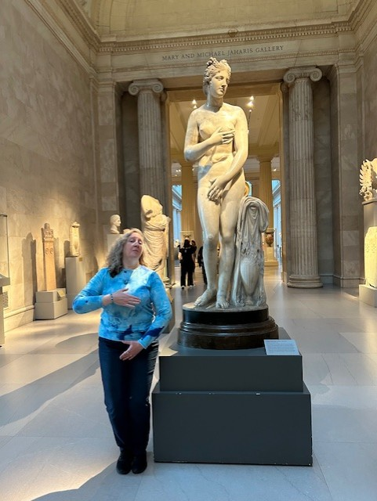

Slide 6
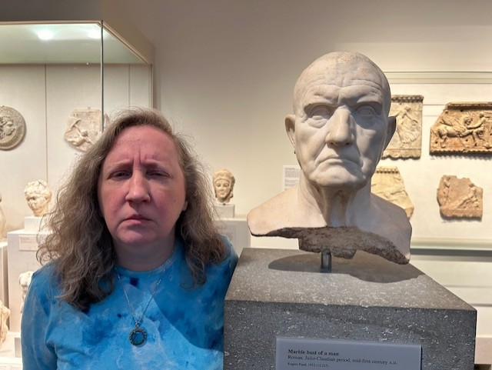

Slide 7
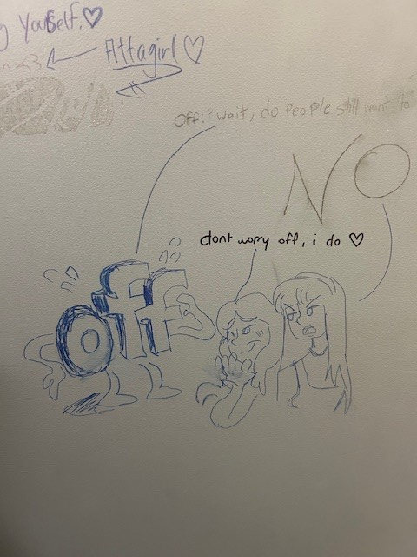
In Memoriam:

Slide 8
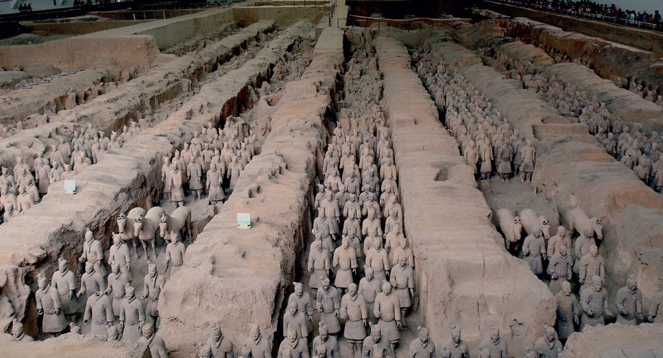
Army of the First Emperor of Qin, Shi Huangdi, in pits next to his burial mound, Lintong, China,
Qin dynasty, ca. 210 bce. Painted terracotta, average figure 5' 11”

Slide 9
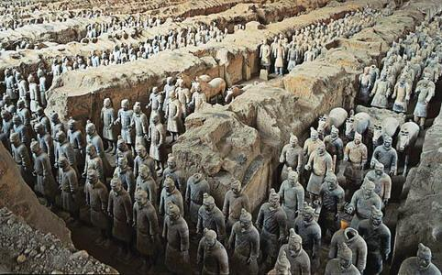
Soldiers, Tomb of First Emperor, Qin Dynasty, 210 BCE

Slide 10
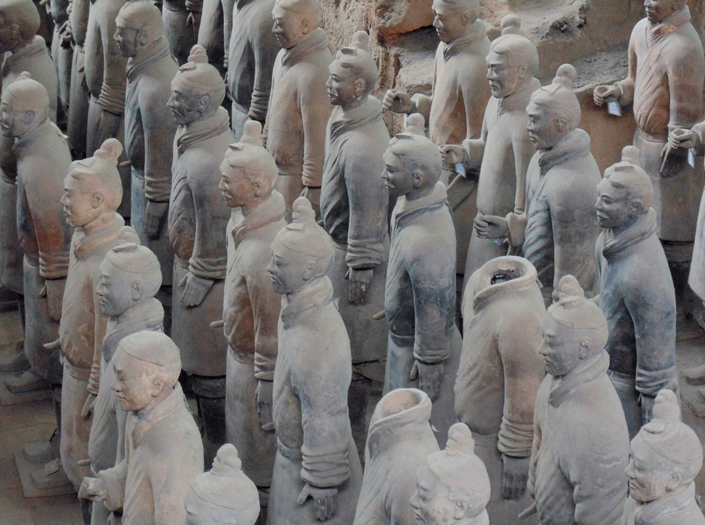

Slide 11
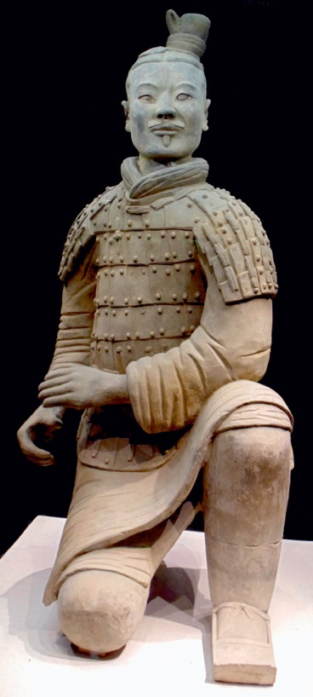

Slide 12
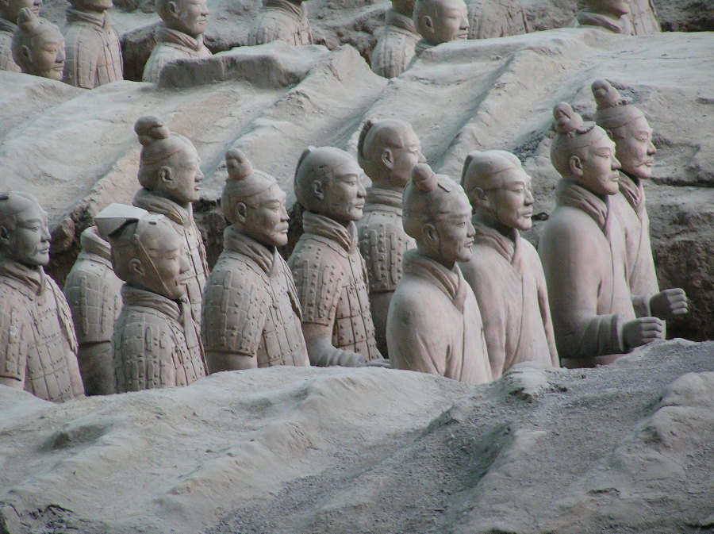

Slide 13
Confucianism: Key Ideas
Humanism: belief through education and cultivation all humans can be “perfected” and live in well-ordered society
Virtues: high moral standards, goodness, integrity, decency
Ren– love of humanity, human-heartedness & empathy for fellow man (golden rule)
Li– the courtesy one sees in a cultivated, polite person, respect for “rituals” of daily life
{Li >> Relationships—respect for those before you Father to son, elder to junior, ruler to subject}

Slide 14
“The mind of the superior man is concerned with what is right, the mind of the small man is concerned with gains he may receive” --Confucius

Slide 15
Taoism (Daoism)
The Tao: meaning “The Way” or the “Ultimate” way of the universe or the rhythm of the universe (pulse)
To follow the Tao– to seek a quiet, humble life, unconcerned with success, appreciative of simplicity, harmony
Te: Virtue, wants us to discard knowledge, directions, or rules, to “unlearn” away from civilization and back to nature to achieve action through non-action
Balance of opposite forces—yin / yang
Even applies to government

Slide 16
“If we renounce wisdom and banish righteousness, people would again be respectful and kind”
“When we renounce learning we have no troubles”

Slide 17
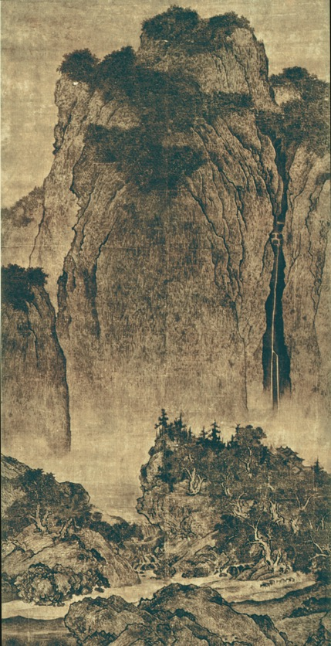
Fan Kuan,
Travelers Among Mountains and Streams, Song Dynasty, 11th century CE,
7’ hanging scroll

Slide 18
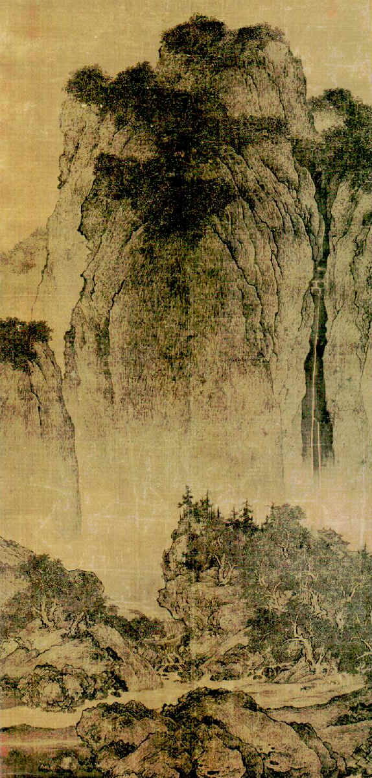
Fan Kuan,
Travelers Among Mountains and Streams, Song Dynasty, 11th century CE,
7’ hanging scroll

Slide 19
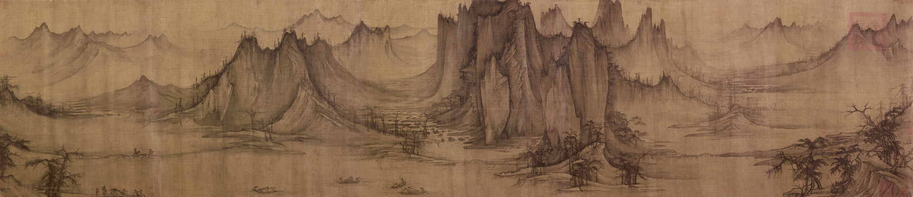
Xu Daoning, Section of Fishing in a Mountain Stream, Song Dynasty, 11th cent

Slide 20
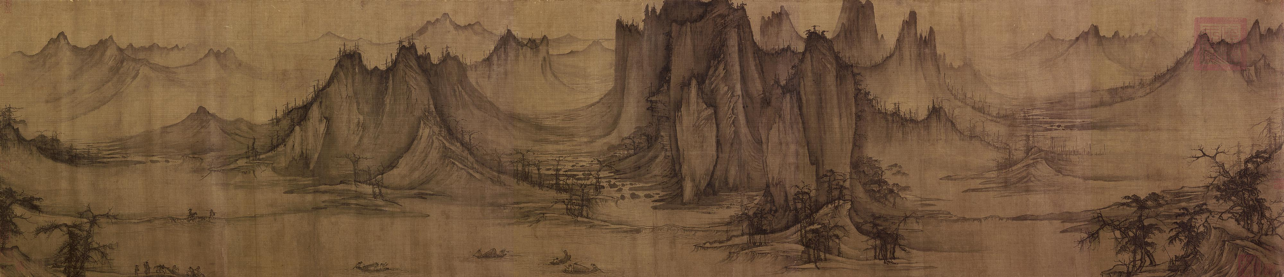

Slide 26
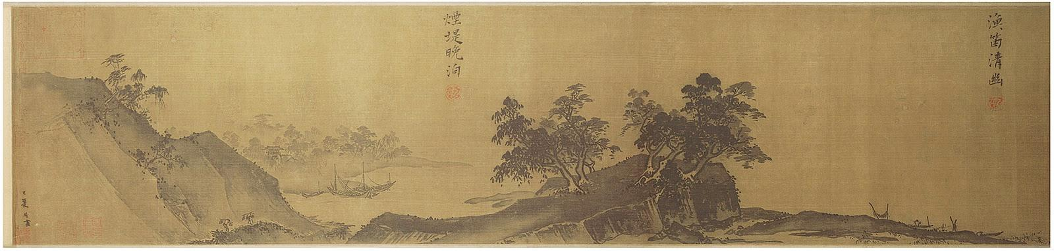
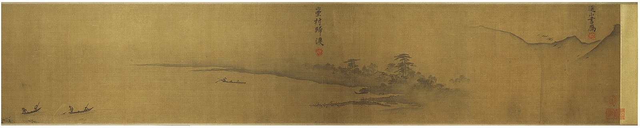
Xia Gui, Section of Twelve Views of a Landscape, Southern Song Dynasty, early 13th century CE

Slide 27
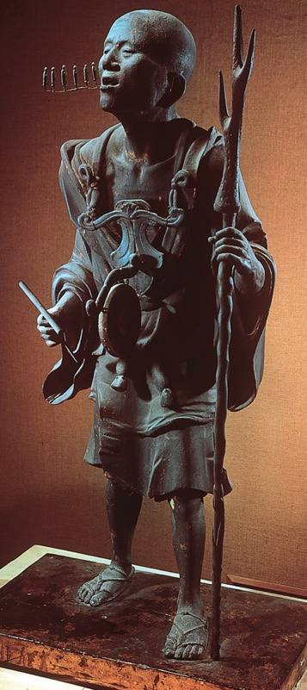
Japan
Kosho, portrait statue of the Buddhist priest Kuya preaching,
Kamakura period, early 13th century
Painted wood, 3' 10 1/4" high

