Slide 1
Ancient Egypt

Slide 2
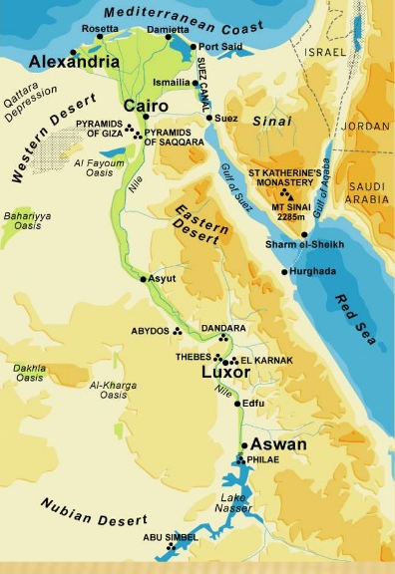
Lower Egypt
Upper Egypt
Ancient Egypt

Slide 3
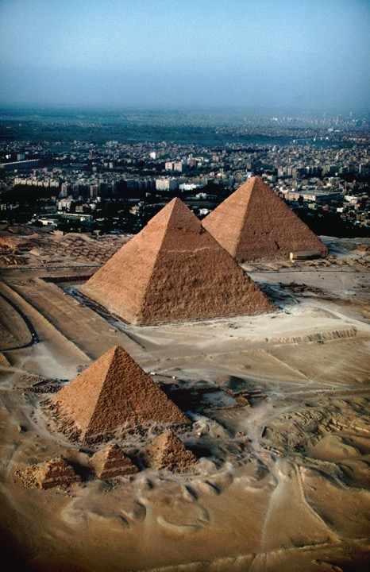
Aerial view of the
4th Dynasty pyramids
(looking north), Giza, Egypt.
From bottom:
Pyramids of Menkaure,
ca. 2490–2472 BCE;
Khafre, ca. 2520–2494 BCE;
and Khufu, ca. 2551–2528 BCE.

Slide 4
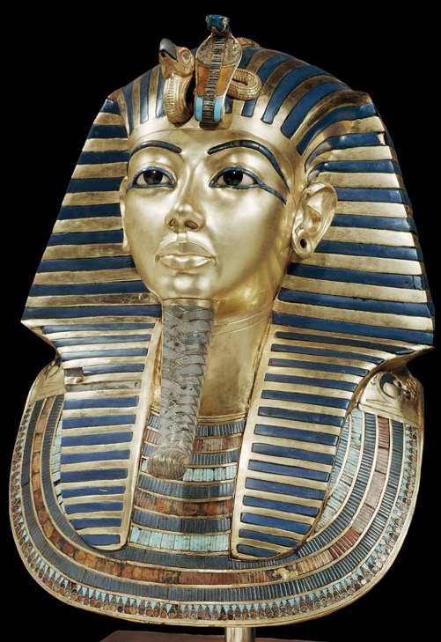
Ka - life force
or soul of the human
Funerary Mask of Tutankhamun, 18th Dynasty , 1327 BCE
Gold inlaid with glass and semi-precious stones, height approx. 21”.

Slide 5
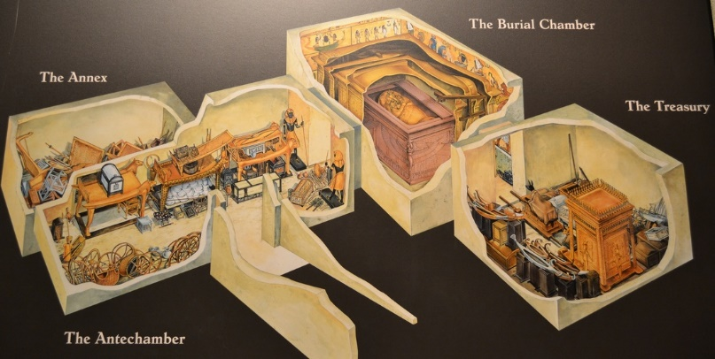
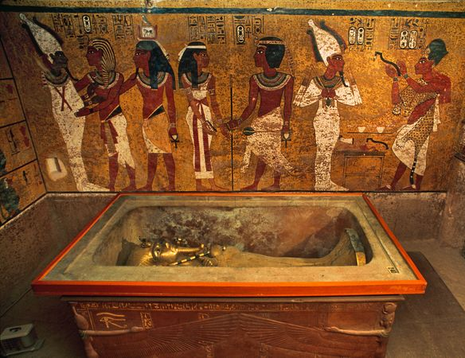

Slide 6
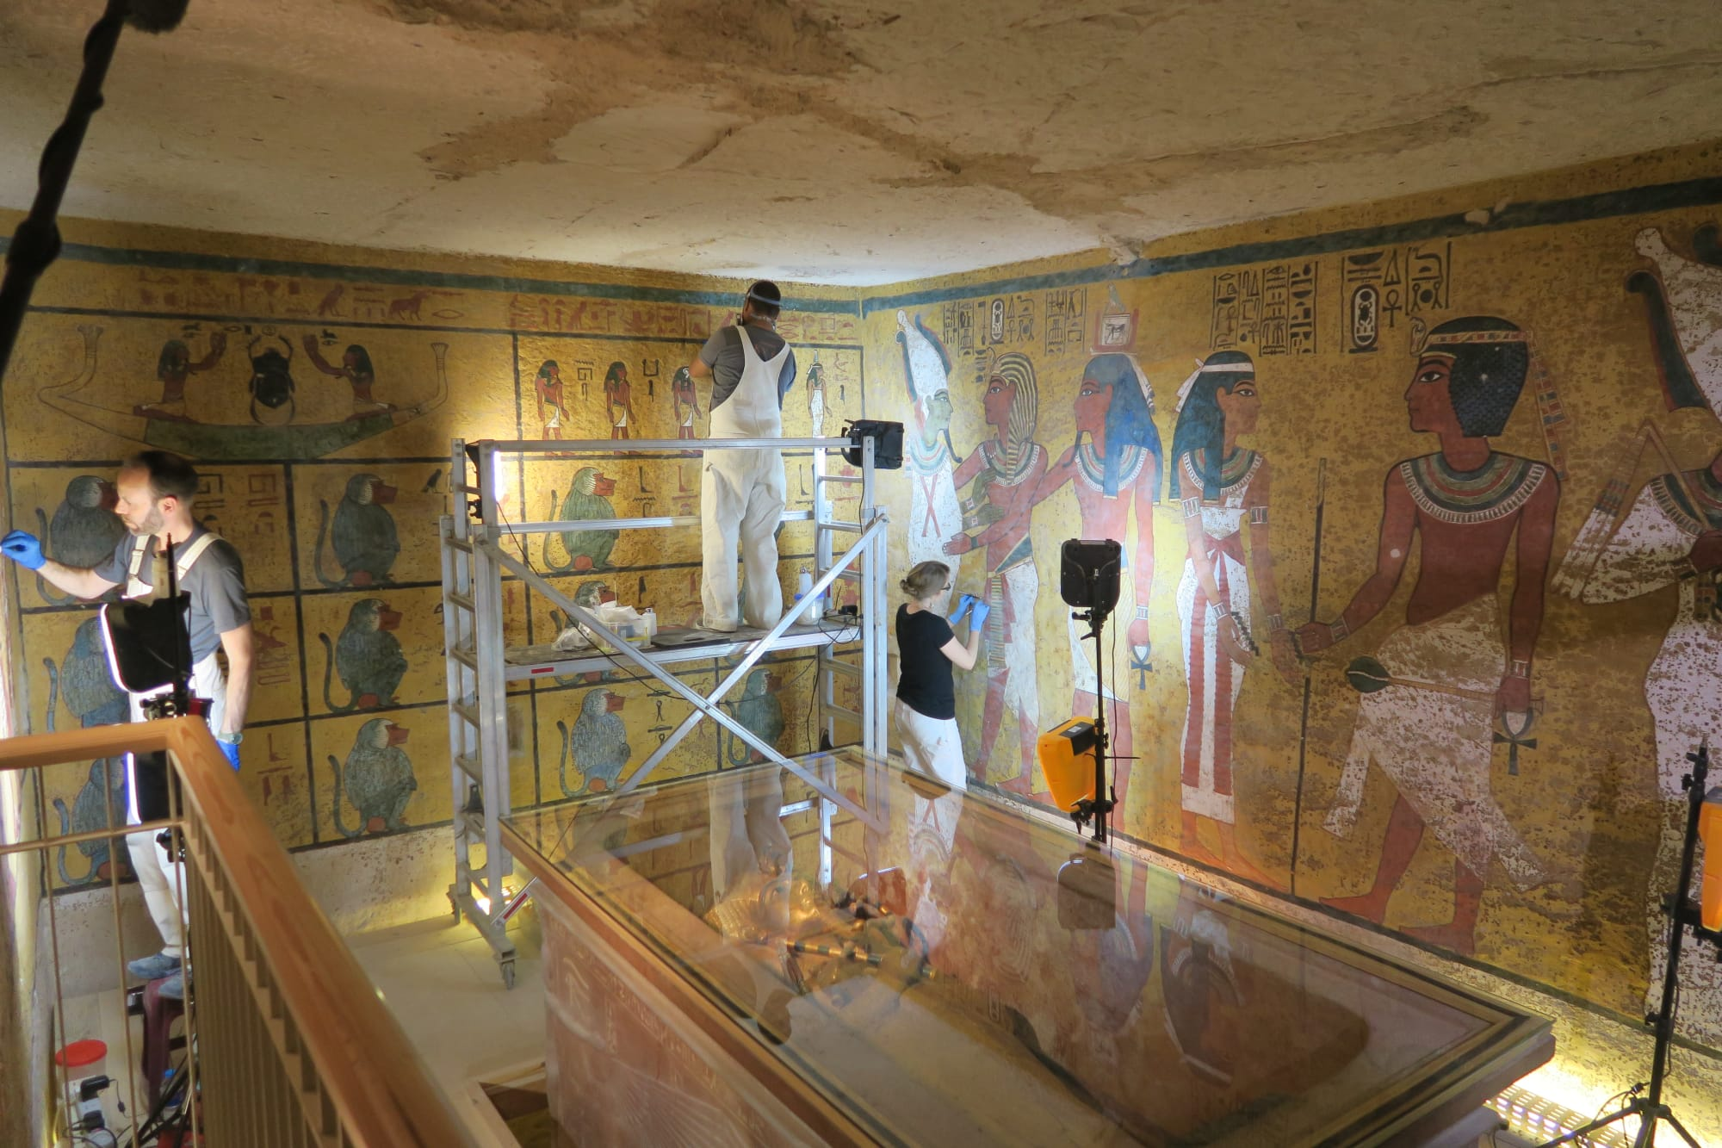
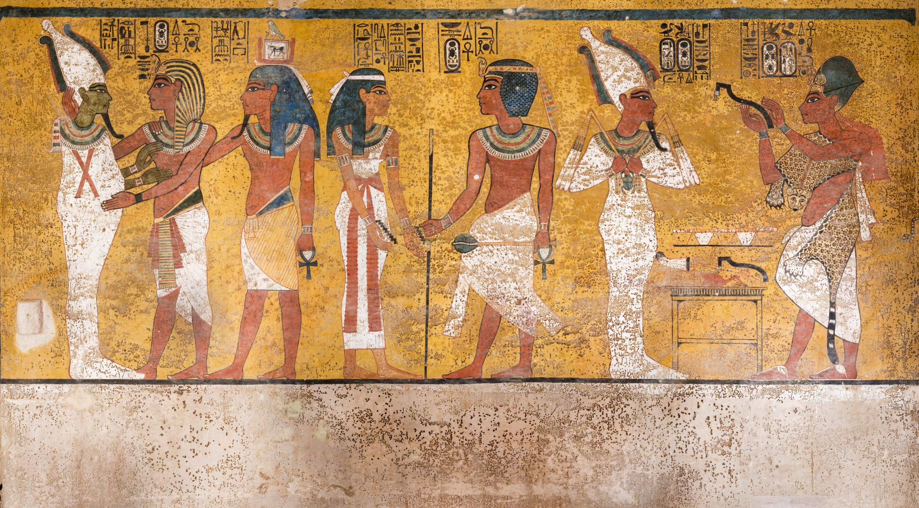
Interior of King Tut’s tomb under restoration

Slide 7
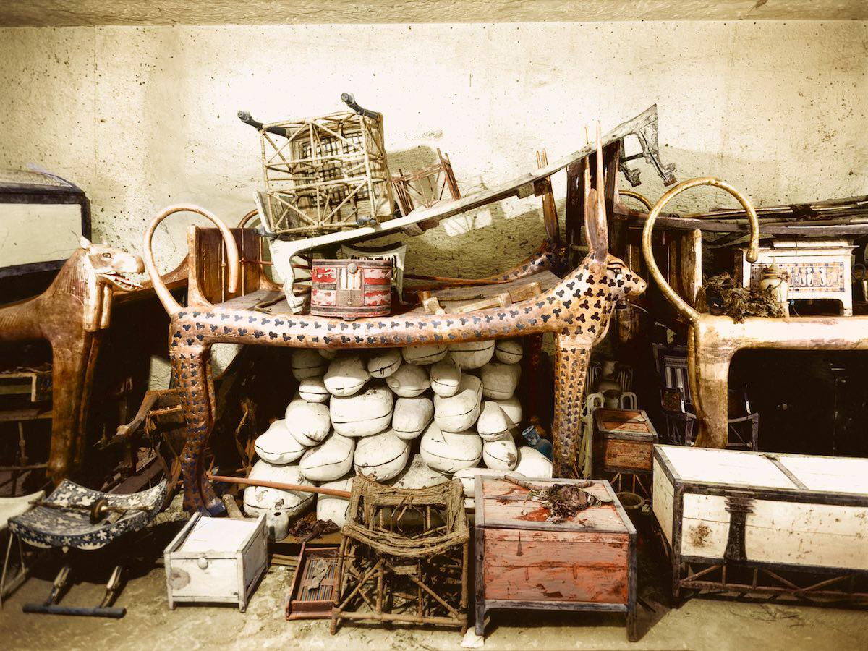
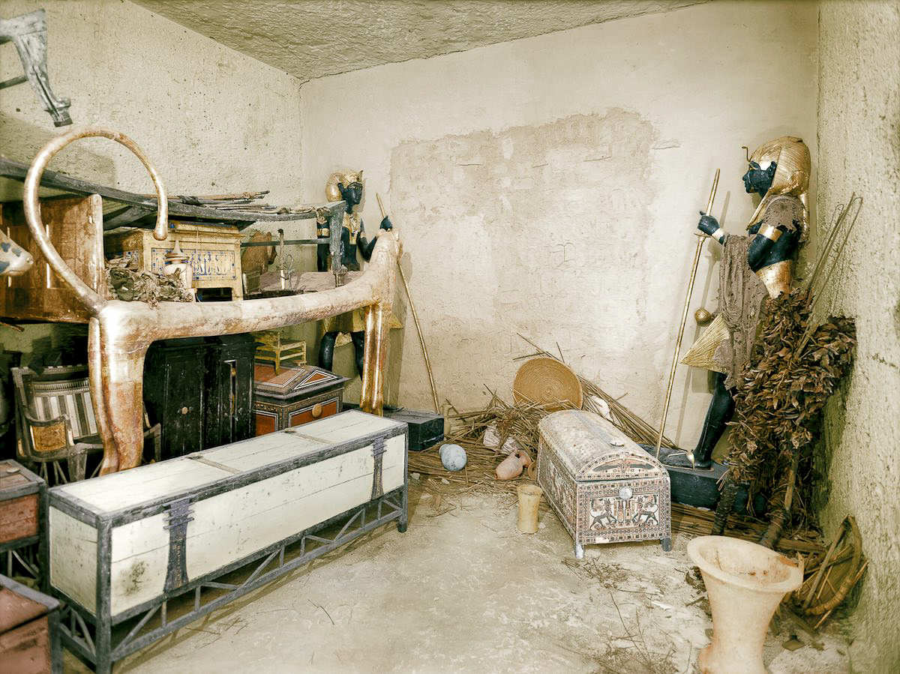
Artifacts from the antechamber to King Tut’s tomb.

Slide 8
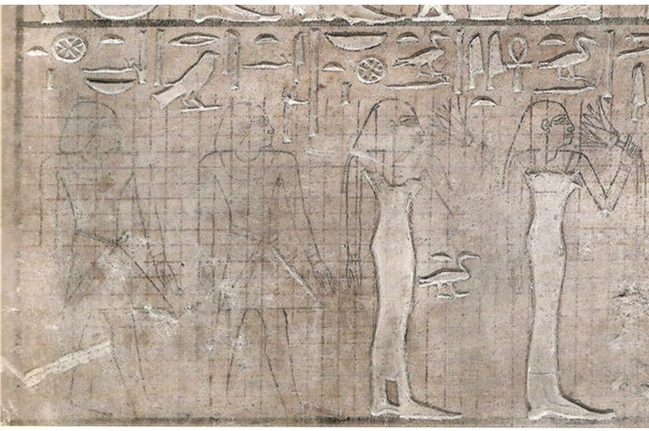
Canon of Proportions – A set of ideal mathematic ratios in art based on measurements, as in the proportional relationships among the basic elements of the human body
Detail of the Stele of the Sculptor Userwer

Slide 9
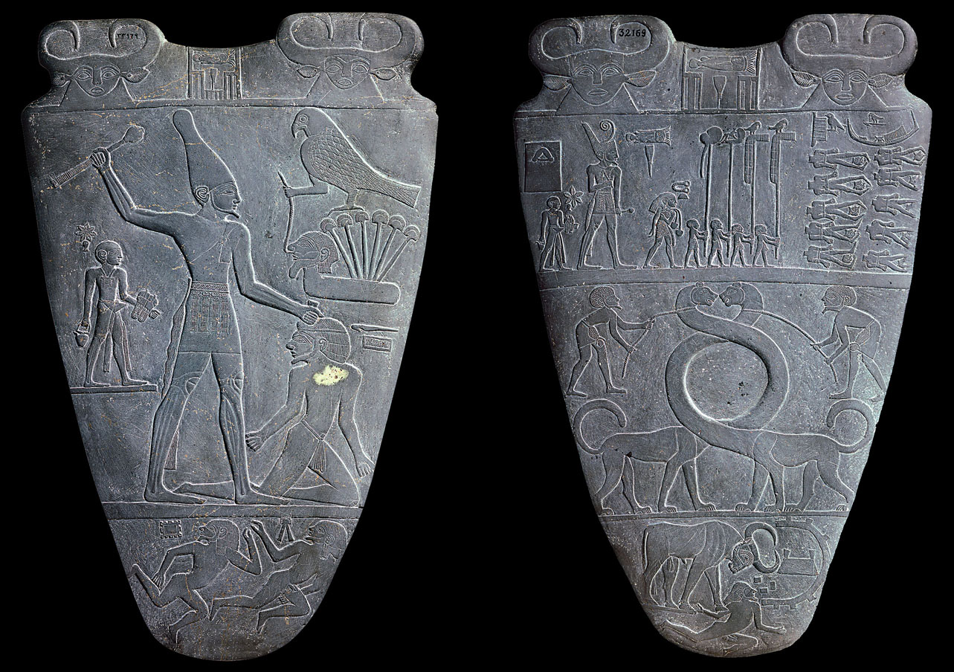
The Palette of Narmer, Hierakonpolis, Early Dynastic period,
c. 2950 BCE Green schist, height 25”

Slide 10
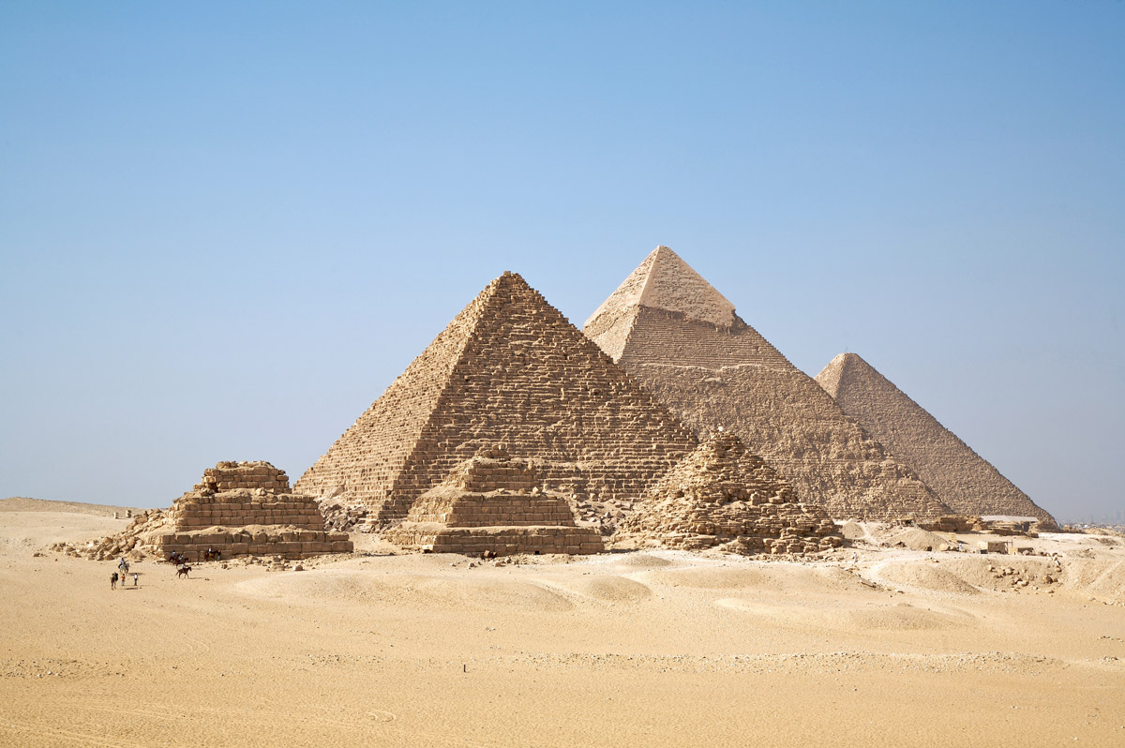
Great Pyramids, Giza. Fourth Dynasty (c. 2575-2450 BCE) Erected by Menkaure, Khafre and Khufu. Limestone and Granite, height of Pyramid Khufu, 450’

Slide 11
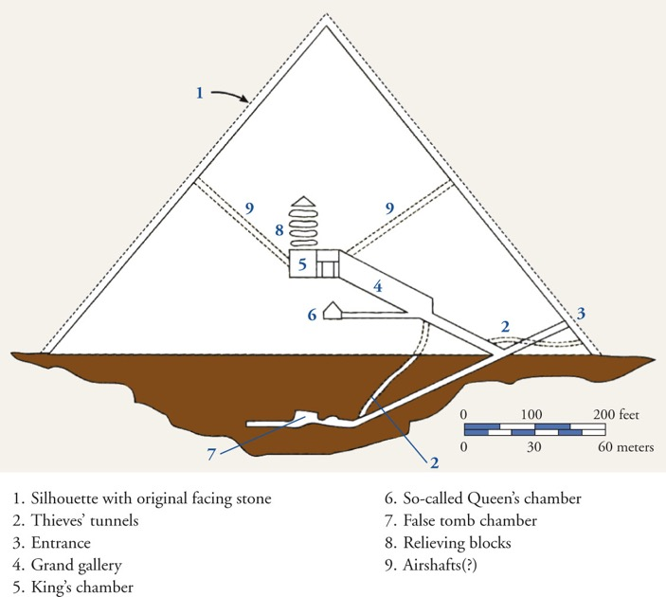
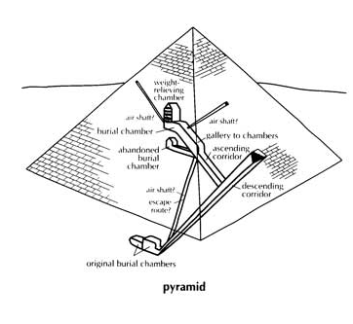

Slide 12
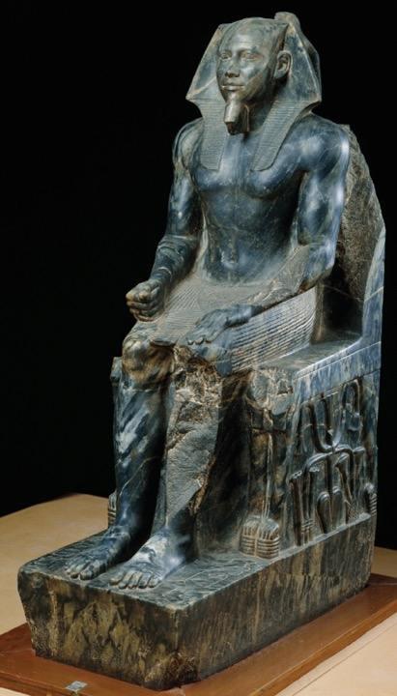
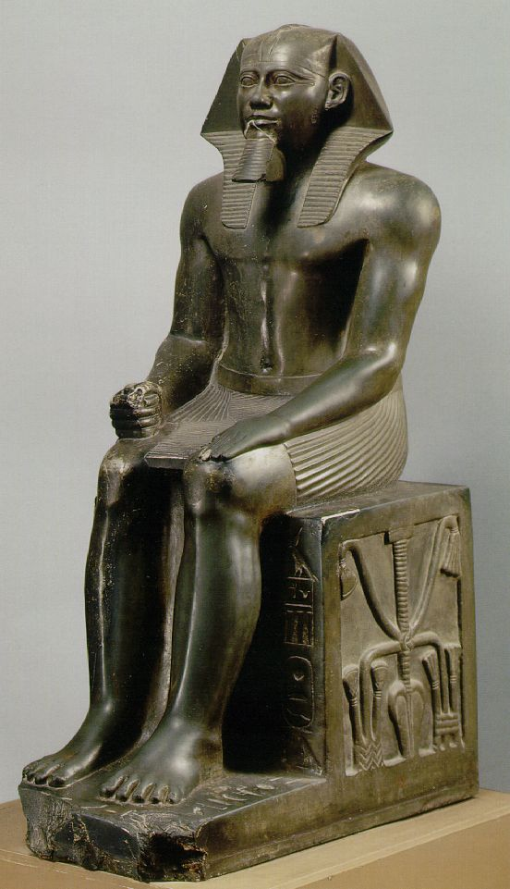
King Khafre, Gizeh, Valley Temple of Khafre, 4th Dynasty,
c.2520-2494 BCE, Diorite-gabbro gneiss, height 5’6”.

Slide 13
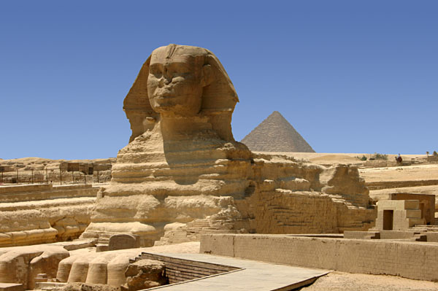
Great Sphinx, Funerary Complex of Khafre, Gizeh, Old Kingdom,
c. 2520-2494 BCE, Sandstone, height approx. 65’

Slide 14
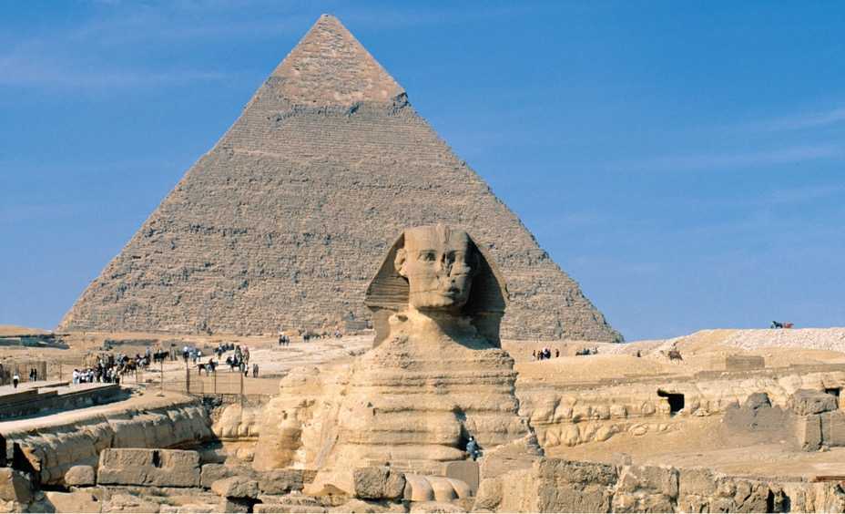
Great Sphinx (with Pyramid of Khafre in the background at left), Gizeh, Egypt, 4th Dynasty, ca. 2520–2494 BCE. Sandstone, 65’ X 240’

Slide 15
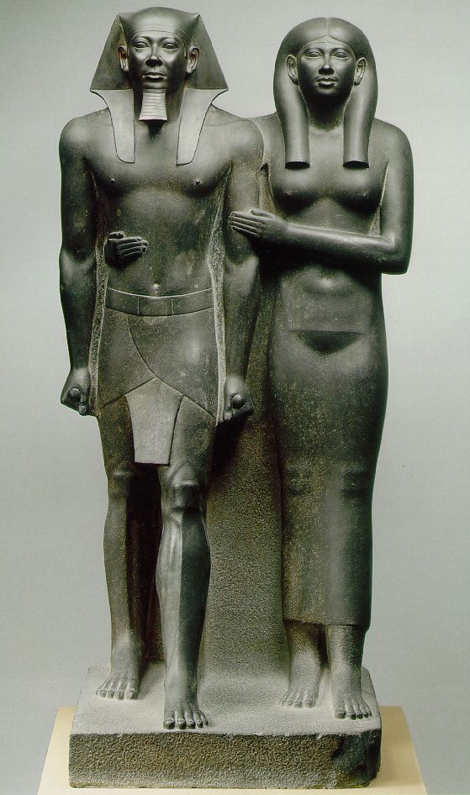
King Menkaure and a Queen. Giza, Fourth Dynasty, 2490-2472 BCE.
Graywacke with Traces of red and black paint, height 54”

