Slide 1
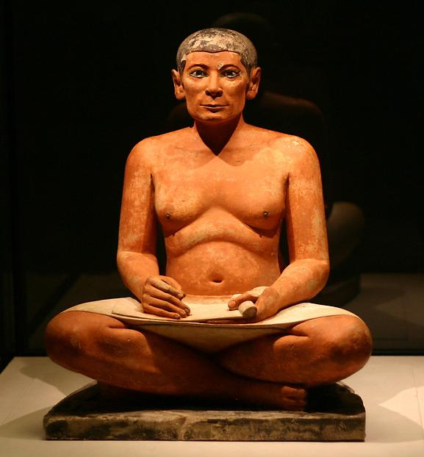
Seated Scribe, Found near tomb of Kai, Saqqara. Fifth Dynasty, c. 2450-2325 BCE
Painted Limestone with inlaid eyes of rock crystal, calcite and magnesite mounted in copper, height 21”

Slide 2
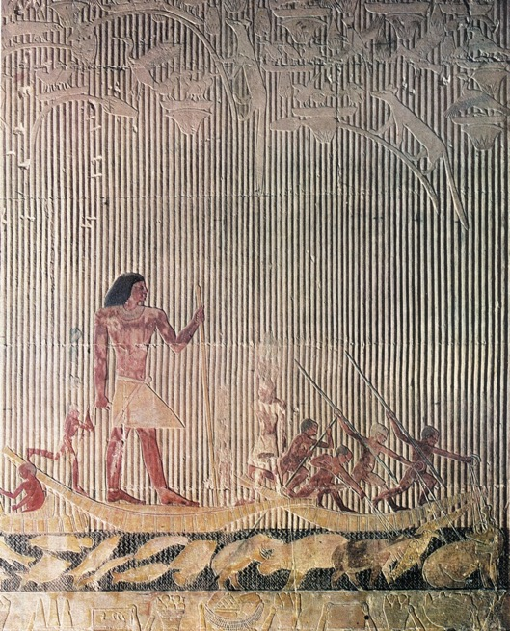
Ti Watching a Hippopotamus Hunt, Tomb of Ti, Saqqara, Fifth Dynasty,
c. 2450-2325 BCE. Painted limestone relief, height approx. 45”

Slide 3
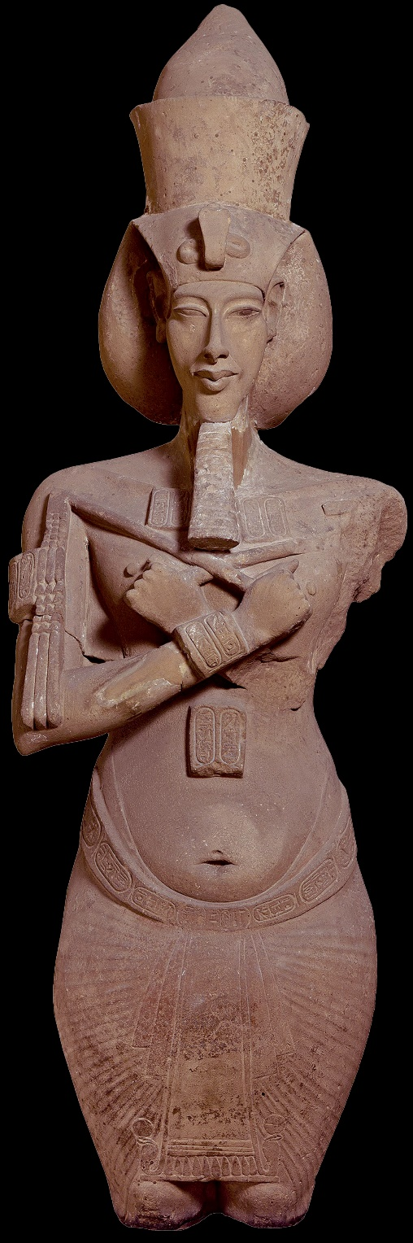
Aten – single, supreme life-giving sun god of new religion founded by Akhenaten
Colossal Figure of Akhenaten, Temple of Gempaaten, Sandstone, height about 13’

Slide 4
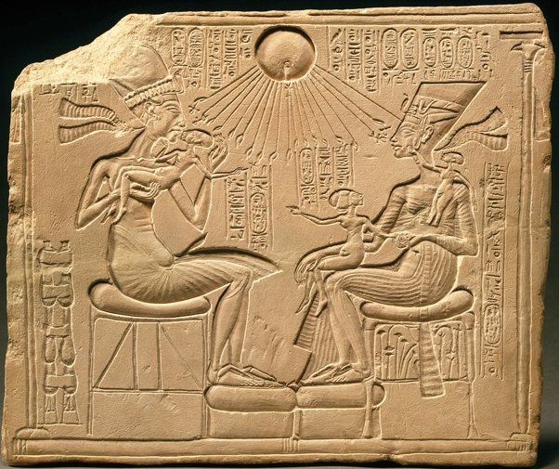
Akhenaten and his Family, Akhetaten, 18th Dynasty, c. 1353-1336 BCE,
Painted Limestone relief, approx. 12x15”

Slide 5
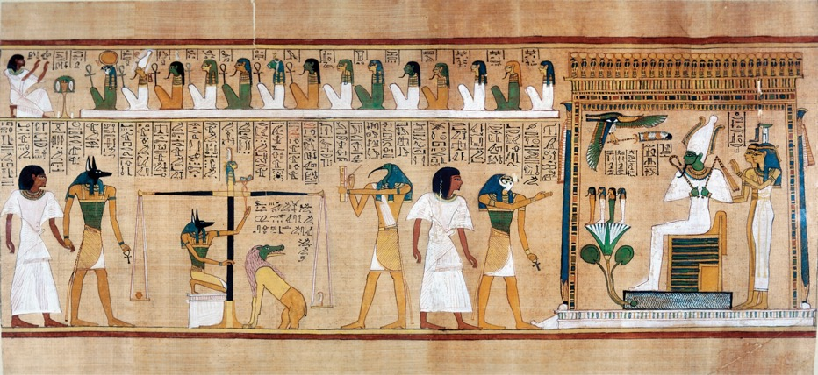
Judgement of Hunefer Before Osiris, Illustration from the Book of the Dead, Thebes,
19th Dynasty c. 1285 BCE, Painted papyrus, height approx. 16”
Osiris- the god of the underworld

Slide 6
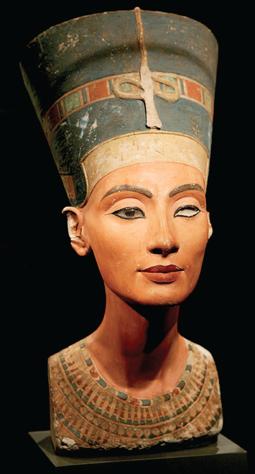
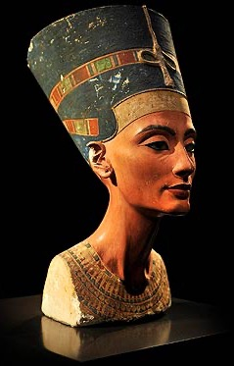
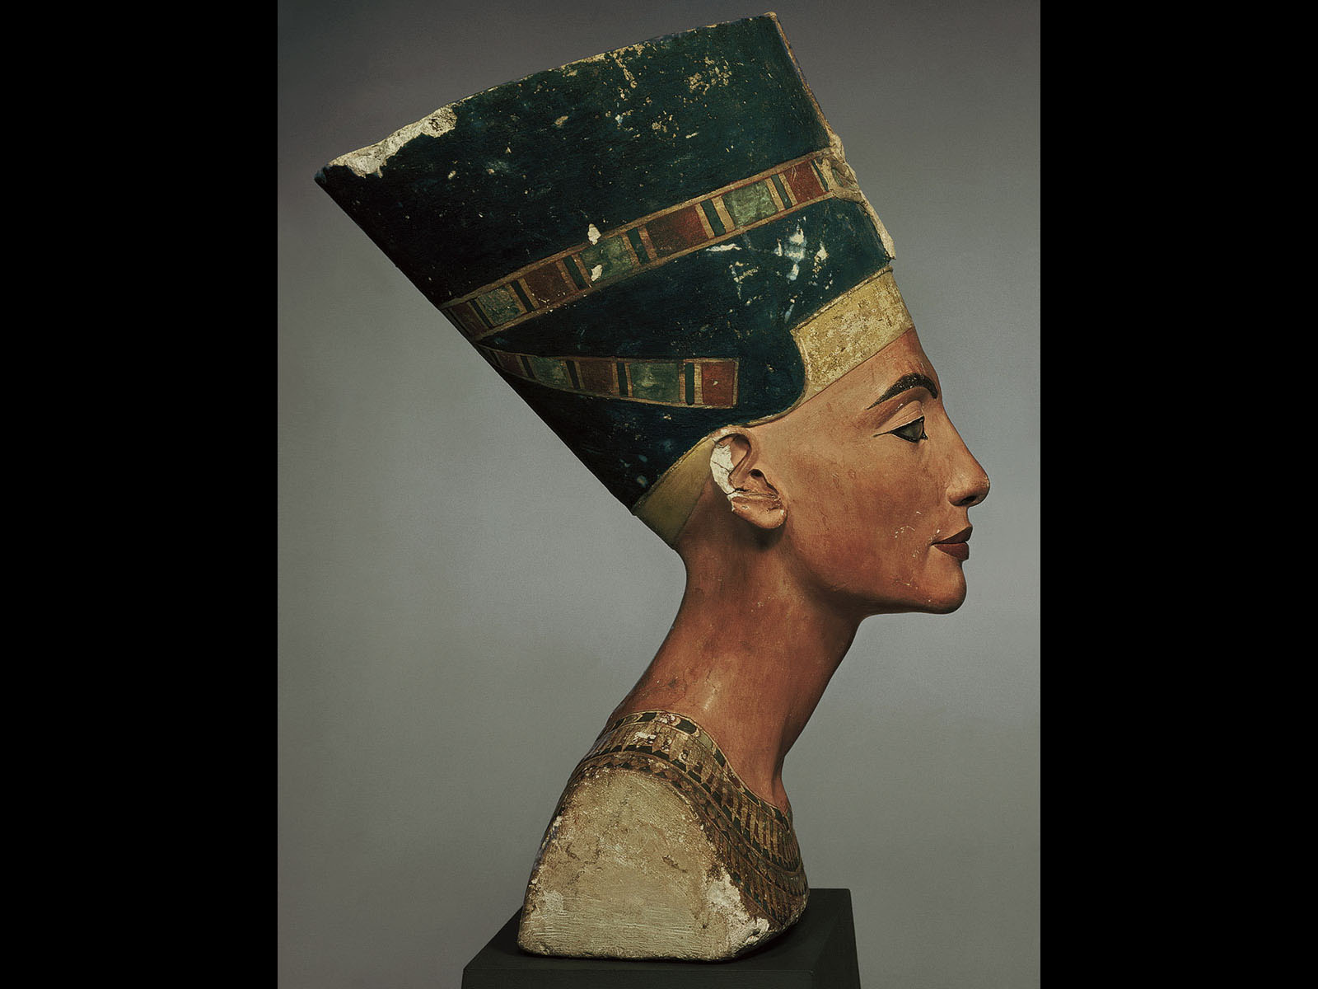
Bust of Nefertiti,
from Amarna, Egypt, 18th Dynasty,
ca. 1353–1335 BCE. Painted limestone, 1’ 8”

Slide 7
