Slide 1
Art of Ancient Greece

Slide 2
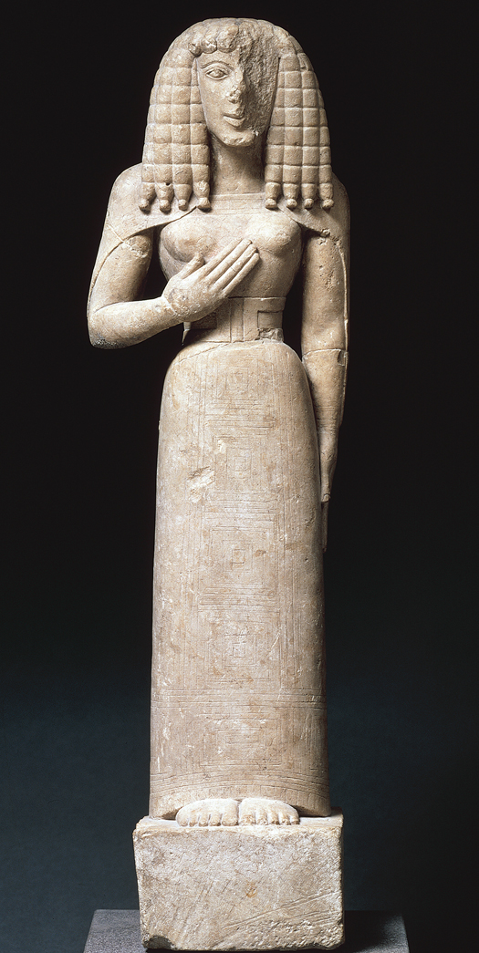
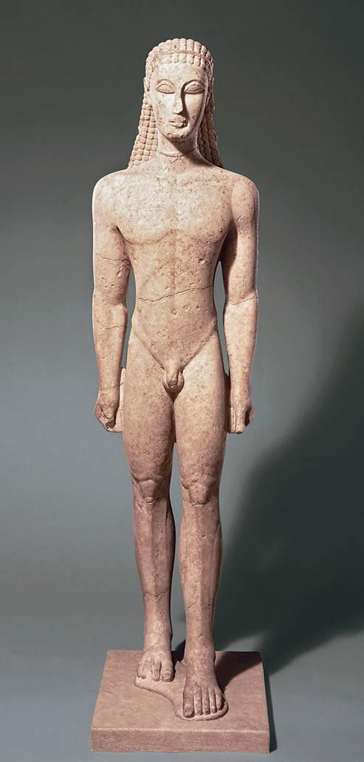

Slide 3
Kouros
(Kouroi)
Archaic Smile
New York Kouros. Attica. c. 600 BCE.
Marble, Height 6’.

Slide 4
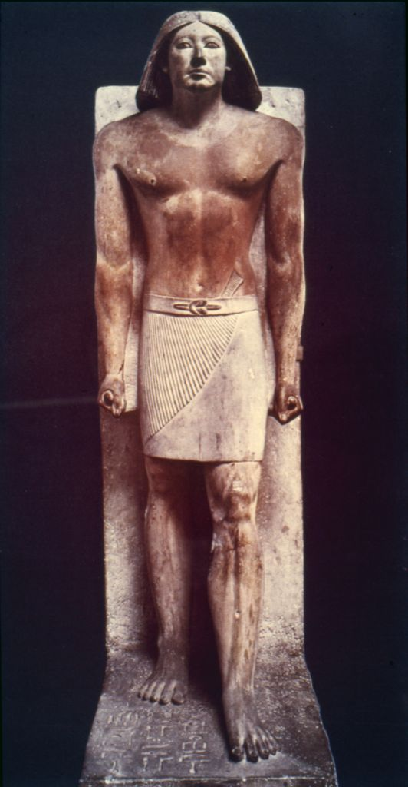
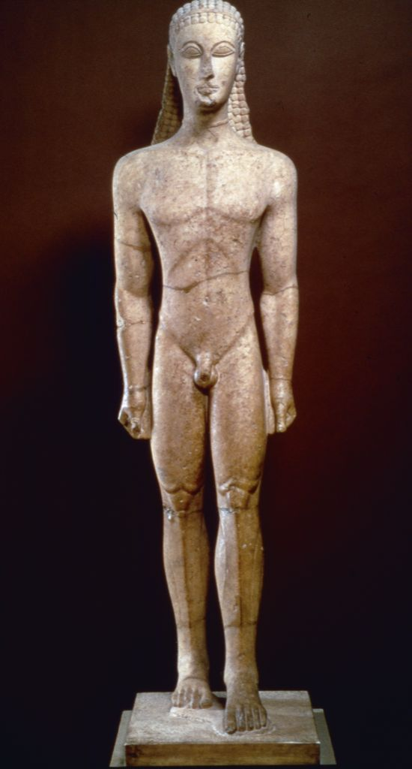

Slide 5
Kore (Maiden), c.630 BCE

Slide 6
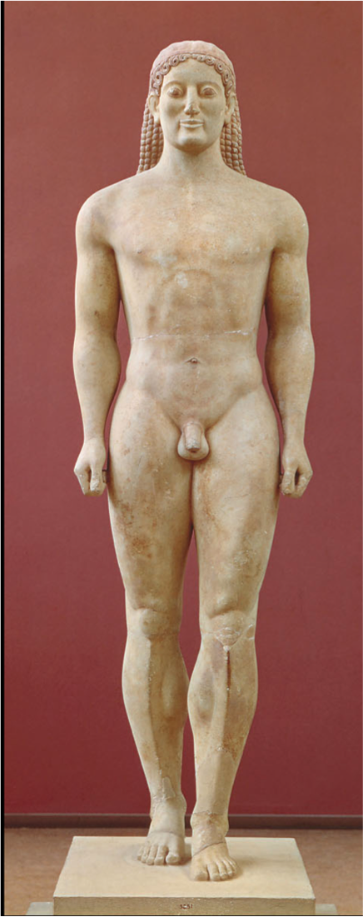
Arete
Anavysos Kouros. Cemetery at Anavysos, Athens. c. 530 BCE. Marble with remnants of paint, height 6’4”

Slide 7
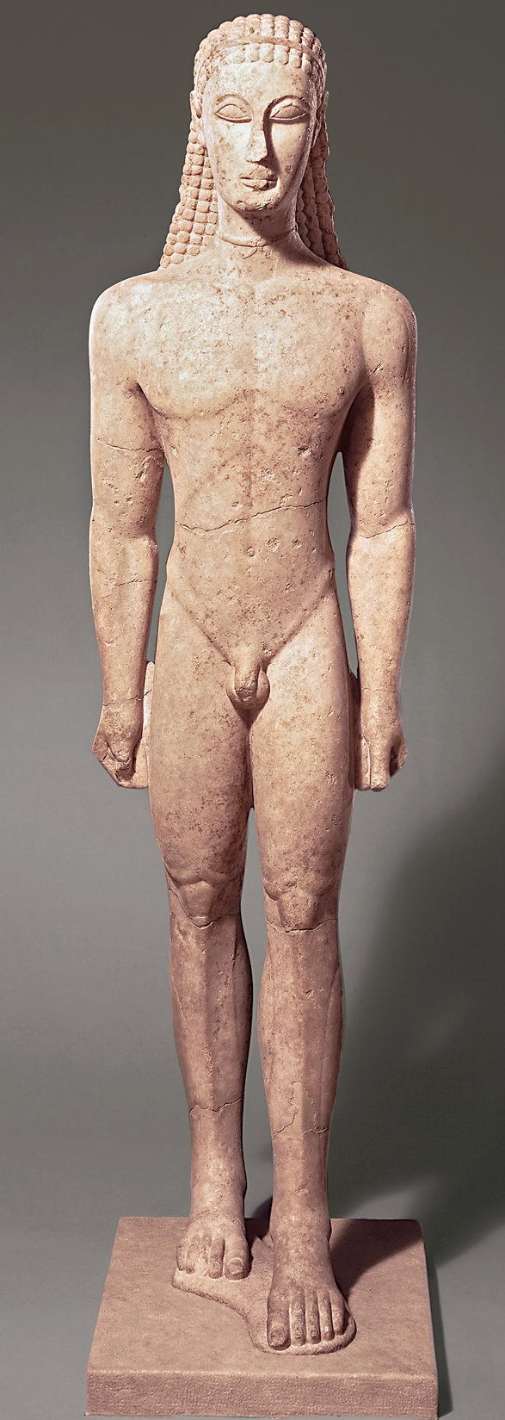
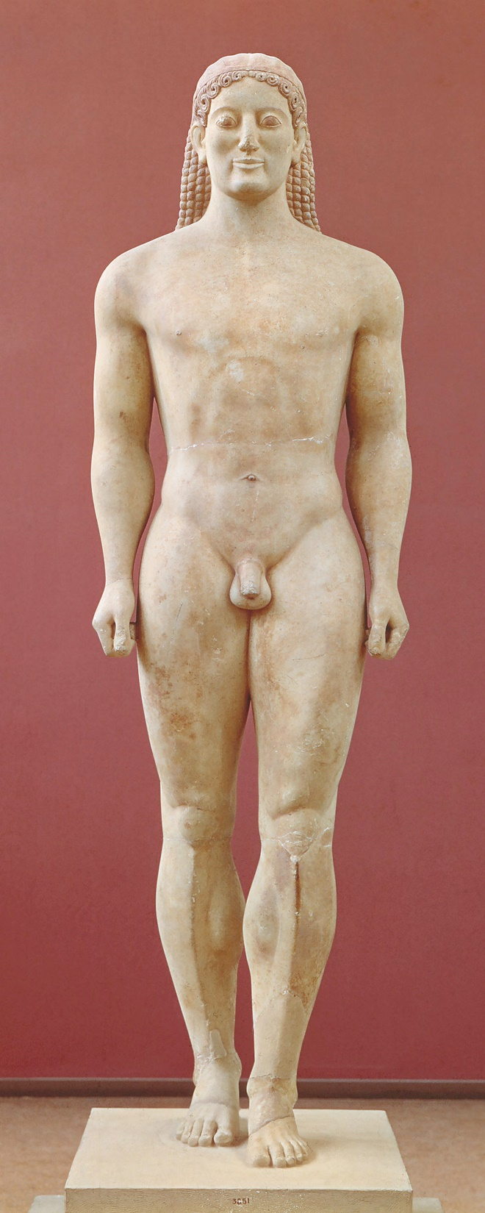
NewYork Kouros
“ Kroisos”

Slide 8
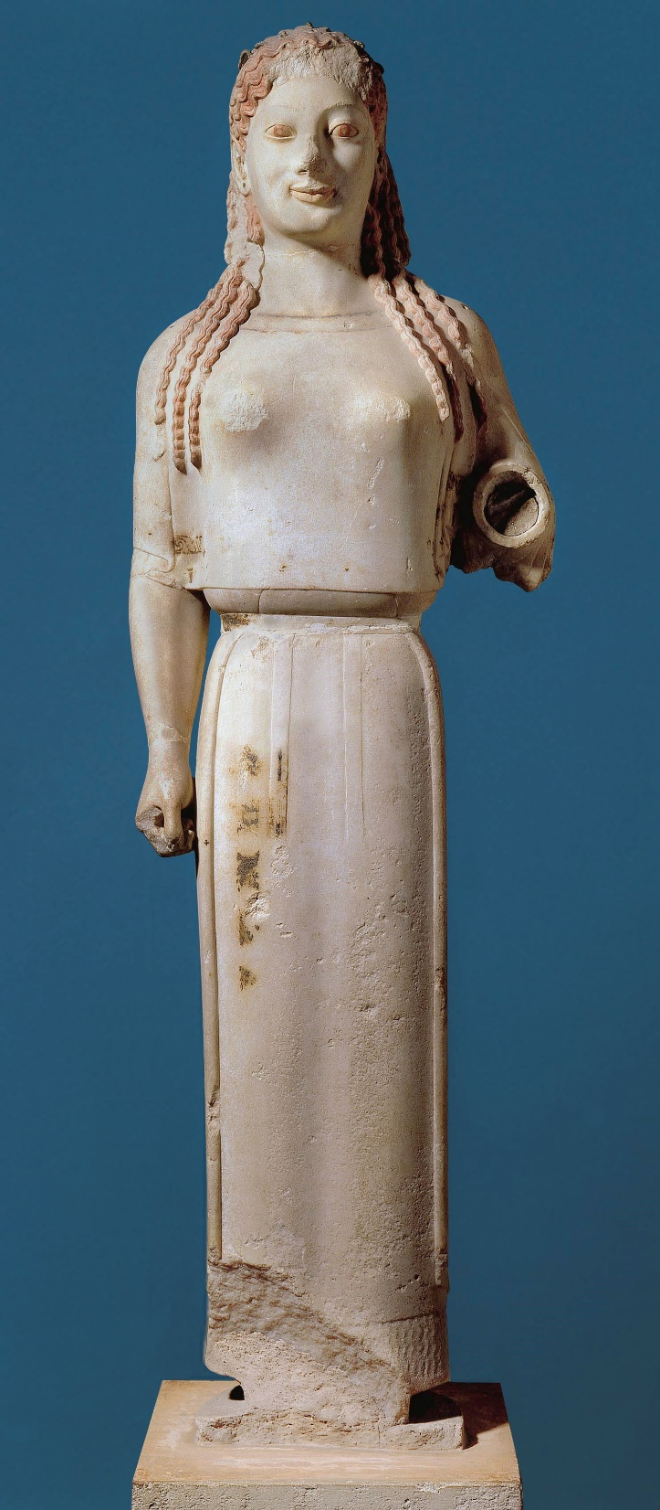
Kore
(Korai)
Peplos Kore, Acropolis, Athens.
c. 530 BCE. Marble, height 4’

Slide 9
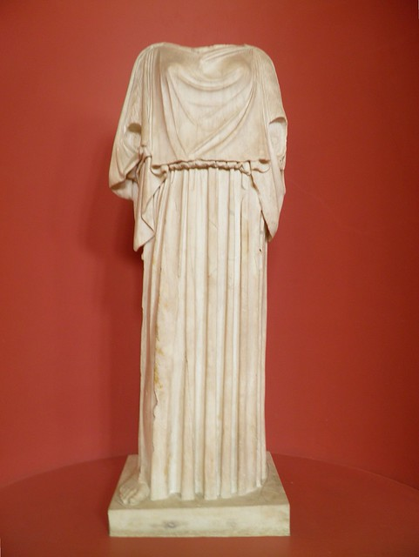
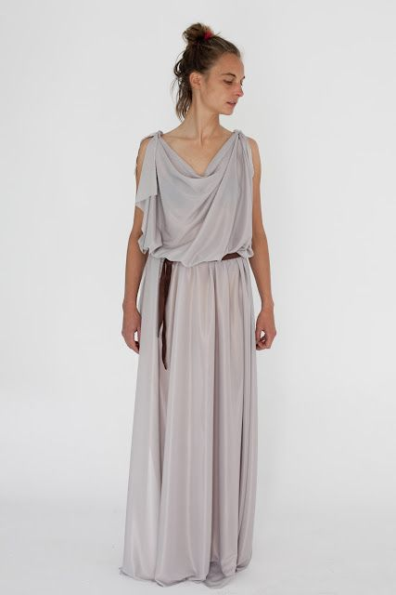
Peplos
PEPLOS
A loose outer garment worn by women of ancient Greece
A cloth rectangle fastened on the shoulders and belted below the bust or at the waist

Slide 10
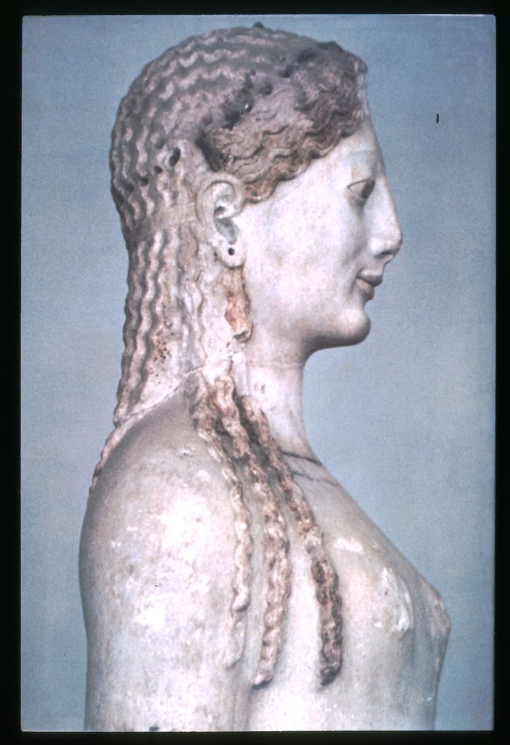
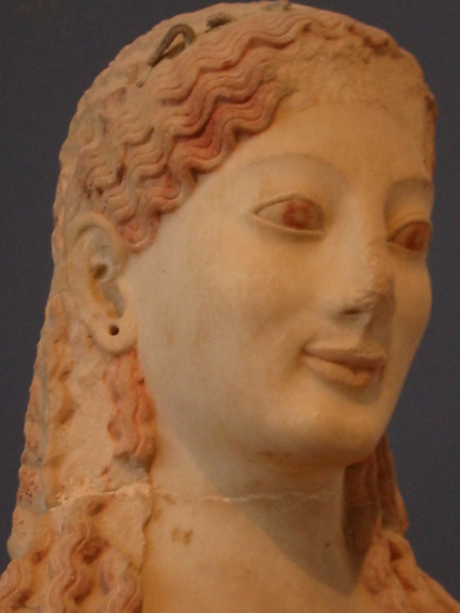
Aidos
Sophrosyne
Peplos Kore, Acropolis, Athens.
c. 530 BCE. Marble, height 4’

