Slide 1
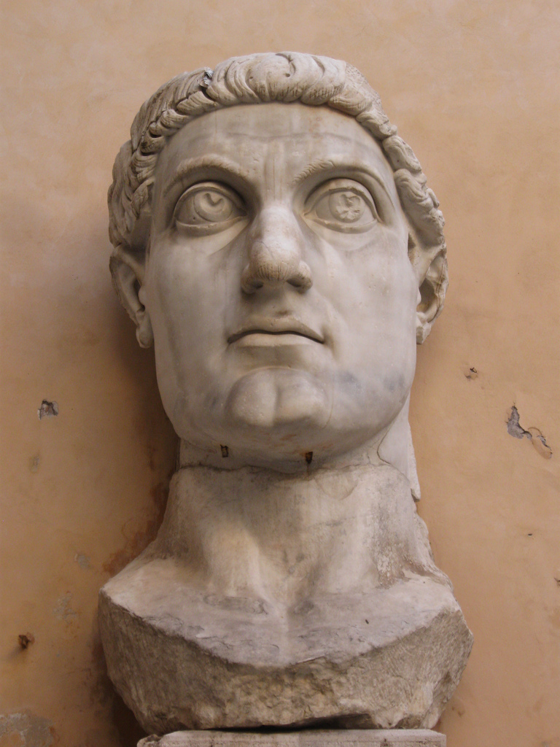
Byzantine Art
Constantine the Great: The Christian Empire (c. 305 CE)

Slide 2
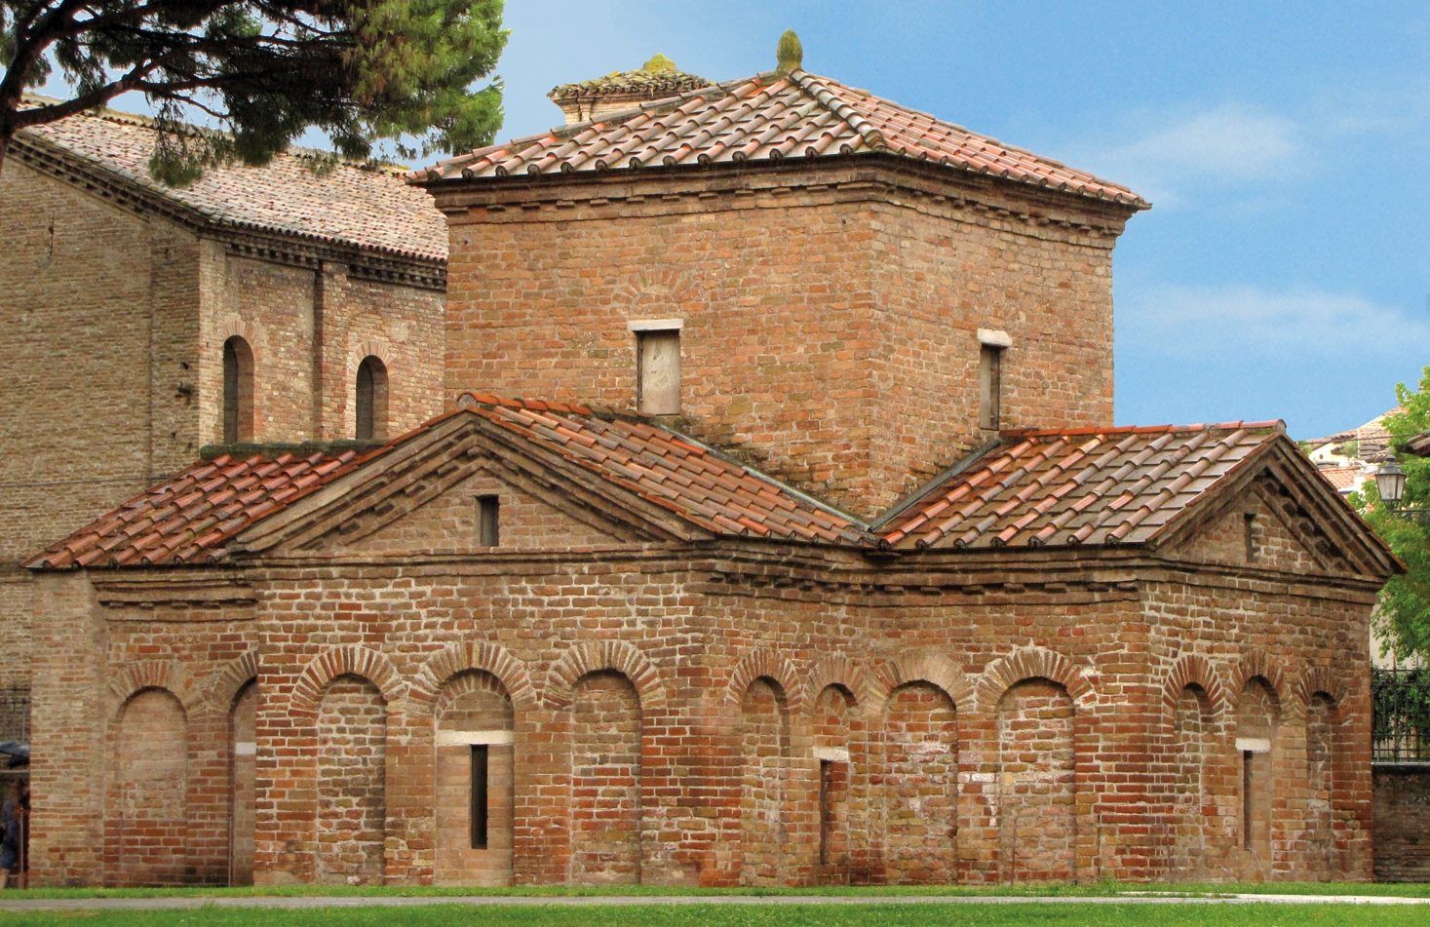

Slide 3
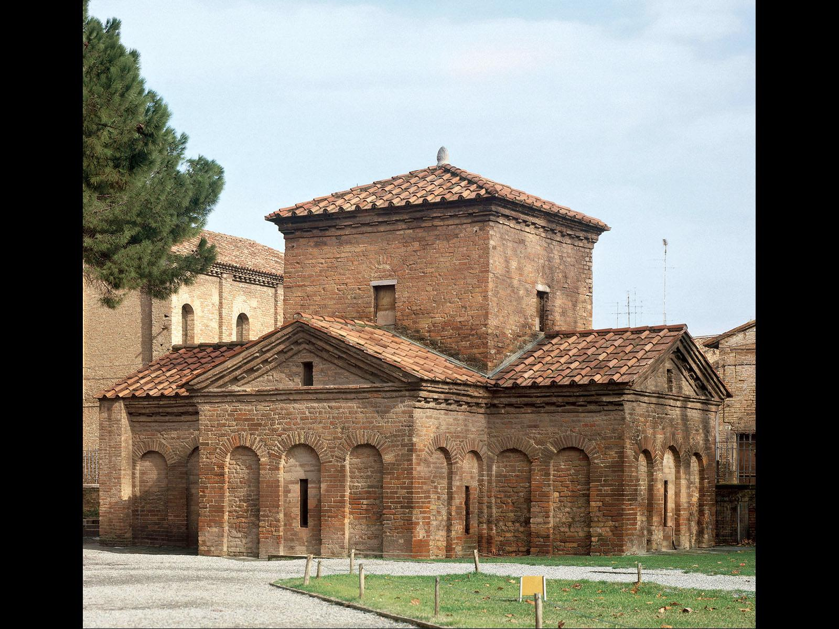
Oratory of Galla Placidia, Ravenna. c. 425-426

Slide 4
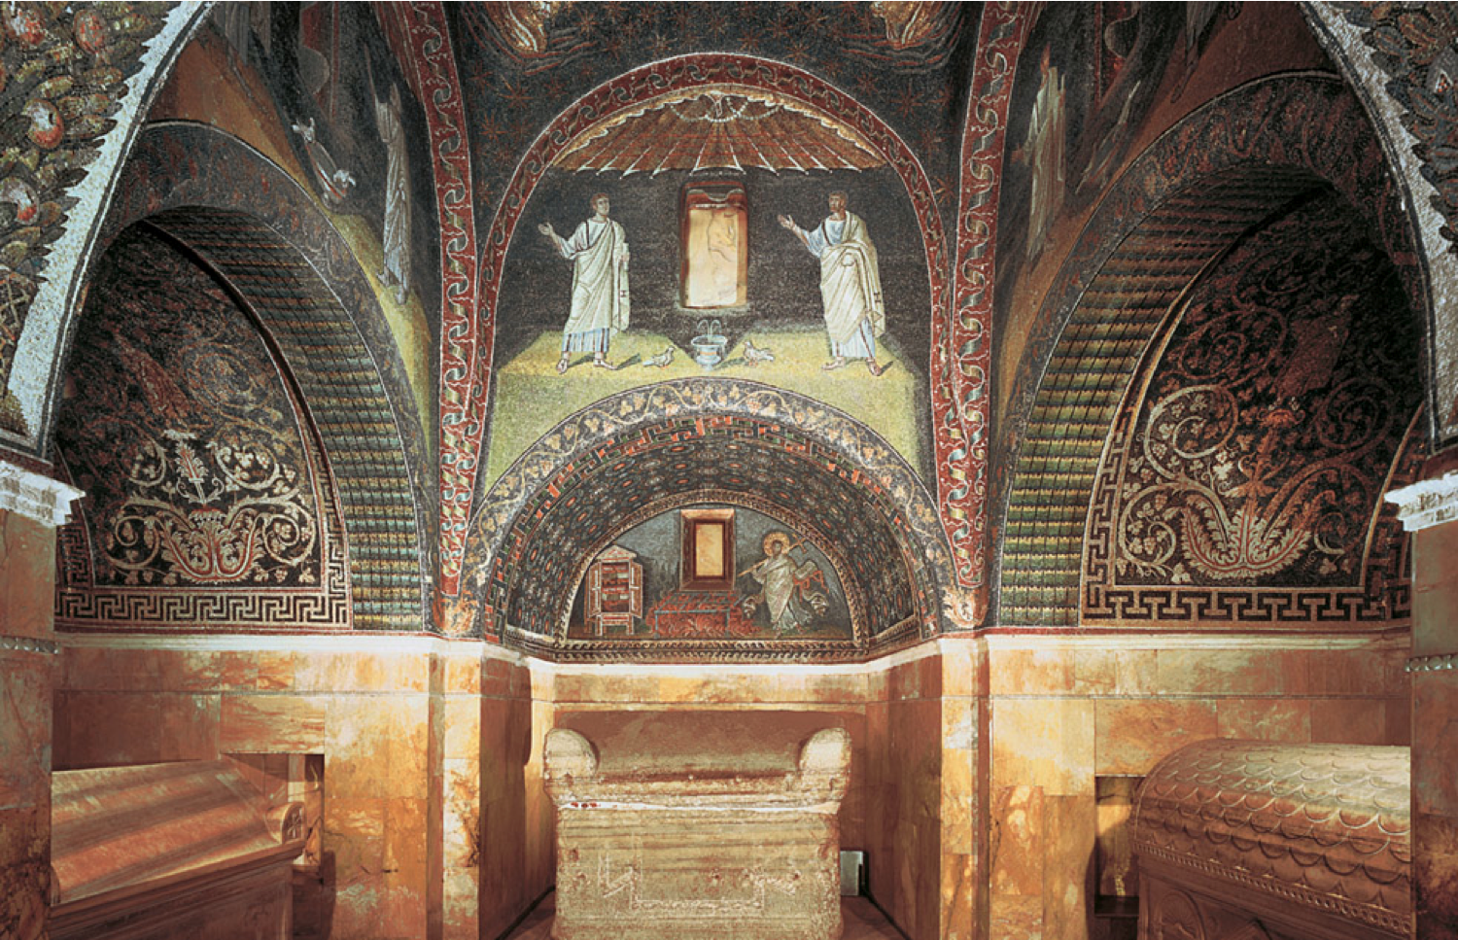
Oratory of Galla Placidia, Ravenna, C. 425-426

Slide 5
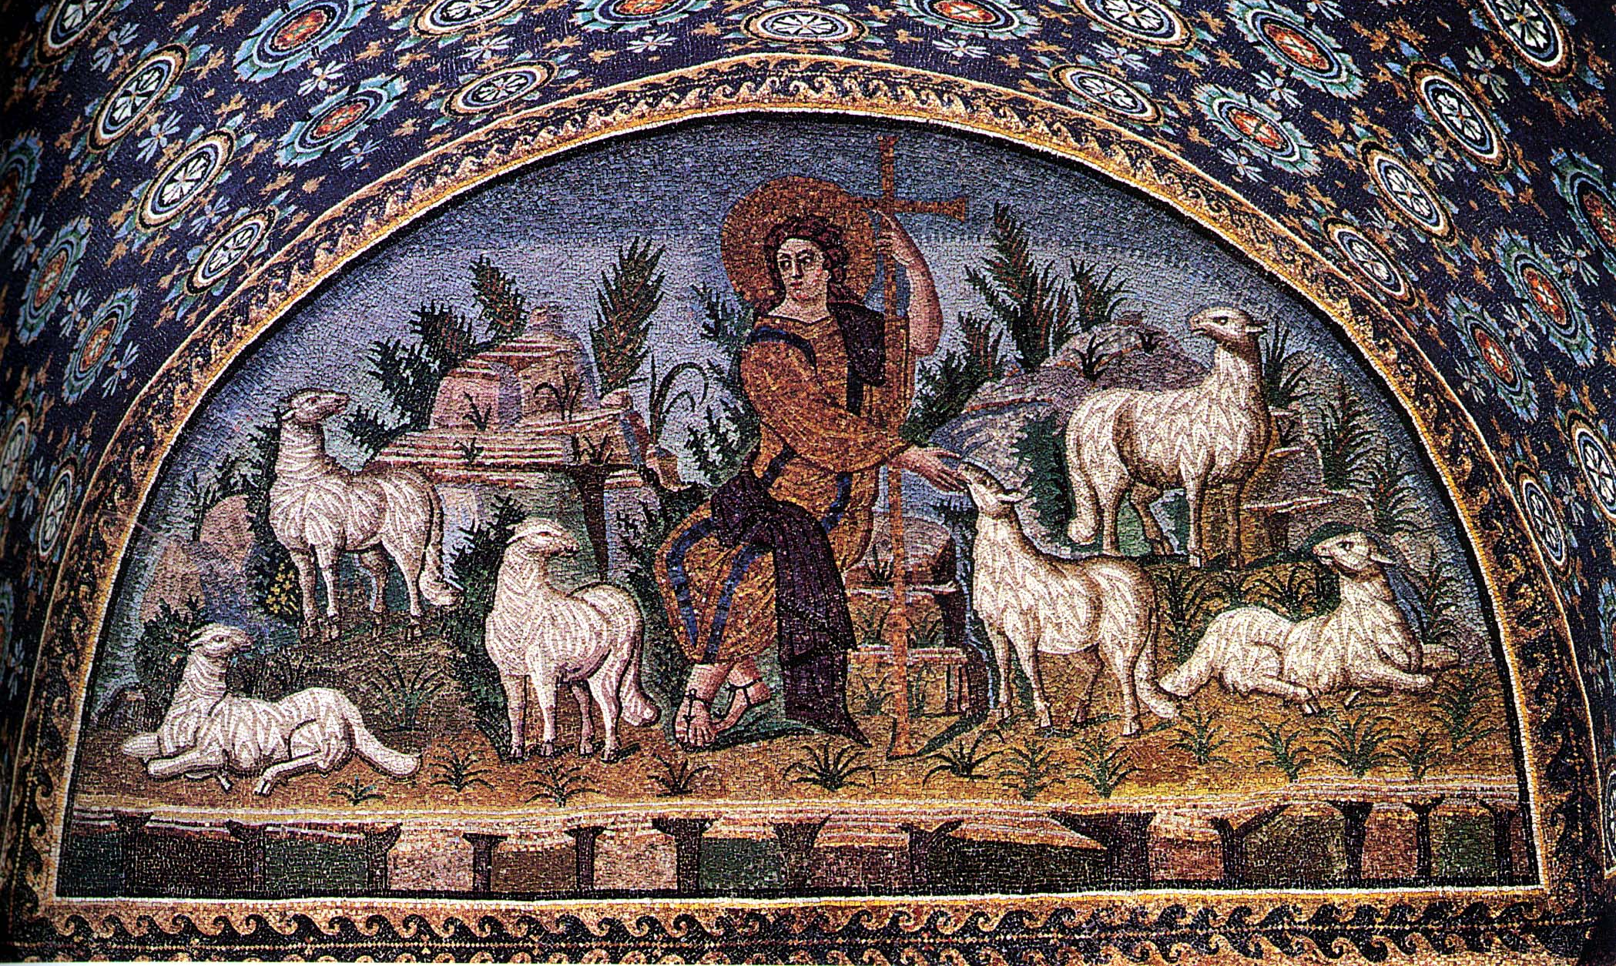
The Good Shepherd, Ravenna

Slide 6
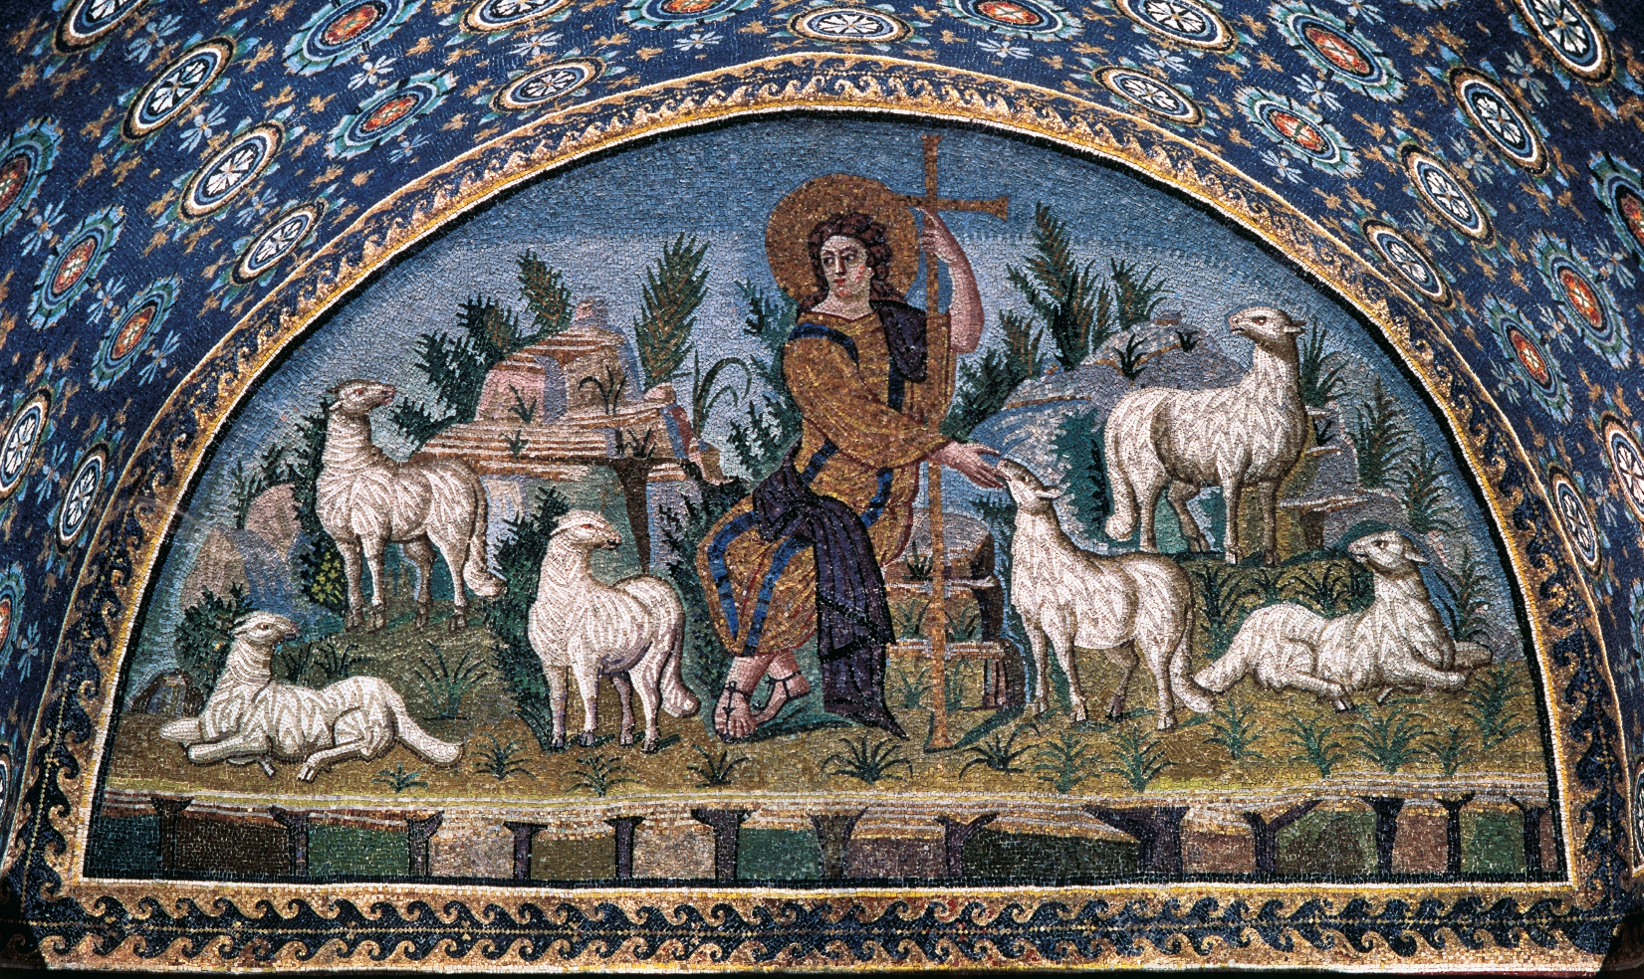
The Good Shepherd, Ravenna

Slide 7
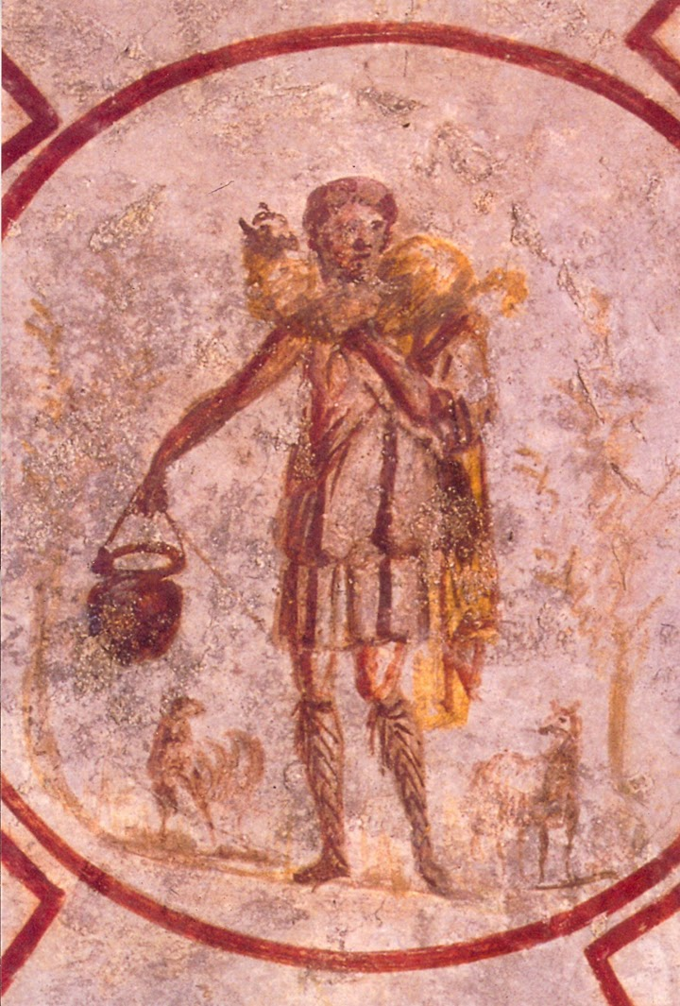

Slide 8
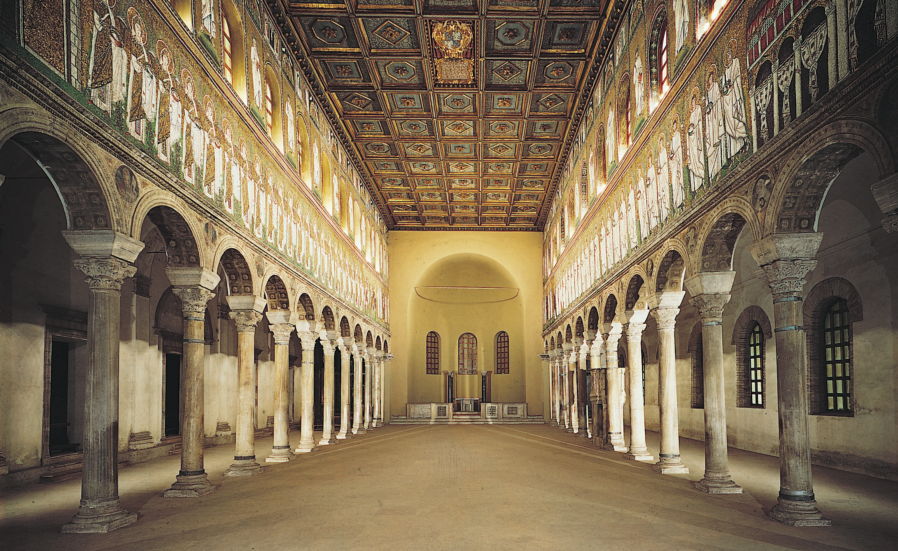
Interior of Sant’Apollinare Nuovo, Ravenna, Italy, dedicated 504

Slide 9
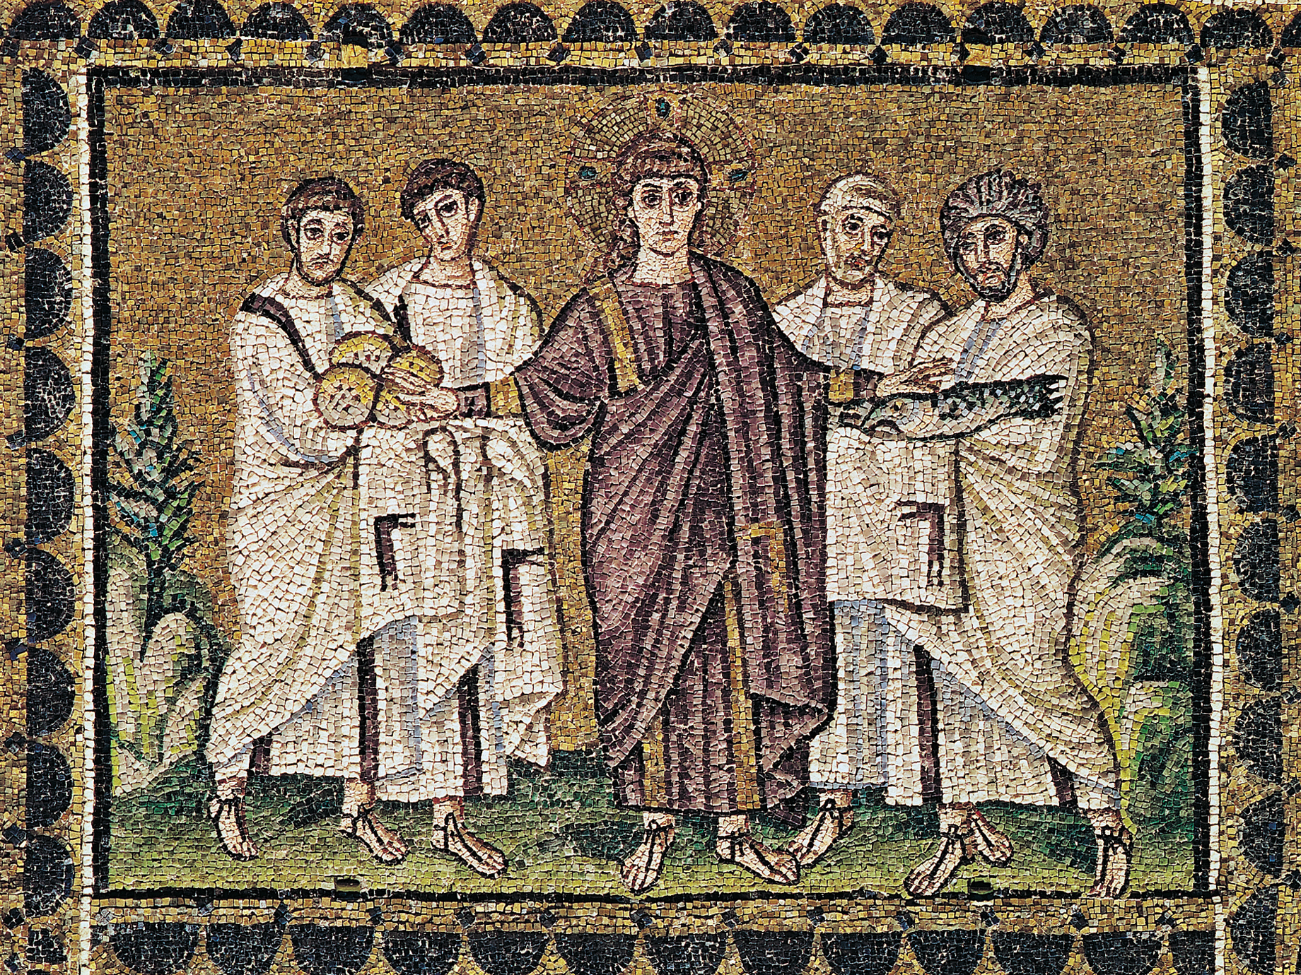
Miracle of the Loaves and Fishes, mosaic from Sant’Apollinare Nuovo, Ravenna, Italy, ca. 504

Slide 10
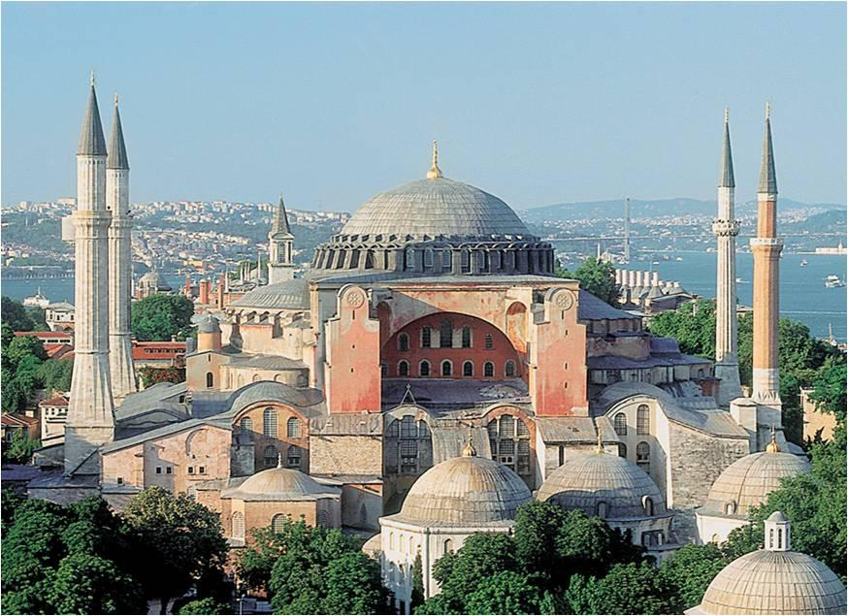
Church of Hagia Sophia, Constantinople (Istanbul), 532- 537

Slide 11
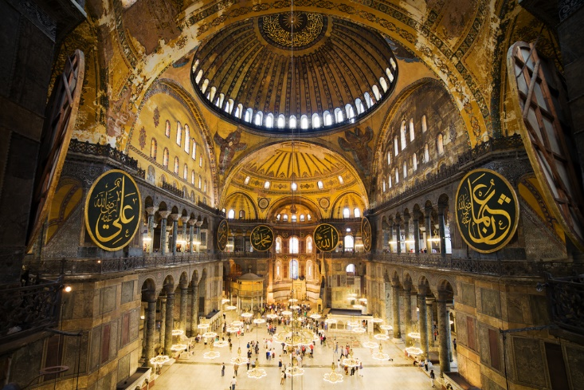
Interior of the church of Hagia Sophia

Slide 12
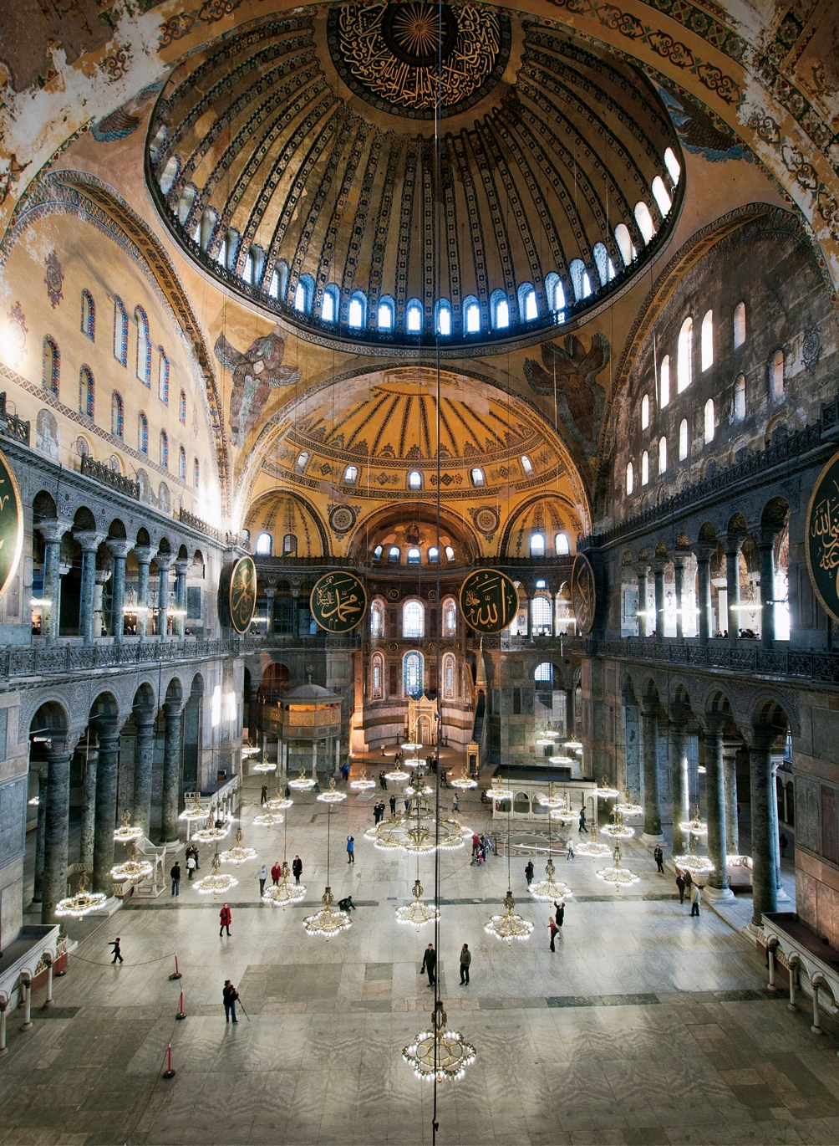
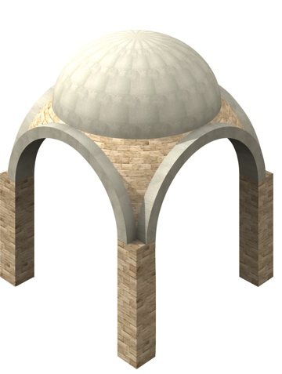
Pendentives

Slide 13
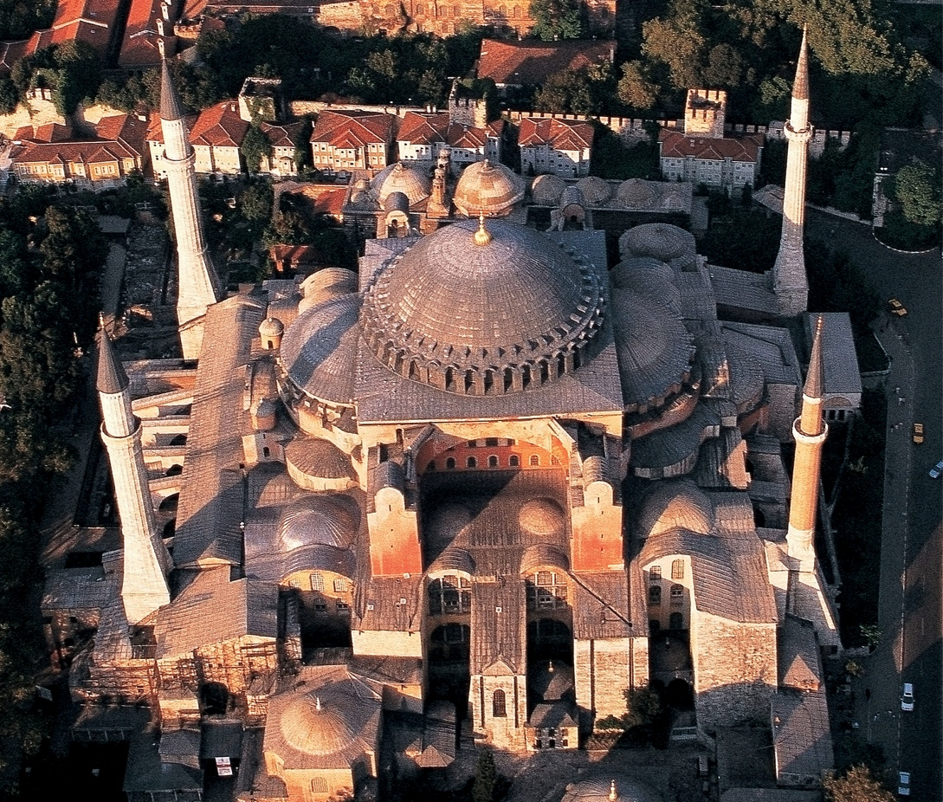

Slide 15
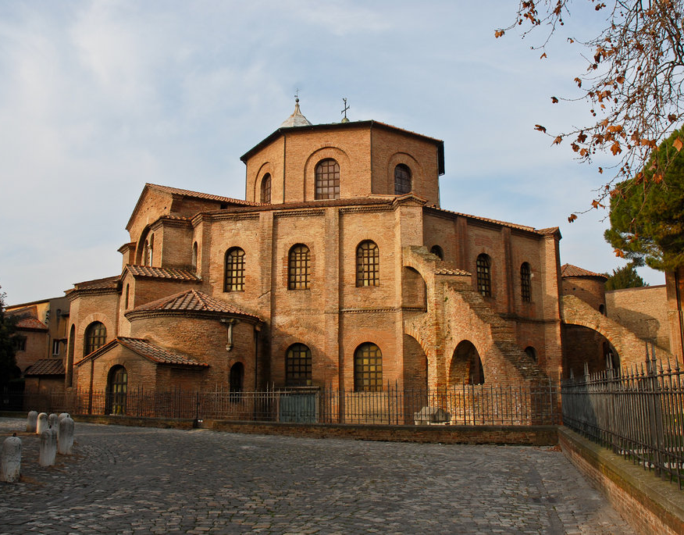
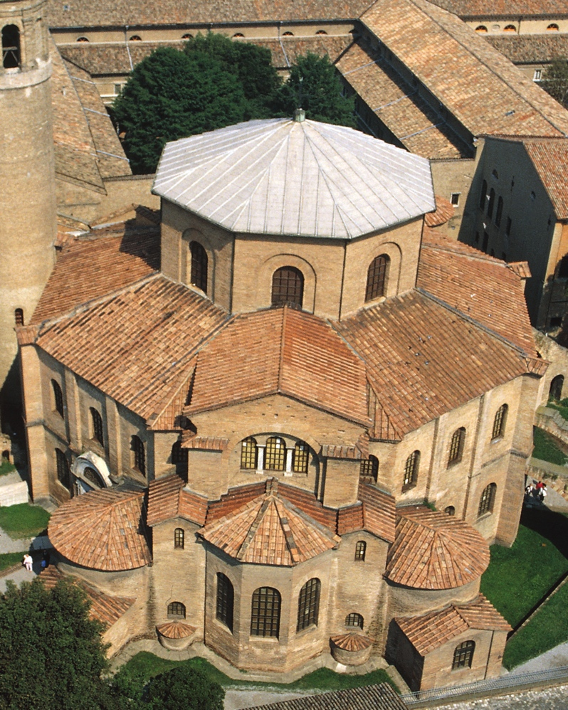
Exterior, Church of San Vitale, Ravenna, 547 CE

Slide 16
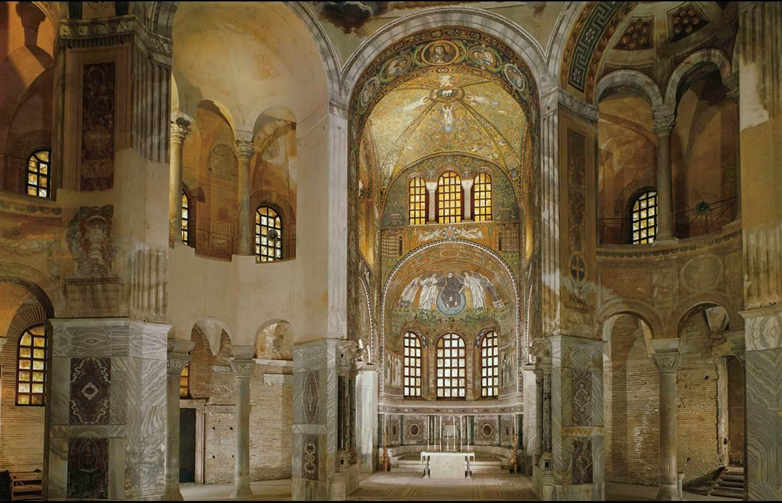
Church of San Vitale, Ravenna, C 547

Slide 17
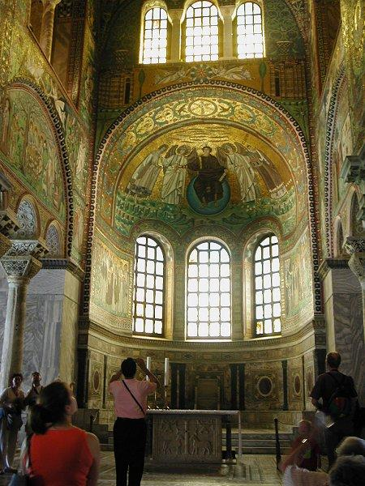
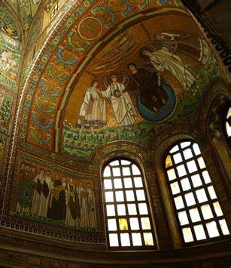
Church of San Vitale, Ravenna, C 547

Slide 18
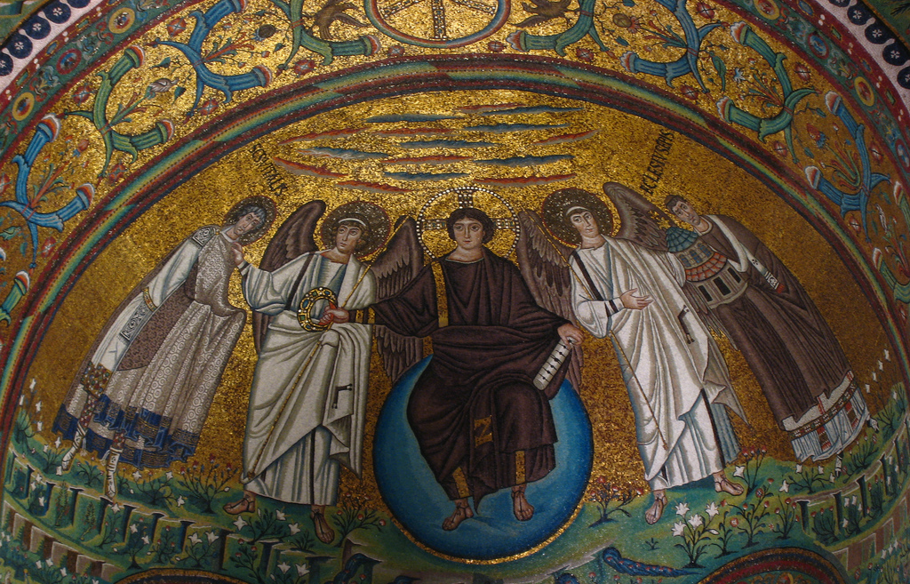
Christ Enthroned, Flanked by Angels, St. Vitalis and Bishop Ecclesius. Church of San Vitale, Ravenna

Slide 19
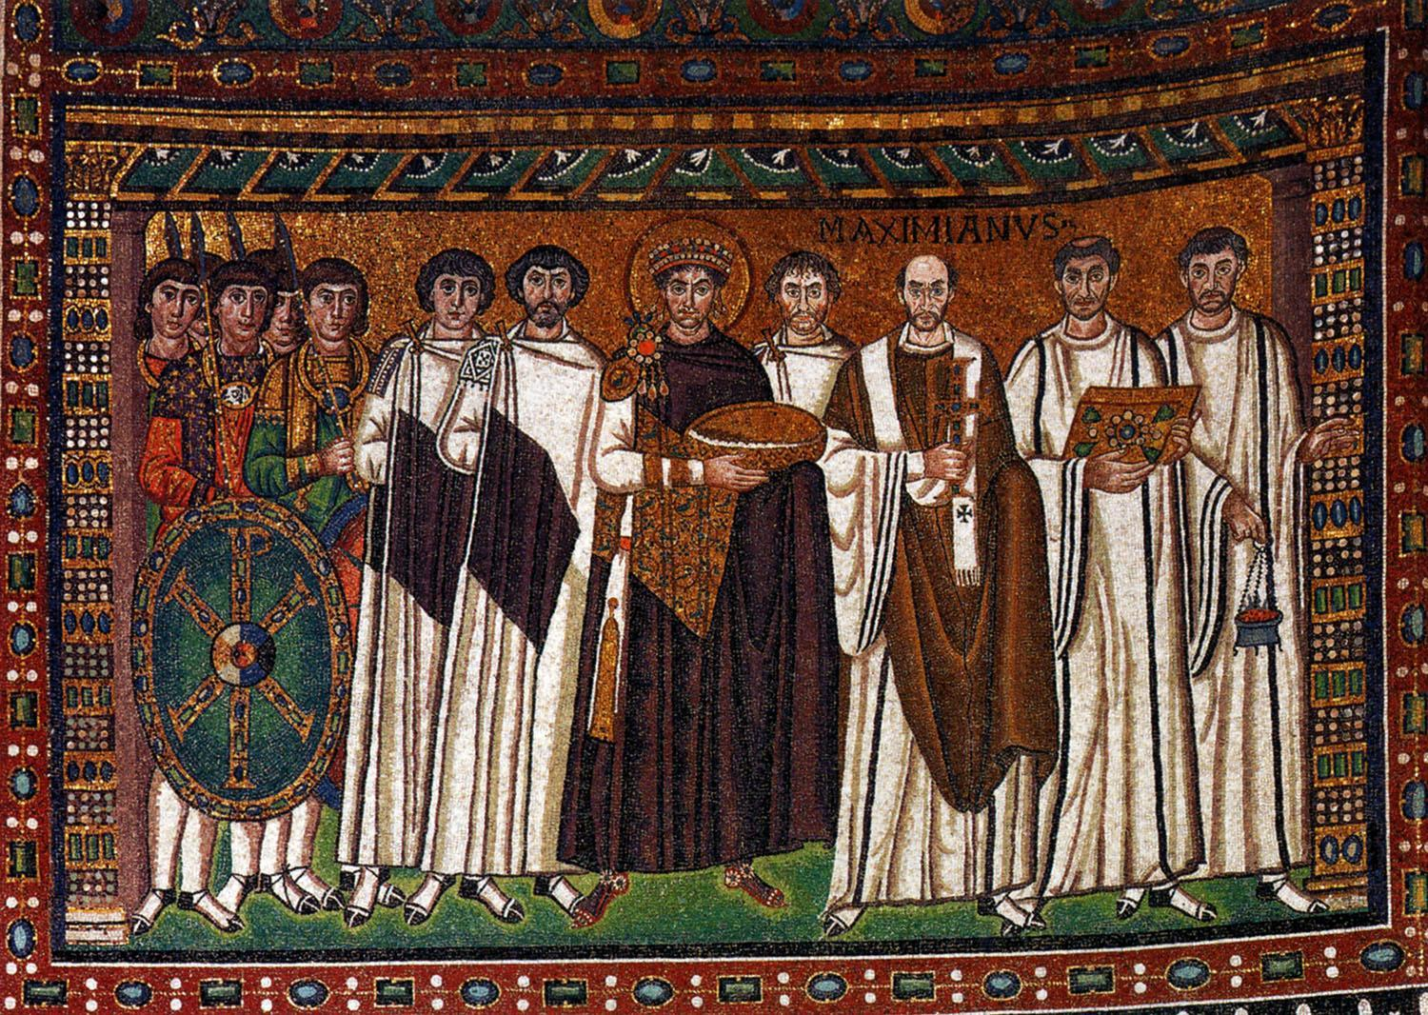
Emperor Justinian and his Attendants, North Wall of the Apse, Church of San Vitale, Ravenna

Slide 20
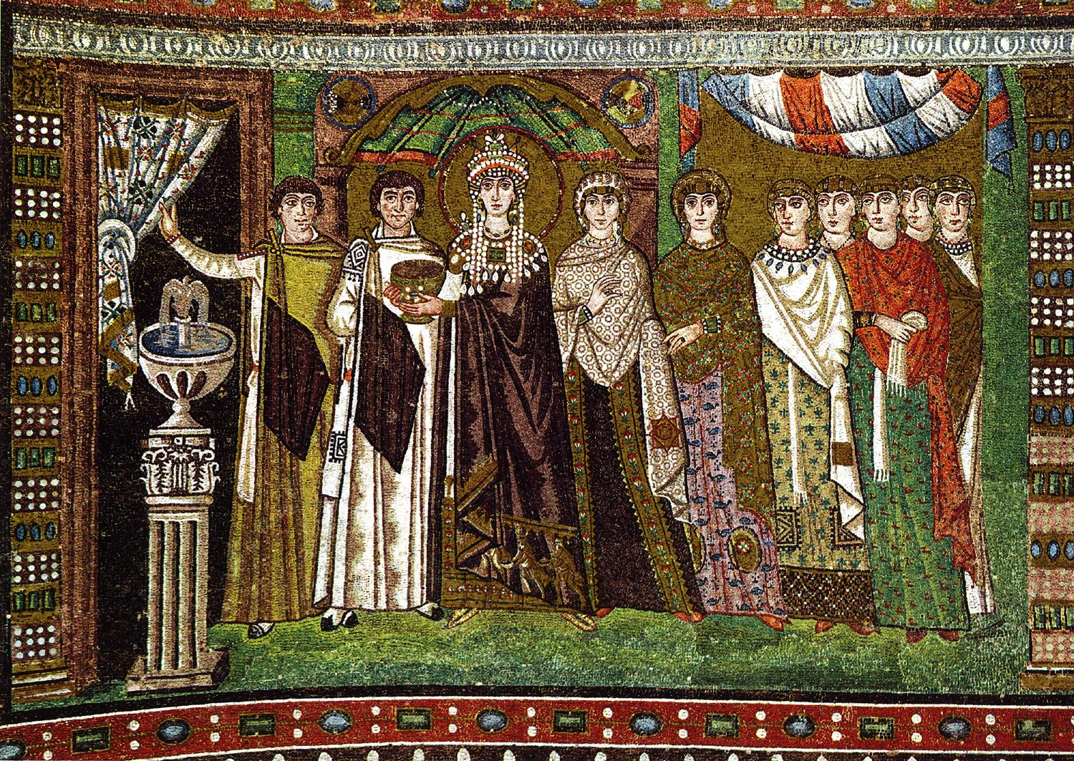
Empress Theodora and Her Attendants, South Wall of the Apse, Church of San Vitale, Ravenna

Slide 21
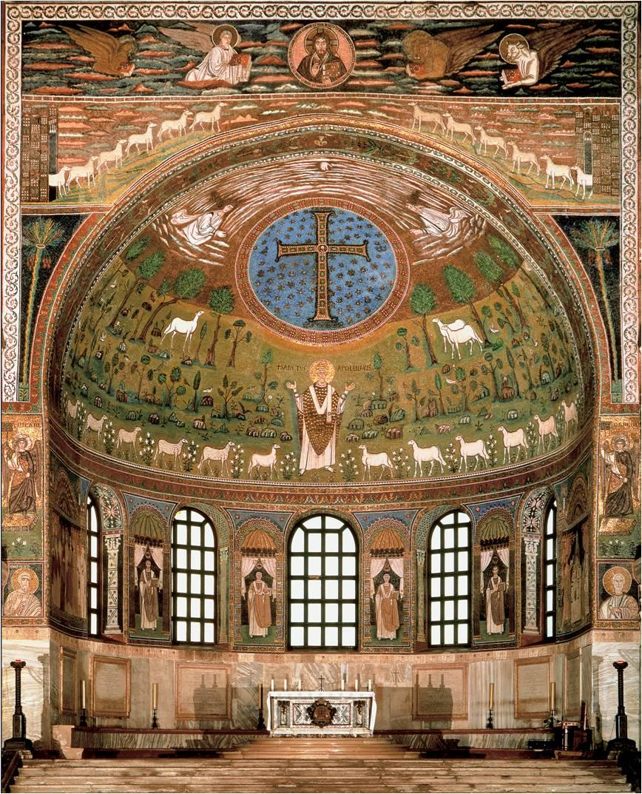
The Transfiguration of Christ with Sant’ Apollonaire, First bishop of Ravenna, 7th Century

Slide 22
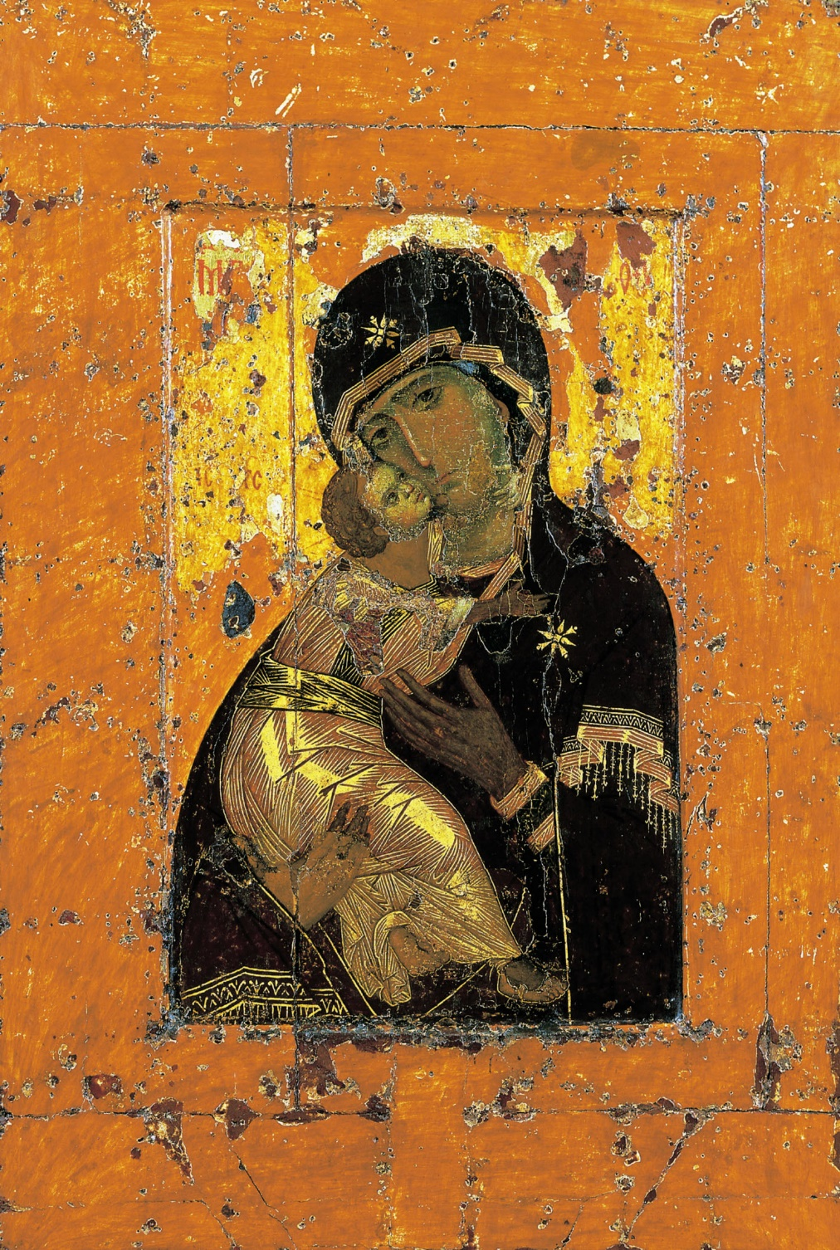
Icon
Iconoclasm
Virgin of Vladmir. Icon. 11th-12th century, Moscow

Slide 23
Visual Analysis Paper—Due Sunday, Oct 20th
Select an artwork from the time periods we have covered (Prehistoric Man to Roman Art—up to approximately the 1st century CE) that we haven’t covered in class. [Ideally, at an art gallery! Back up: from online collection, or even text book.]
Make an arguement and prove it— {“This is an example of Egyptian Art because…”}--to someone who knows nothing! NOT a research paper!
Make specific connections to what we have studied—show off what you’ve learned!
2-3 pages, 12pt font, double-spaced, normal margins
Due submitted on MyCourses

