Slide 1
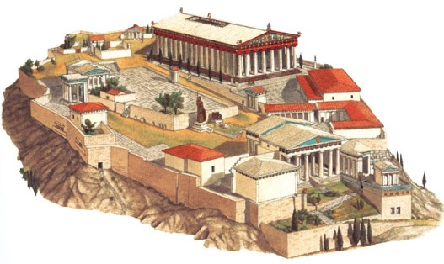
High Classical (c. 450-400 BCE)
“The Golden Age”
Model of the Acropolis, Athens

Slide 2
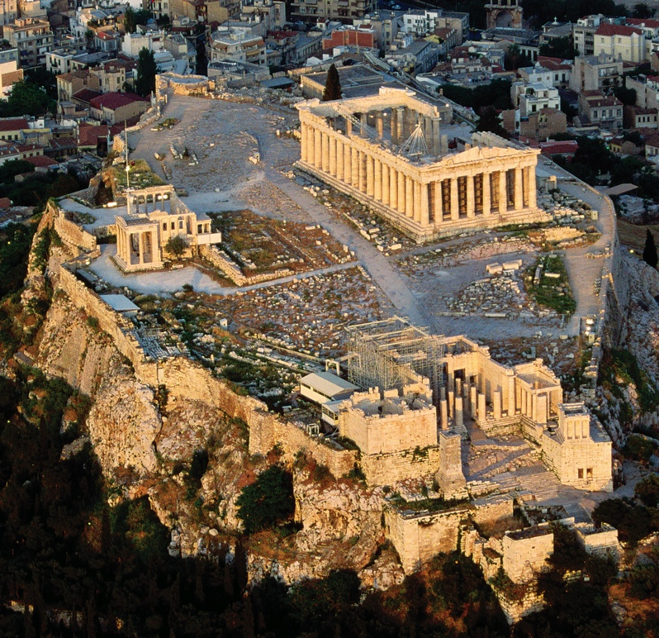
The Acropolis, Athens, Greece

Slide 3
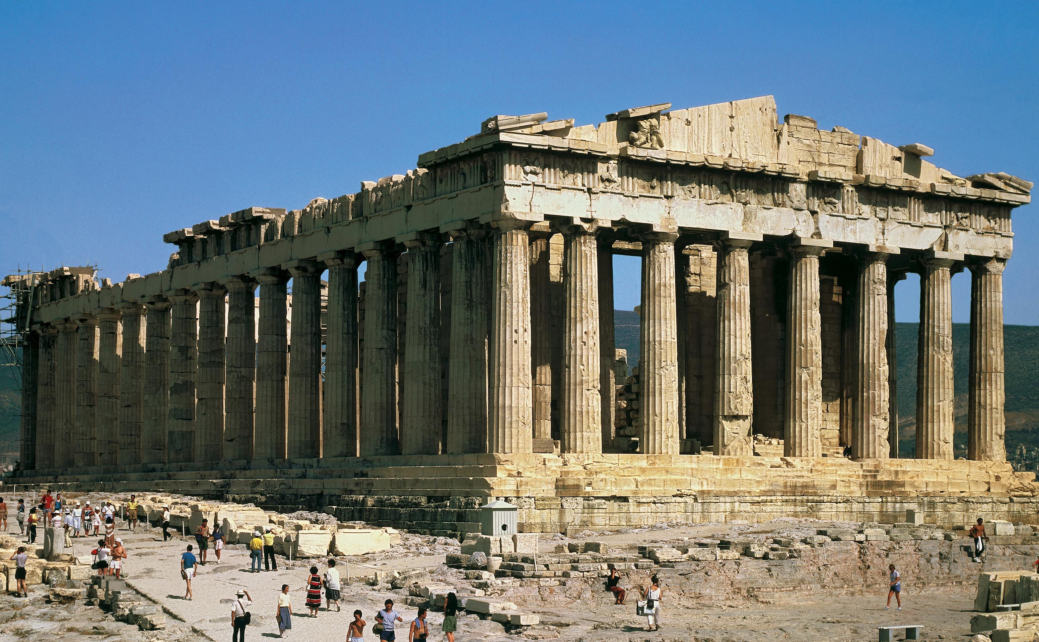
Parthenon, Acropolis, Athens
c.447-432 BCE, Pantelic Marble

Slide 4
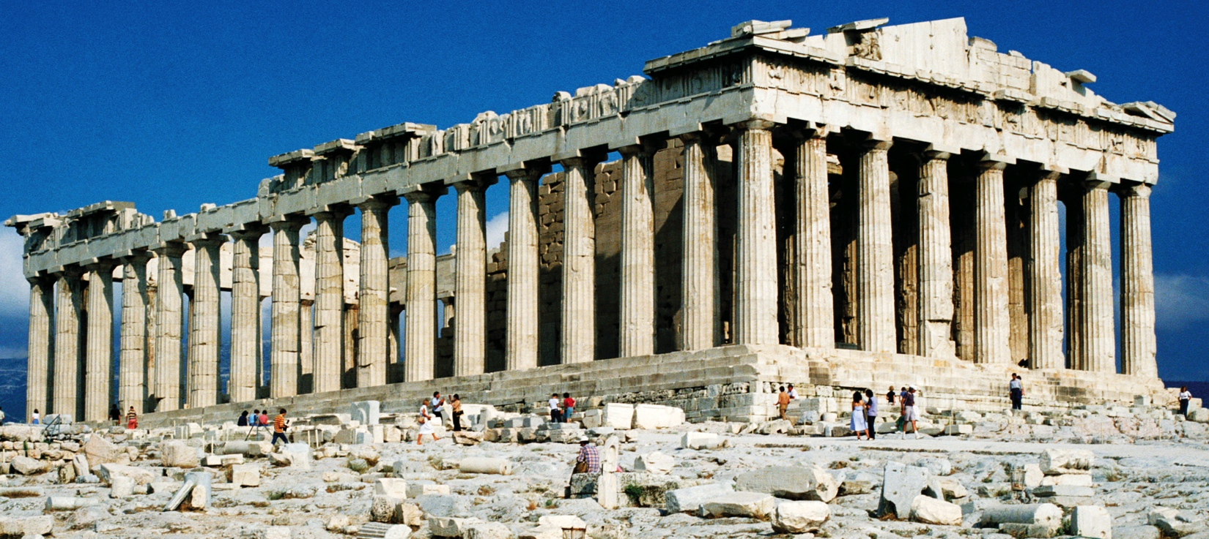

Slide 5
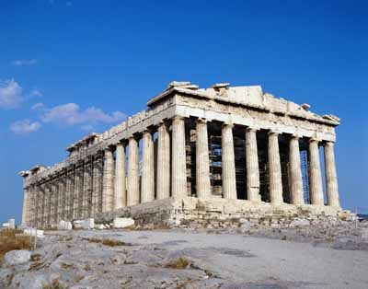
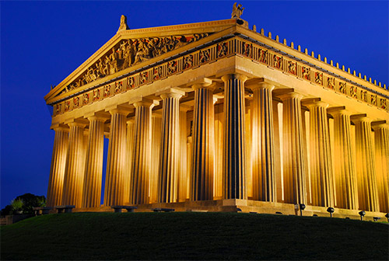
Reconstruction of Parthenon

Slide 6
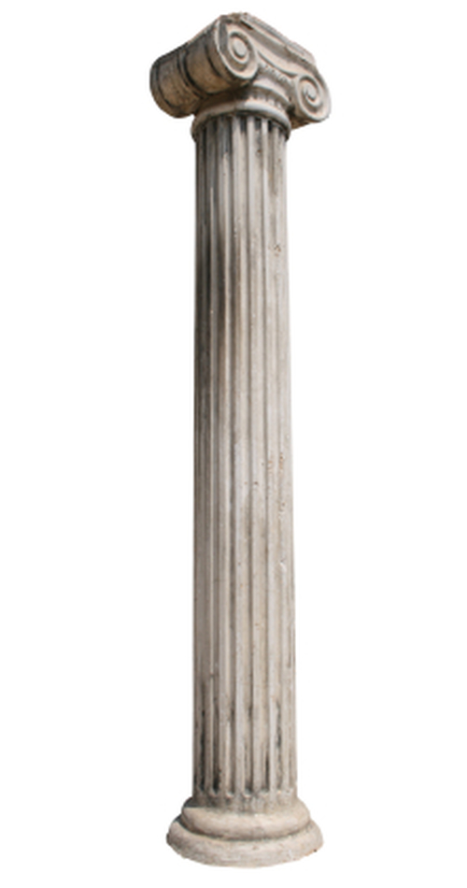
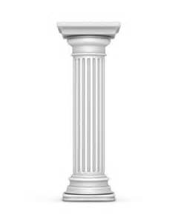
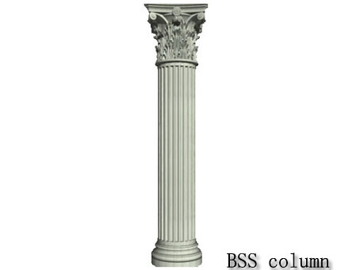
Doric
Corinthian
Ionic

Slide 7
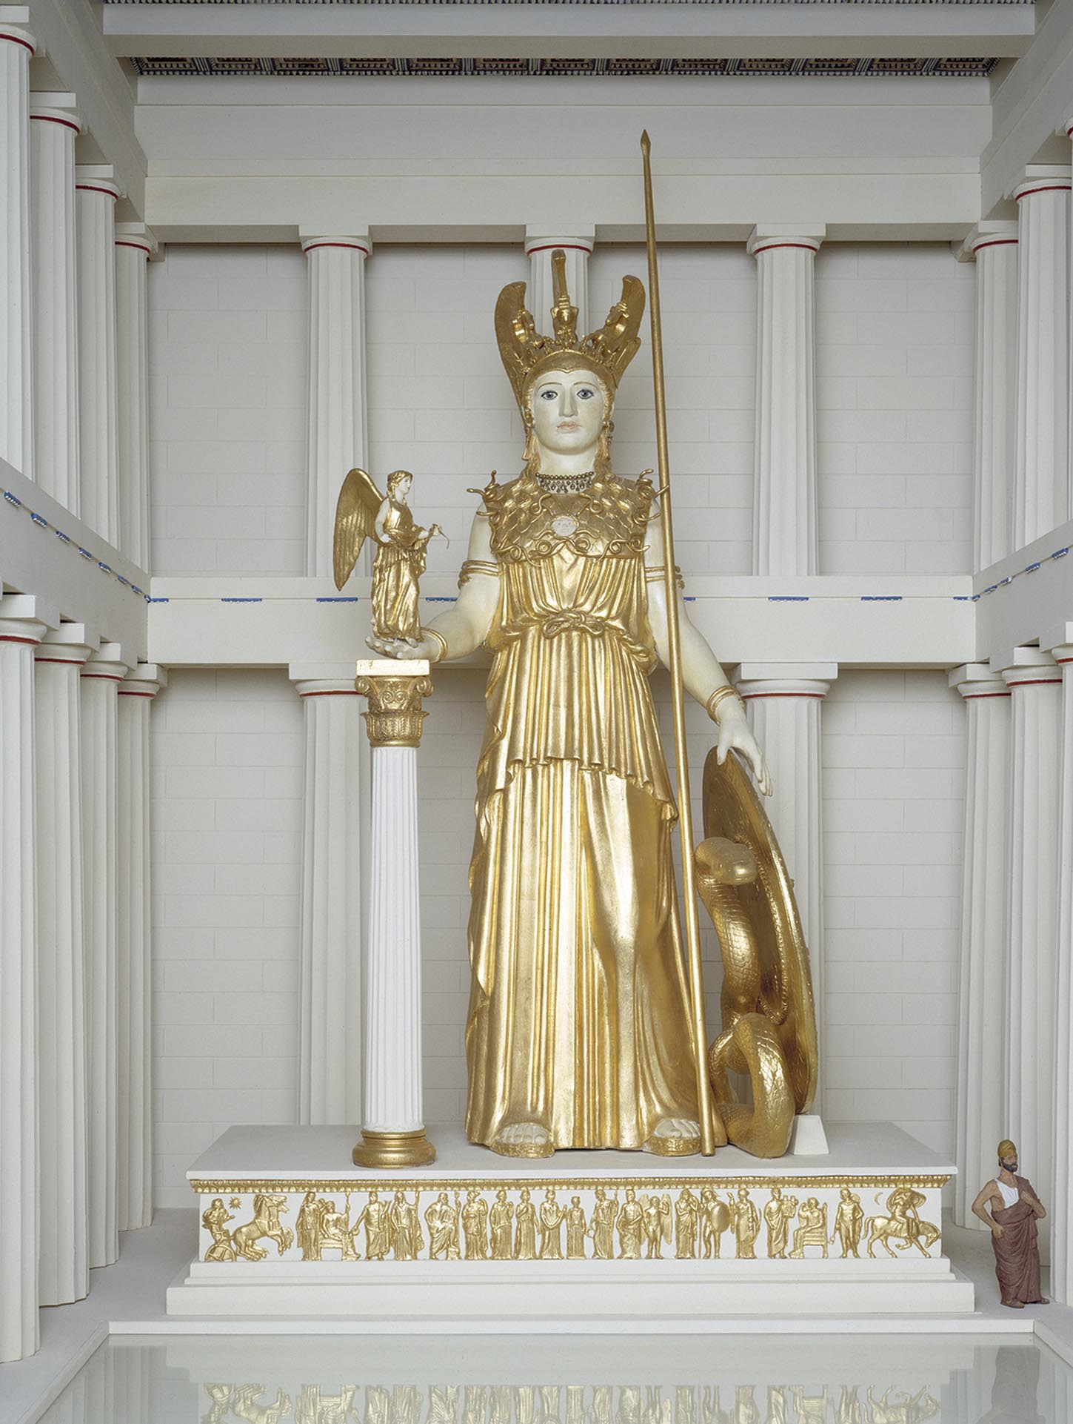
Recreation of Pheidias’ Huge Gold and Ivory Figure, aprox 38’

Slide 8
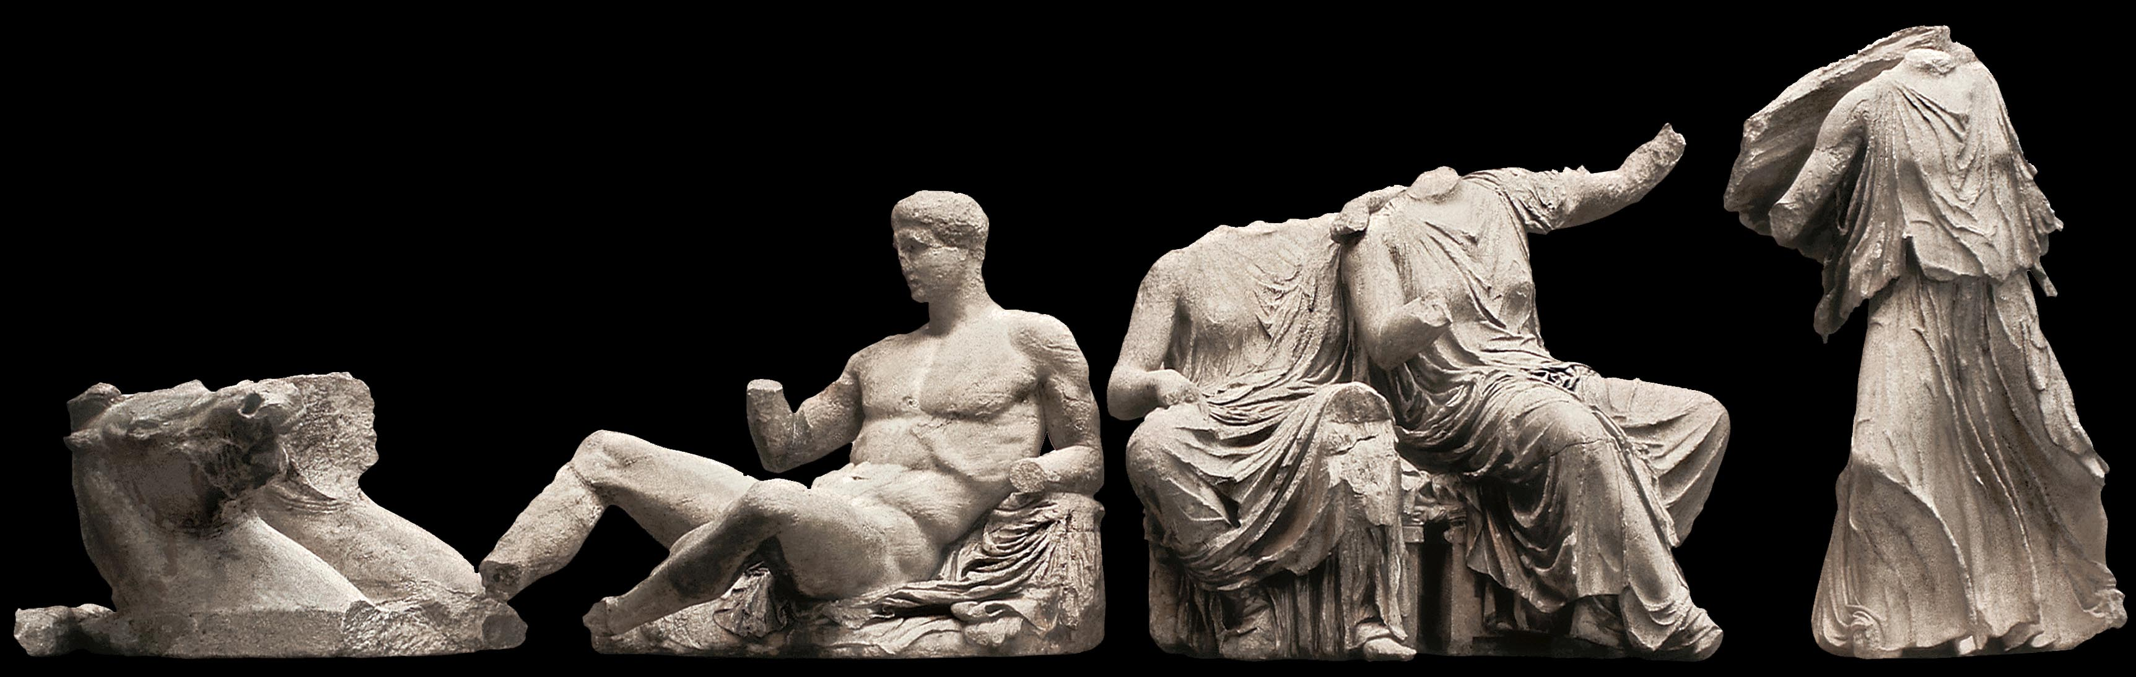
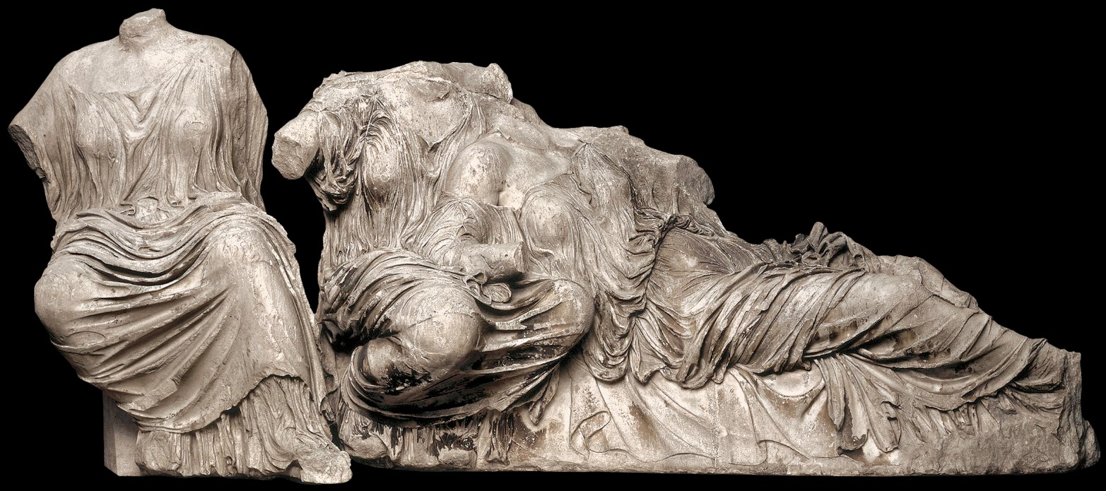
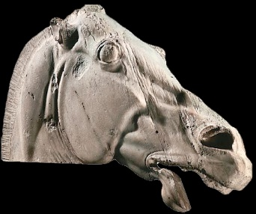
Reconstruction of the East Pediment of the Parthenon. c. 447-432 BCE

Slide 9
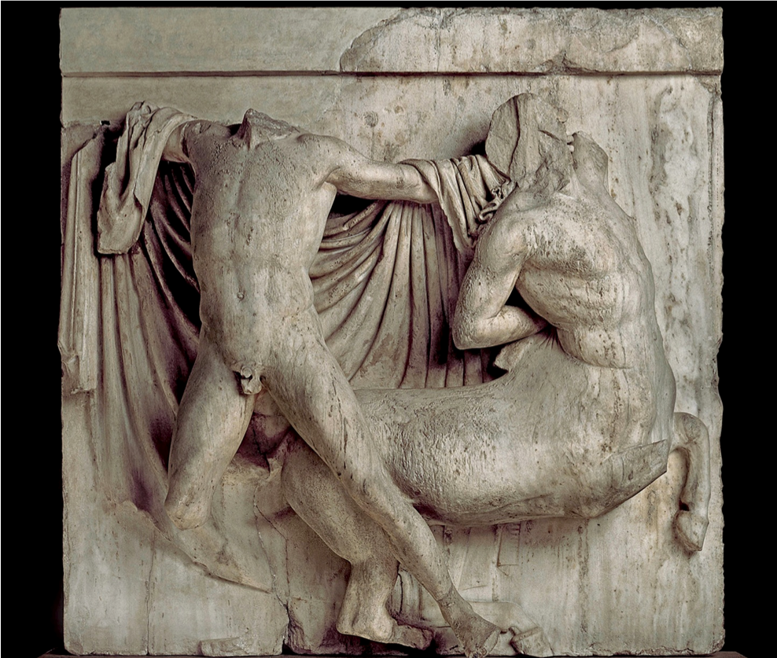
Lapith Fighting a Centaur, Metope Relief from the Doric Frieze on the south side of the Parthenon, c. 447-432 BCE, Marble, height 56”

Slide 10
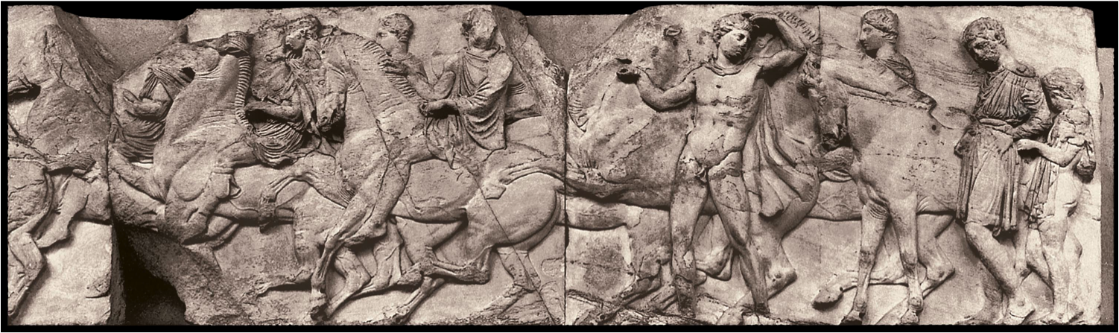
Horsemen, Detail of the Procession, from the Ionic Frieze on the north side of the Parthenon, c. 447-432 BCE, Marble, height approx. 3’6”

Slide 11
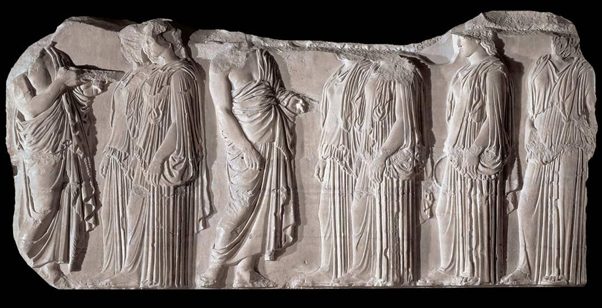
Marshals and Young Women, Details of the Procession from the Ionic Frieze on the east side of the Parthenon, c. 447-432 BCE, Marble, height 3’6”

Slide 12
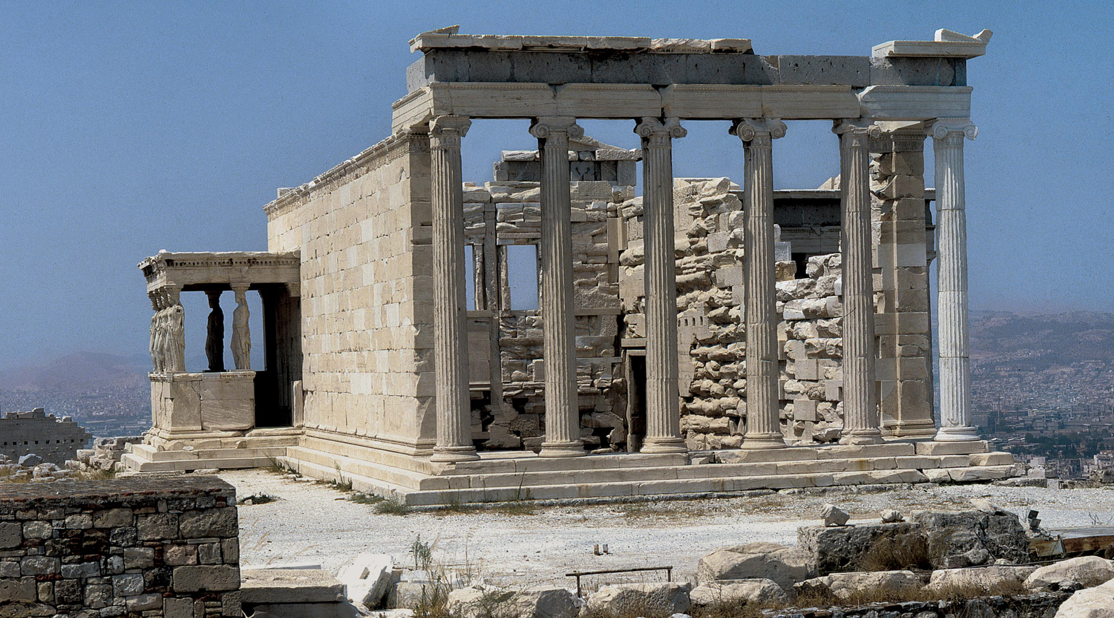
Erechtheion. Acropolis, Athens, 421-406 BCE, View from the East, Porch of the Maidens at the left; the north porch can be seen through the columns of the east wall

Slide 13
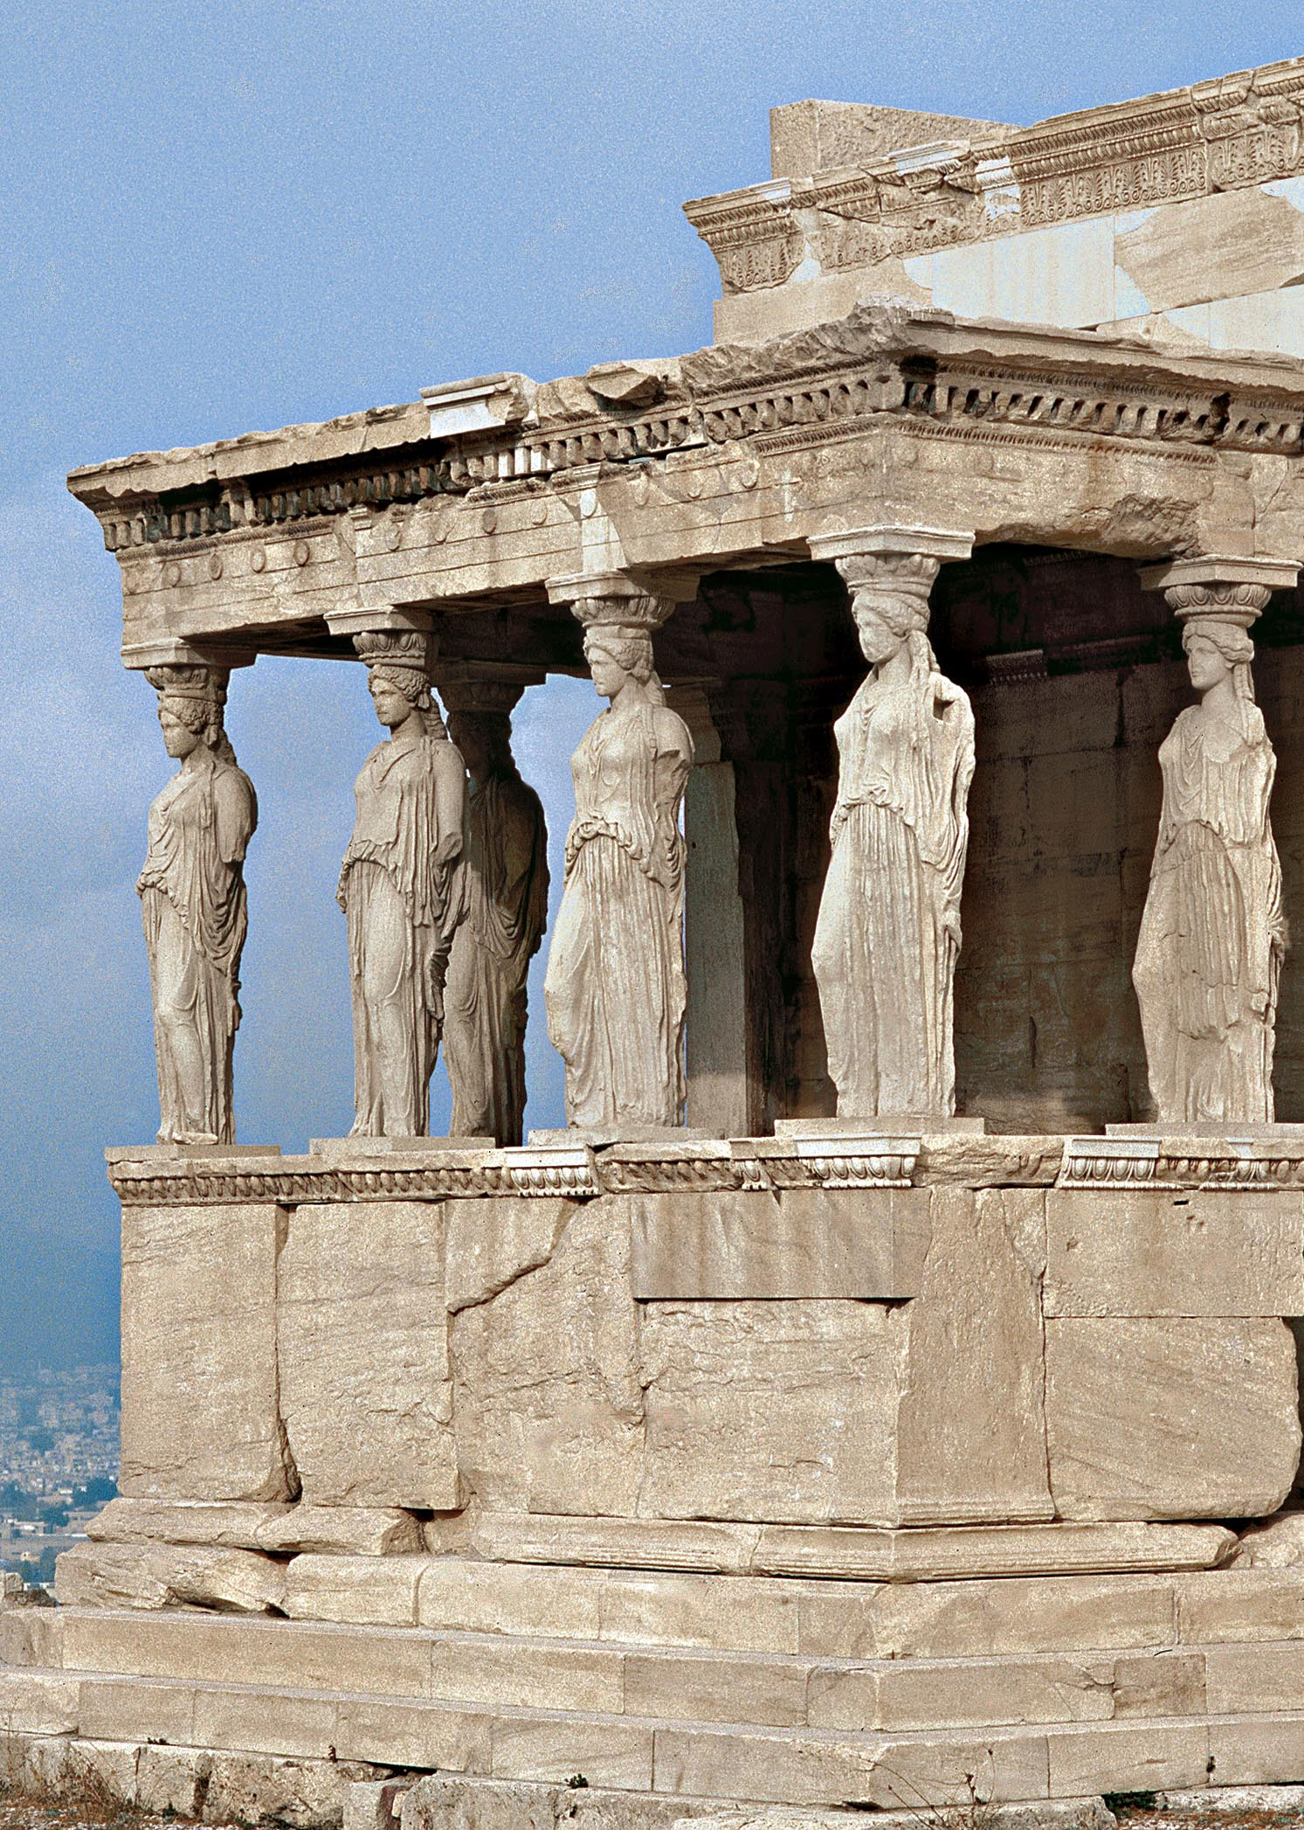
Porch of the Maidens,
South Porch of Erechtheion,
Acropolis, Athens, c. 420-10BCE

Slide 14
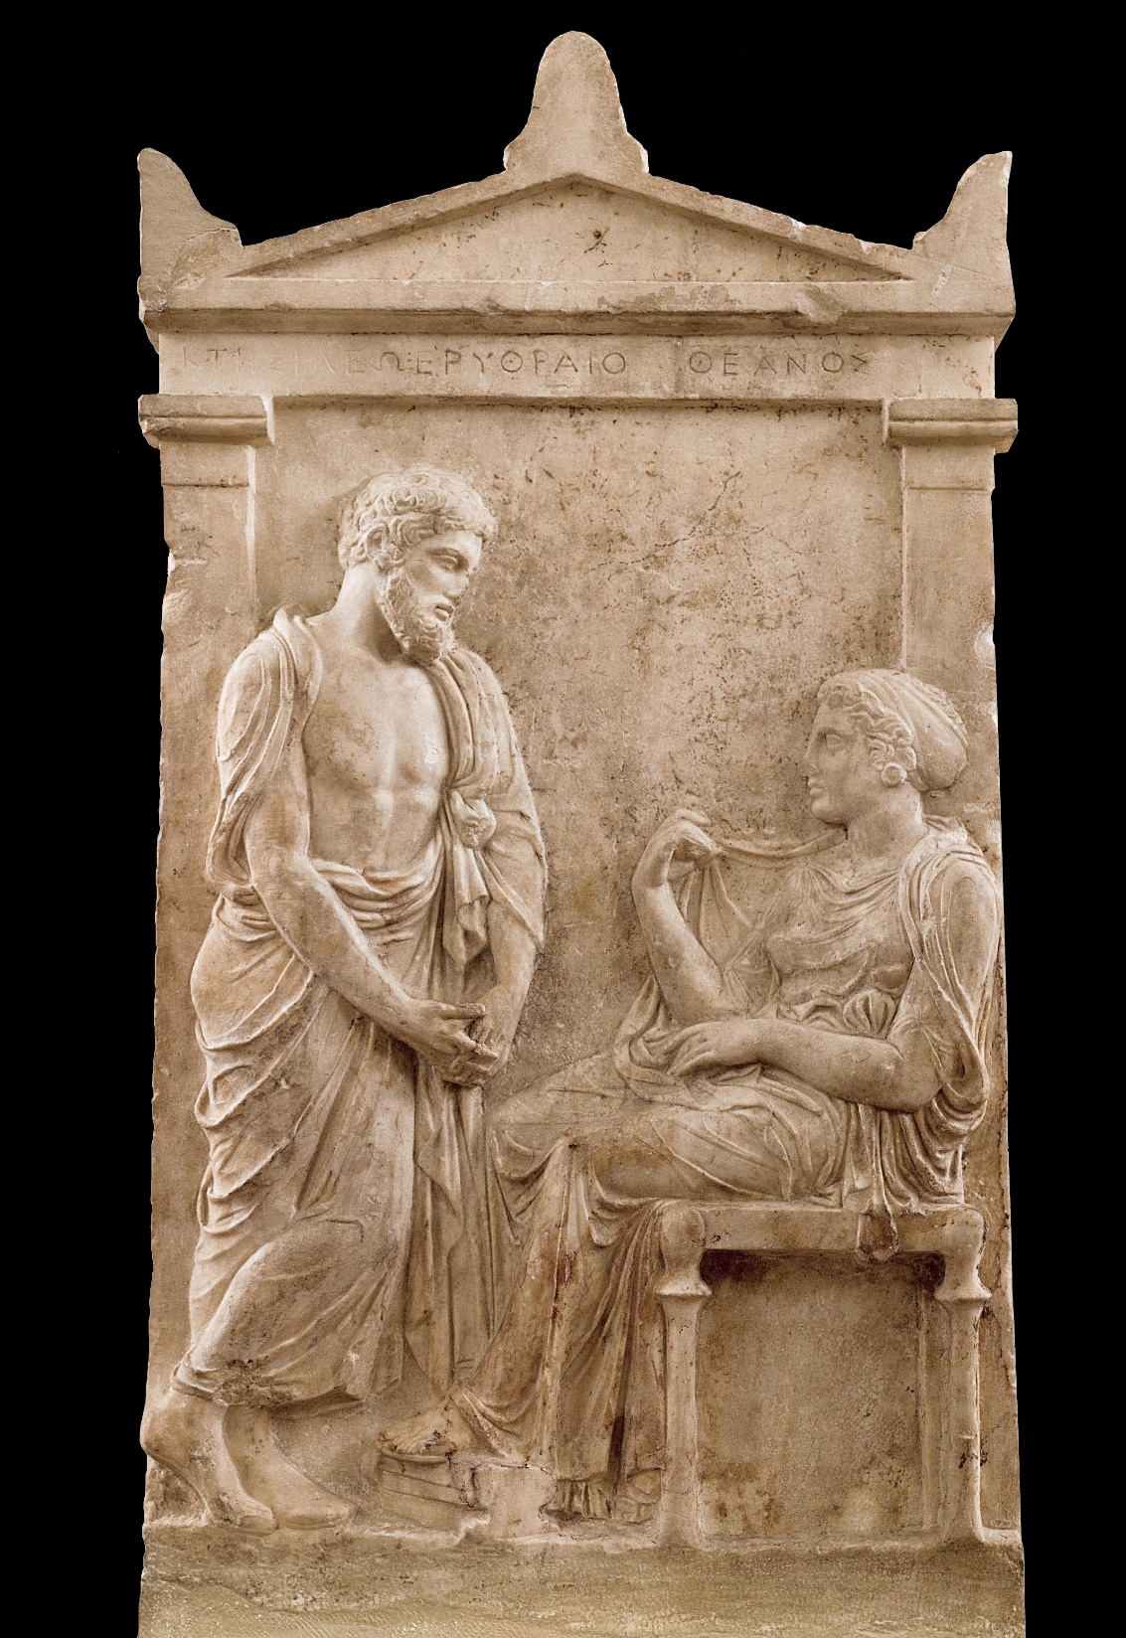
Grave Stele of Ktesilaos and Theano. c. 400 BCE. Marble, height approx. 36 “

Slide 15
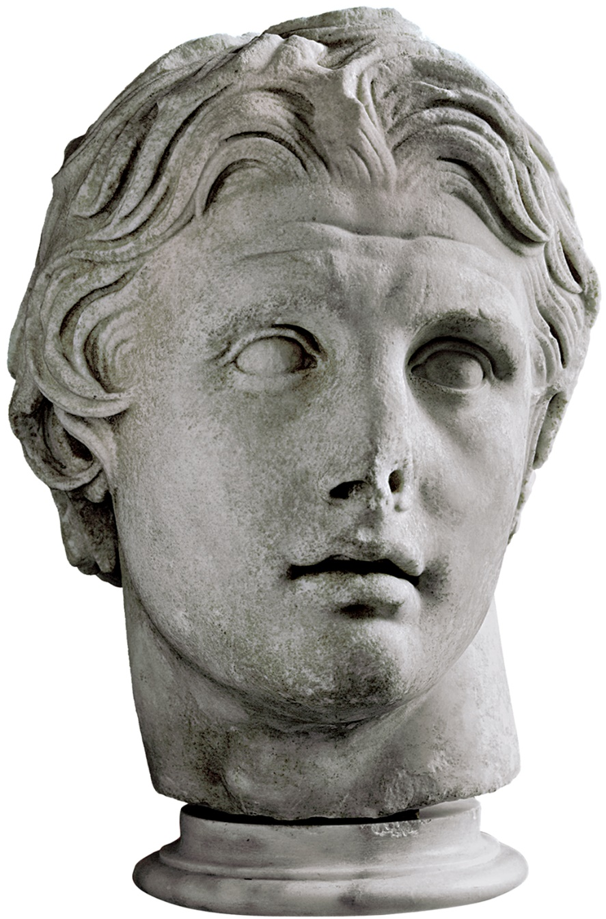
Hellenistic
or Late Classical
Alexander the Great

Slide 16
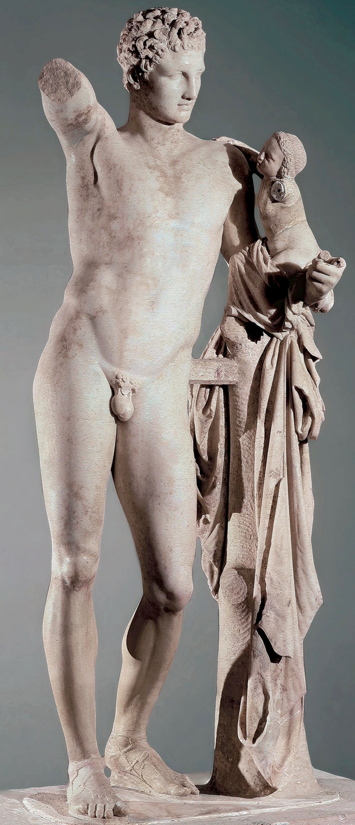
Hellenistic or Late Classical
Praxiteles, Hermes and the Infant Dionysos.
Hellenistic or Roman copy
after late Classical 4th century BCE original.
Marble height 7’1”

Slide 17
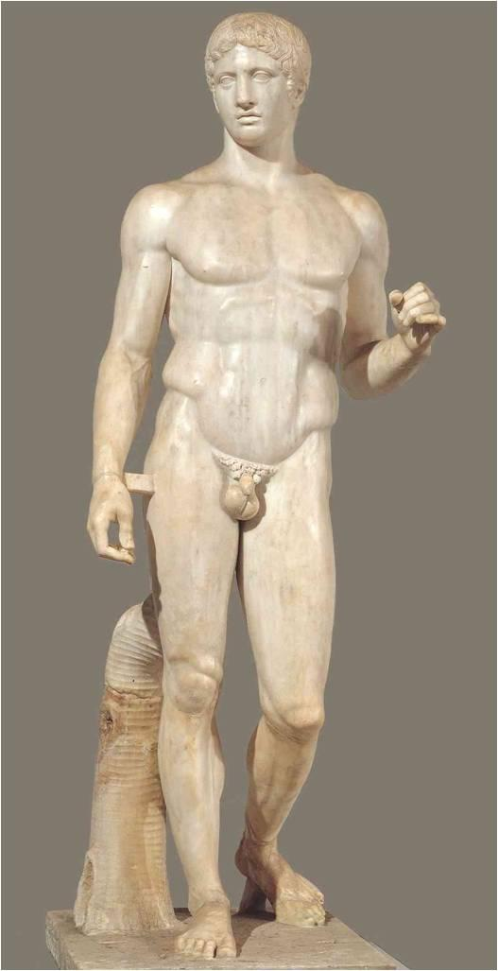
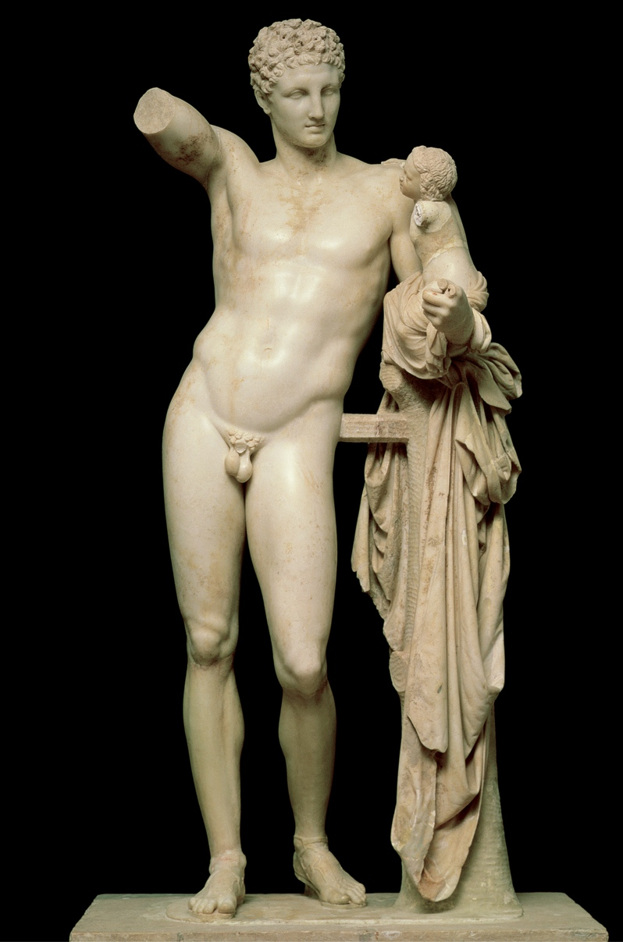

Slide 18
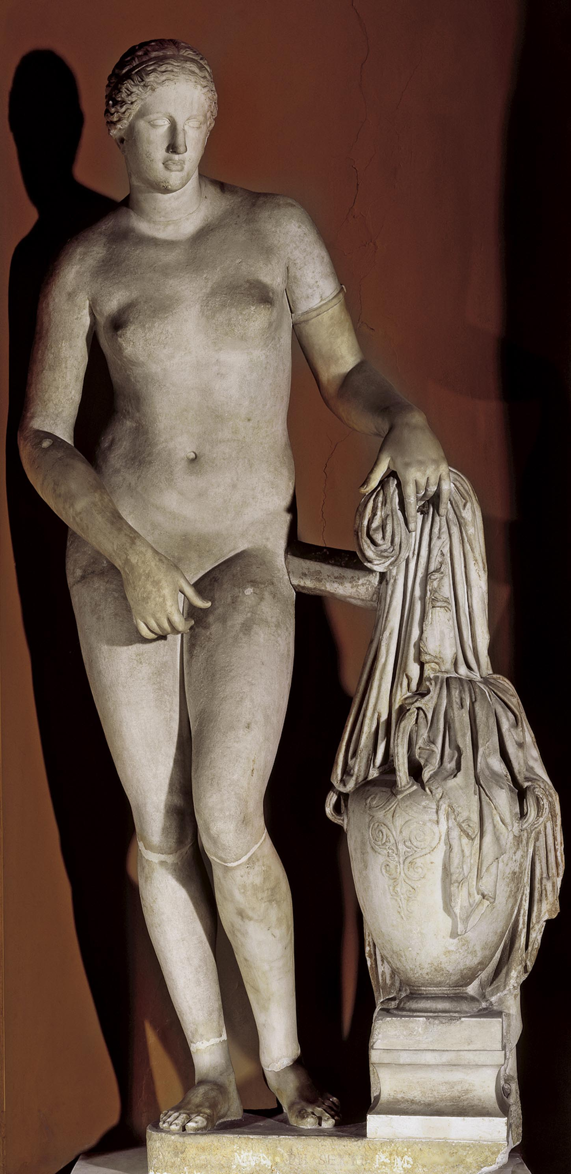
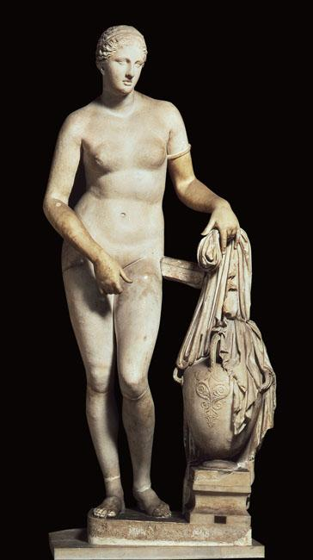
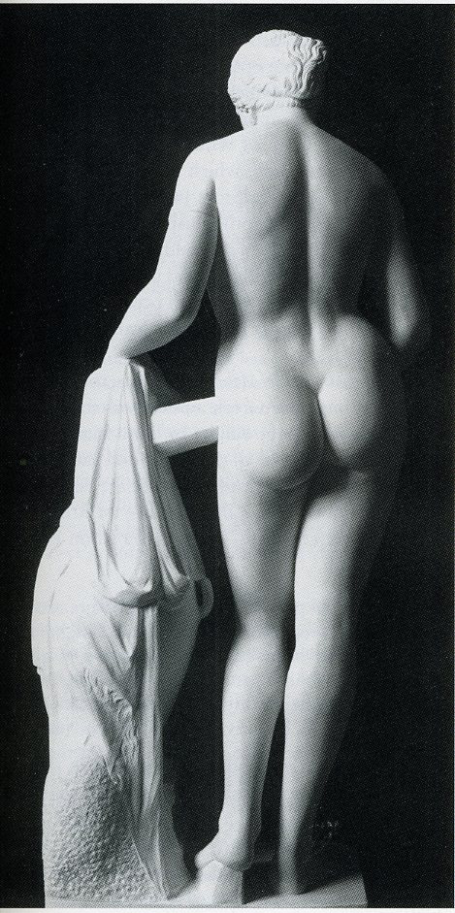
Praxiteles, Aphrodite of Knidos, c. 350 BCE. Marble, height 6’8”

Slide 19
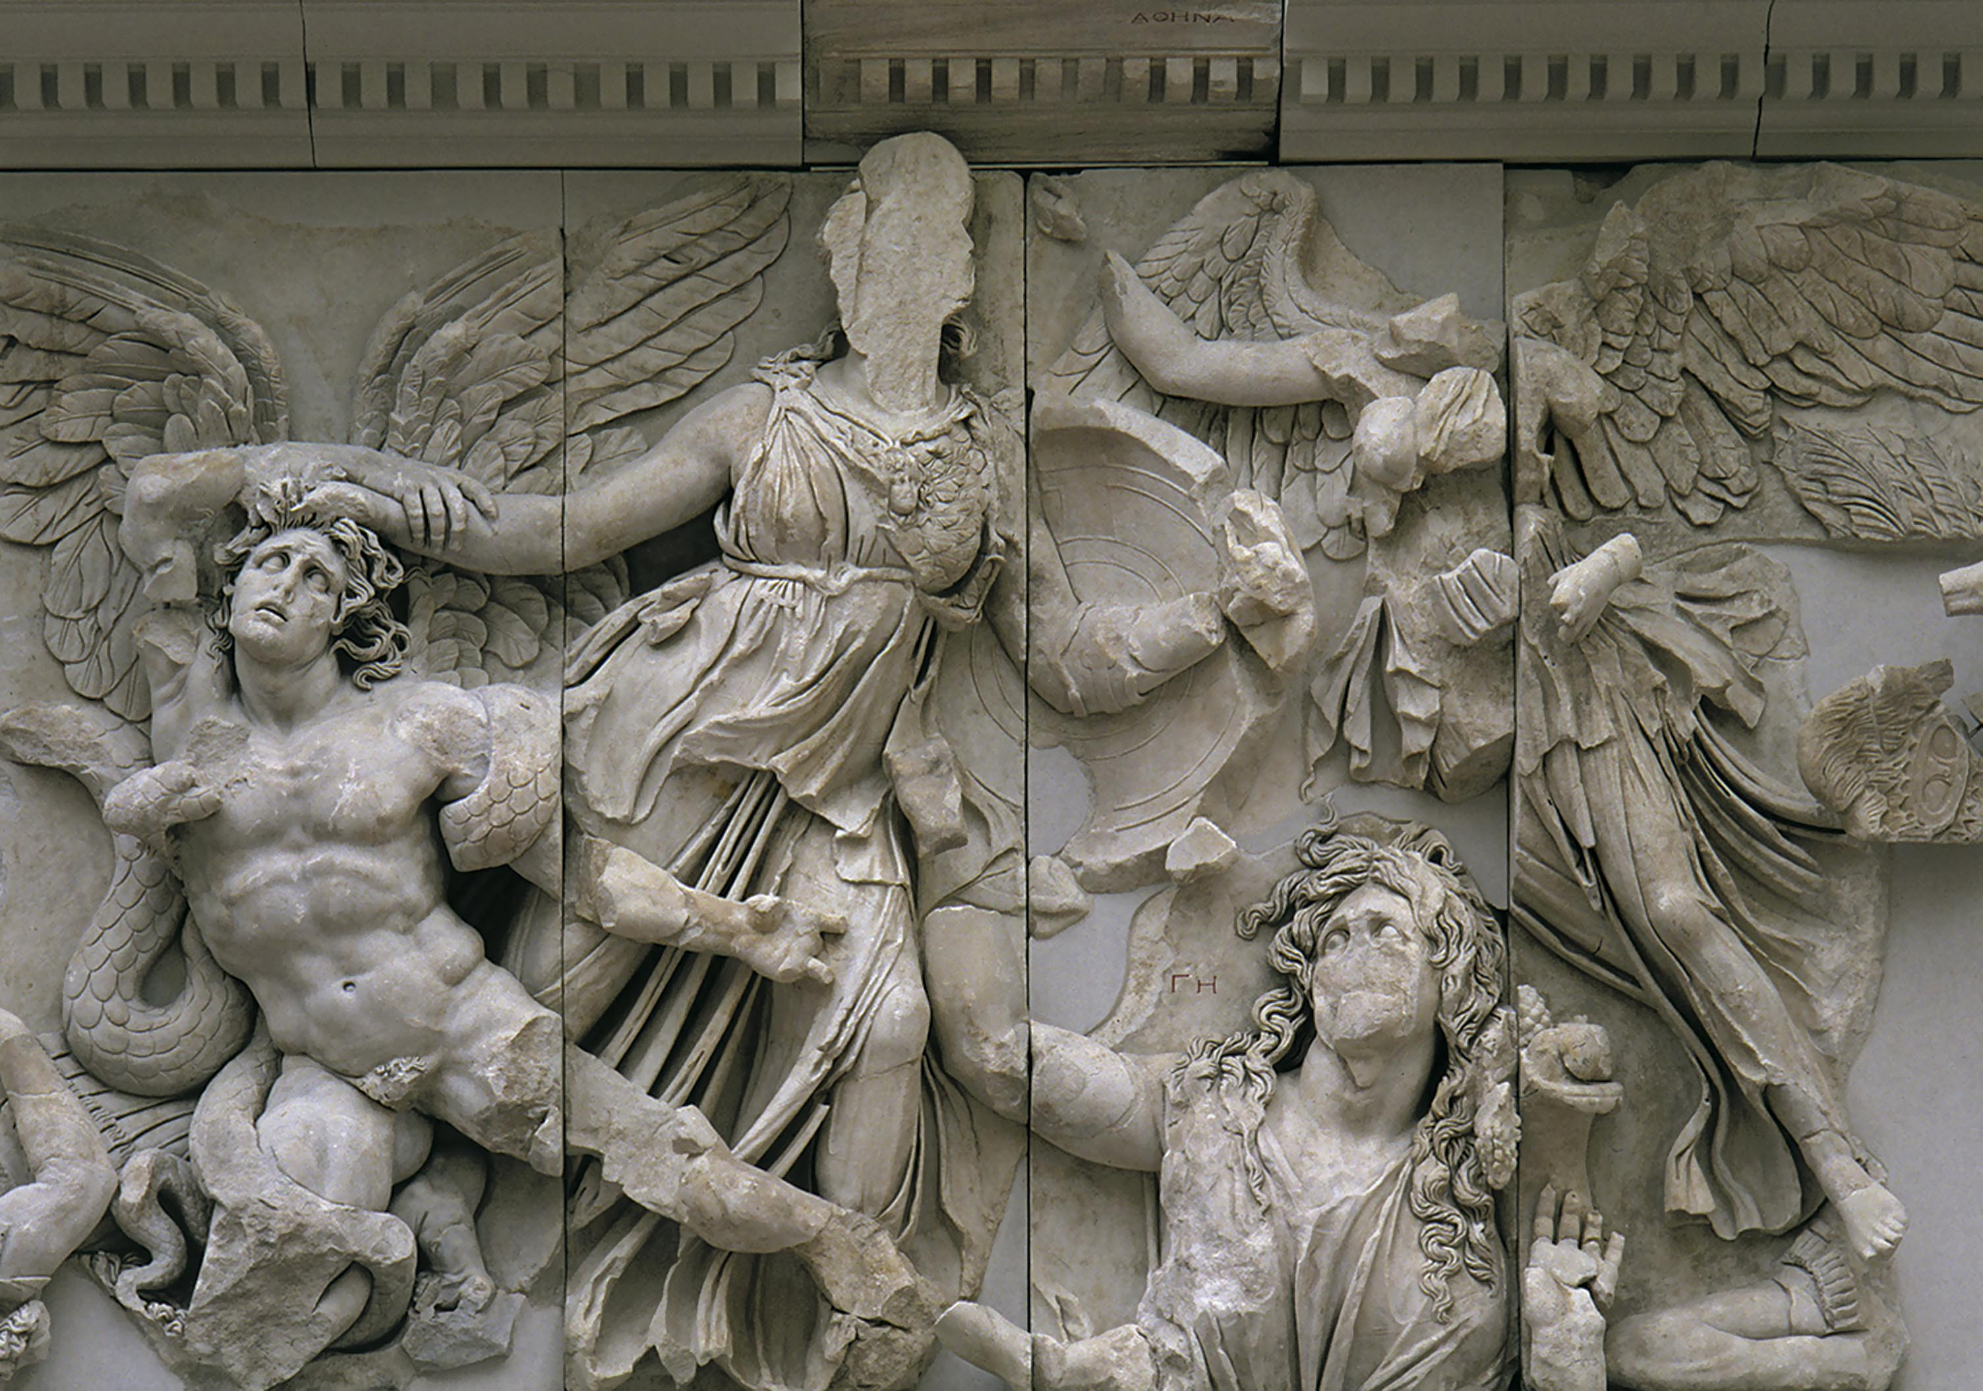
Athena Attacking the Giants, Detail of the frieze from the east front of the altar from Pergamon, C. 175-150 BCE, Marble, frieze height 7’7”

Slide 20
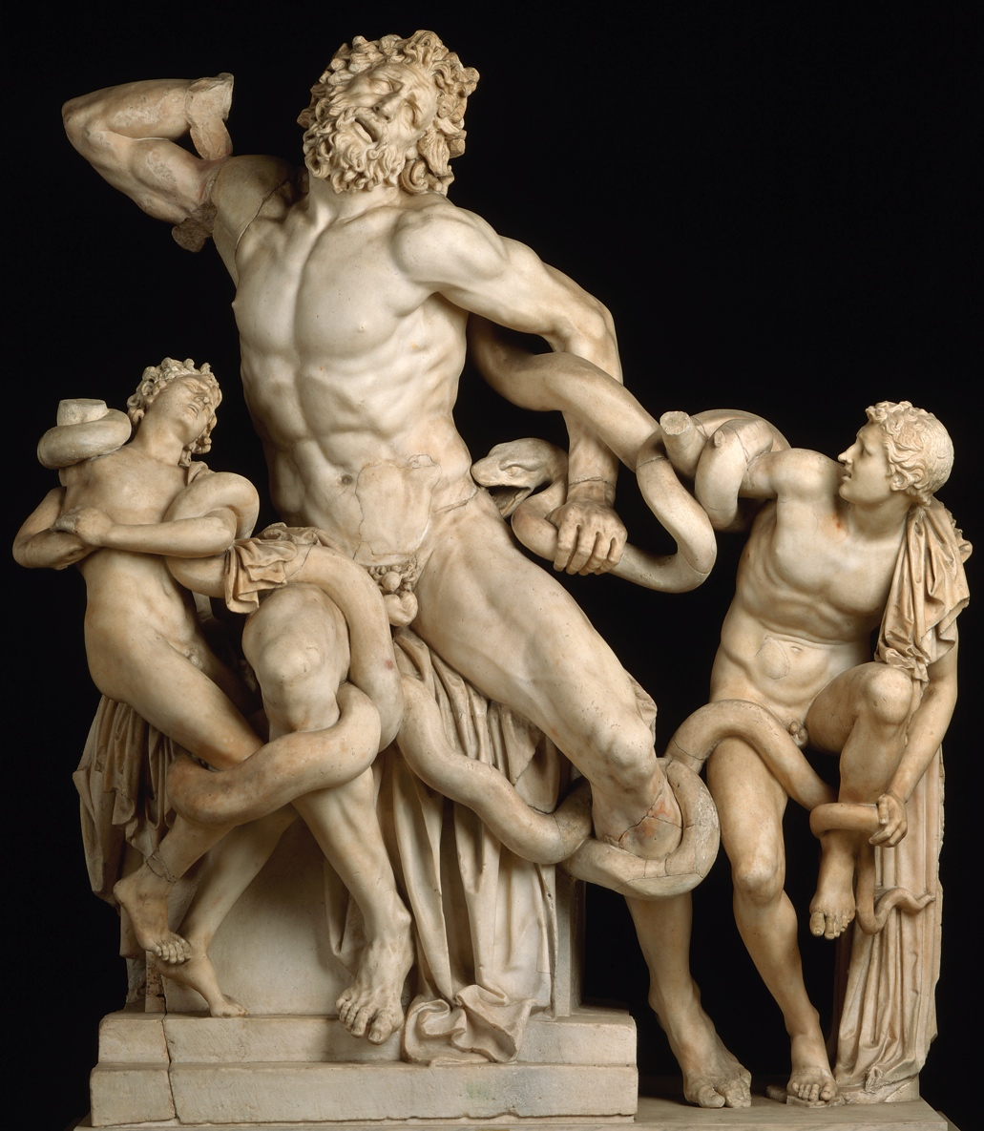
Hagesandros, Polydoros, and Athenodoros of Rhodes,
Laocoon and His Sons,
original of 1st century BCE
Marble, height 8’

Slide 21
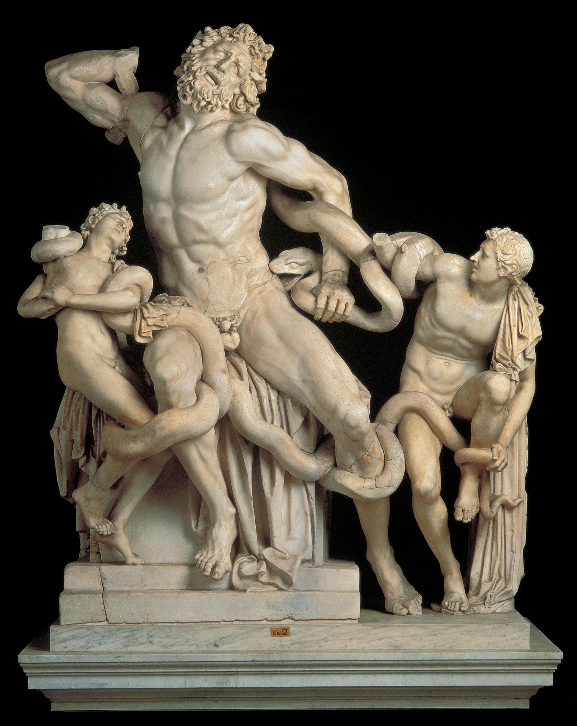
Hagesandros, Polydoros, and Athenodoros of Rhodes,
Laocoon and His Sons,
original of 1st century BCE
Marble, height 8’

Slide 22
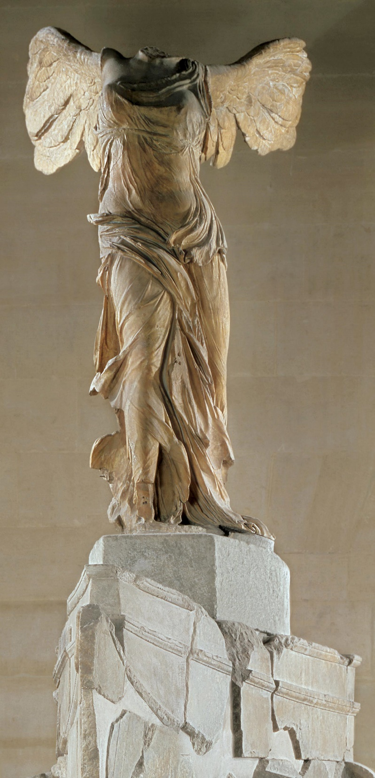
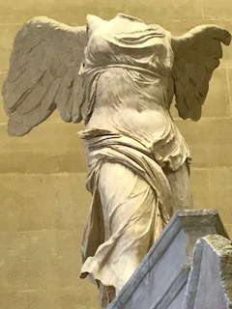
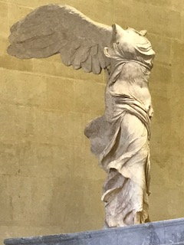
Nike (Victory) of Samothrace,
Sanctuary of the Great Gods, Samothrace c. 180 BCE (?) Marble, height 8’1”

Slide 23
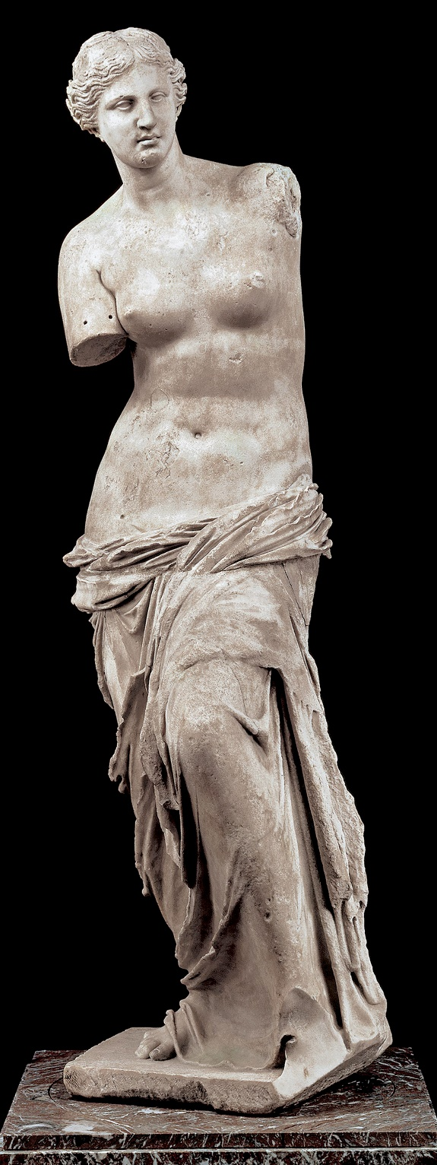
Aphrodite of Melos (Venus de Milo) c. 150-100 BCE. Marble, height 6’8”

Slide 24
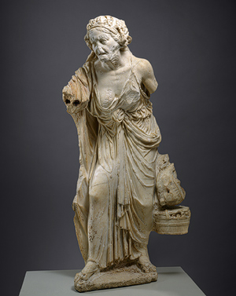
Old Woman, Roman Copy, 1st century CE. Marble, height 49.5”

