Slide 1
“Classical Greece”: (600-300 BC)
Concepts
Humanism
Rationalism
Idealism
Time Periods
Early Classical: (c.480-450 BCE)
High Classical: (450-400 BCE)
Late Classical: (400-323 BCE)

Slide 2
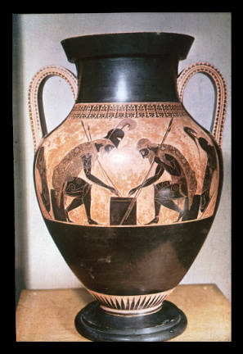
Exekias (potter and painter)
Ajax and Achilles Playing a Game,
c. 540-530 BCE
Black-figure painting on a
ceramic amphora, height 2’

Slide 3
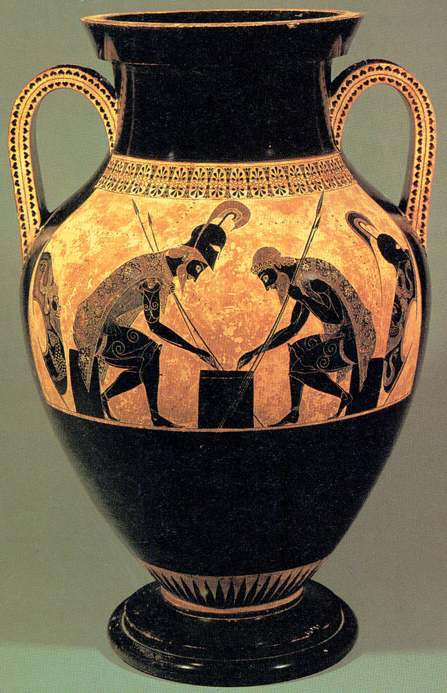
Exekias (potter and painter)
Ajax and Achilles Playing a Game,
c. 540-530 BCE
Black-figure painting on a
ceramic amphora, height 2’

Slide 4
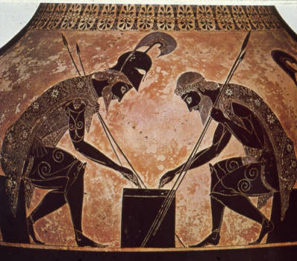
Exekias (potter and painter), Ajax and Achilles Playing a Game, c. 540-530 BCE
Black-figure painting on a ceramic amphora, height 2’
Notes:
Ajax and Achilles playing dice, all dressed and ready for battle, throwing dice on the camp stool, during the Trojan war, draw your attention down to where the two hands are, Achilles just threw a four, Ajax threw a three, shortly after Ajax commits suicide, about human destiny

Slide 5
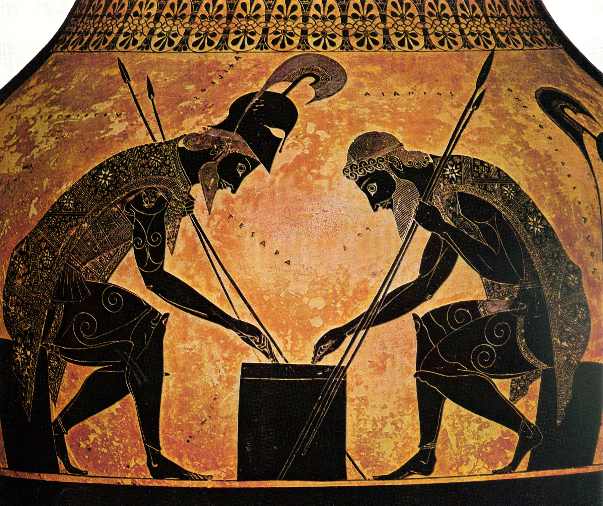
Exekias (potter and painter), Ajax and Achilles Playing a Game, c. 540-530 BCE
Black-figure painting on a ceramic amphora, height 2’

Slide 6
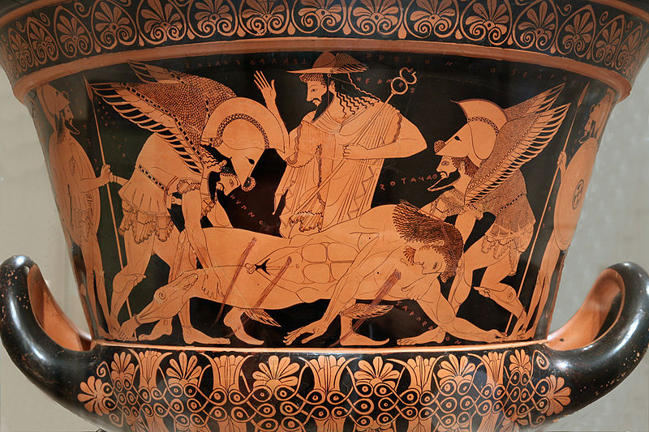
Euphronios (painter) and Euxitheos (potter). Death of Sarpedon. c. 515 BCE.
Red figure decoration on a calyx krater. Ceramic, height of krater 18”, Rome

Slide 7
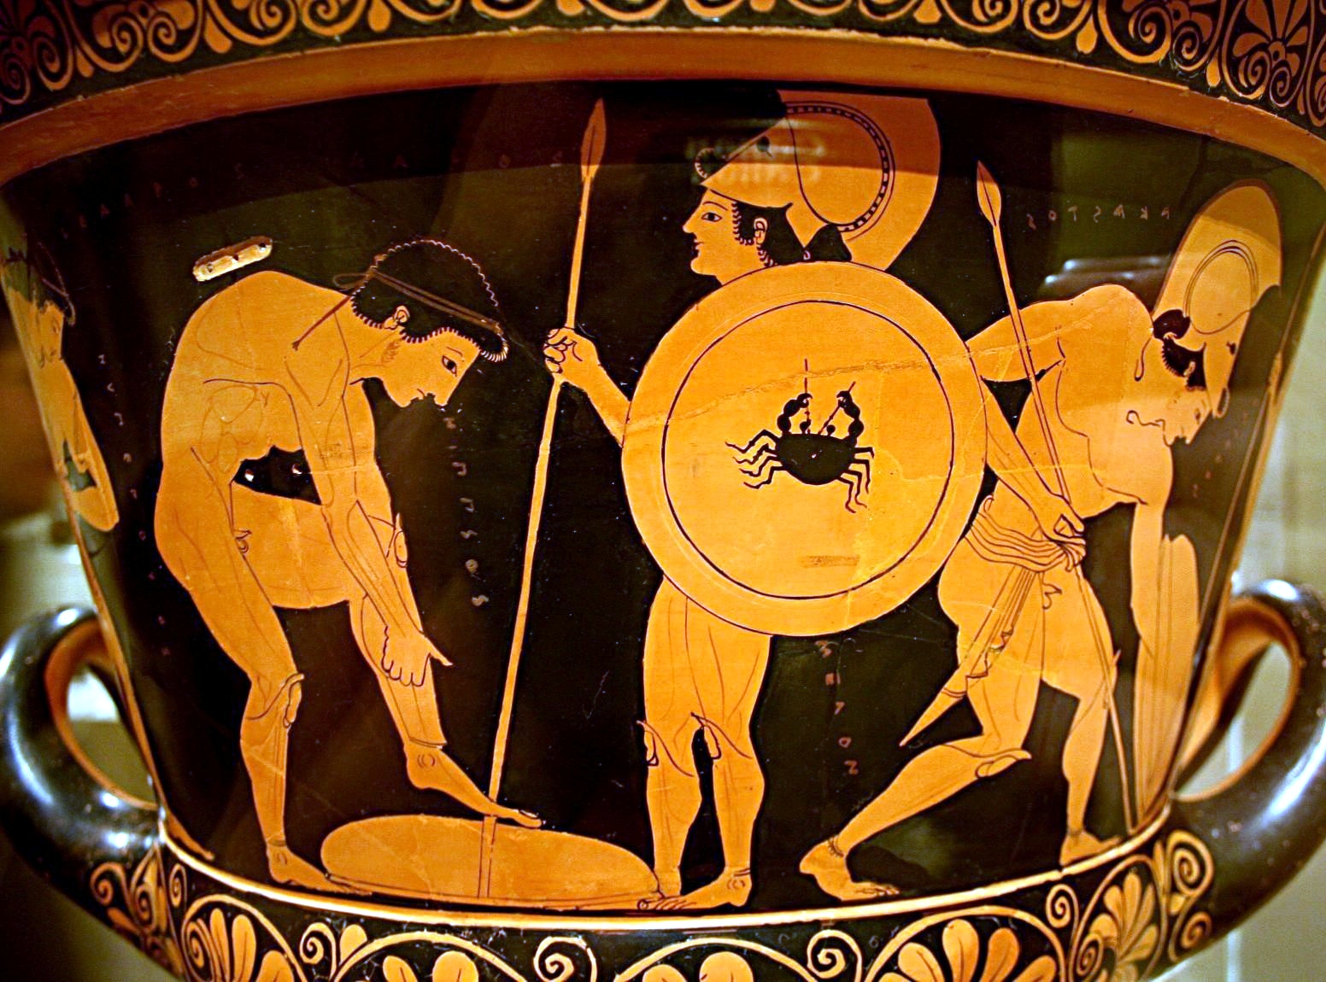
Notes:
Young men, whose names are not mythological, aimed at a male audience, the moral here is the son of god dies, you too may die in battle, your’e mortal

Slide 8
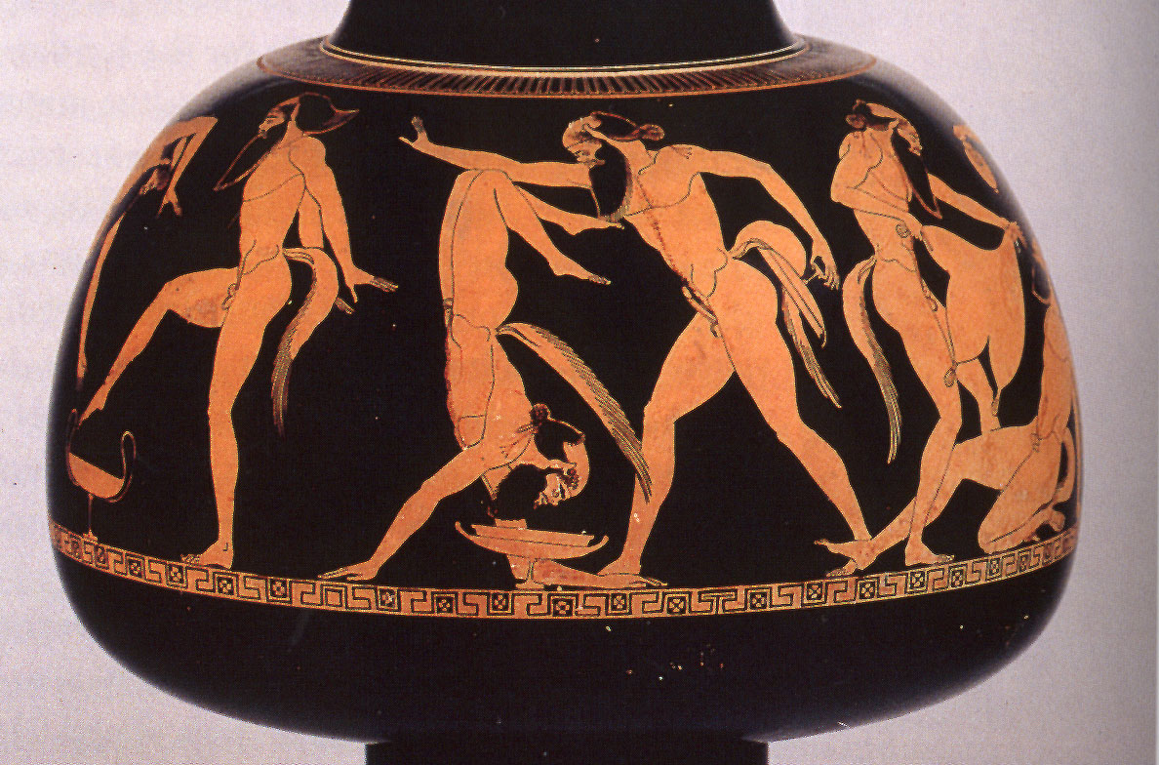
Douris. Frolicking Satyrs. Red Figure decoration on a psykter. c. 480 BCE
Notes:
Satyrs are shown gallavating around

Slide 9
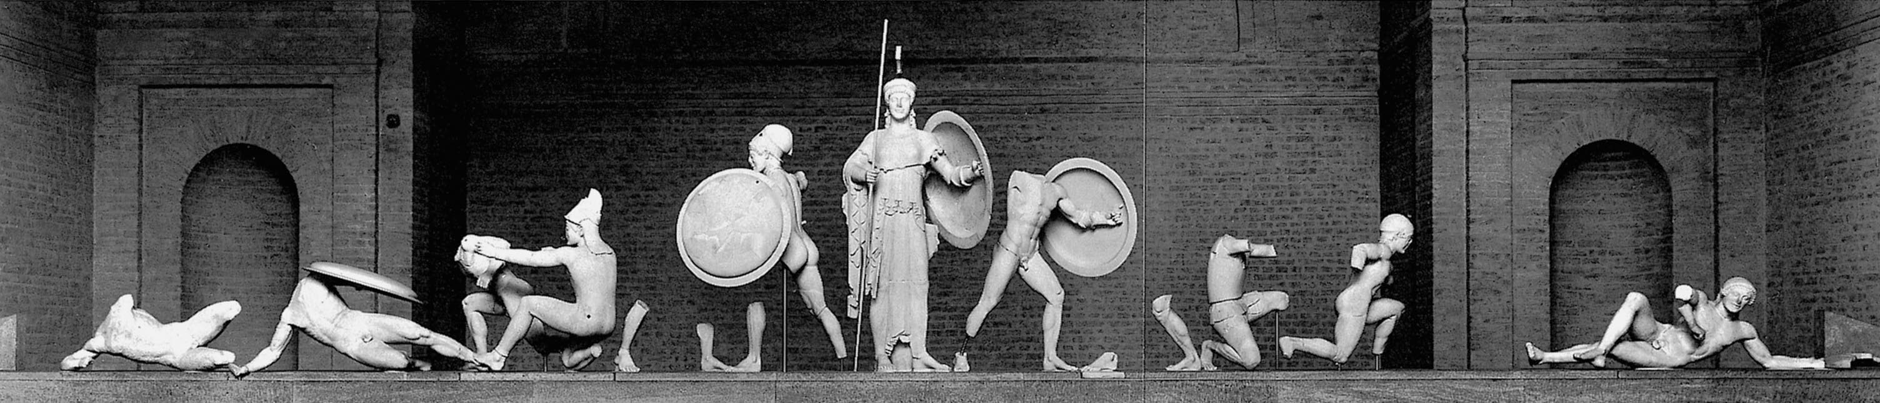
Trojan war Pediment
West Pediment of the Temple of Aphaia, Aegina. c. 500-49 BCE. Width about 49’. Surviving fragments assembled

Slide 10
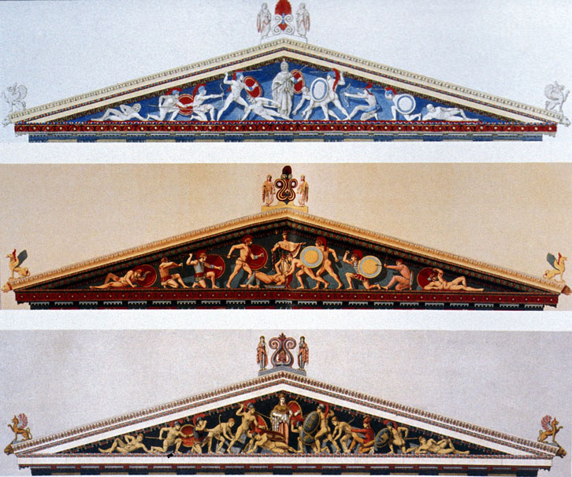

Slide 11
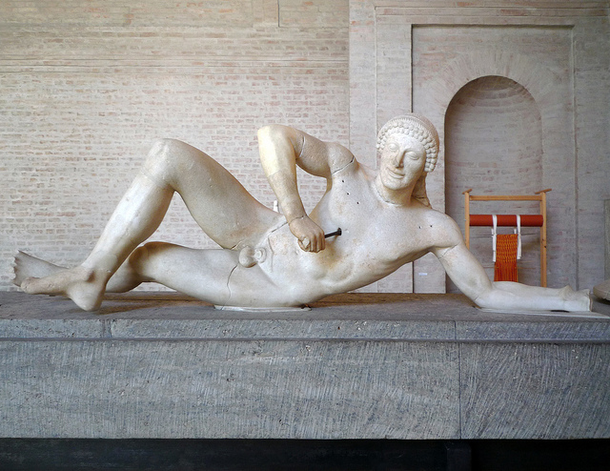
Dying Warrior. From the right corner of the west pediment of the Temple of Aphaia, Aegina. c. 490-480 BCE. Marble, length 5’6”

Slide 12
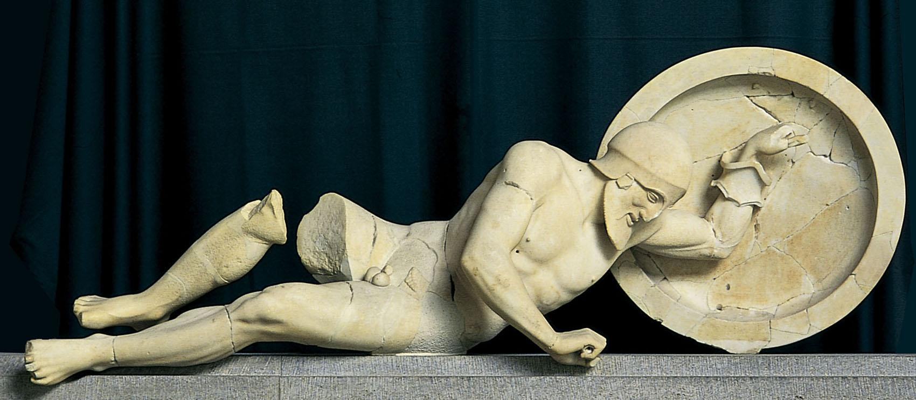
Dying Warrior. From the left corner of the east pediment of the Temple of Aphaia, Aegina. c. 500-490 BCE. Marble, length 6’

Slide 13
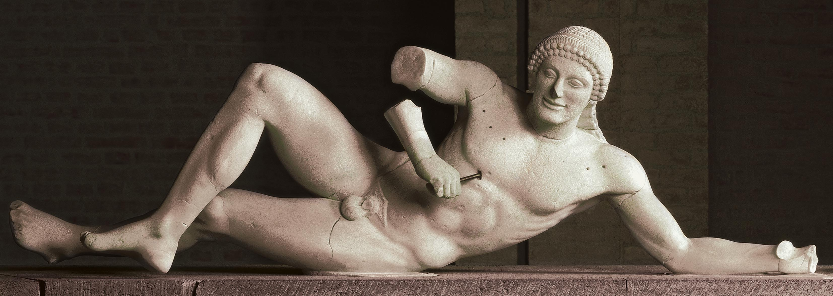
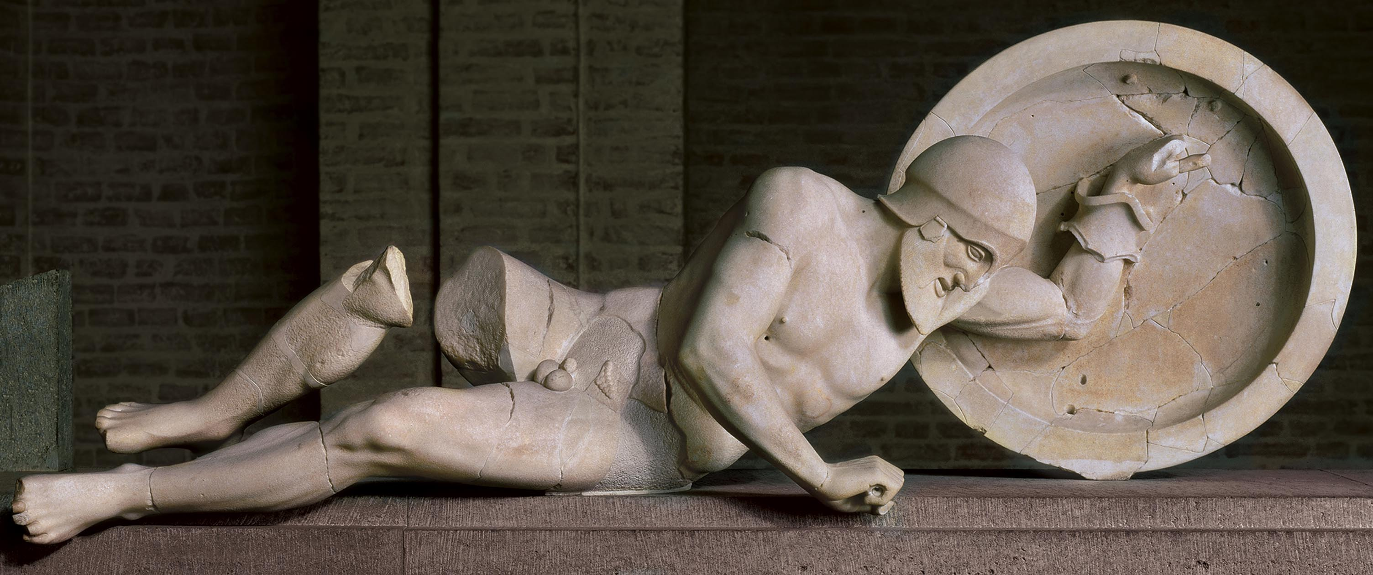

Slide 14
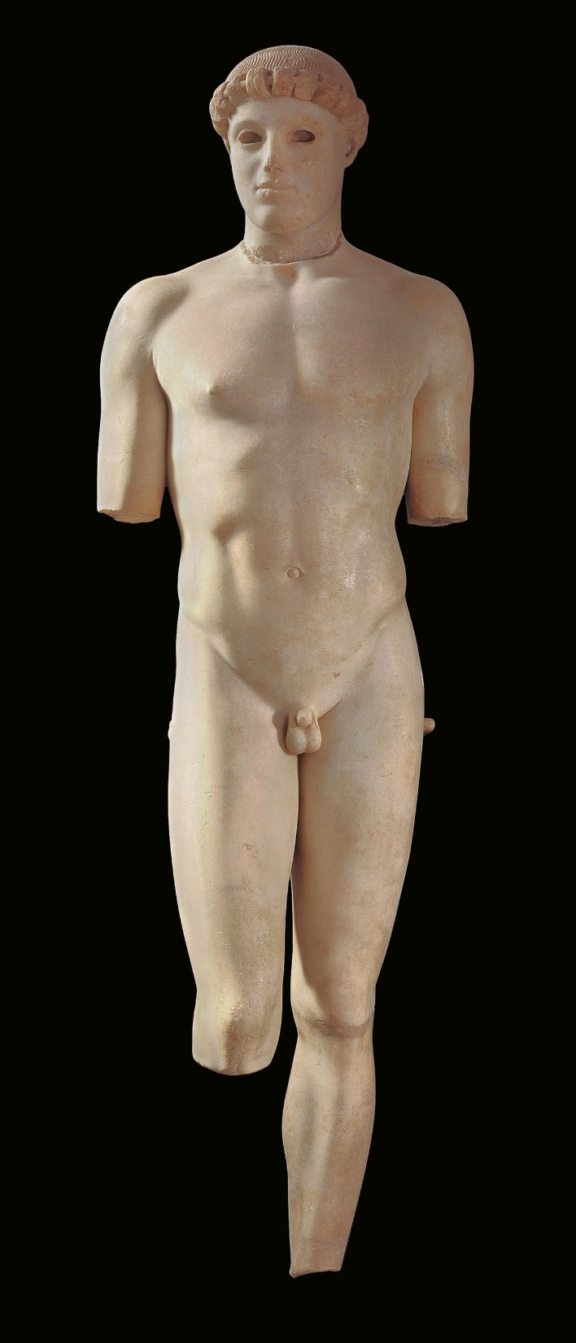
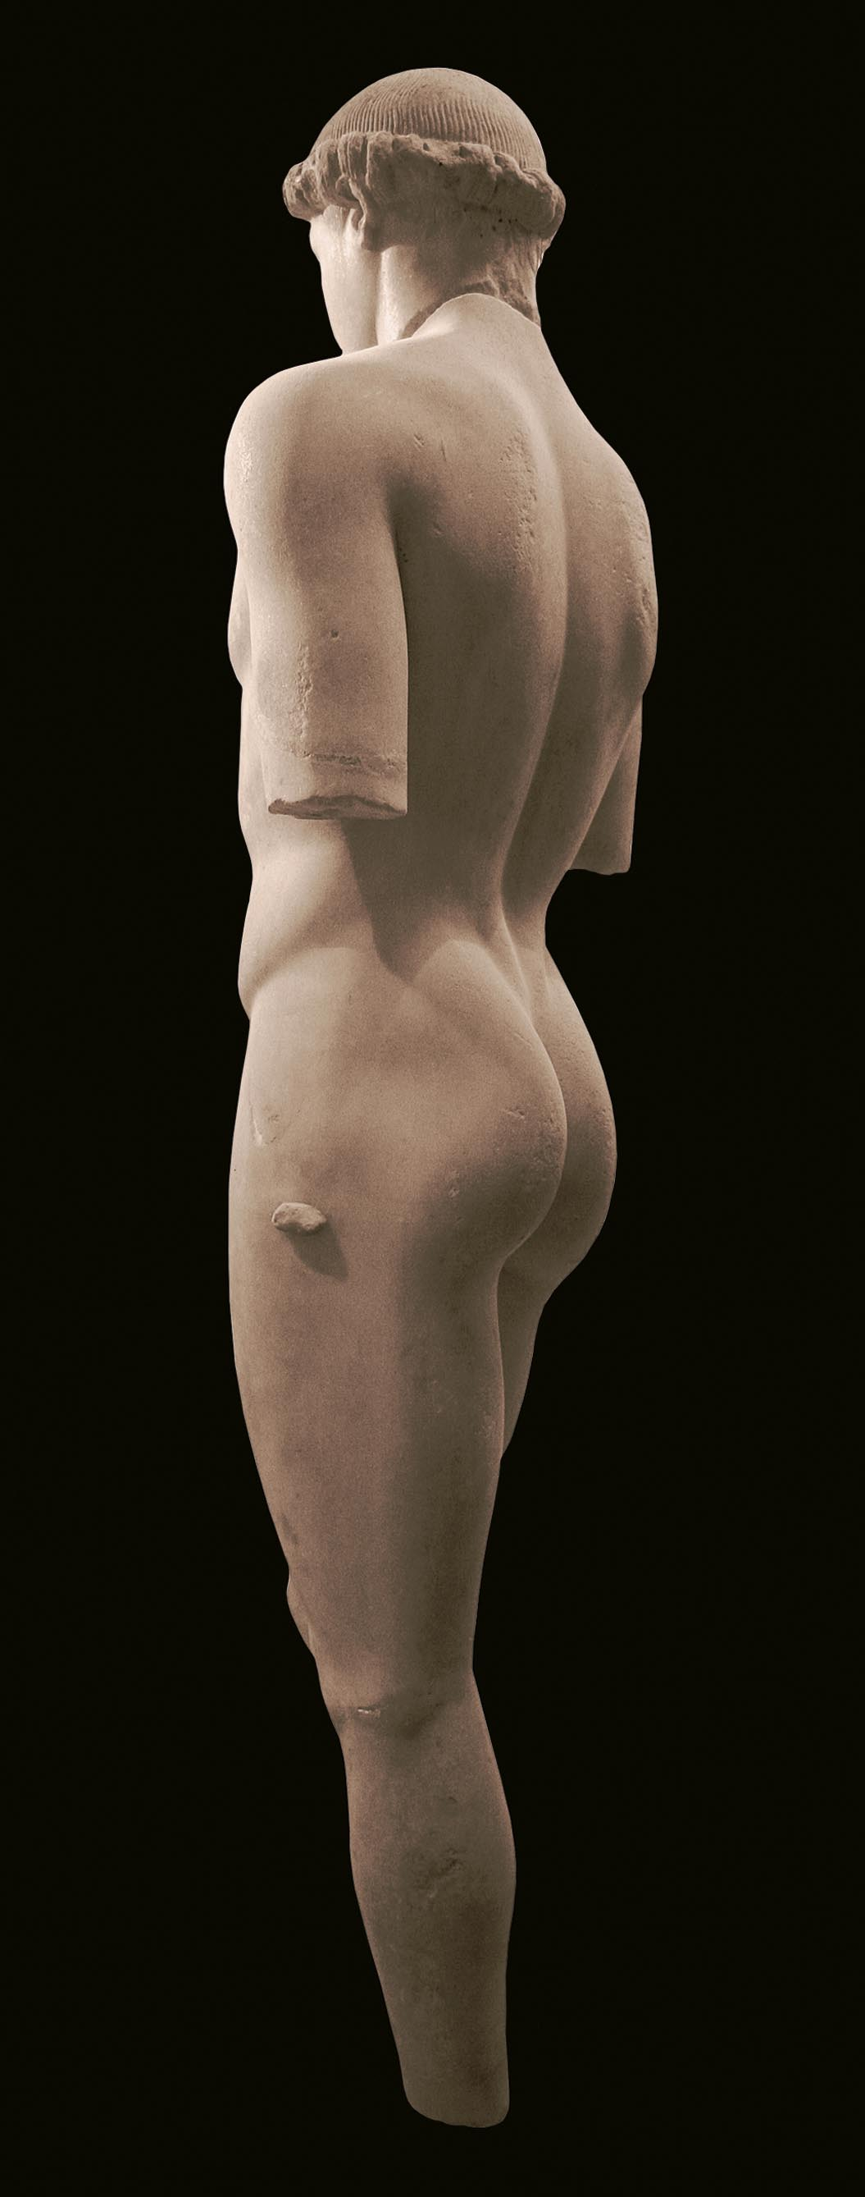
Early
Classical
Kritios Boy. From Acropolis, Athens. c. 480 BCE. Marble, height 3’10”

Slide 15
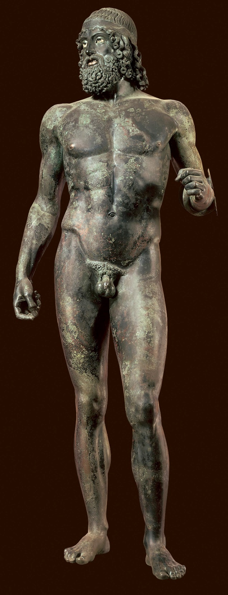
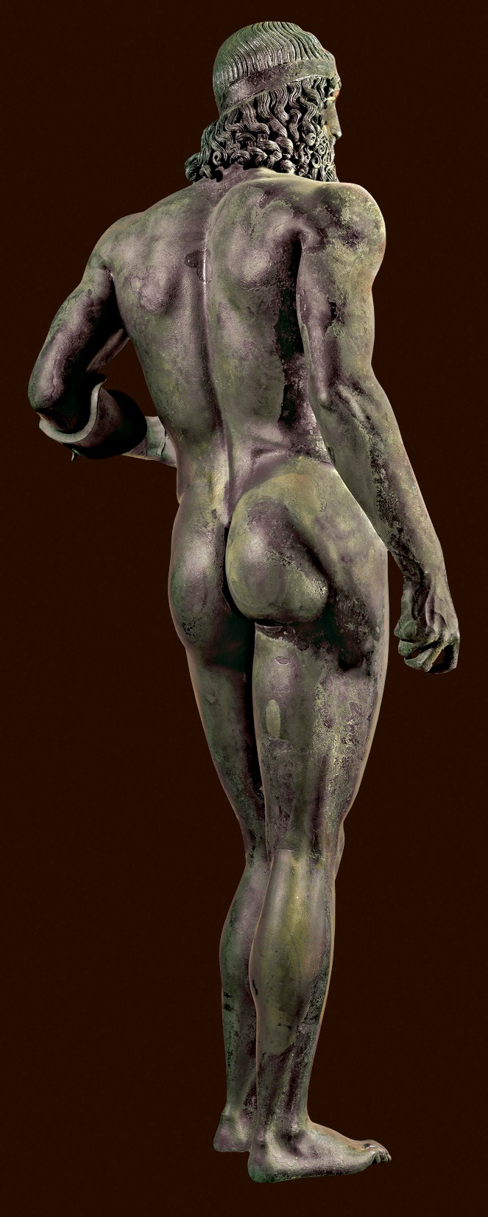
Riace Warrior

Slide 16
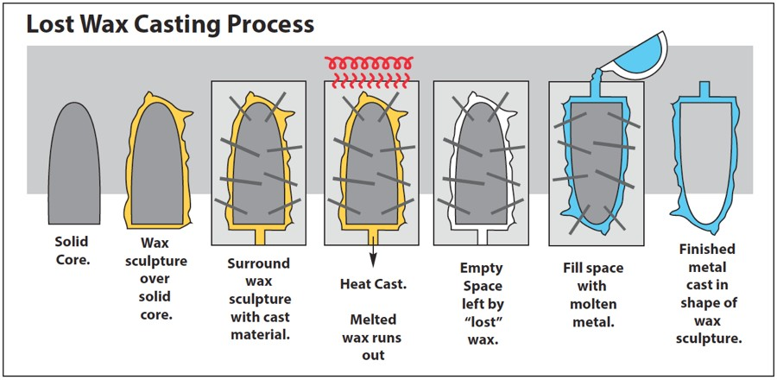
Lost Wax Method

Slide 17
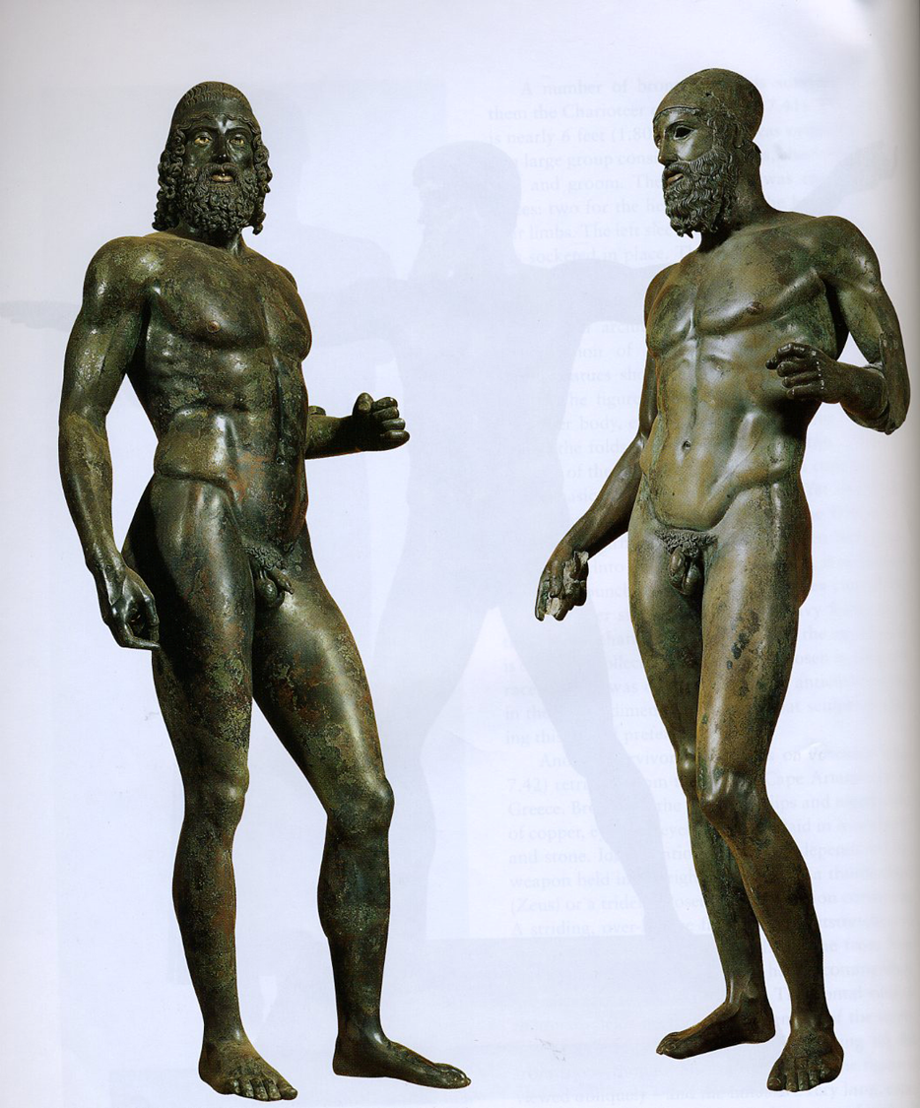
Riace Warriors, Found in the sea off Riace, Italy. c. 460-450 BCE.
Bronze with bone and glass eyes, silver teeth and copper lips and nipples, height 6’6”

Slide 18
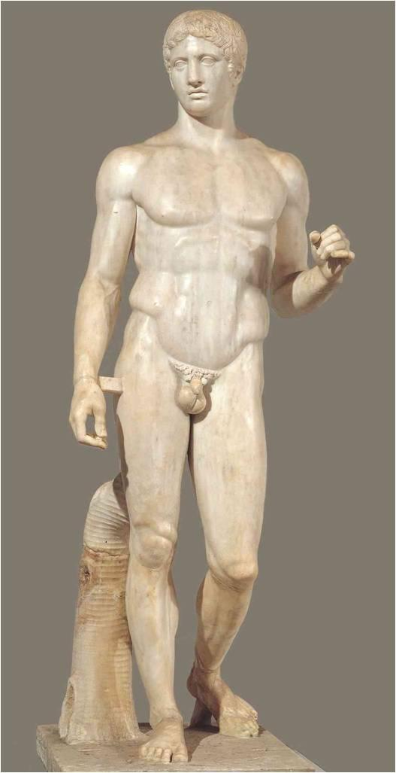
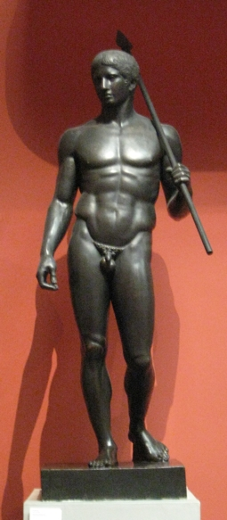
Symmetria- relationship of body parts to one another,
“symmetry” of the body
Polykleitos- Greek mathematician and sculptor
Polykleitos, Spear Bearer (Doryphoros)
Roman Copy after the original bronze of c. 450-440 BCE. Marble, height 6’11”

Slide 19
Contrapposto:
Italian word for “set against.”
•A composition developed by the Greeks
to represent the movement of a figure.
•one weight-­‐bearing leg, one bent, shift in
hips and shoulders – to avoid stiffness,
increase animation and sense of
movement
•The parts of the body are placed
asymmetrically in opposition to each
other around a central axis, and careful
attention is paid to the distribution of
weight ---graceful disposition of the
parts of the body so that they form
sideways axes turning around a central
vertical axis – head, torso, legs, arms
twisted
The Spear Bearer

