Slide 1
Christianity

Slide 2
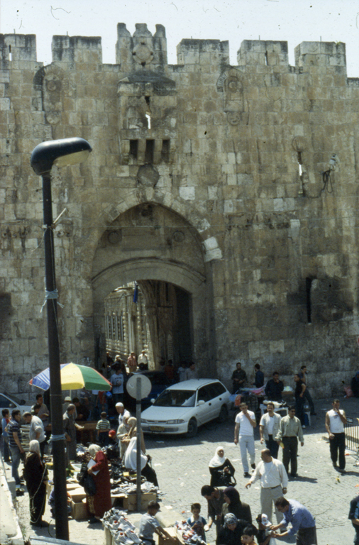

Slide 3
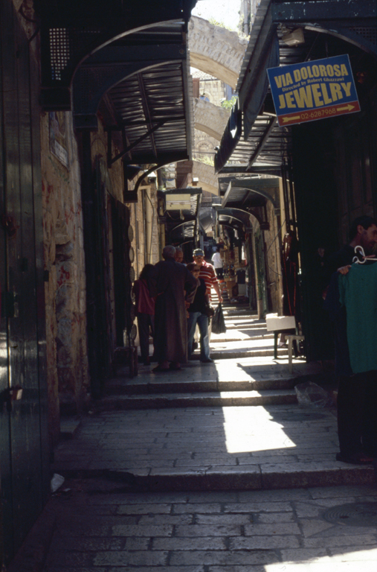

Slide 4
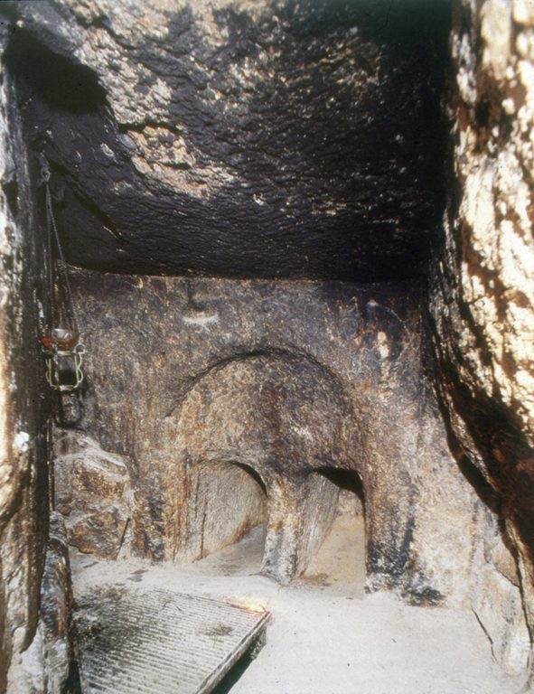

Slide 5
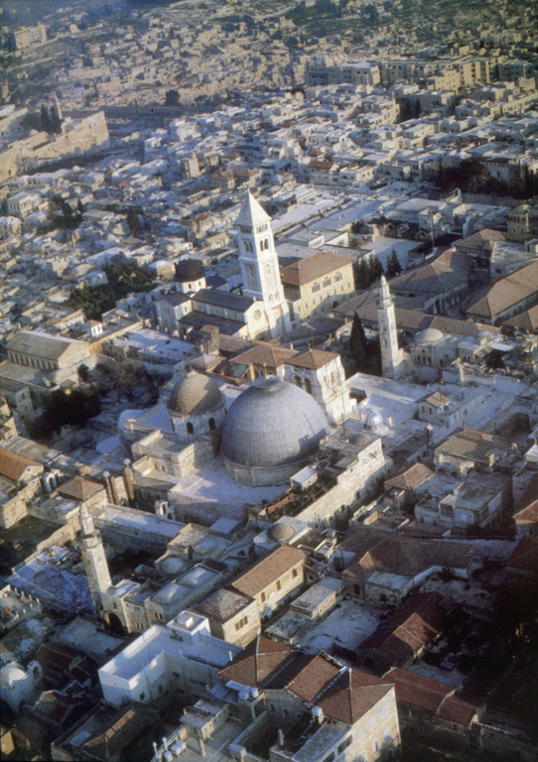

Slide 6
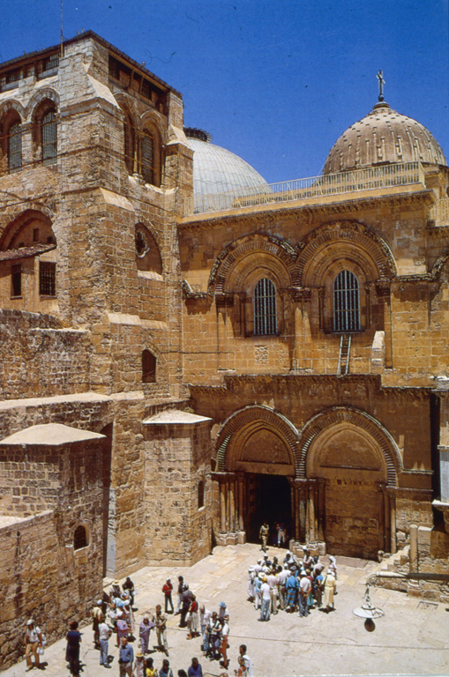
Exterior Church of the Holy Sepulchre,
326 AD, Jerusalem

Slide 7
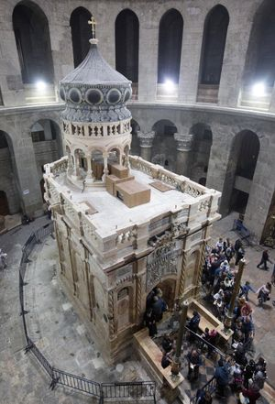
Interior Church of the Holy Sepulchre

Slide 8
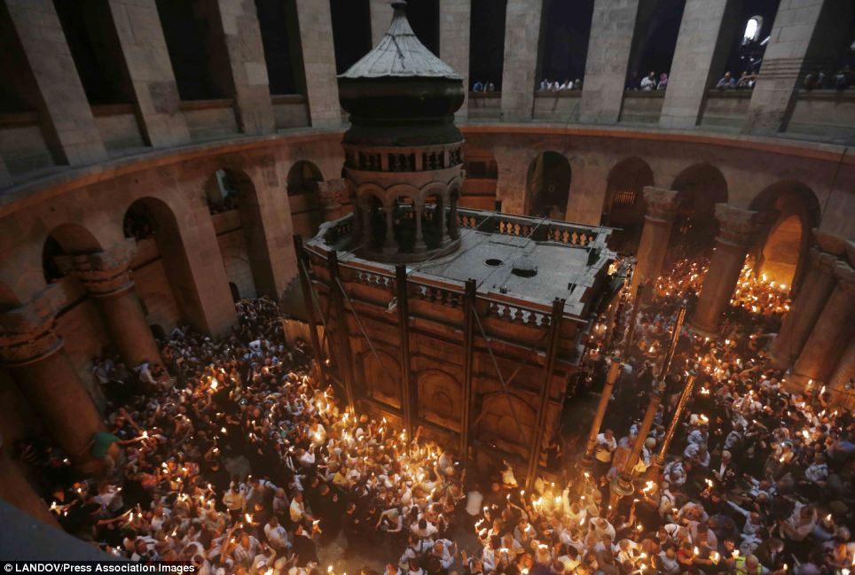
Interior Church of the Holy Sepulchre, Jerusalem

