Slide 1
Medieval Europe:
Early Middle Ages
{The “Dark Ages”}

Slide 2
Early Medieval Europe
Fall of Roman Empire 410 CE
Creation of European City/States
Time of “Barbarians” >> “Dark Ages,” “Middle Ages”
    mixture of three artistic styles: local “Barbarians” (such as the Hiberno-Saxon, Viking), Christian, and Classical.
    Migrations >> Viking raids, 800-1100 CE

Slide 3
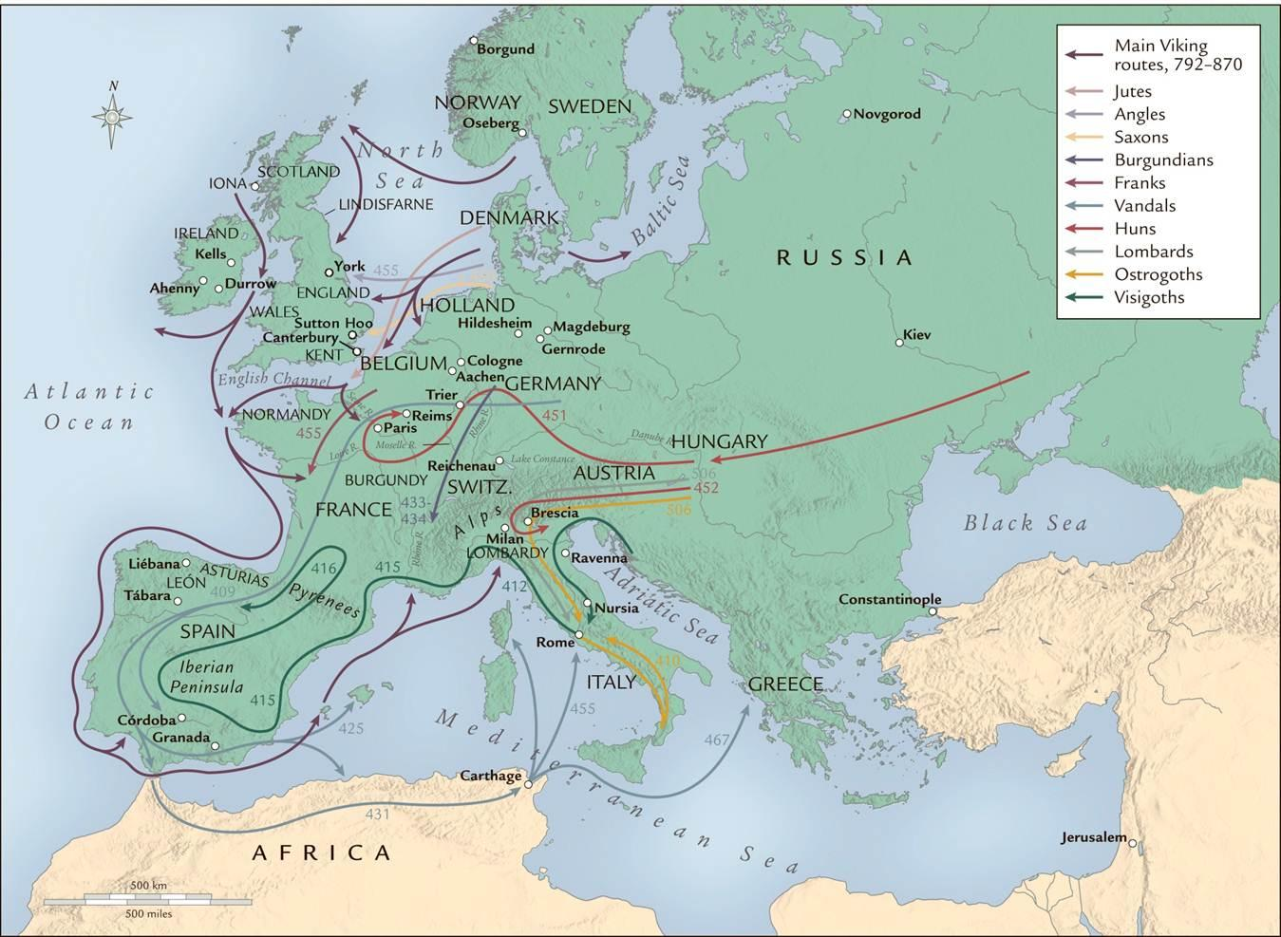

Slide 4
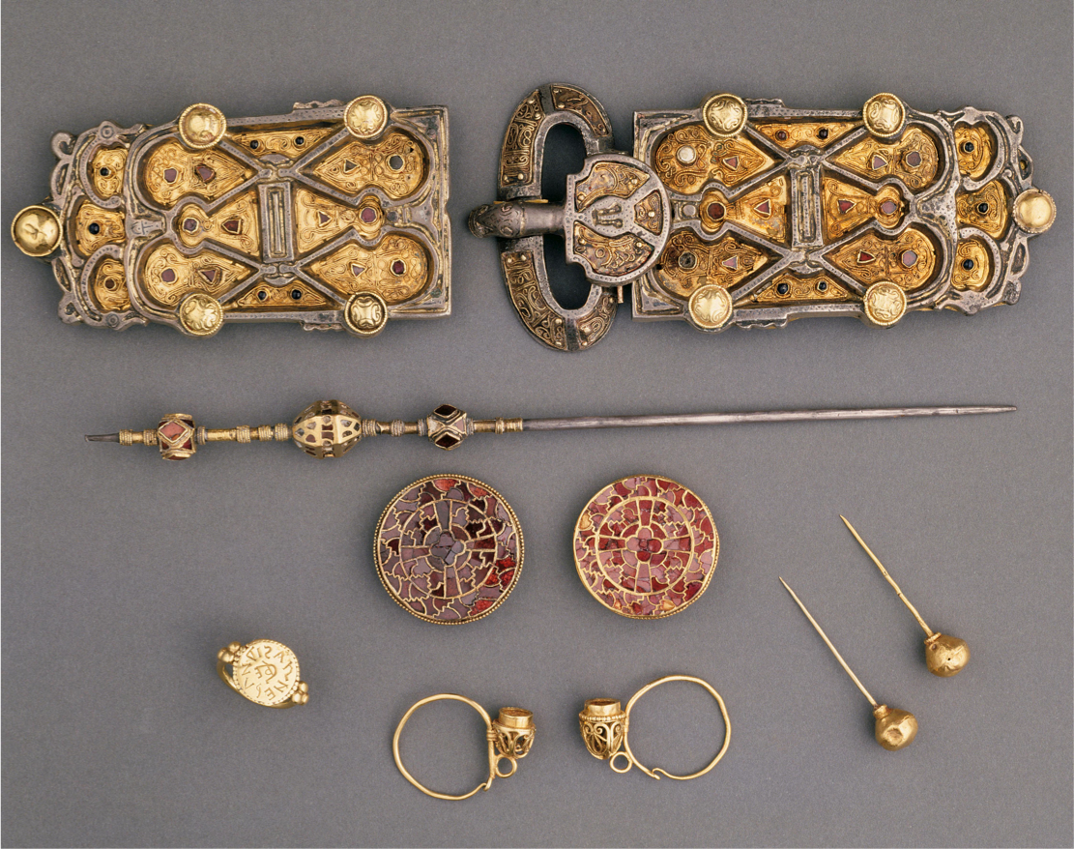
Cloisonné
Jewelry of Queen Arnegunde, c. 580-590, France

Slide 5
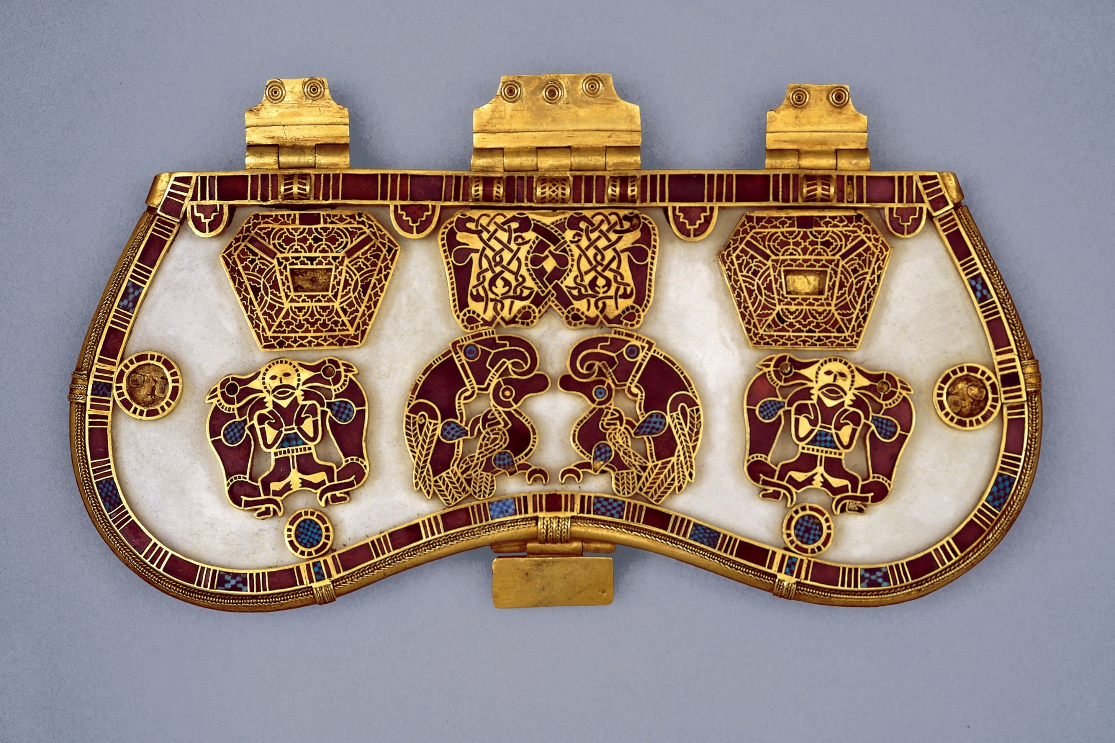
Hinged Clasp of Purse, from the Sutton Hoo Burial Ship, England, 615, cloisonné

Slide 6
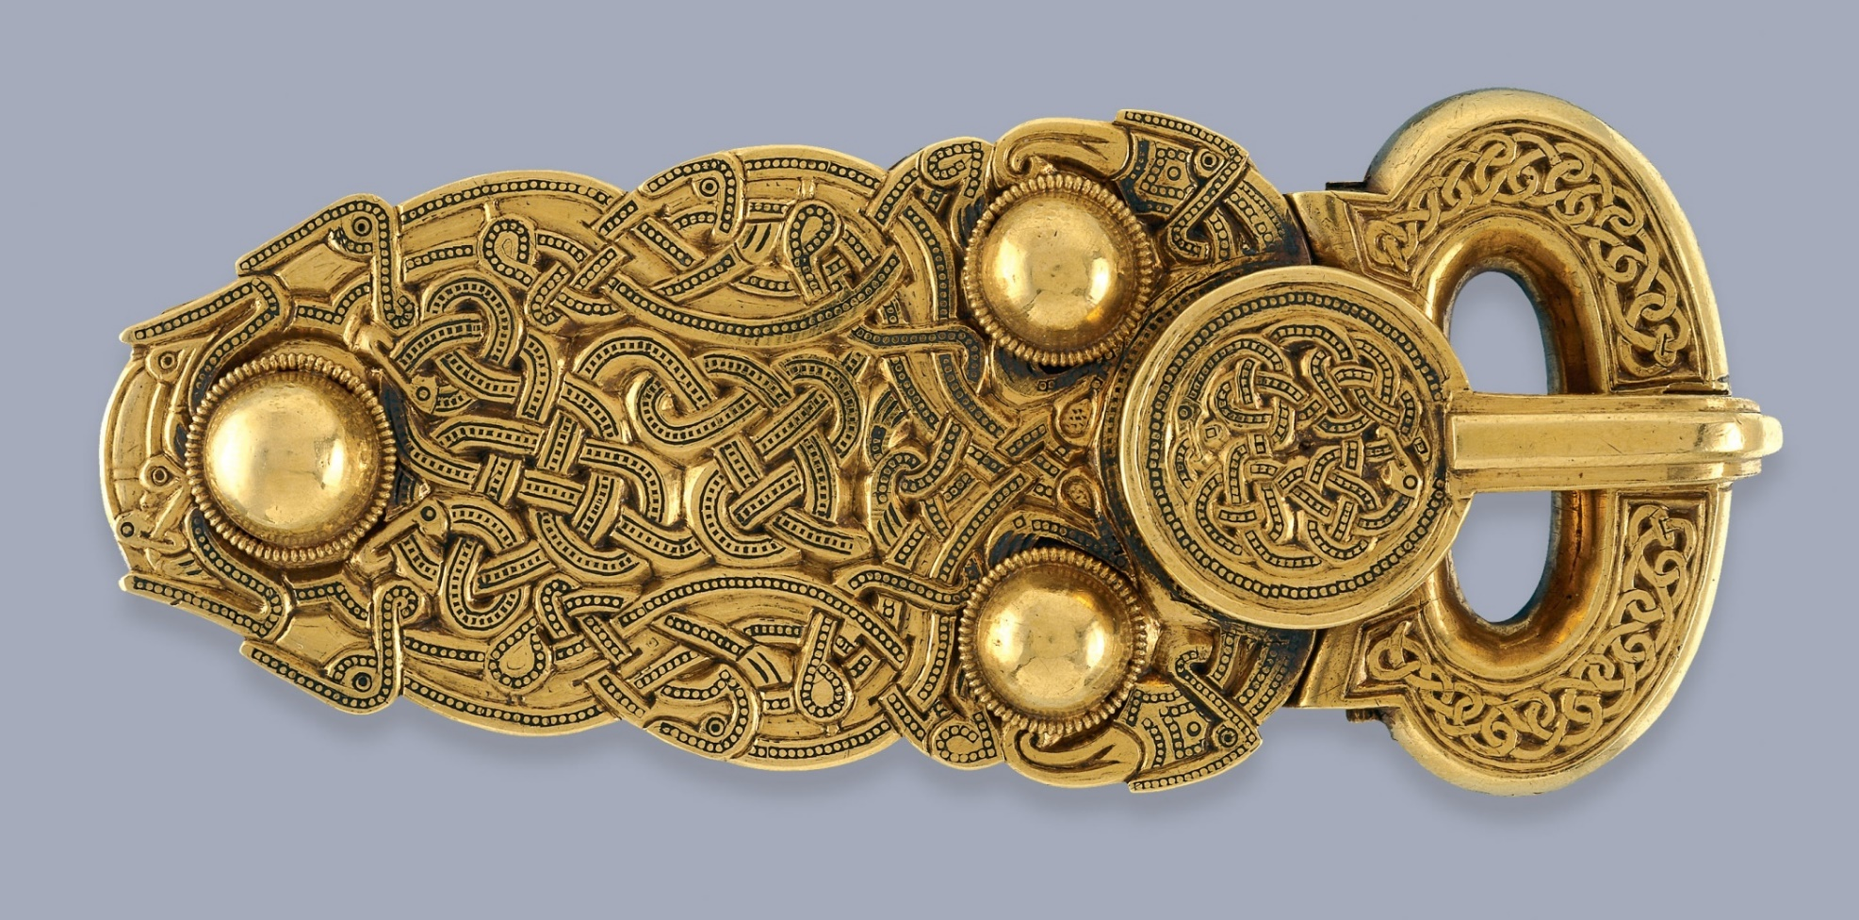
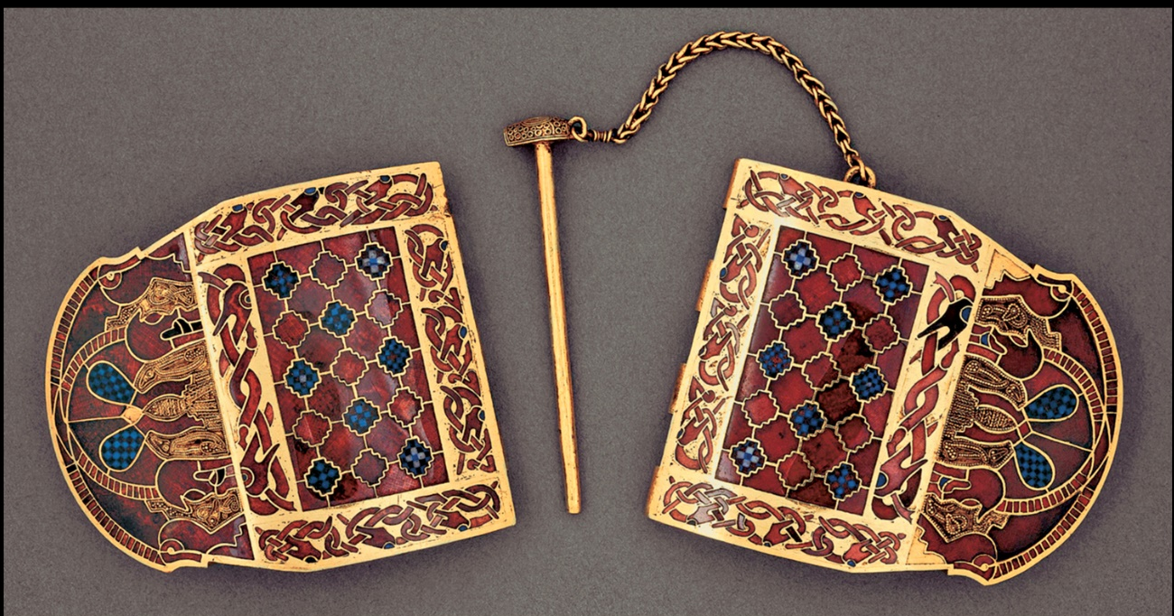
Belt Buckle and Hinged Clasp,
from the Sutton Hoo Burial Ship, England, 615

Slide 7
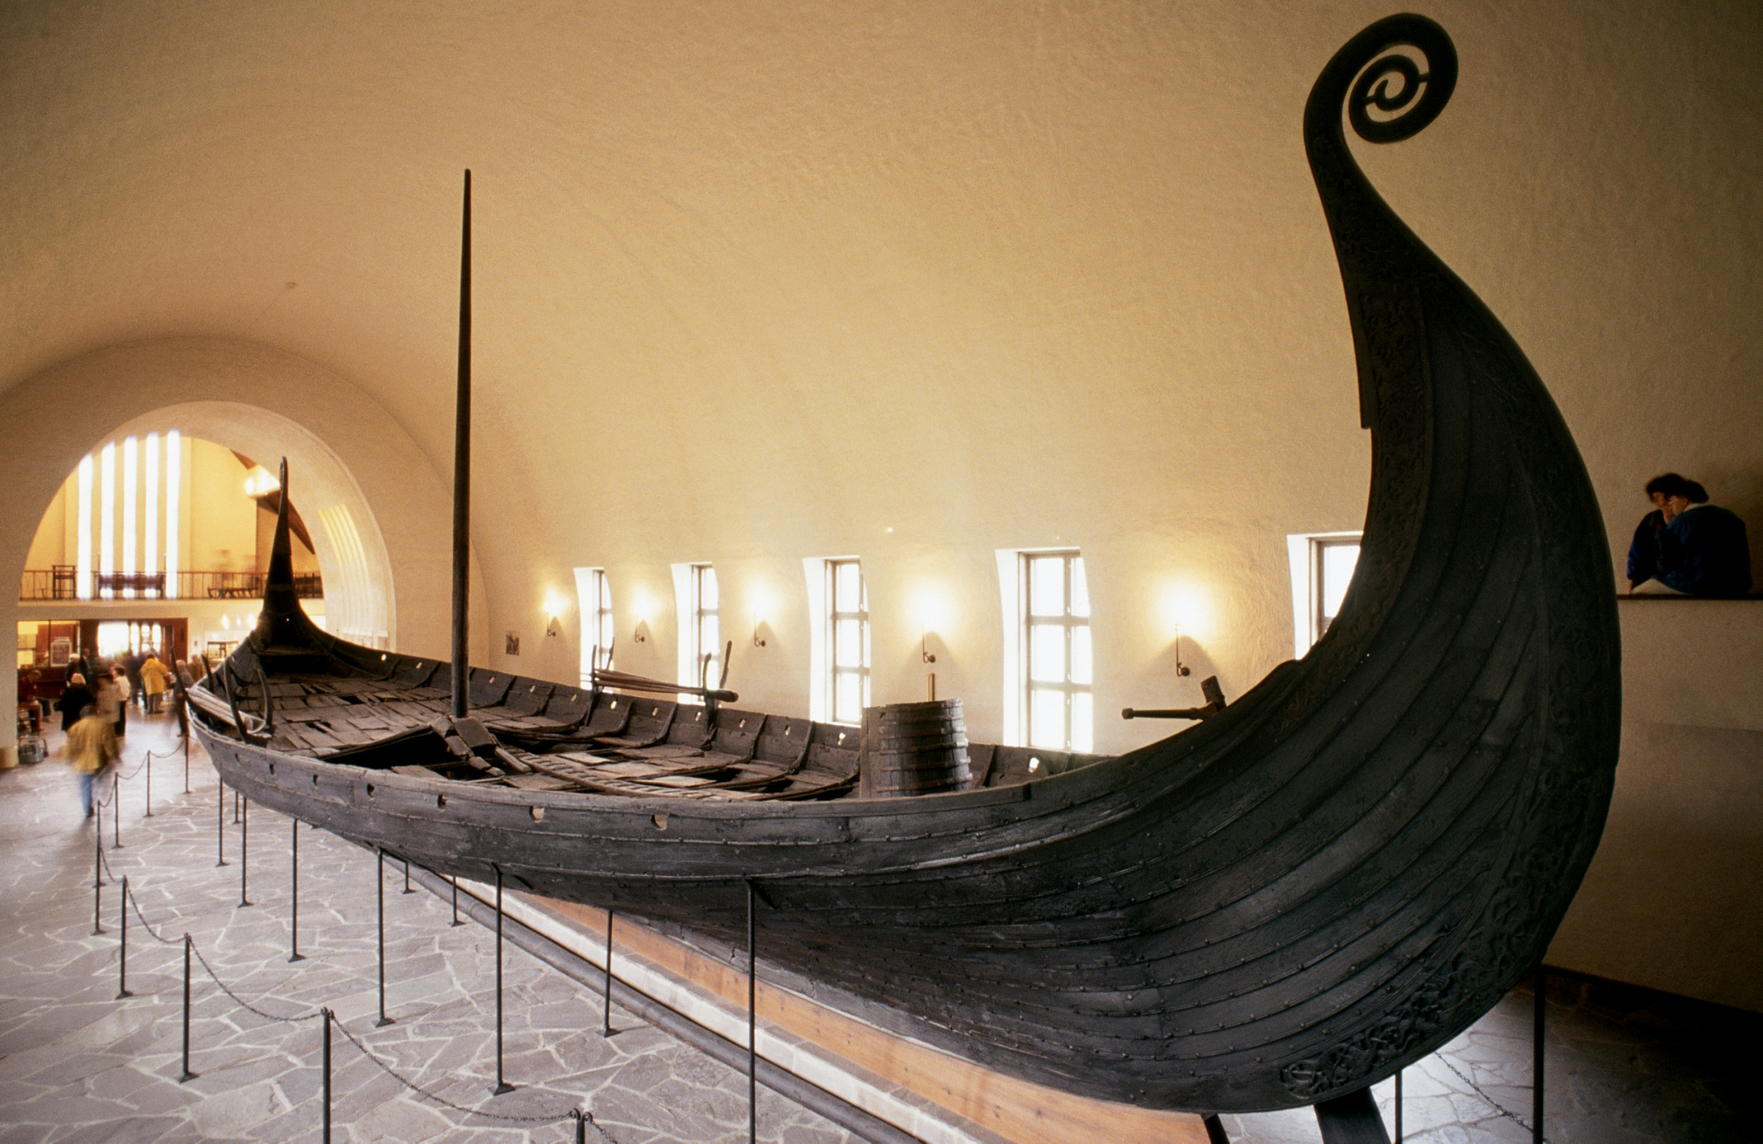
Viking Burial Ship, Oseberg, Norway, ca. 815–820. Wood, 70’ 10 3/8" long

Slide 8
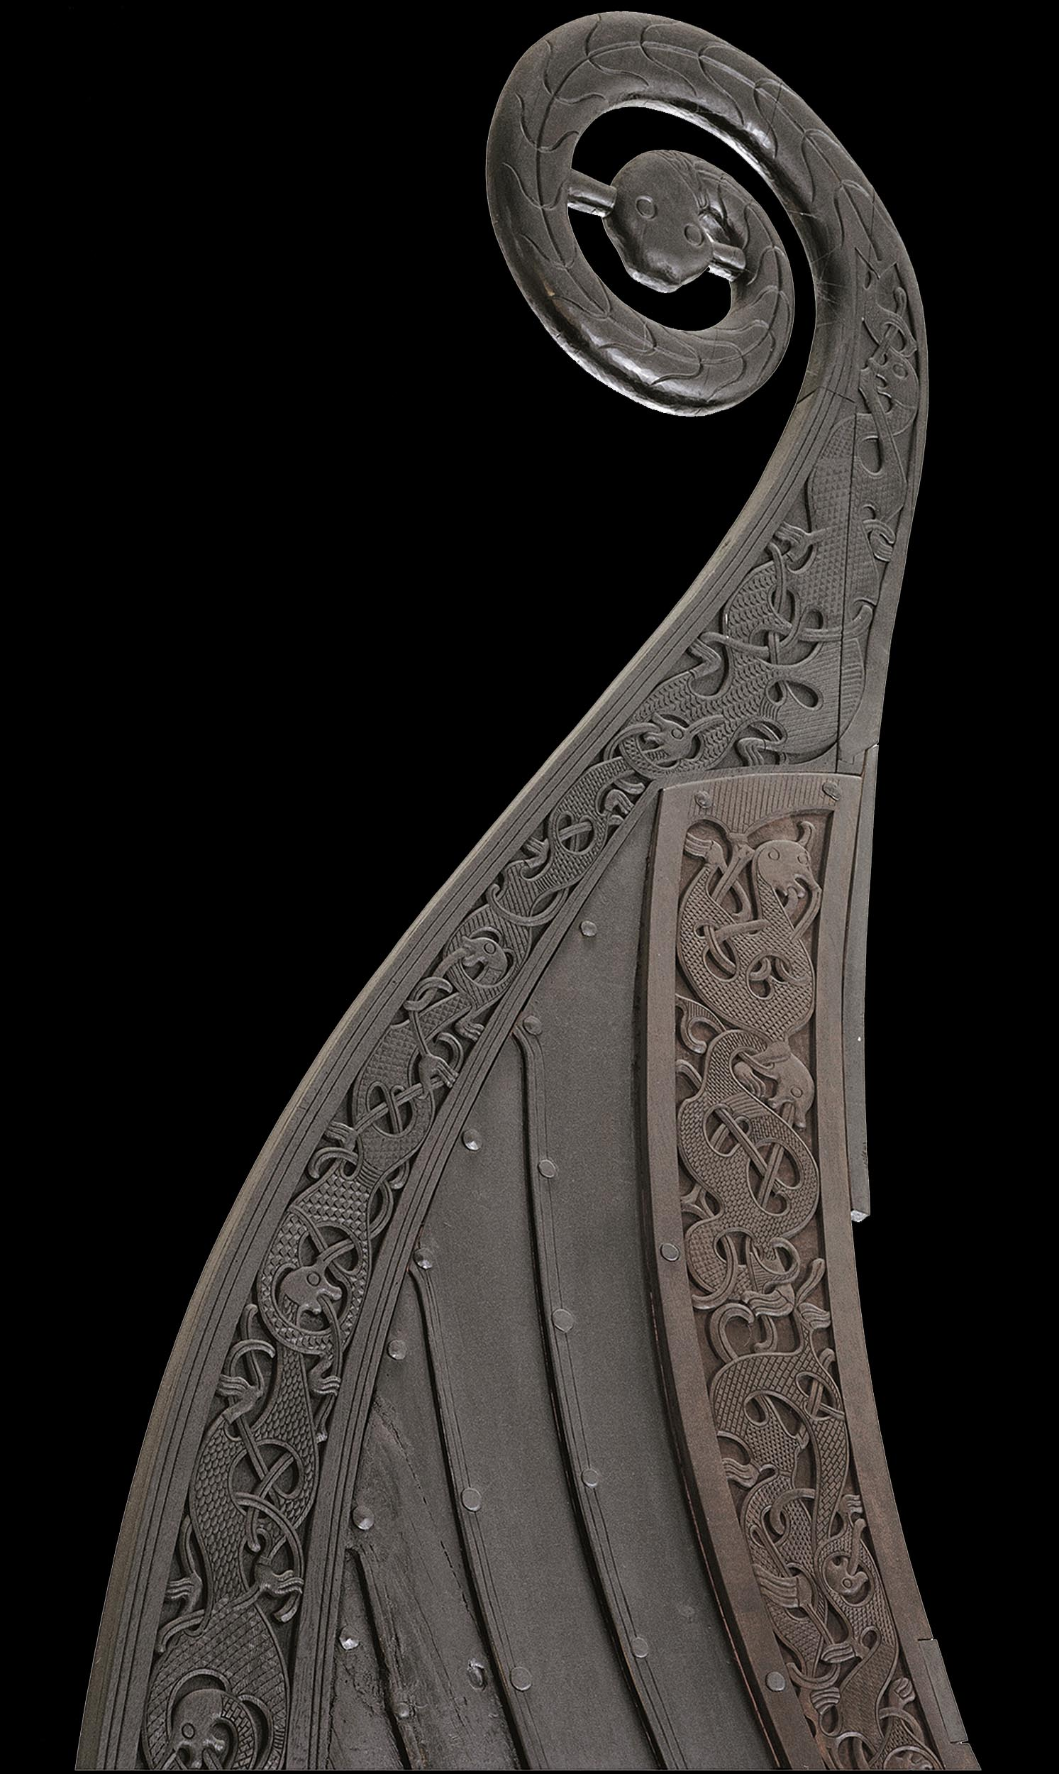
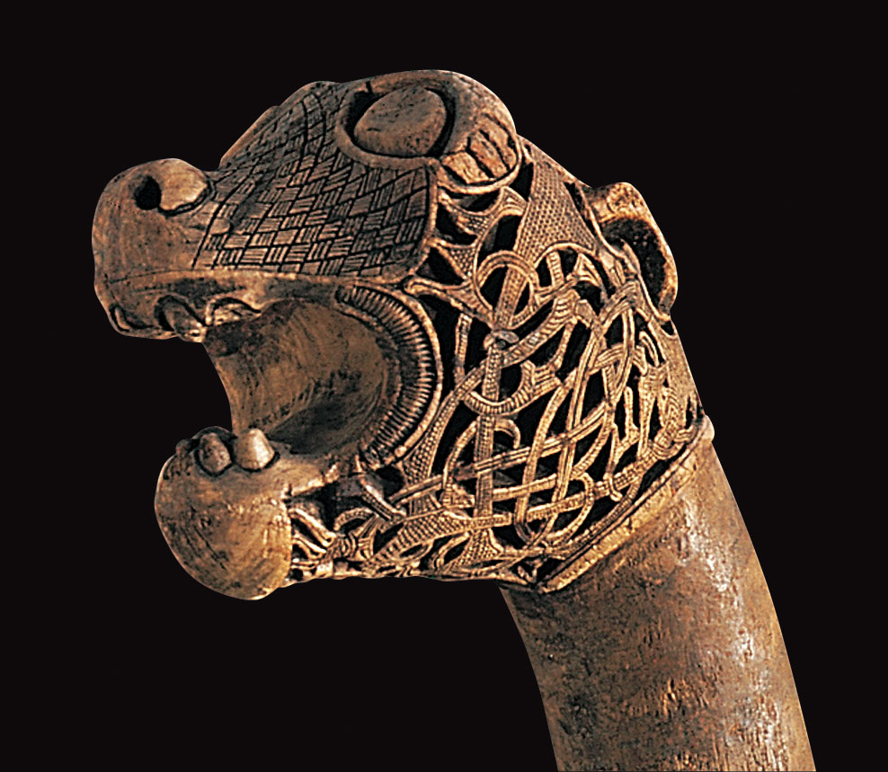
Oseberg Ship (Detail), Norway, 815-820

Slide 9
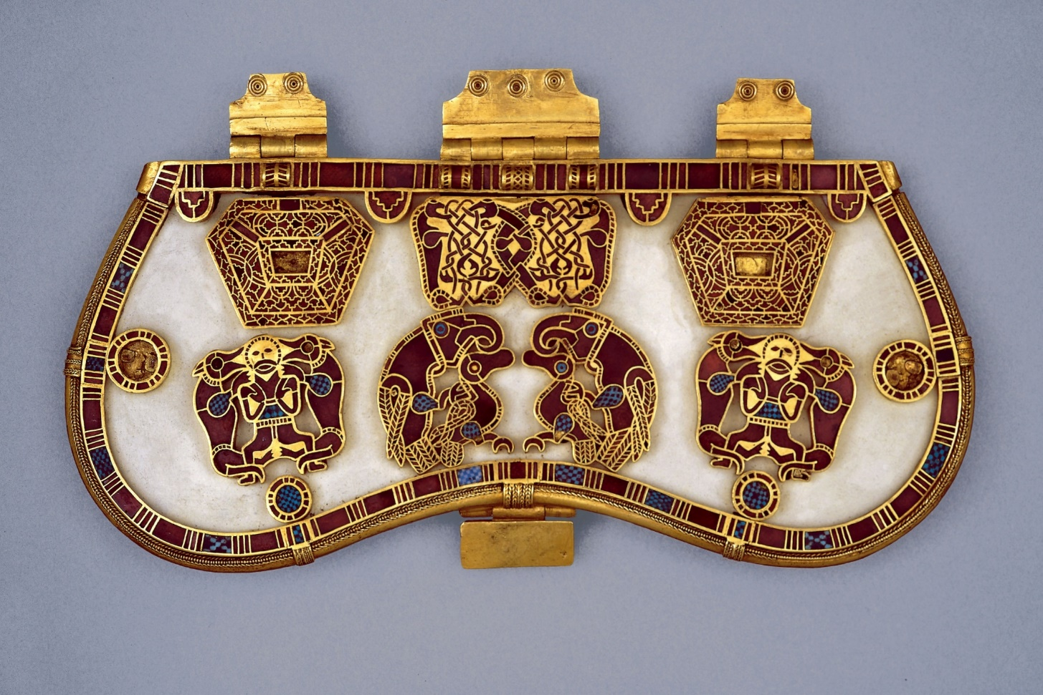
Hiberno-Saxon

Slide 10
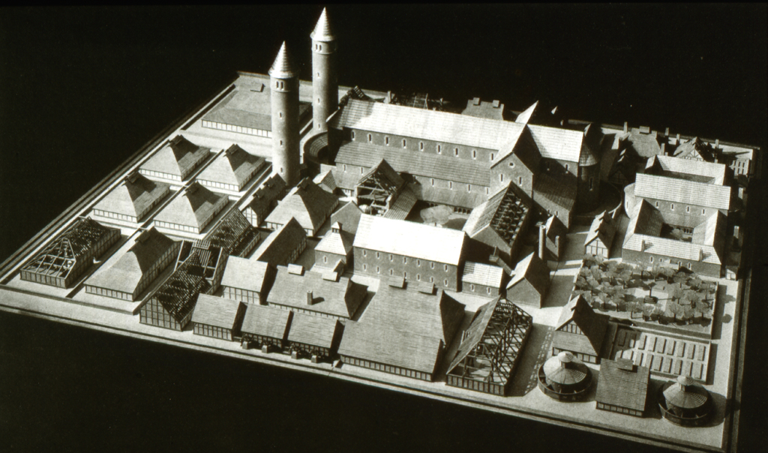

Slide 11
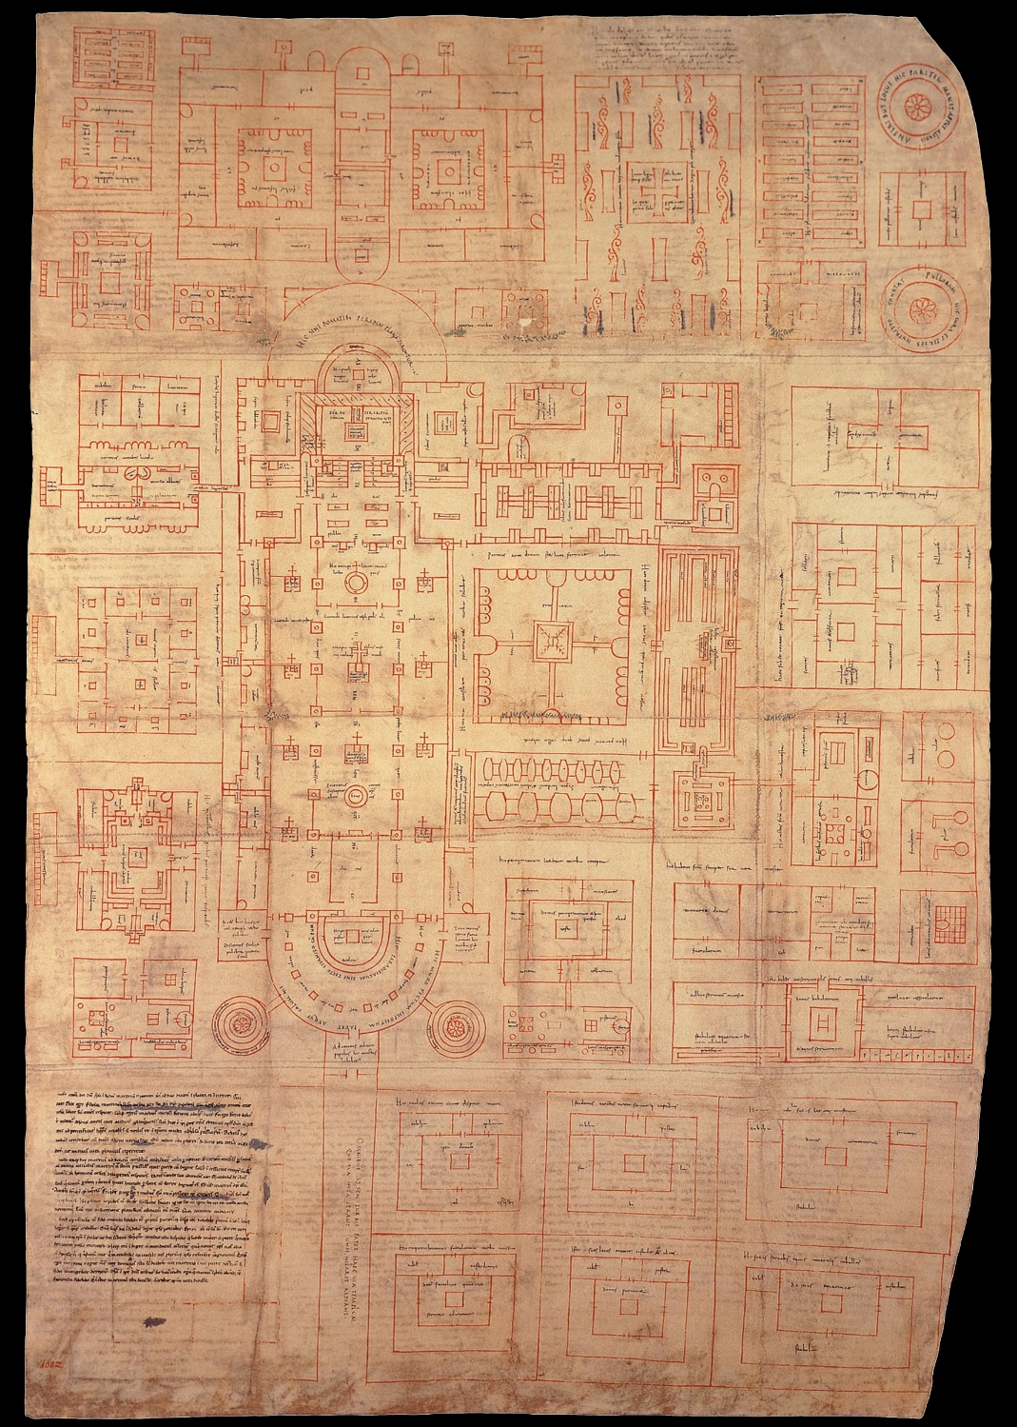
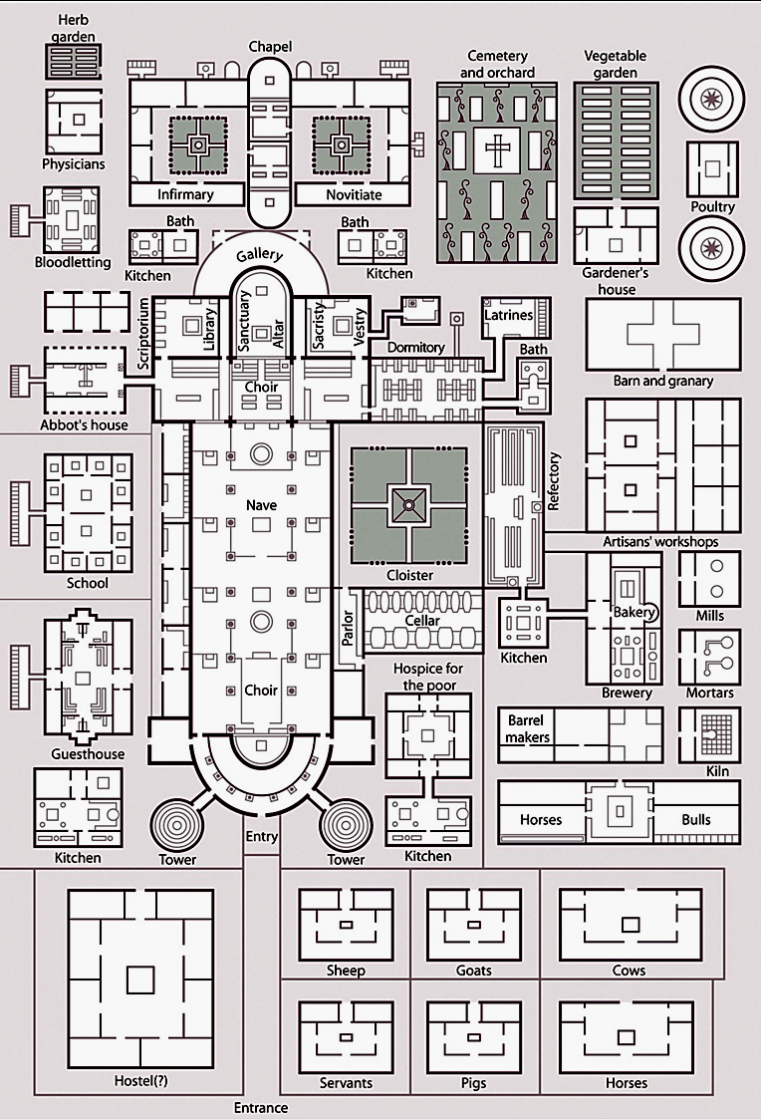
Saint Gall Plan (original and redrawn with captions) c. 817. St. Gall, Switzerland

Slide 12
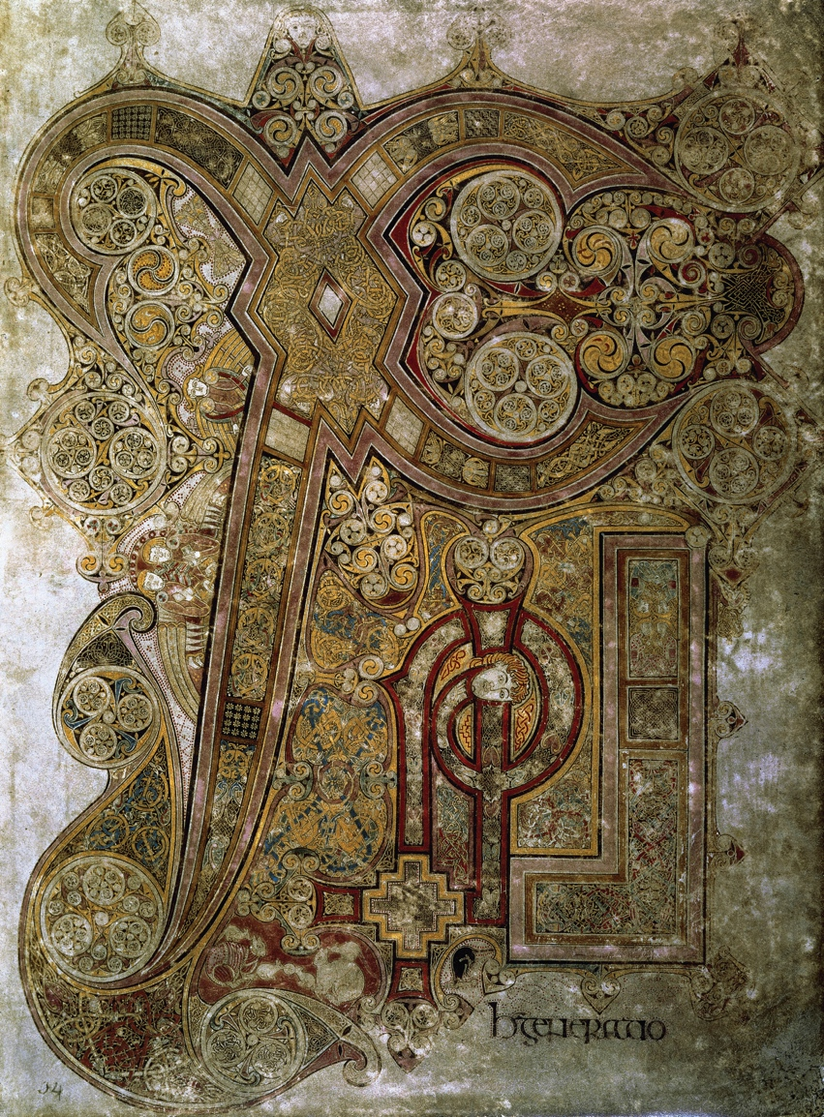
Illuminated Manuscripts
Chi Rho Iota Page,
from the Book of Kells.
Iona, Scotland,
late 8th or early 9th century

Slide 13
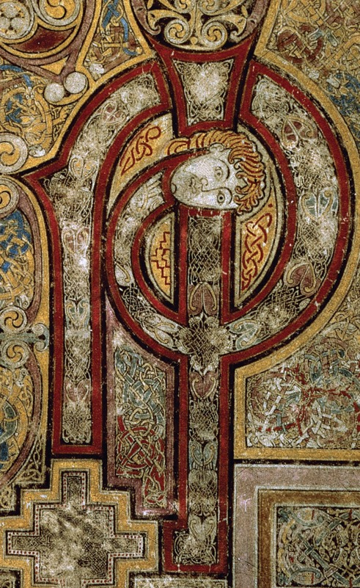
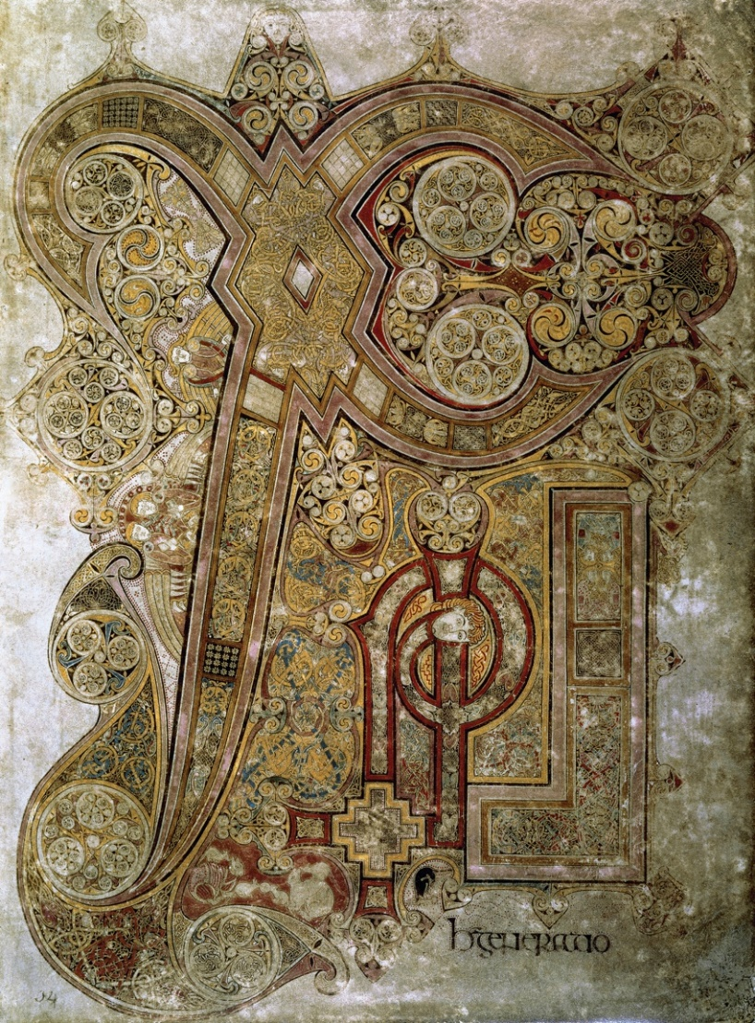

Slide 14
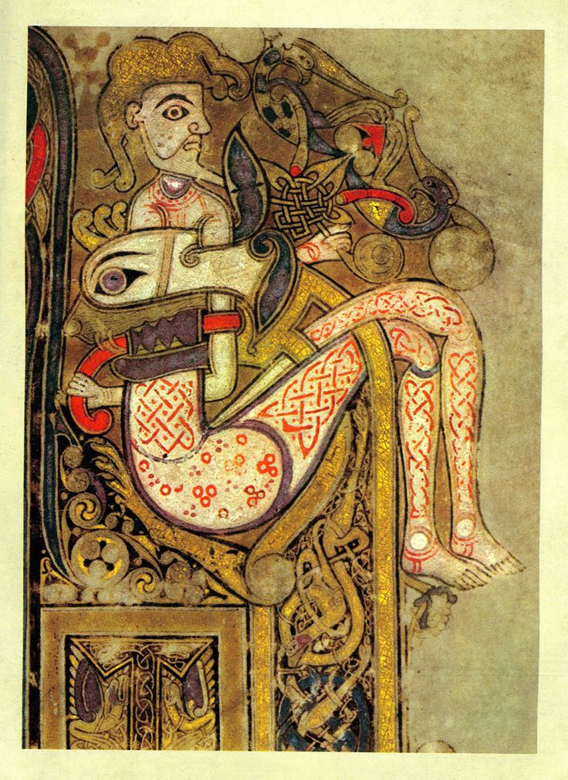
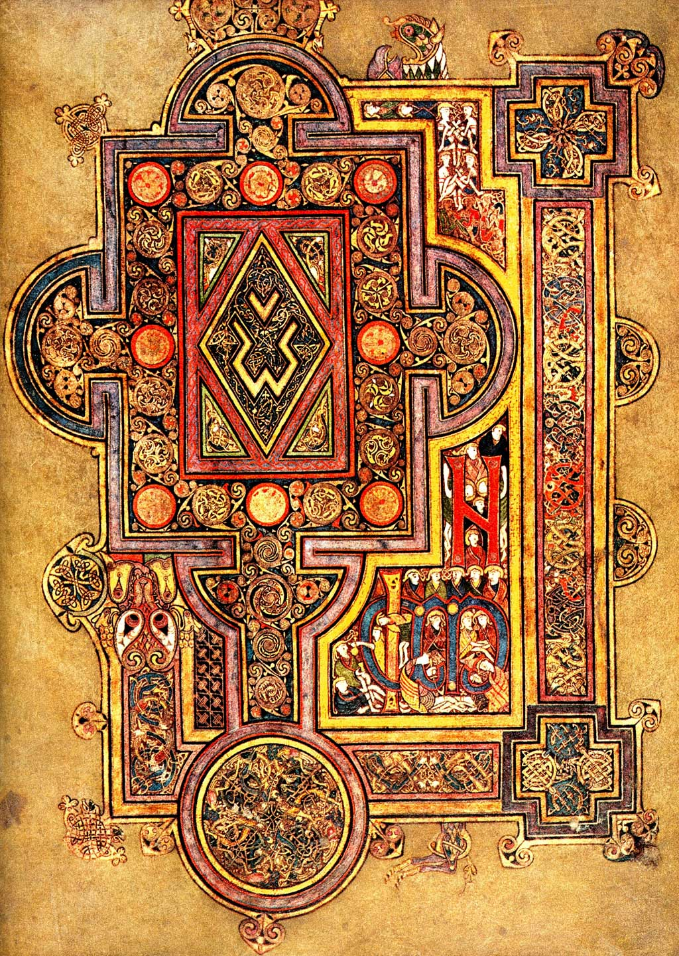

Slide 15
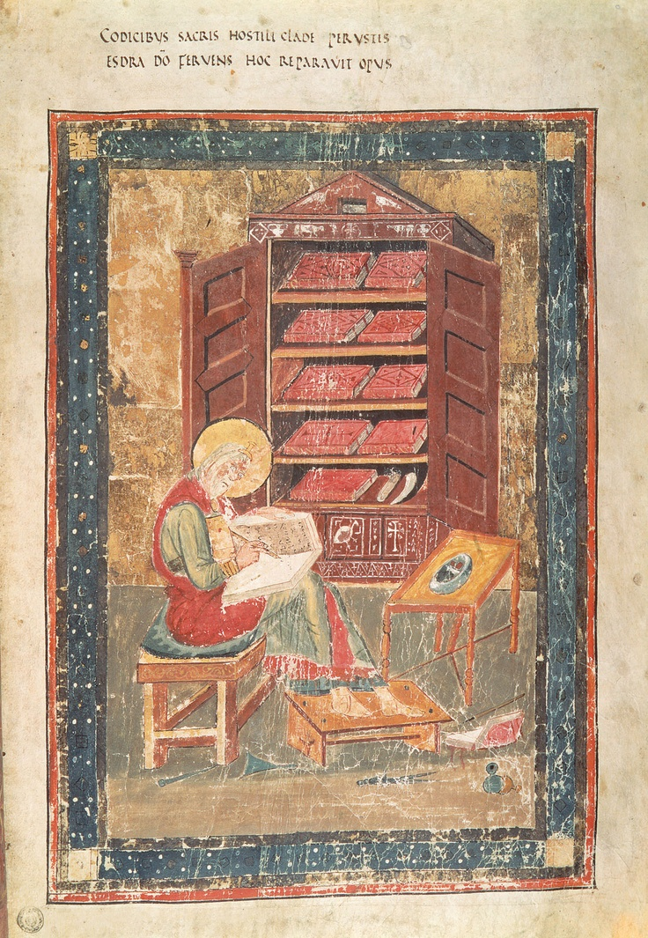
Scriptorium

Slide 16
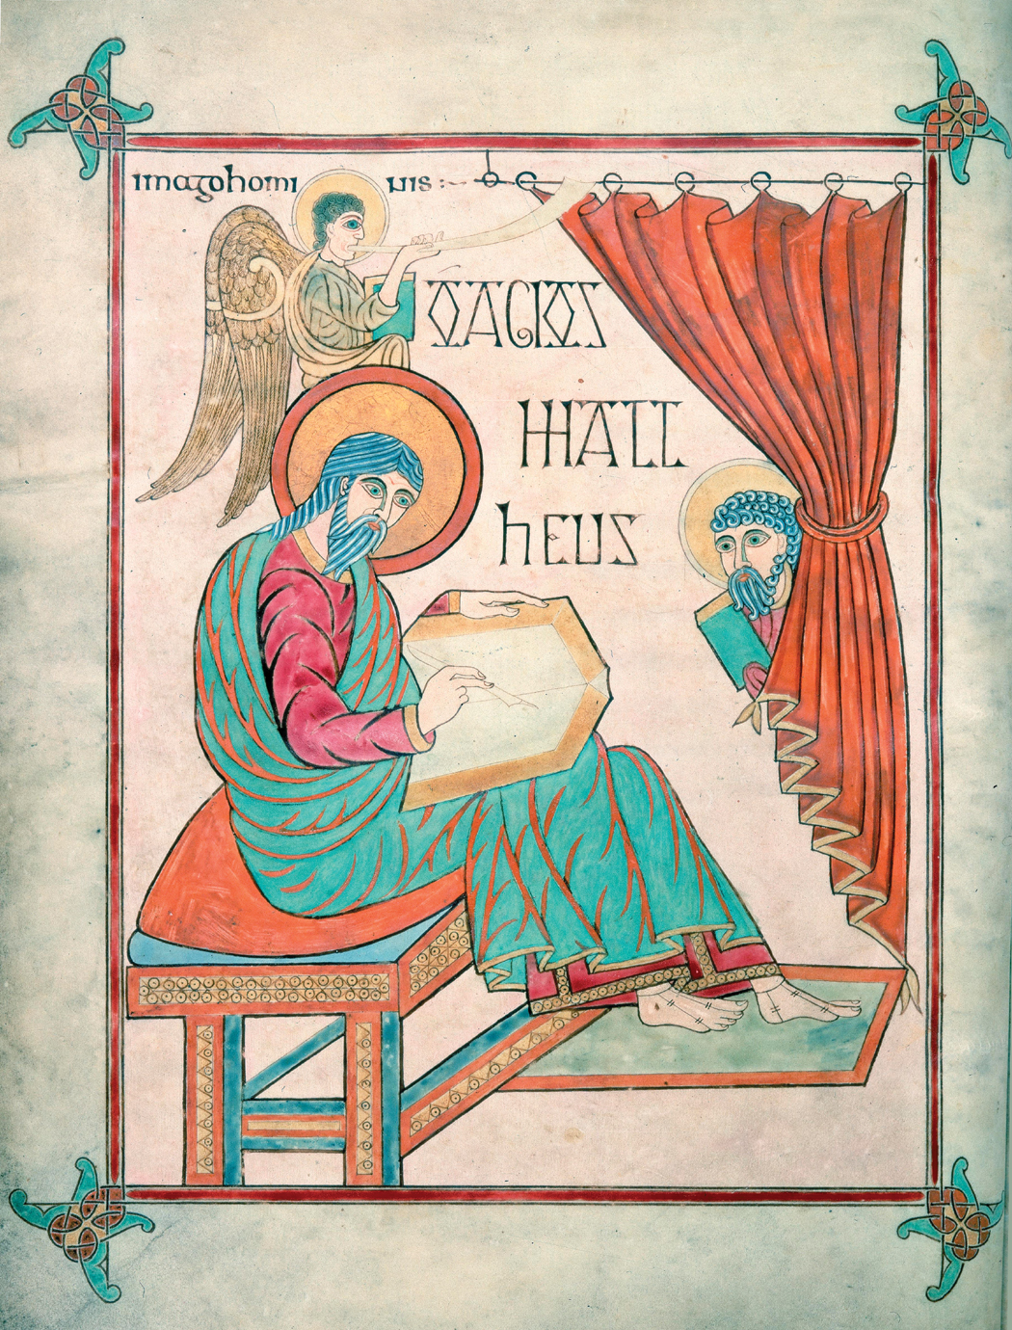
Matthew Writing his Gospel, Lindisfarne Gospel Book, 715-720 Ezra Restoring the Sacred Scriptures, Wearmouth Jarrow,700-715

Slide 17
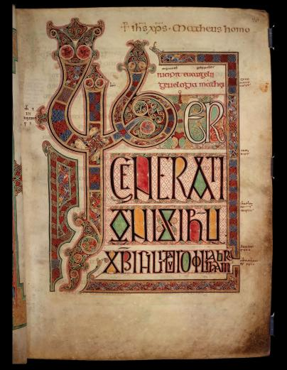
Page with the beginning of the Lindisfarne Gospel

Slide 18
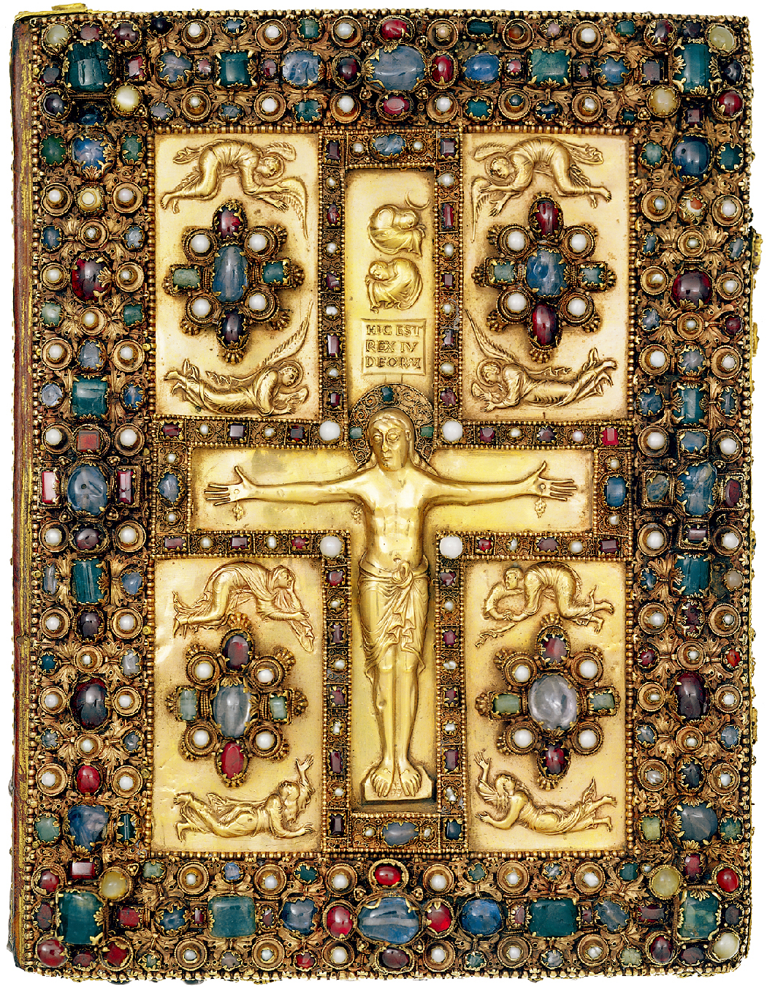
Lindau Gospel cover

Slide 19
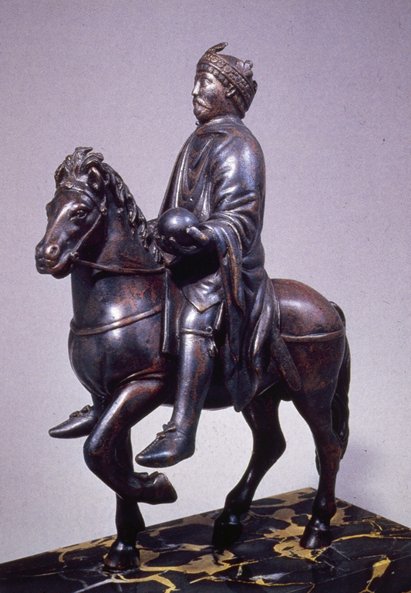
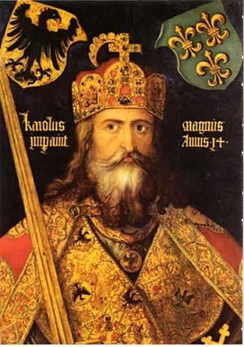
Charlemagne
“Charles the Great”
Renovatio Romani Emperi
Crowned king by Pope
Unites Europe
Carolingian miniscule

