Slide 1
Ancient Near East

Slide 2
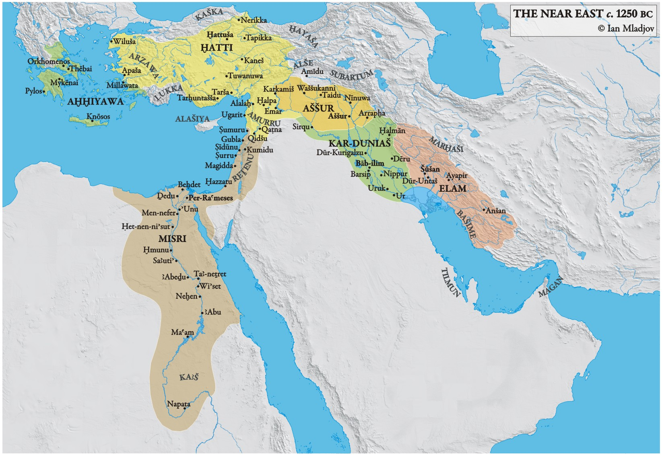
Mesopotamia, “The land between the rivers”
In fifth or sixth millennium BCE, agriculture developed in the alluvial plains between the Tigris and Euphrates Rivers in “The Fertile Crescent” .

Slide 3
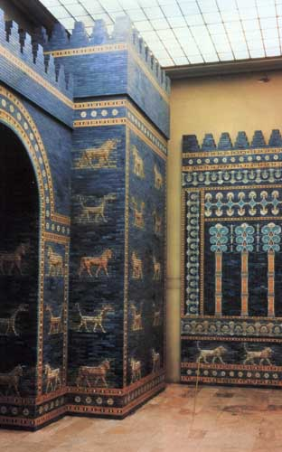
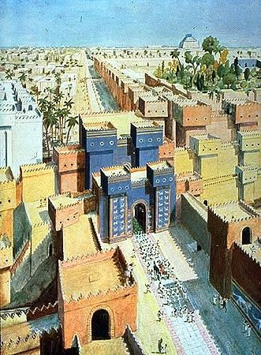
Ishtar Gate and Throne Room Wall [Reconstructed in a Berlin museum]
Originally from Babylon (present day Iraq). c. 575 BCE. Glazed Brick.
Height of Glass originally 40 ‘ with towers rising 100’
Citadel

Slide 4
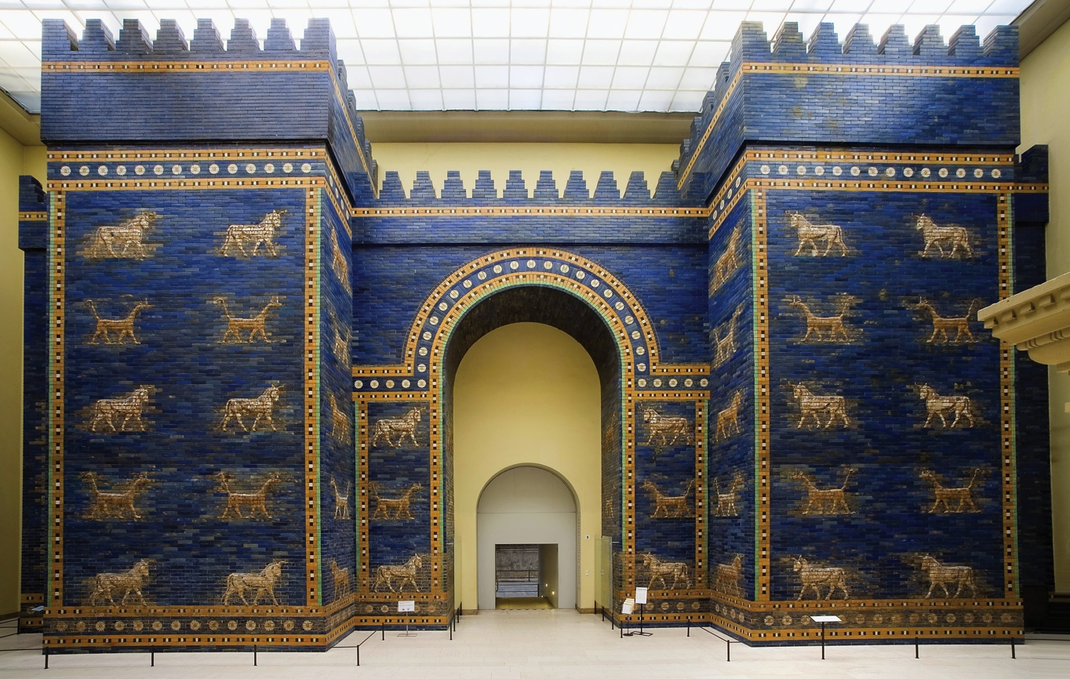

Slide 5
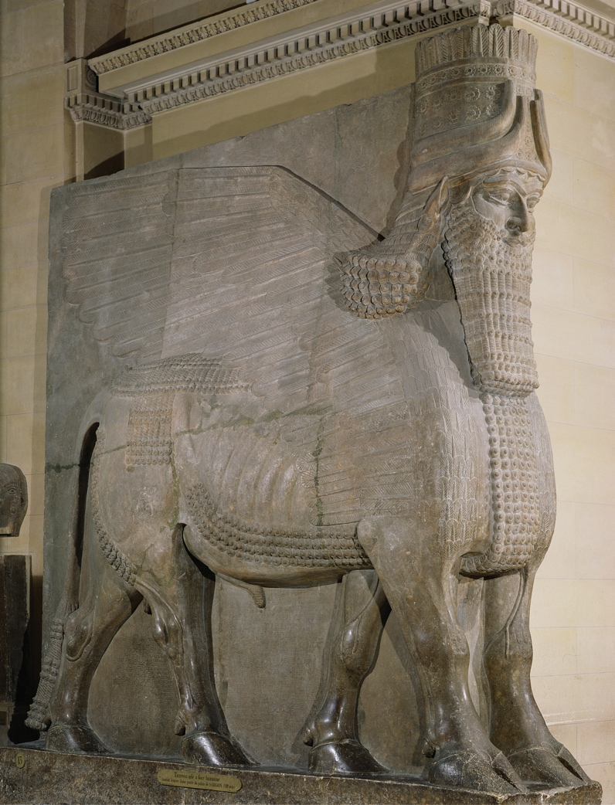
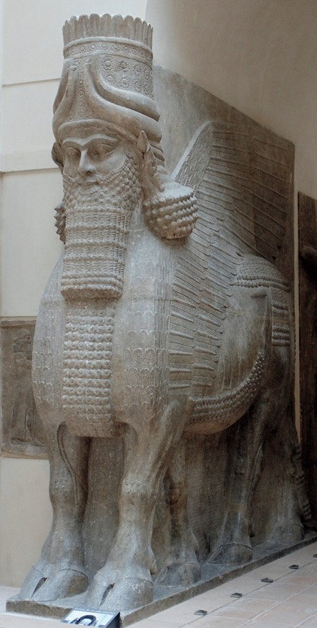
Lamassu (man-headed winged bull), from the citadel of Sargon II, Dur Sharrukin (modern Khorsabad), Iraq, ca. 721–705 BCE. Limestone, 13’ 10” high
COMPOSITE VIEW

Slide 6
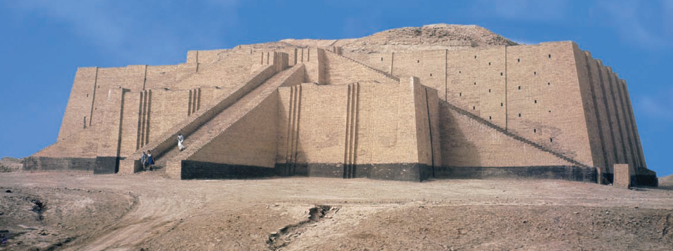
Ziggurat- huge stepped structures with a temple or shrine on top
Nanna Ziggurat, Ur (Present-day Iraq), c. 2100-2050 BCE.

Slide 7
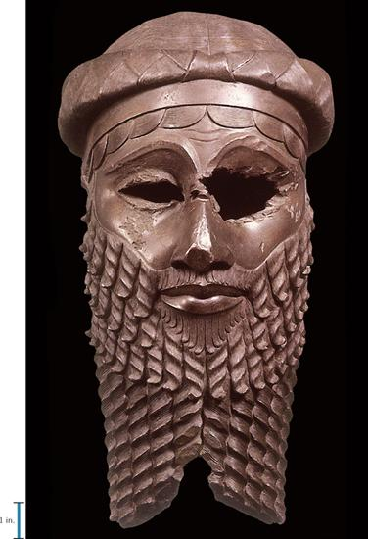
Head of a Man (Known as Akkadian Ruler) From Nineveh.
c. 2300-2200 BCE. Copper alloy, height approx. 14”.

Slide 8
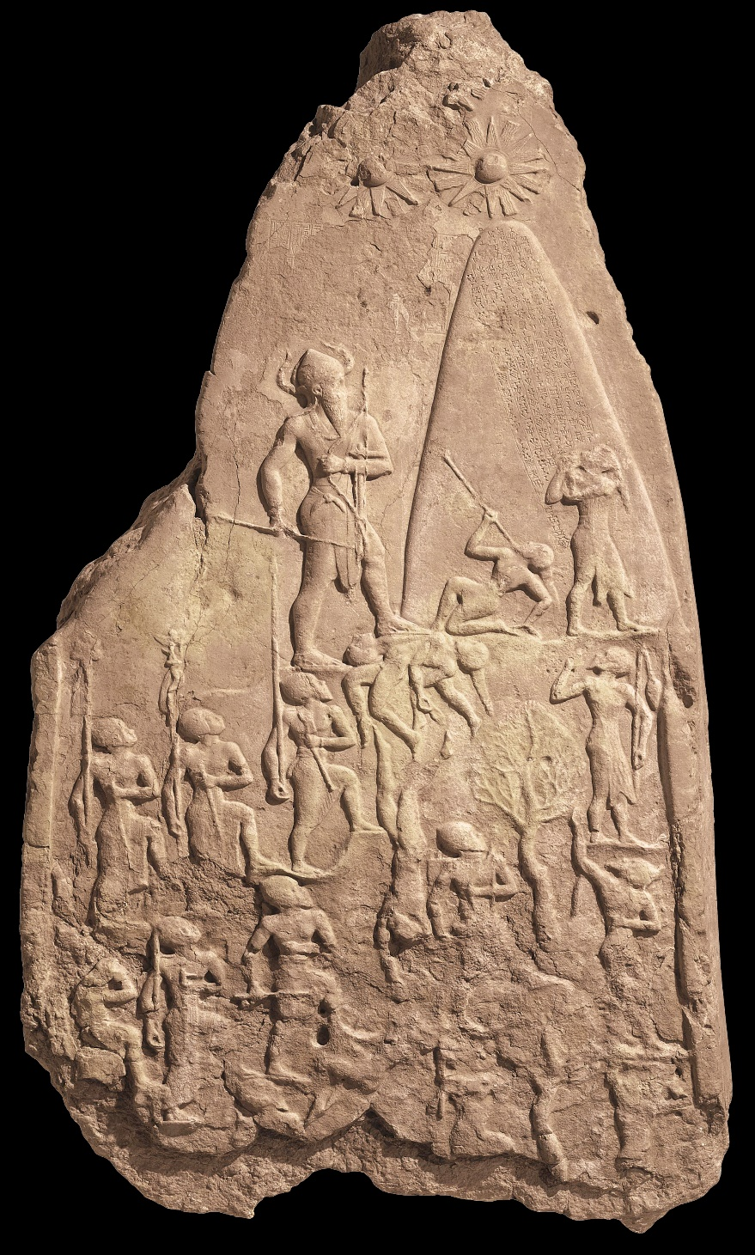
Hieratic scale-
“Hierarchy”--relative size indicates importance
Stele of Naram- Sin,
Sippar, Found at Susa.
2254-2218 BCE. Limestone, height 6’6”

Slide 9
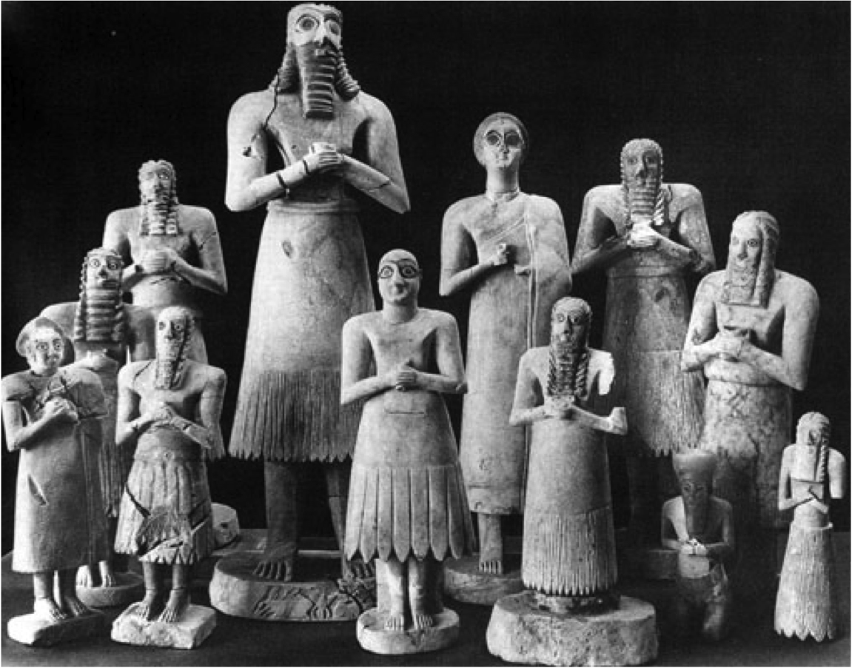
Conventional: a traditional way of expressing forms
–follows set rules
Artisan: craftsperson who creates conventional forms (as opposed to an artist who creates from the imagination)
Votive Figures, From the Square Temple, Eshnunna.
c. 2900-2600 BCE, Limestone, alabaster and gypsum.

Slide 10
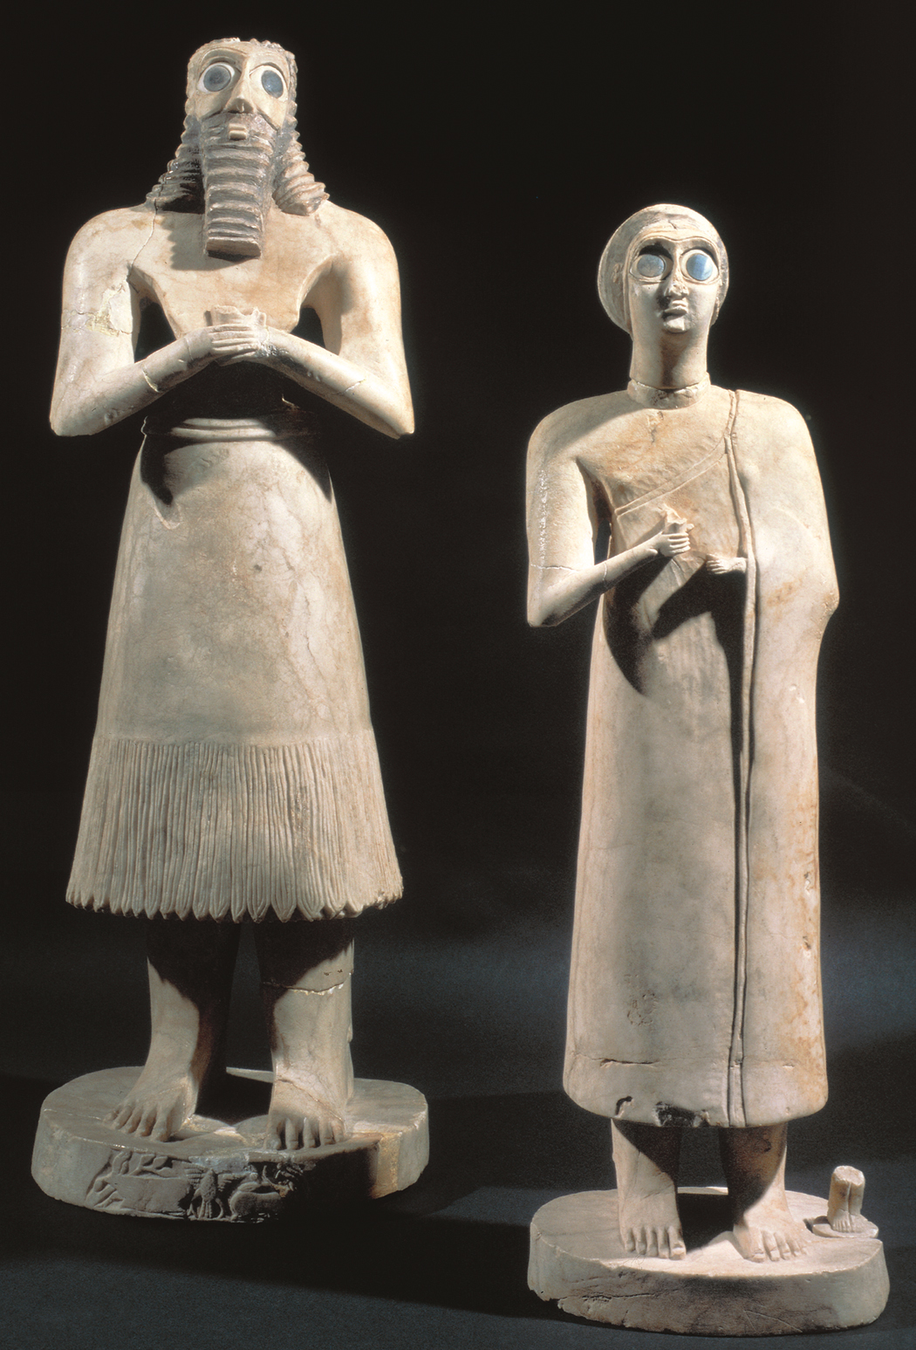

Slide 11
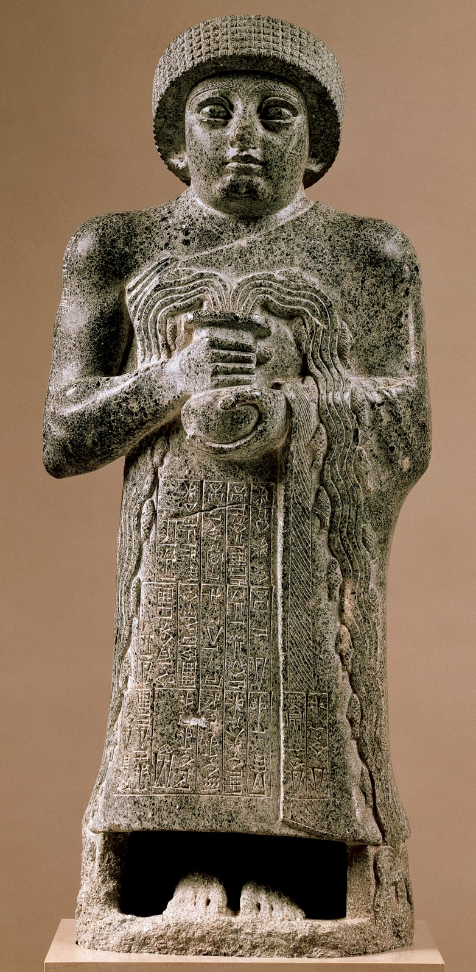
Votive Statue of Gudea,
Girsu (present-day Iraq)
c. 2090 BCE. Diorite, height 29”
CUNEIFORM

Slide 12
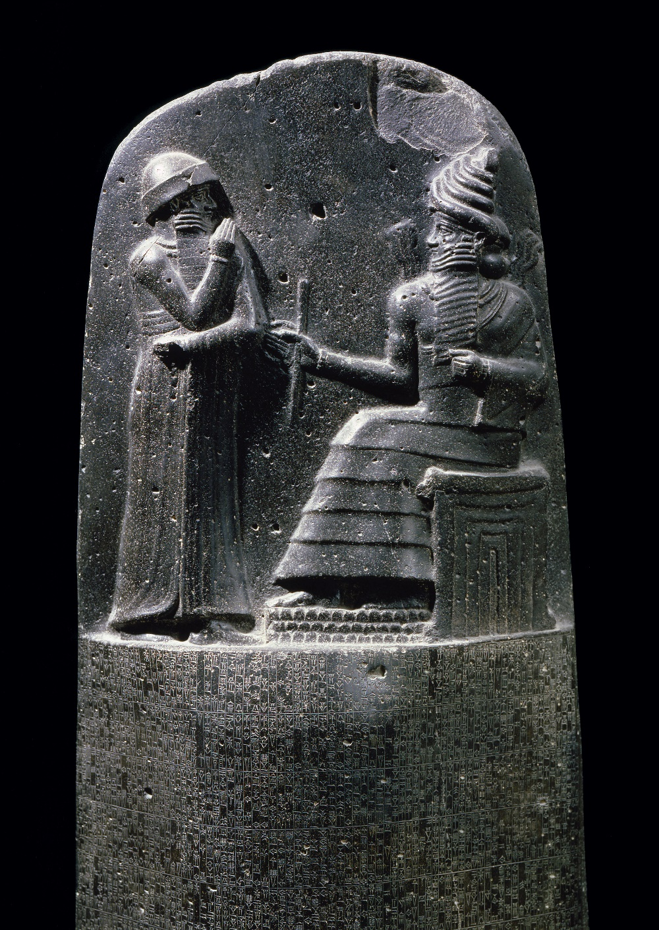
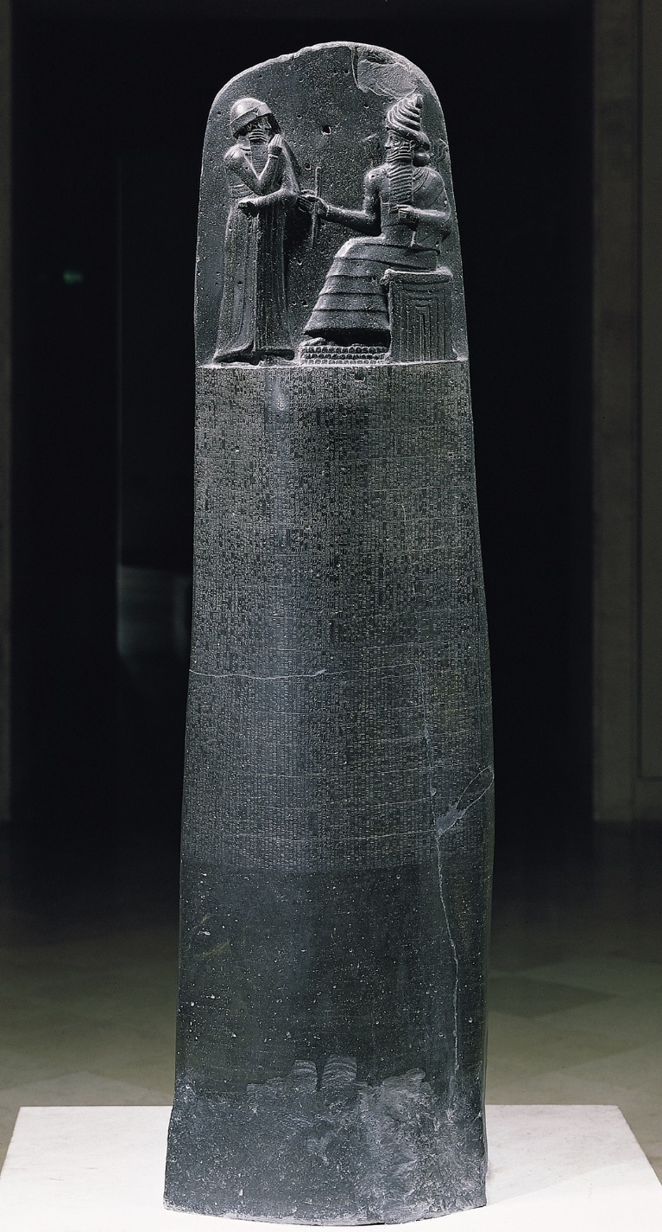
King Hammurabi (1792-1750 BCE) ruled the city of Babylon.
Hammurabi stands in an attitude of prayer before Shamesh, the sun god or god of justice, to give thanks receive the laws.
Stele of Hammurabi, Susa (present day Shush, Iran)
C. 1792 – 1750 BCE. Diorite, height approx. 7’

