Slide 1
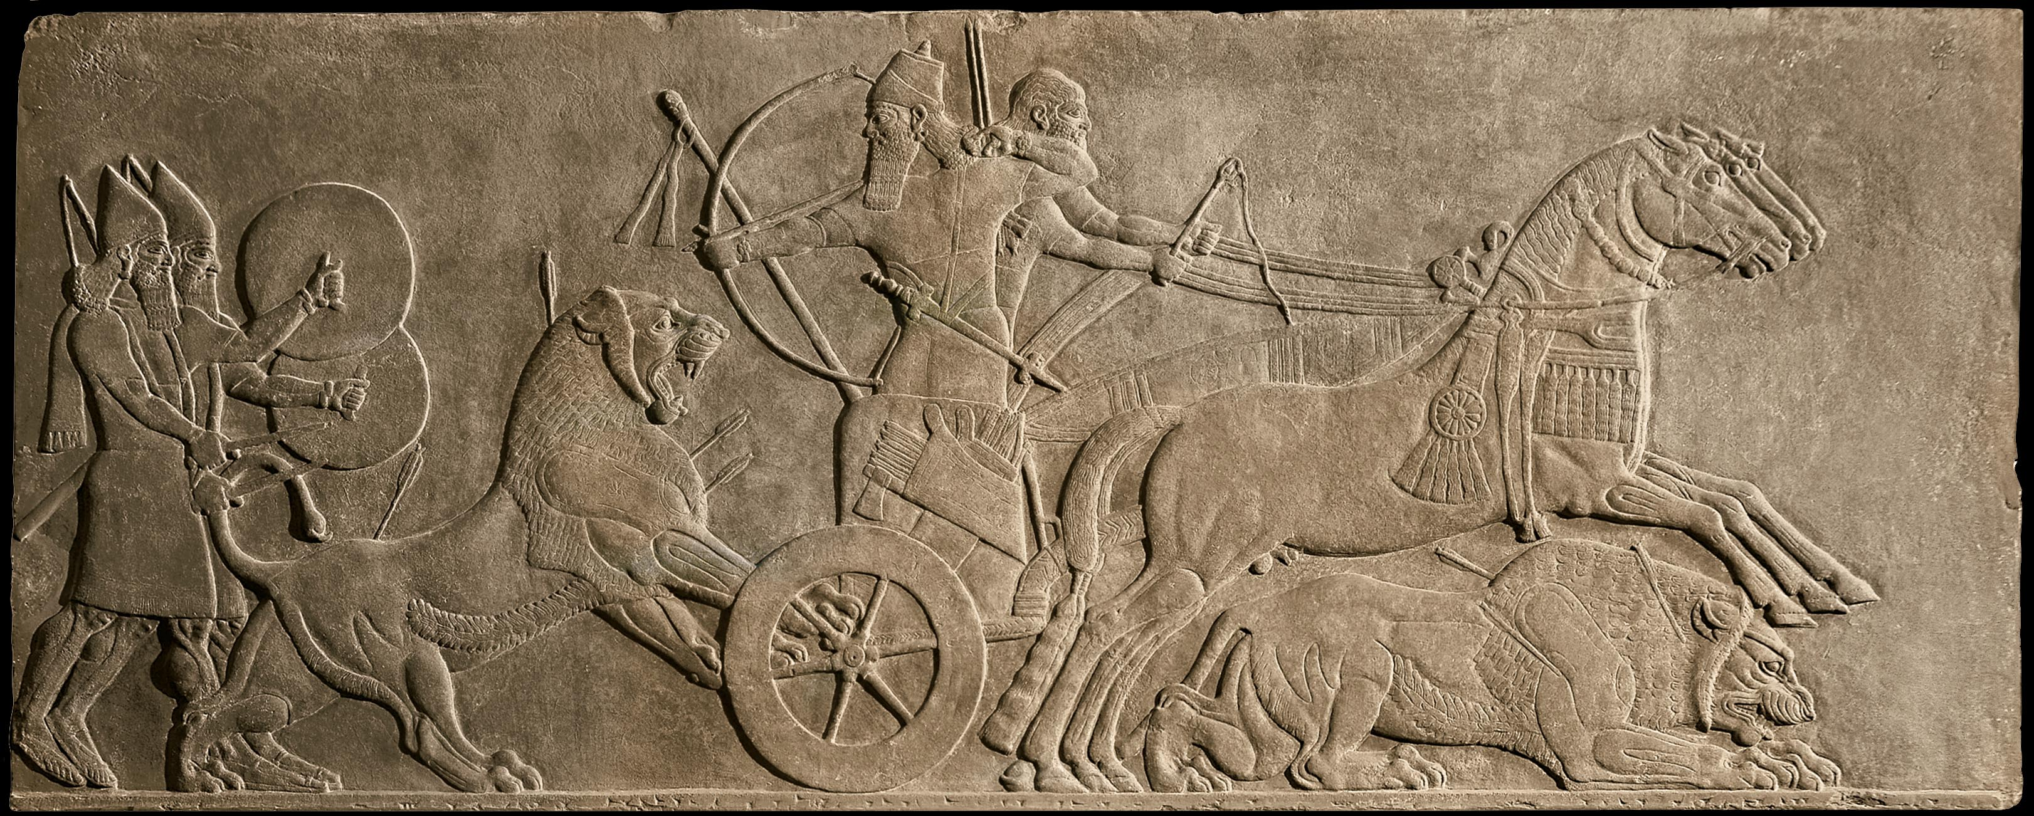
Assyrian King on a Lion Hunt, Kahlu (present day Nimrud, Iraq)
c. 875-860 BCE, Alabaster, height approx. 39 “

Slide 2
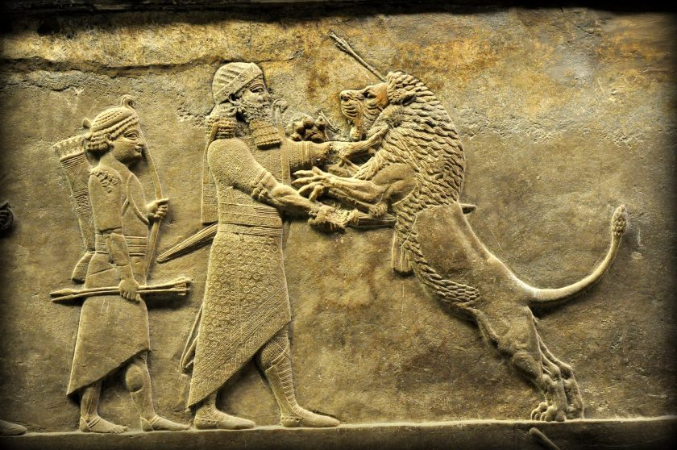

Slide 3
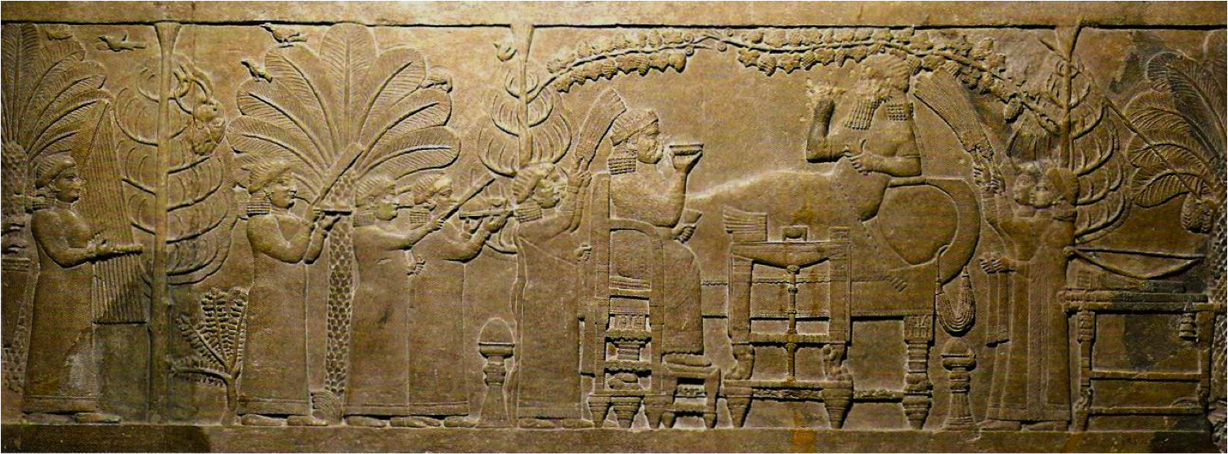
Assurbanipal and his Queen in the Garden, The Palace at Nineveh,
c. 647 BCE, Alabaster, height approx. 21”

Slide 4
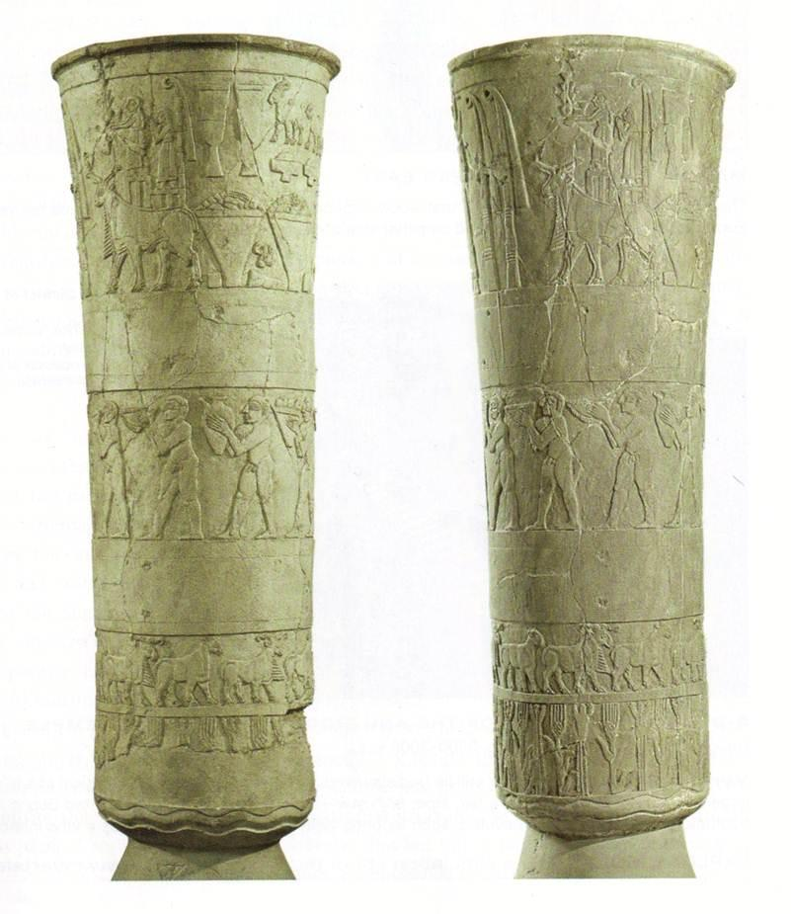
REGISTER
– horizontal bands used to tell a story
Carved Vessel, Presentation of offerings to Inanna from the Inanna temple complex, From Uruk (present-day Warka, Iraq)
c. 3300-3000 BCE, Alabaster, height 36”

Slide 5
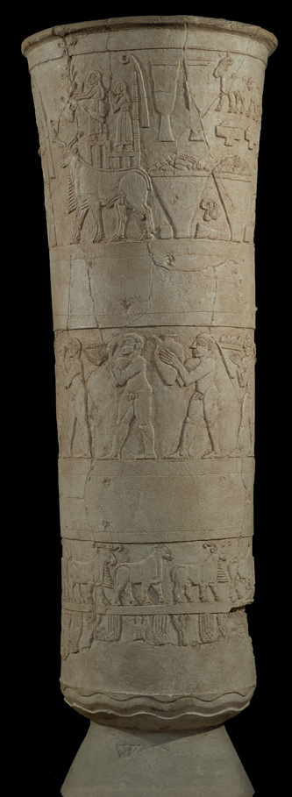
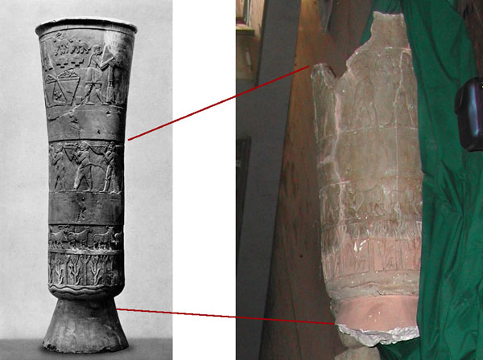
Objects looted from the National Museum of Archeology in Iraq, 2003

Slide 6
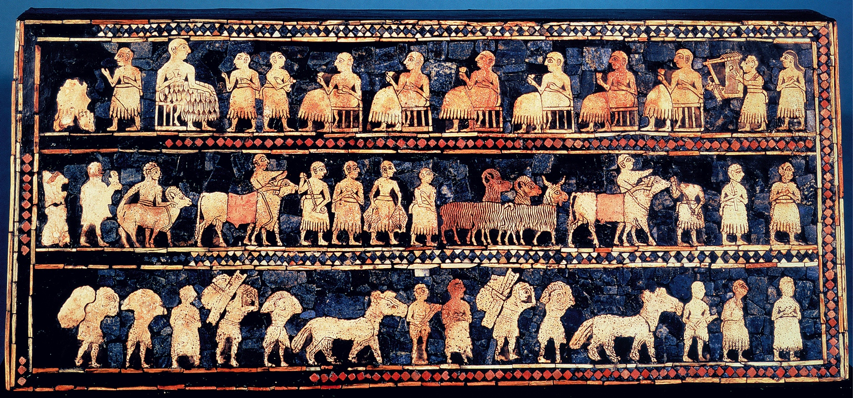
Peace side of the Standard of Ur, from Tomb 779, Royal Cemetery, Ur (modern day Iraq) ca. 2600-2400 BCE. Wood, shell, lapis lazuli, and red limestone, 8ft

Slide 7
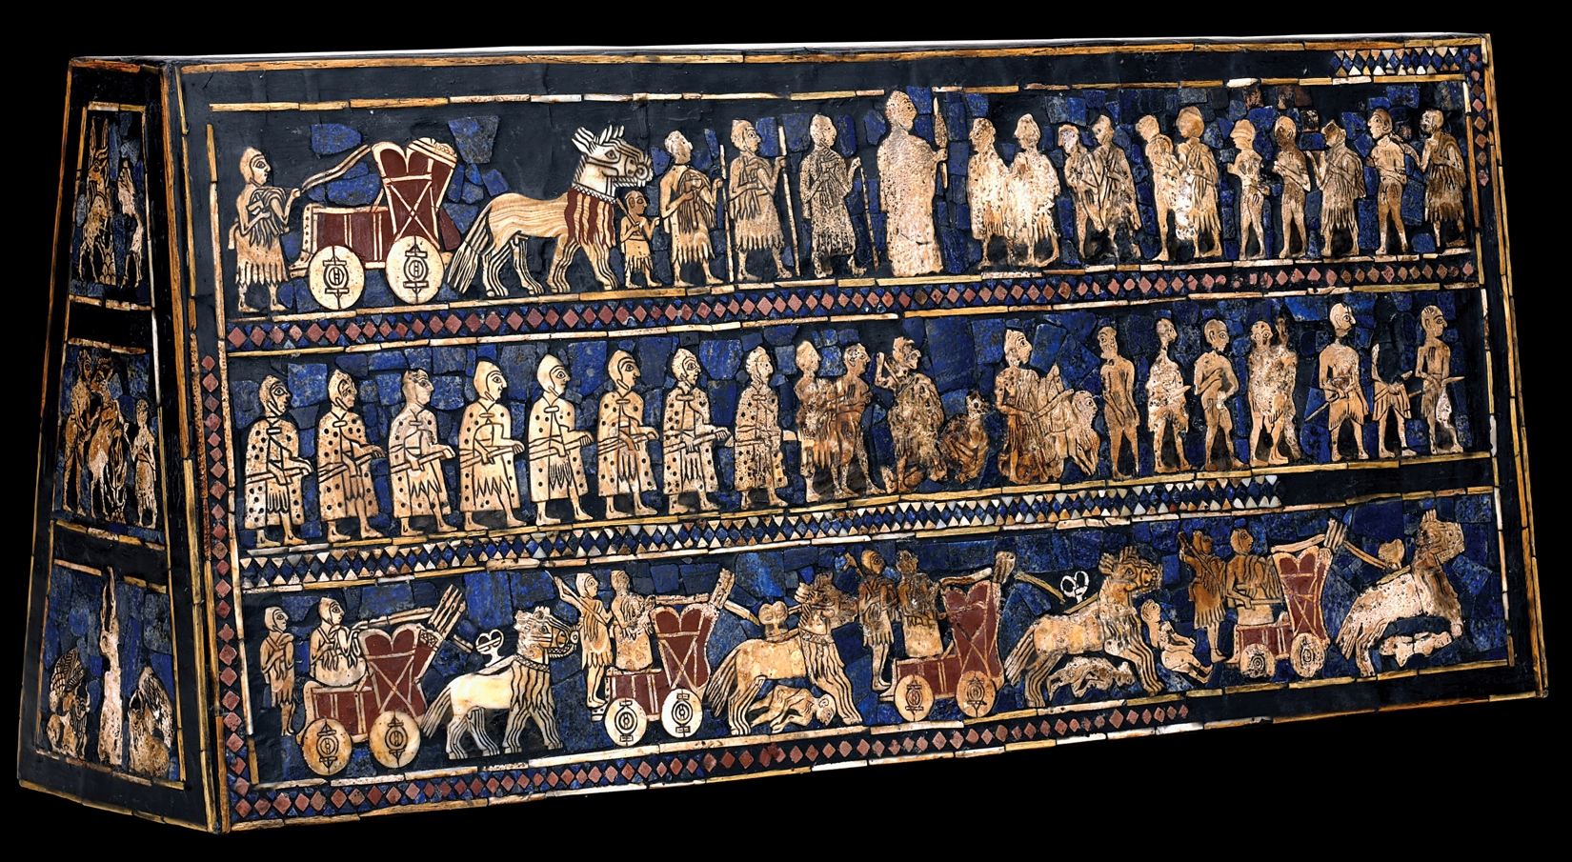
War side of the Standard of Ur, from Tomb 779, Royal Cemetery, Ur (modern day Iraq) ca. 2600-2400 BCE. Wood, shell, lapis lazuli, and red limestone, 8ft

