Slide 1
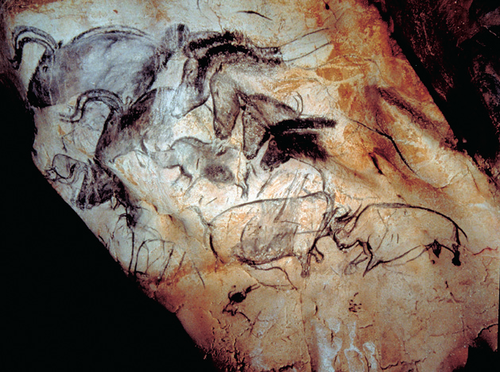
Wall Painting with Horses, Rhinoceroses and Aurochs. Chauvet Cave.

Slide 2
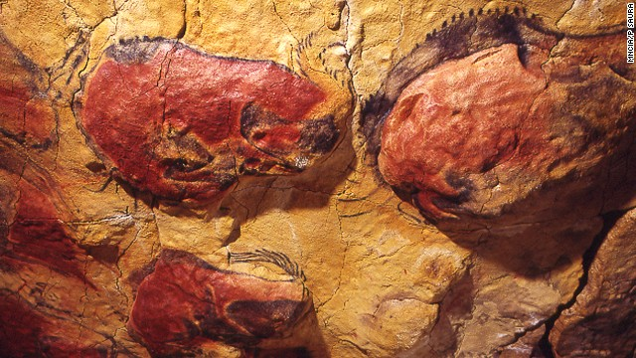
Bison. Ceiling of cave at Altamira, Spain c. 12,500 BCE Paint on limestone, length approx. 8’3”

Slide 3
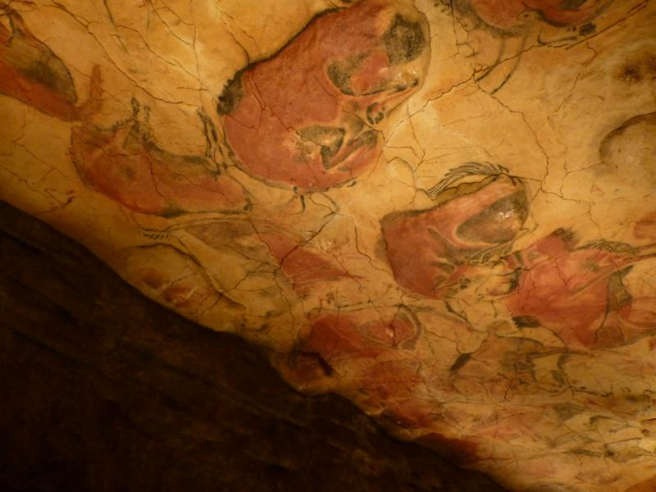
Bison, Ceiling of cave at Altamira, Spain.
c. 12,500 BCE. Paint on limestone, length approx. 8’3”

Slide 4
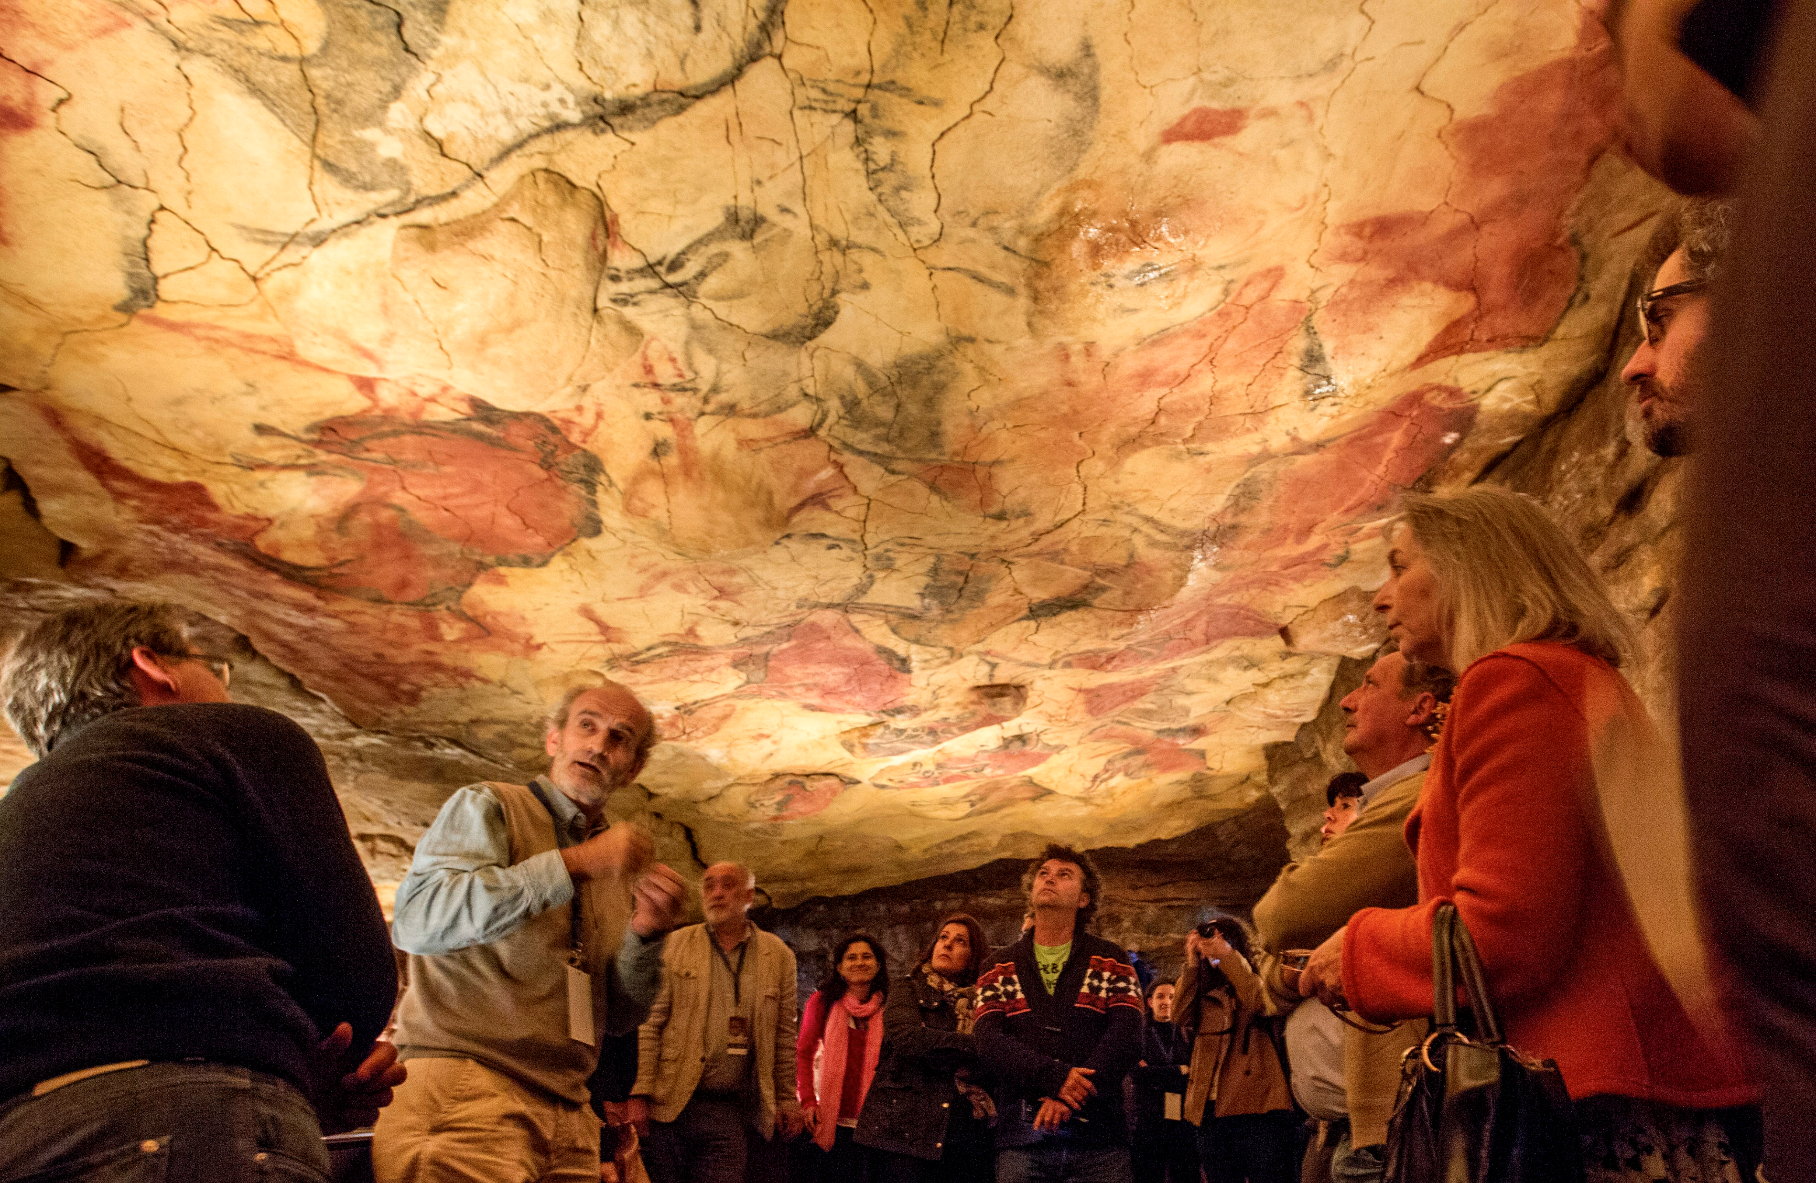

Slide 5
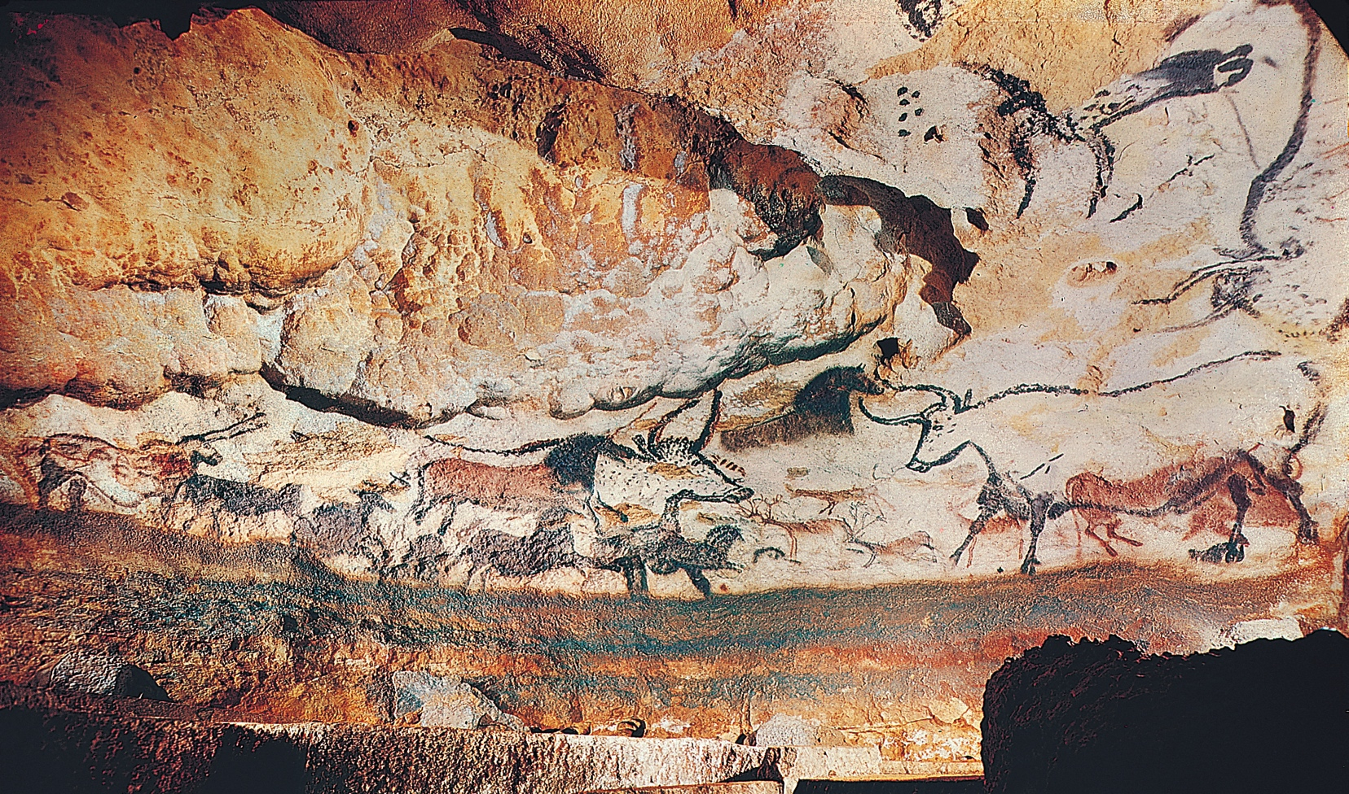
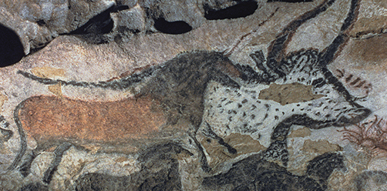
Hall of the Bulls, cave at Lascaux, France,
ca. 16,000-14,000 BCE, Largest bull 11’ 6” long

Slide 6
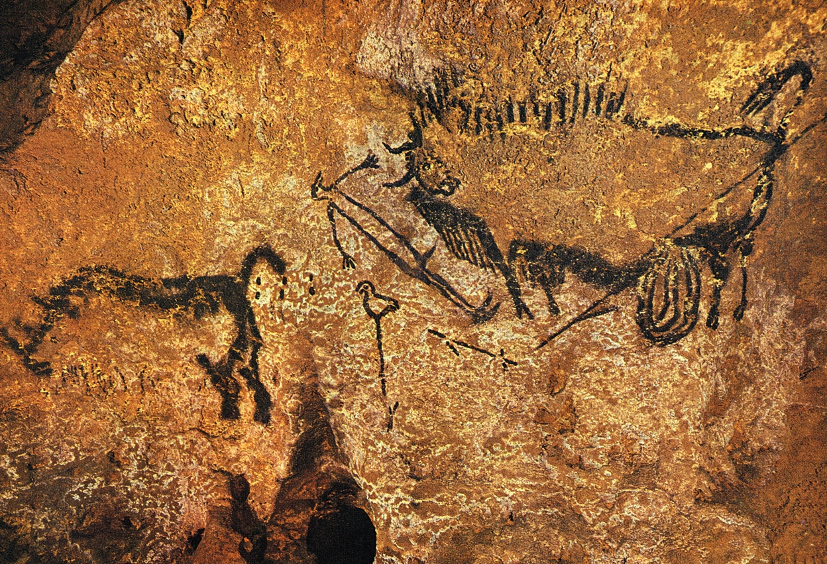
Rhinoceros, Wounded Man, and Disemboweled Bison, Lascaux, France ca. 16,000 – 14,000 BCE. Bison 3’ 4 ½ ” long

Slide 7
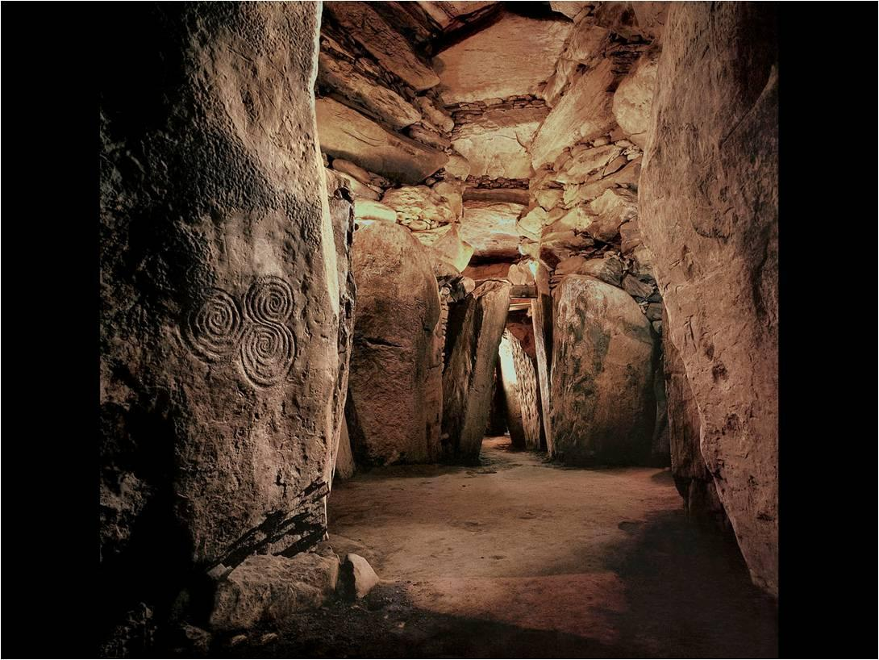
Tomb Interior with Corbeling and Engraved Stones. Newgrange, Ireland. c. 3000-2500 BCE

Slide 8
Neolithic Period
(New Stone Age)
Aprox. 8,000-2,300 BCE
Climate change—from Ice Age
Early Farming—move beyond Hunter/Gather:
  domesticating animals
  cultivating crops
sedentary communities—more permanent (less nomadic):
  Different type of social life
  Early “architecture”

Slide 9
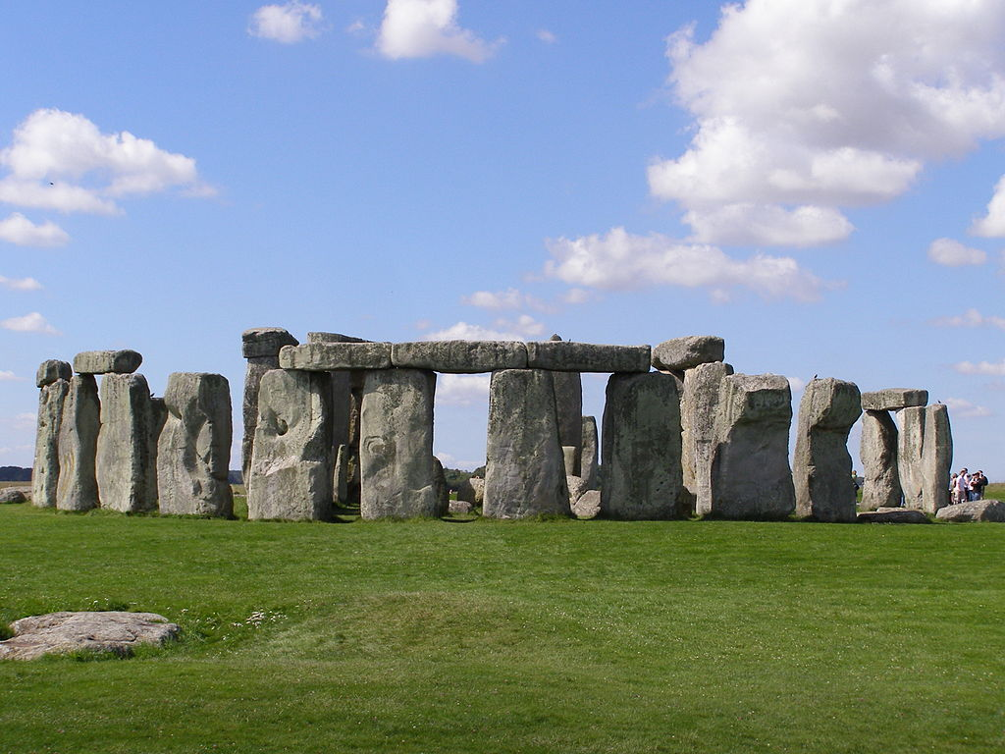
NEOLITHIC
Stonehenge, Salisbury Plain, Wiltshire England, c. 2750-1500 BCE

Slide 10
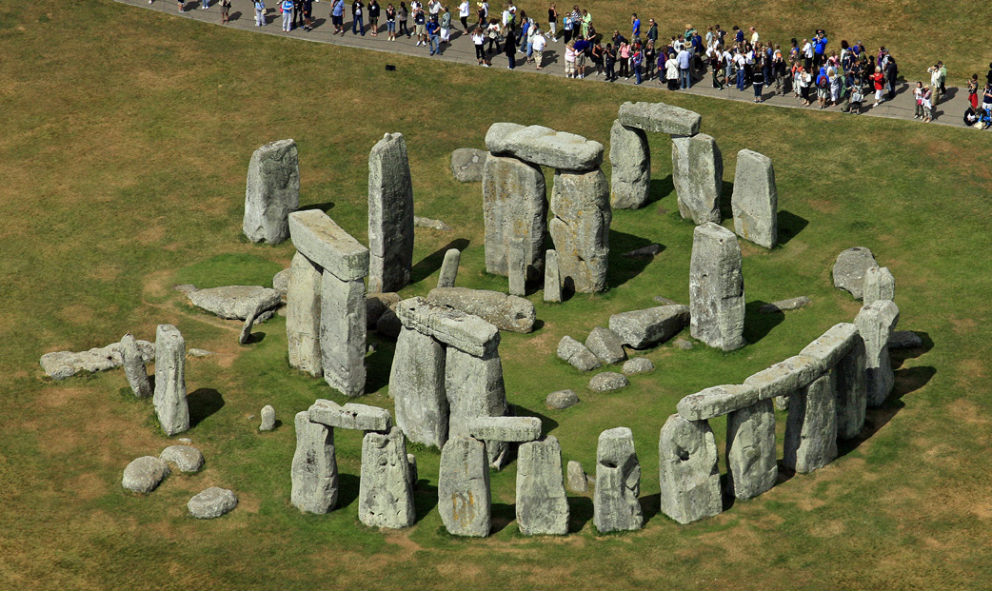

Slide 11
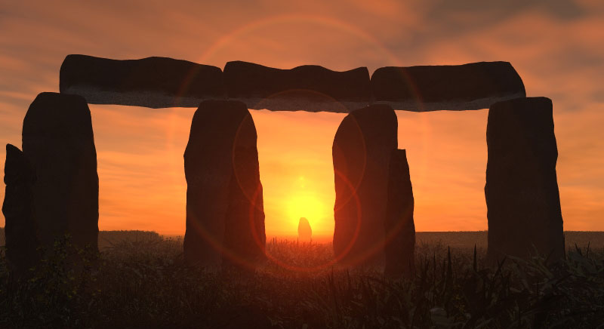

Slide 12
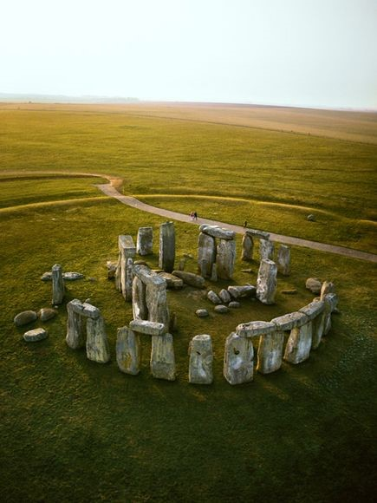

Slide 13
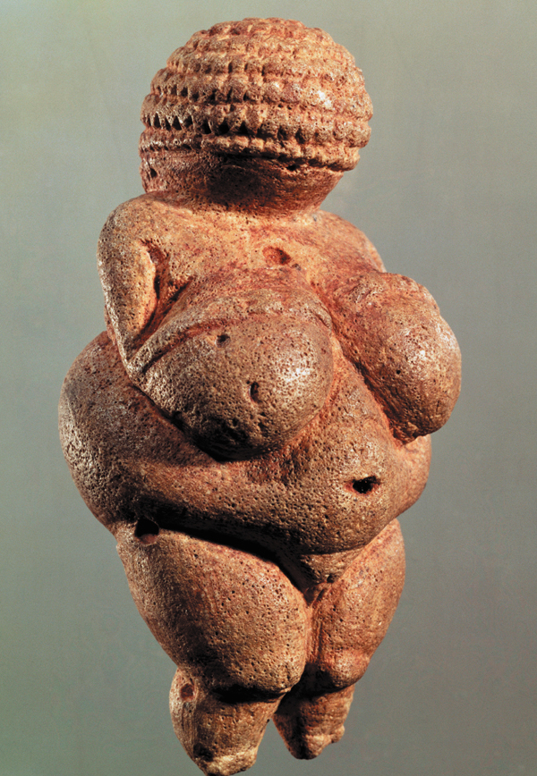
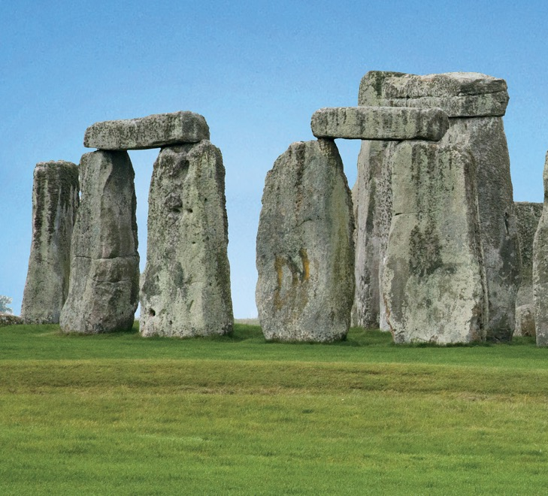
PALEOLITHIC
NEOLITHIC

