Slide 1
Etruscan Art and Pompeii

Slide 2
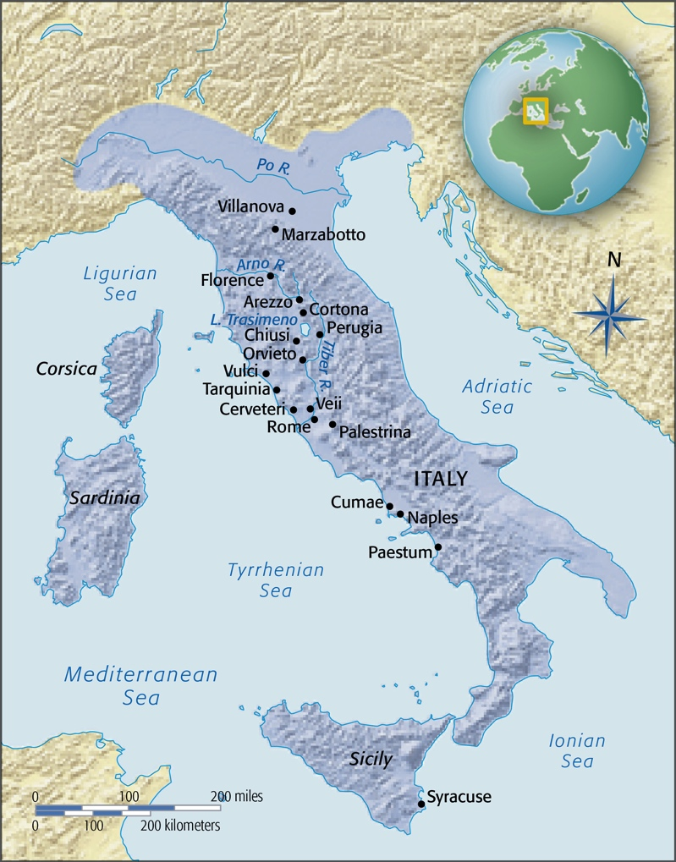
Italy in Etruscan Times

Slide 3
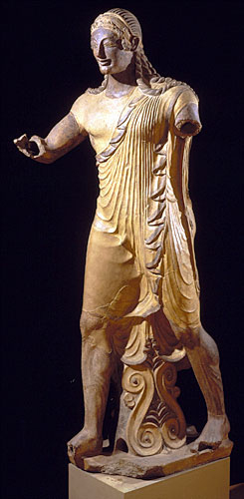
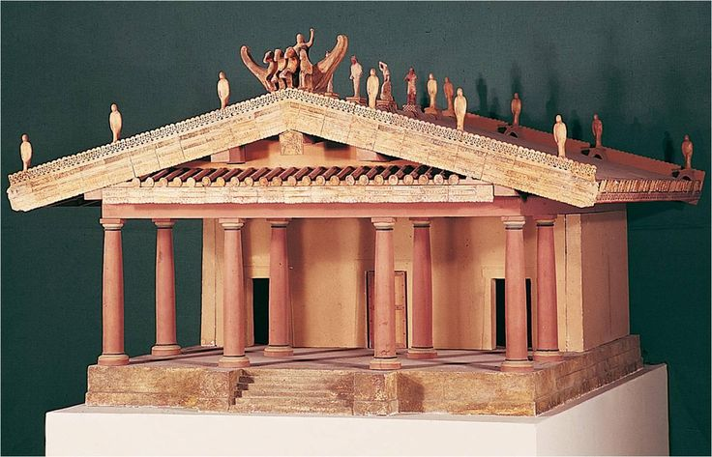
Etruscan
Apollo (Aplu) of Veii, Temple of Minerva, Portonaccio, Veii, c. 510- 500 BCE. Painted terra cotta, height 5’10”

Slide 4
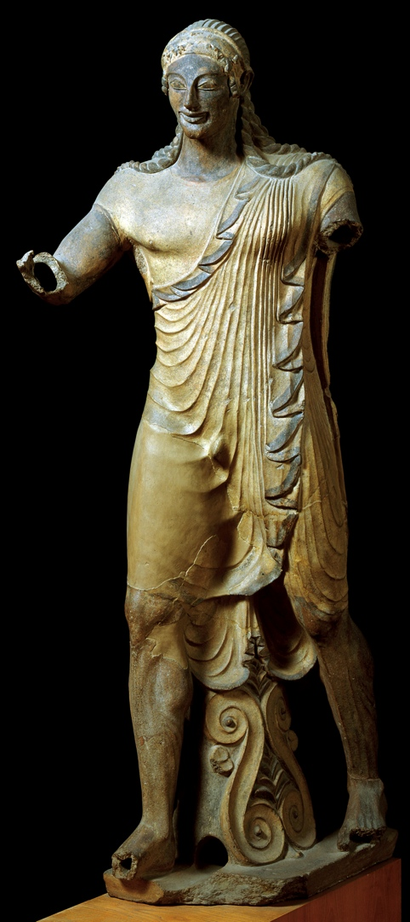
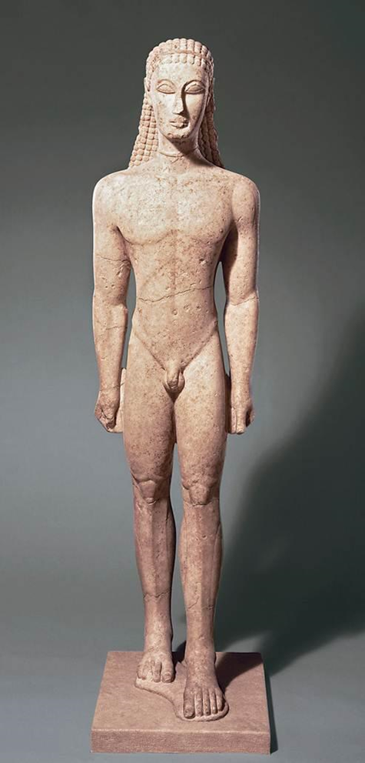
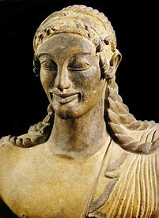
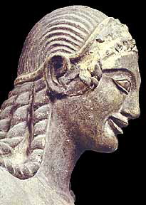
New York Kouros

Slide 5
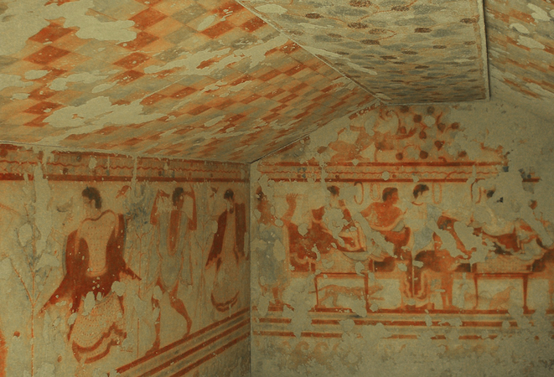
Dancers and Diners, Tomb of the Triclinium, Tarquinia, Italy, c. 480-470 BCE

Slide 6
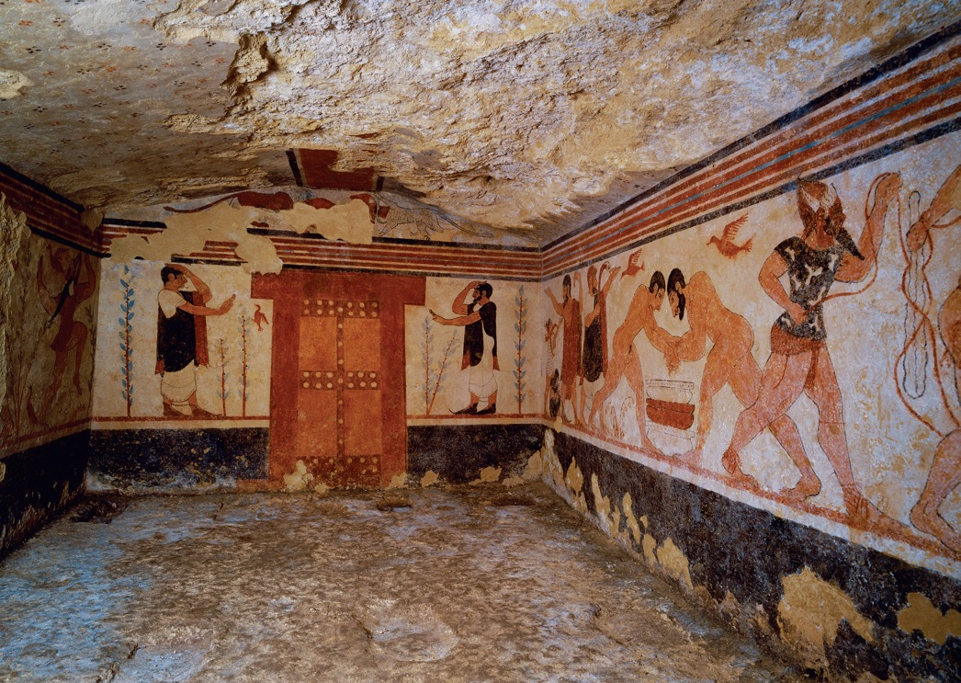
Interior of the Tomb of the Leopards, Tarquinia, Italy, ca. 480–470 BCE

Slide 7
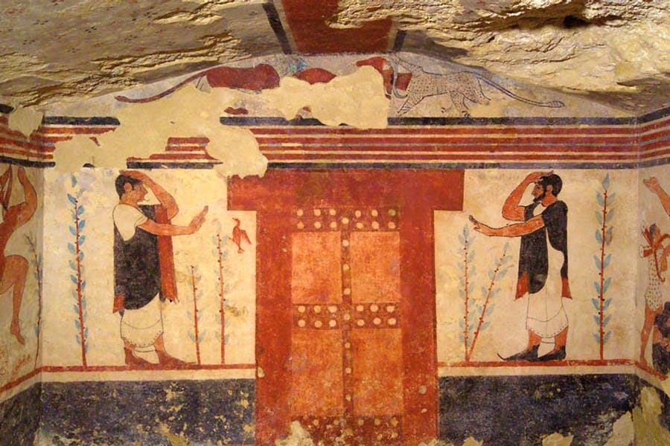

Slide 8
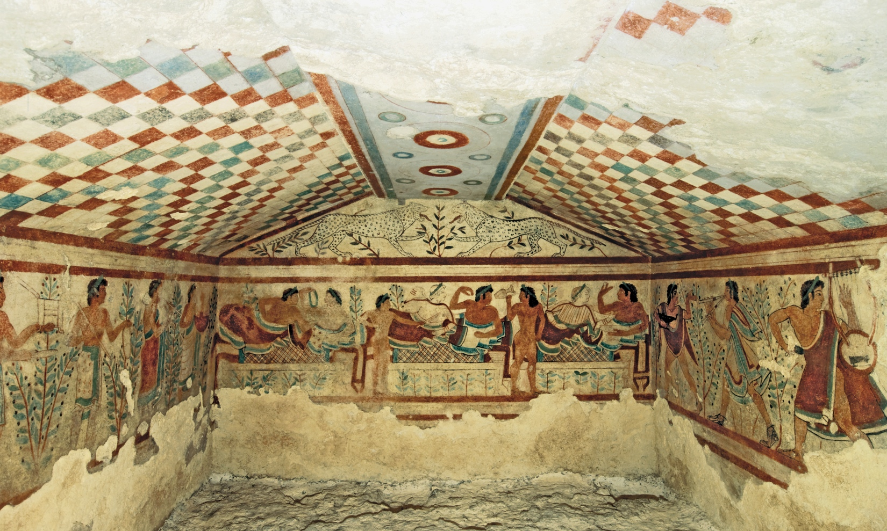

Slide 9
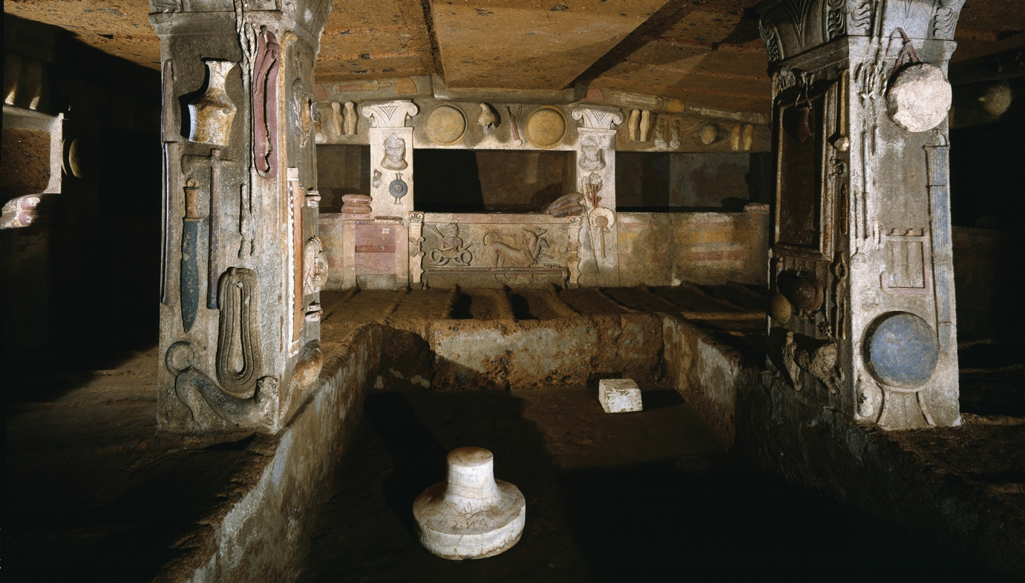
Interior of the Tomb of the Reliefs, Banditaccia Necropolis, Cerveteri, Italy, 3rd century BCE

Slide 10
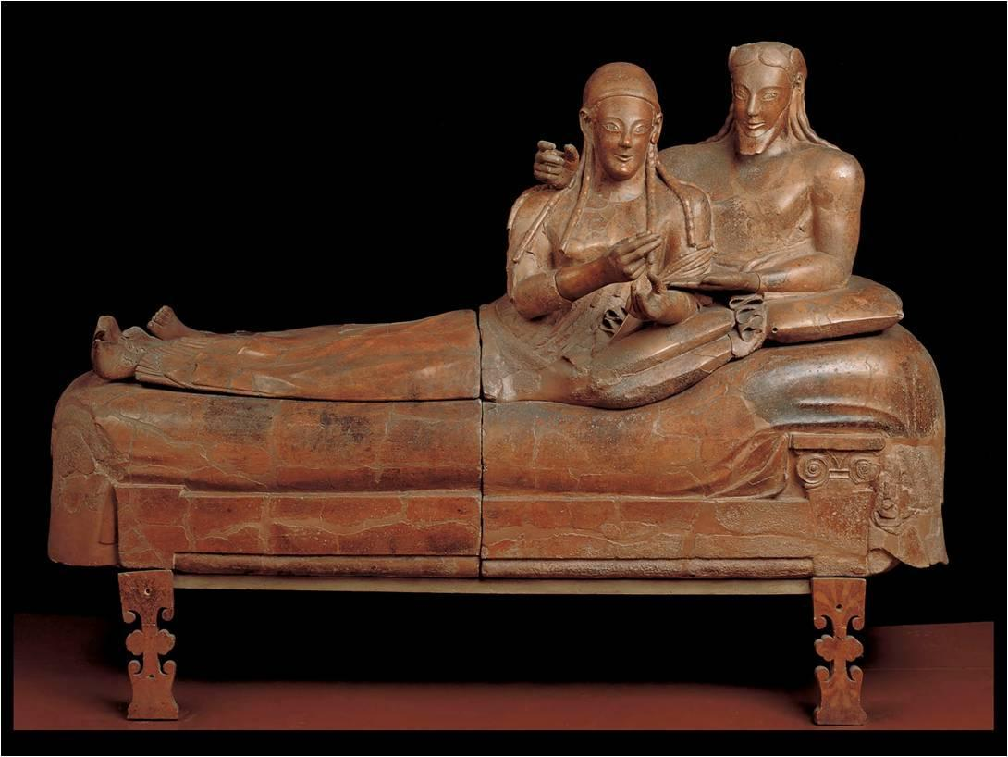
Etruscan
Reclining couple on a Sarcophagus from Cerveteri, c. 520 BCE. Terra cotta

Slide 11
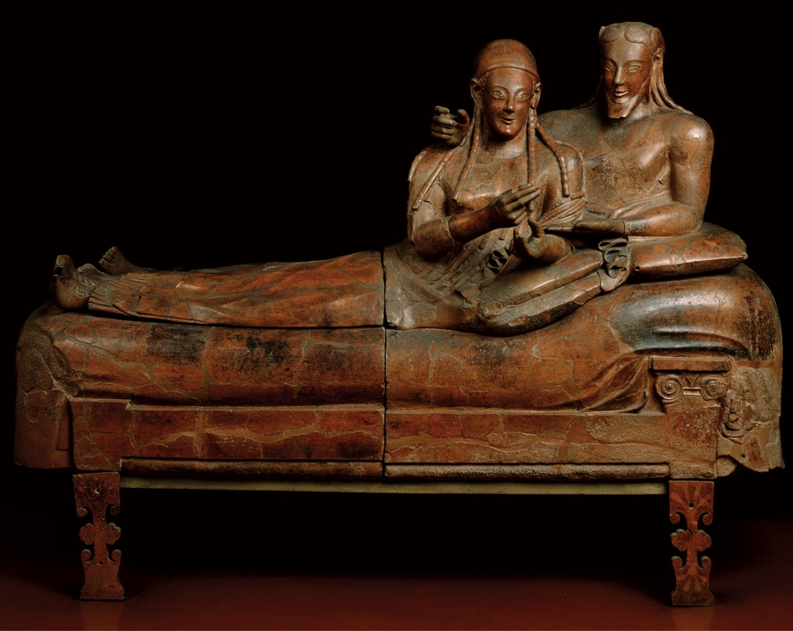
Reclining couple on a Sarcophagus from Cerveteri, c. 520 BCE, Terra cotta

Slide 12
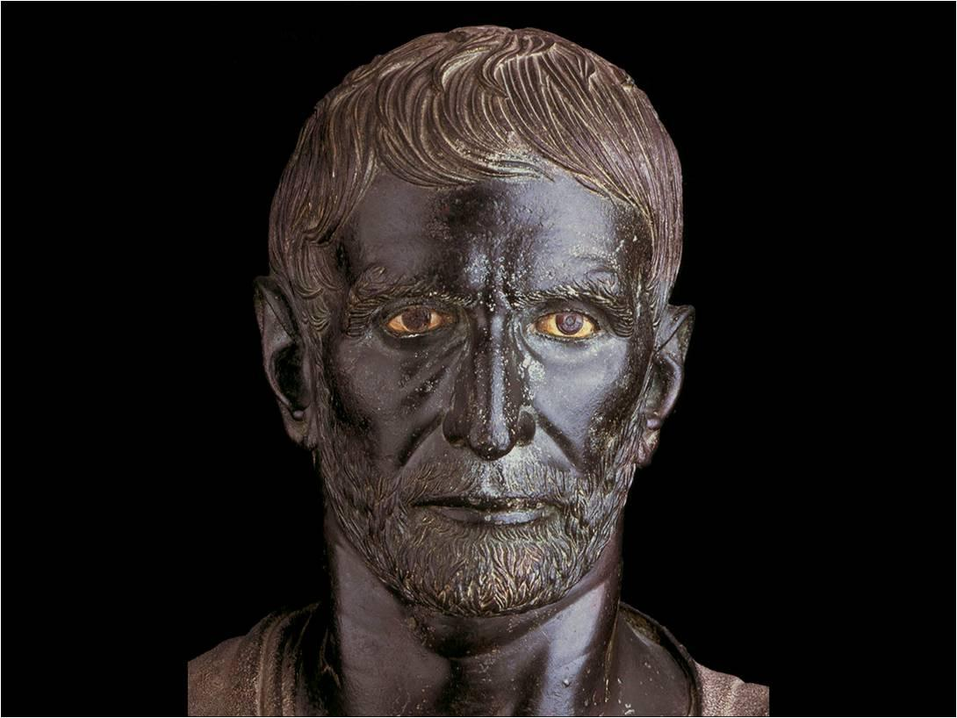
Head of a Man (Brutus) c. 300 BCE. Bronze

Slide 13
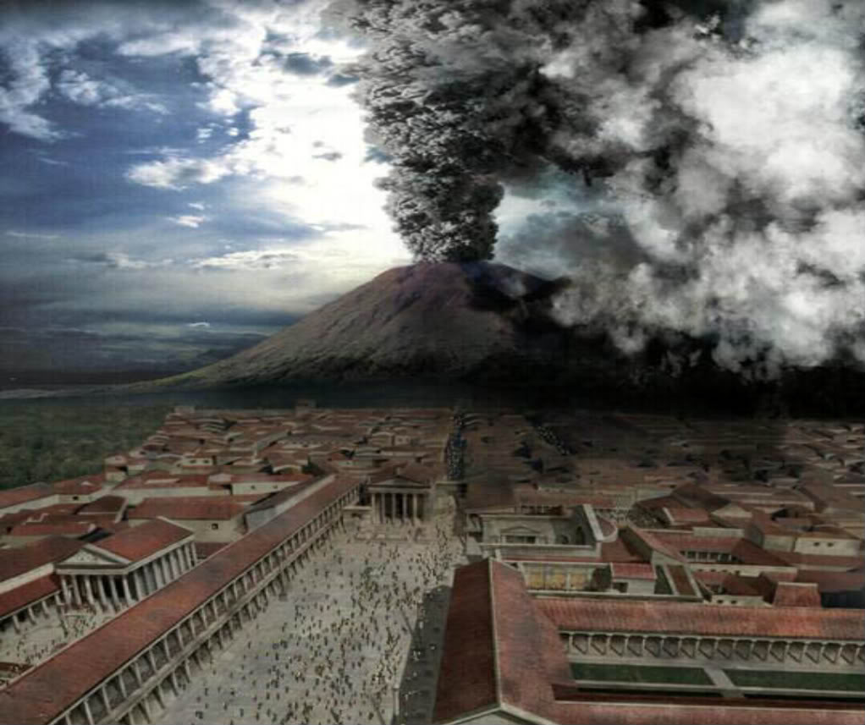
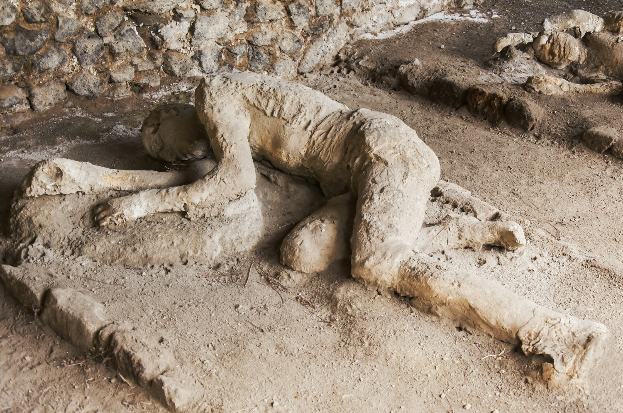
Pompeii, Mount Vesuvius (c. 79 CE)

Slide 14
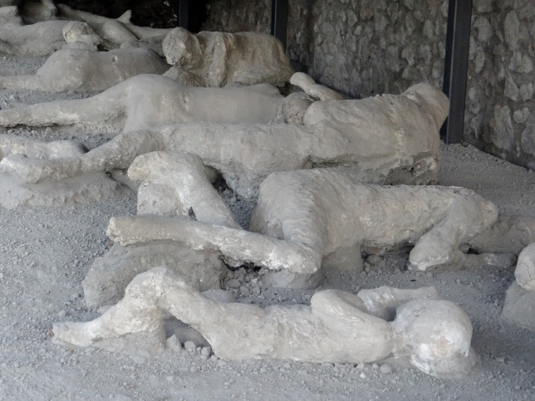
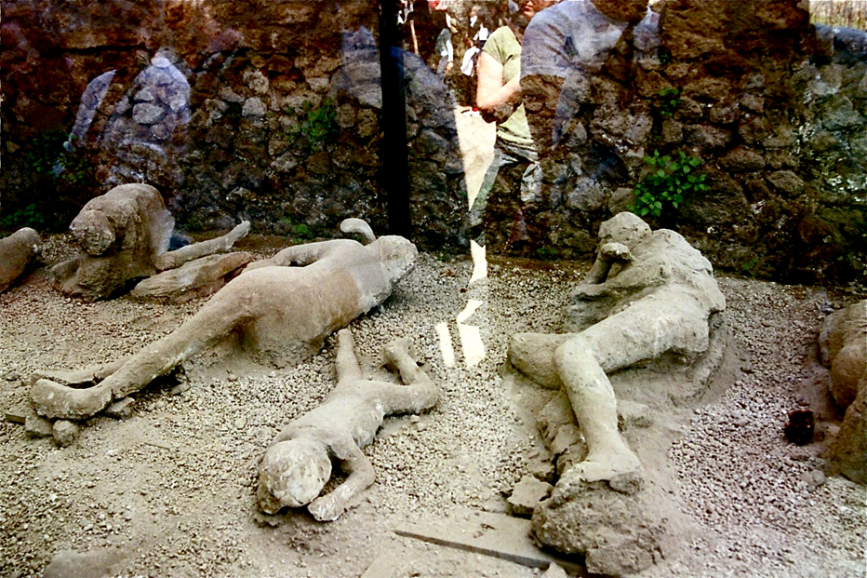

Slide 15
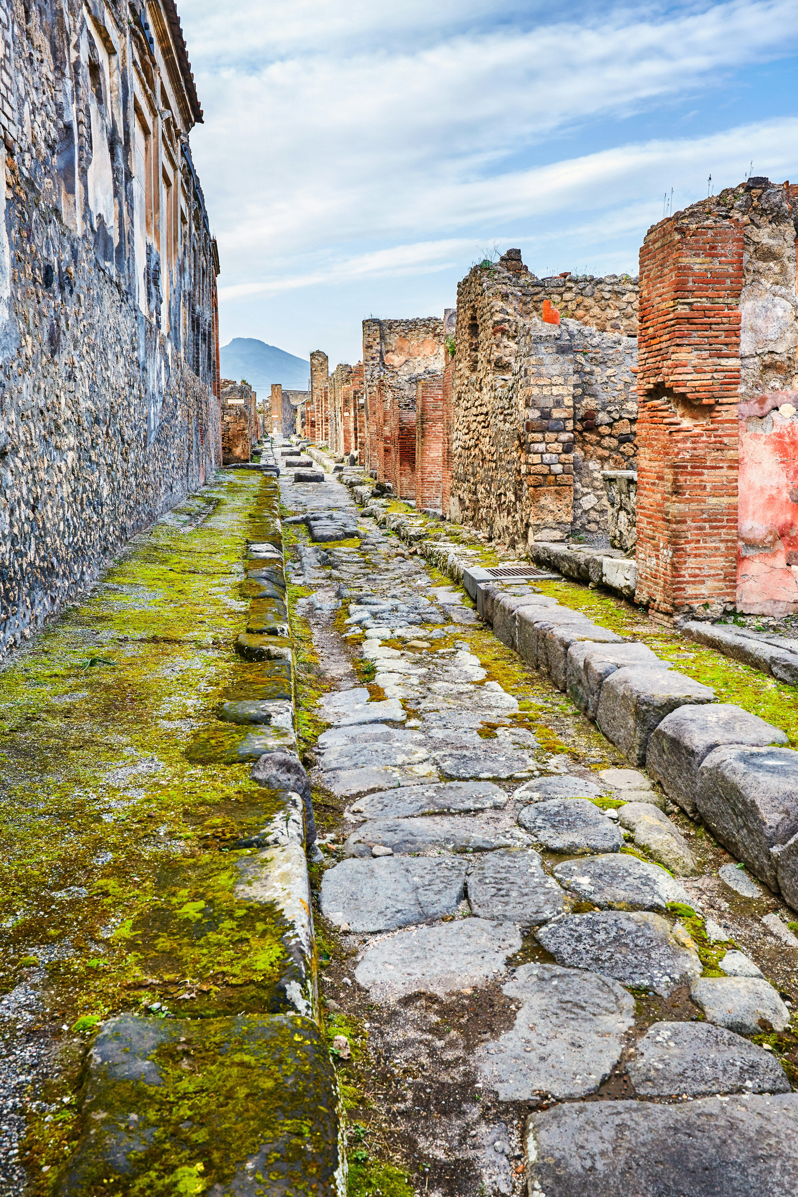

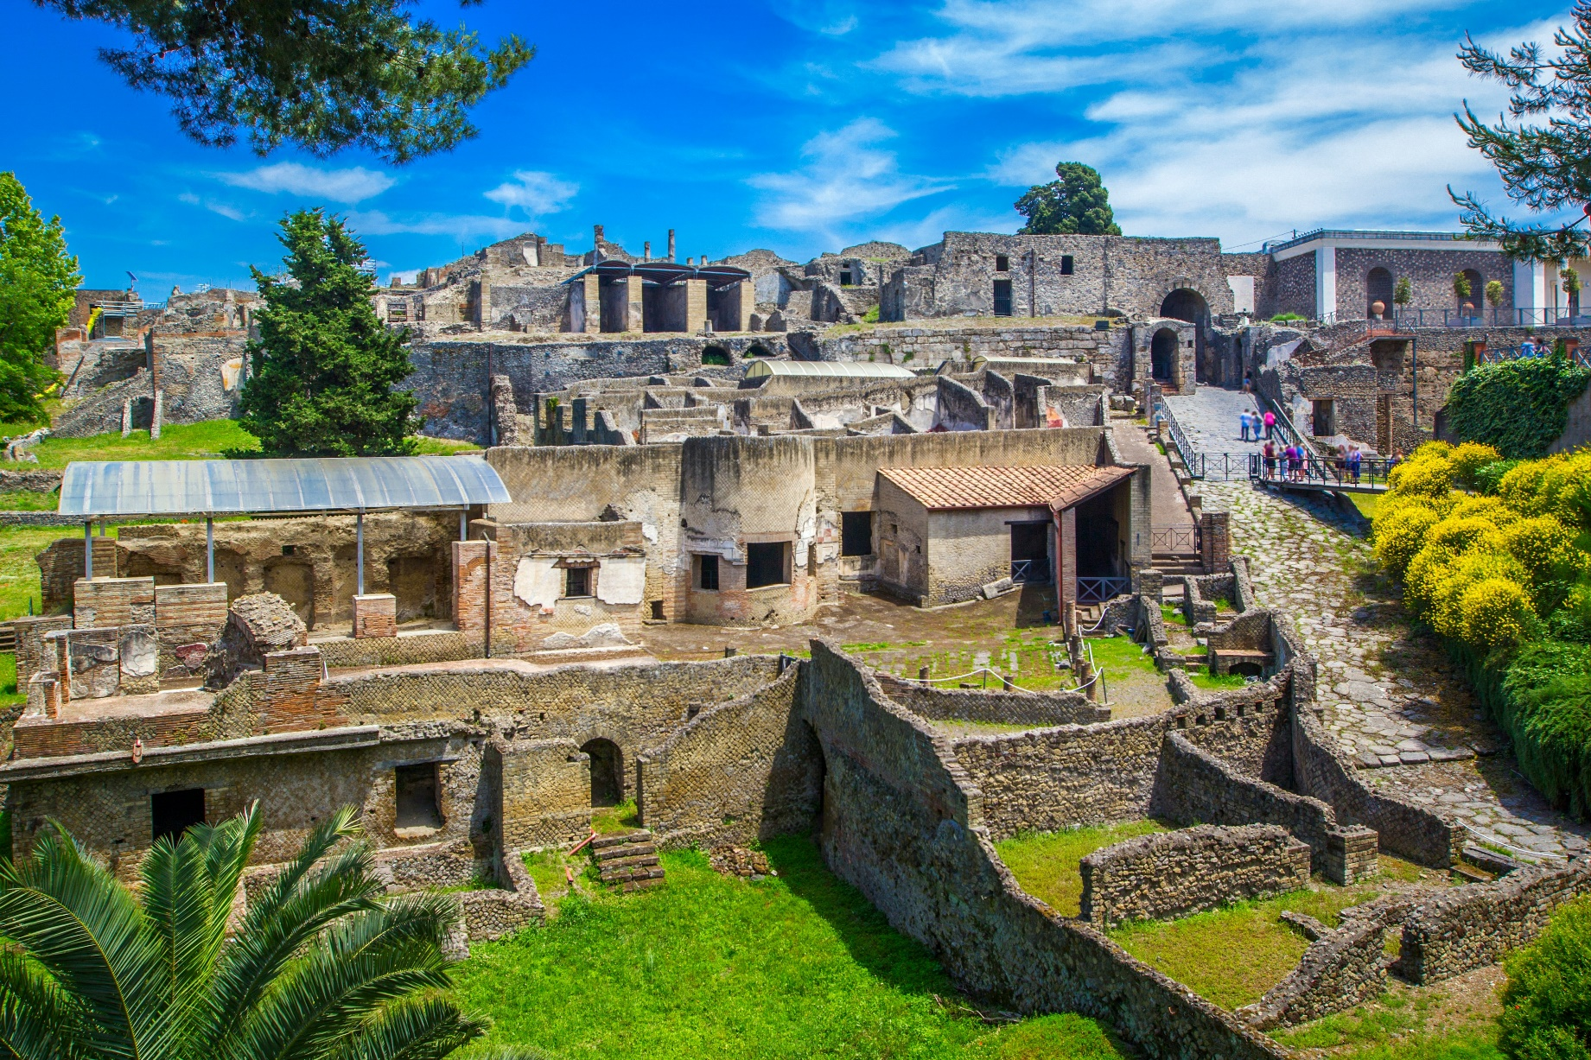

Slide 16
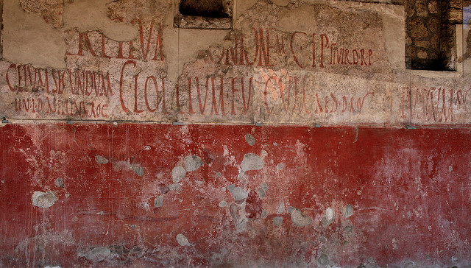

Slide 17
Graffiti in Pompeii
“Marcus loves Spendusa” (18 times!)
“Sarius to Cornelius: Go hang yourself!”
“The weaver Successus loves the innkeeper's slave girl, Iris by name. She doesn't care for him, but he begs her to take pity on him. Written by his rival. So long.”
“Let him who chastises lovers try to fetter the winds and block the endless flow of water from a spring.”
“Health to you, Victoria, and wherever you are may you sneeze sweetly.”
“Claudius' little girl-friend is working for his election as spy”
"Aufidius was here."
“Ampliatus Pedania is a thief”
“Stronnius is a know-nothing”
“Thyas, don’t love Fortunatus”
“I wonder, O wall, that you have not fallen in
ruins from supporting the stupidities of so many scribblers.”
On a bathroom wall:
“Apollinaris, physician of the Emperor Titus,
had a good shit here!”
“Pyrrhus to his chum Chias: I’m sorry to hear you are dead, and so, goodbye!”

Slide 18
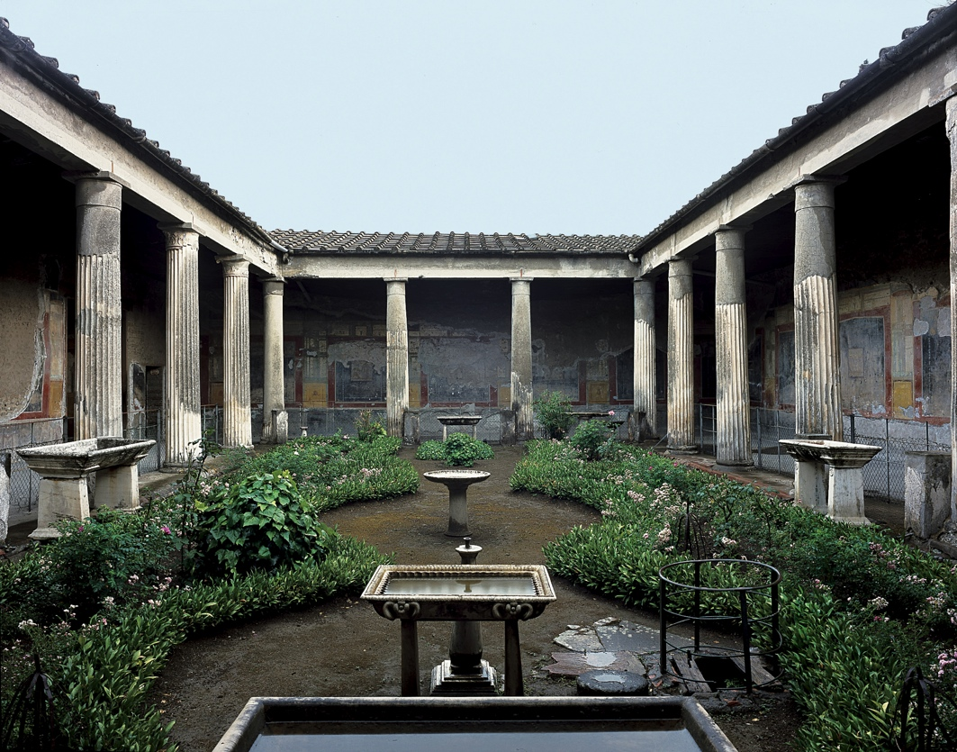
Peristyle Garden, House of the Vetti, Pompeii, 2nd Century BCE, Rebuilt 62-79 CE

Slide 19
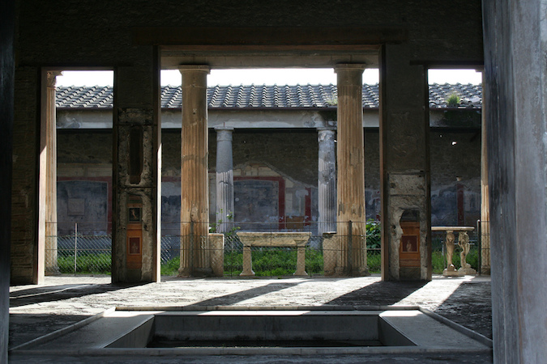

Slide 20
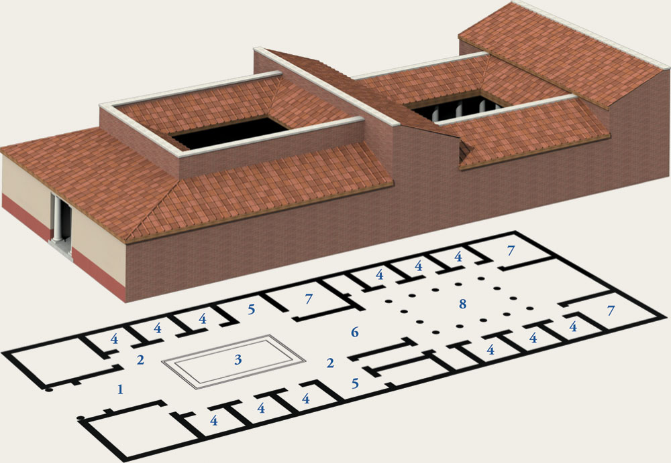
Typical Roman Home 1st & 2nd Century BCE

Slide 21
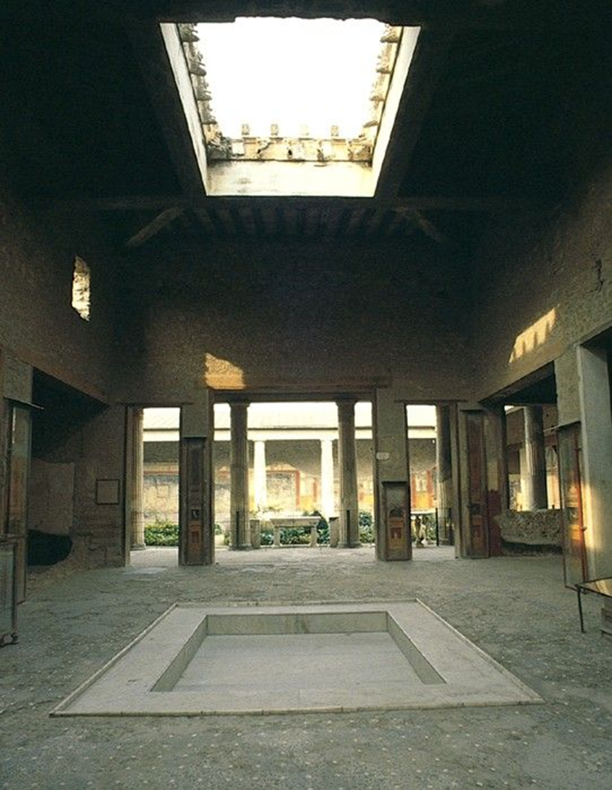
Atrium, House of the Vetti

Slide 22
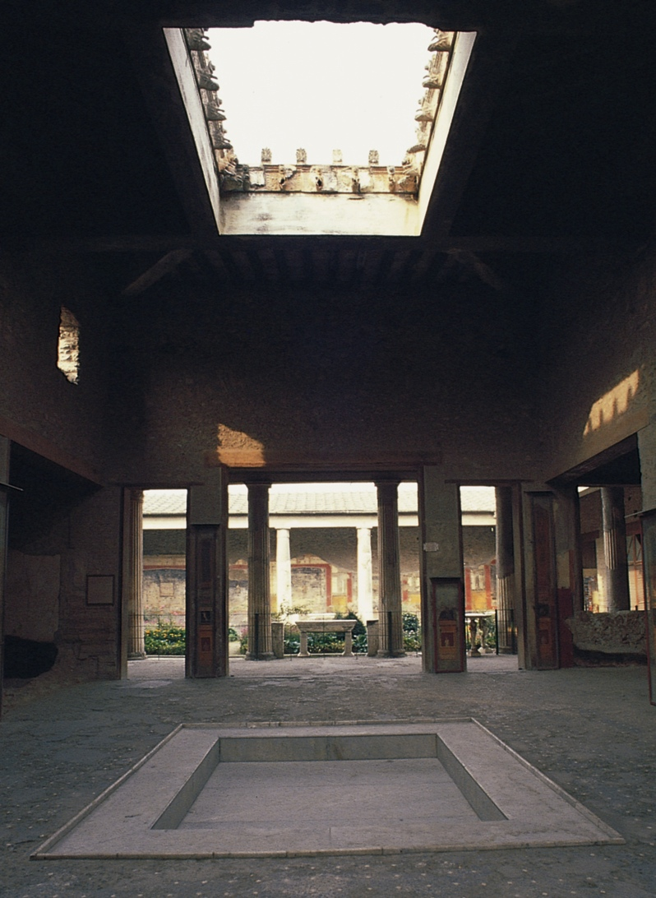
Atrium, House of the Vetti

Slide 23
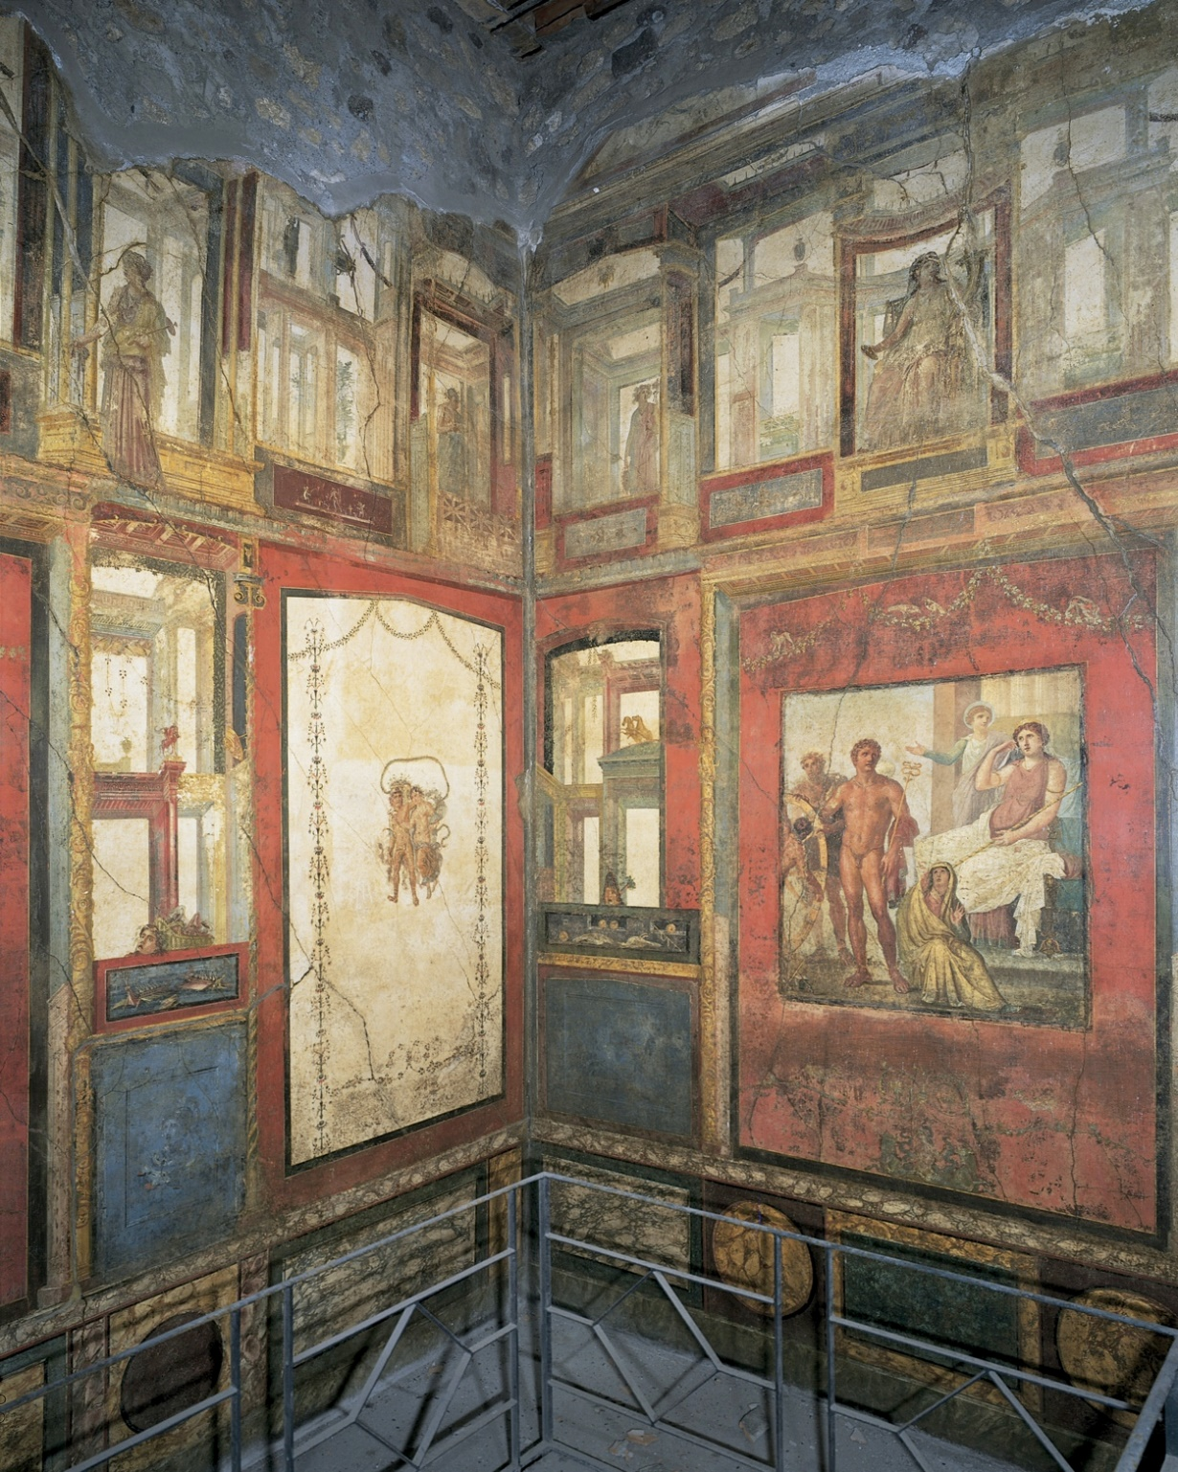
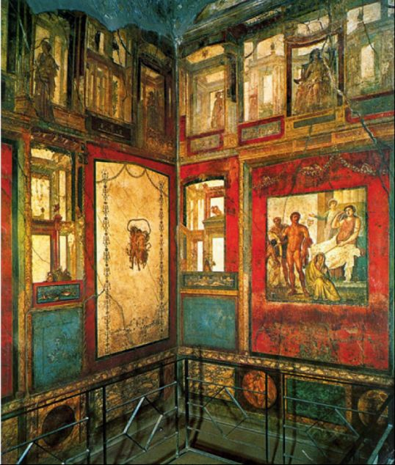
Wall Painting in the Ixion Room, House of the Vetti, Pompeii

Slide 24
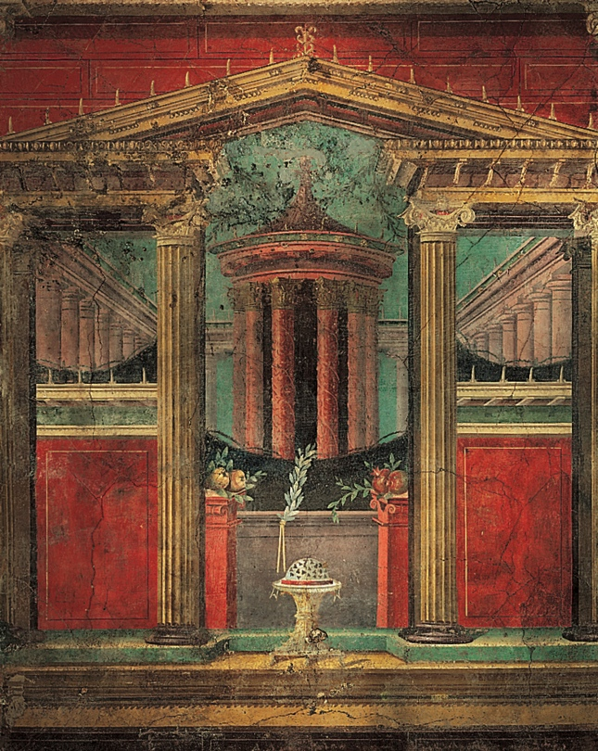
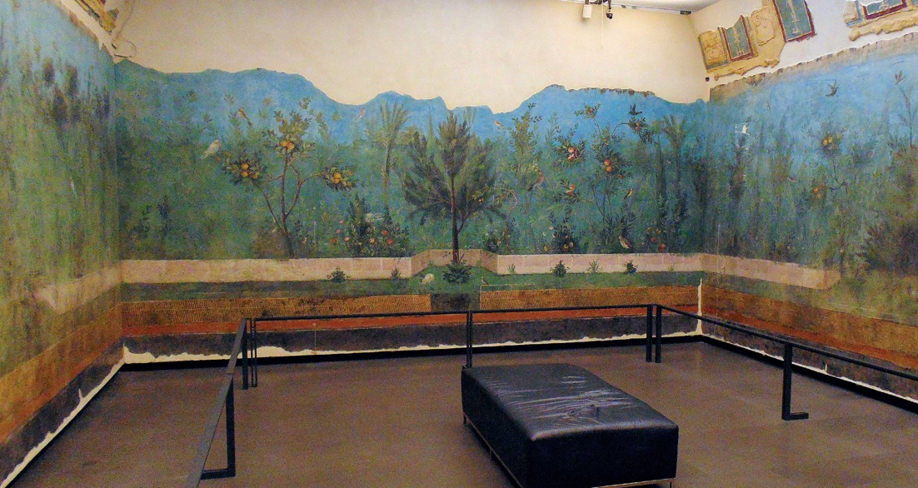

Slide 25
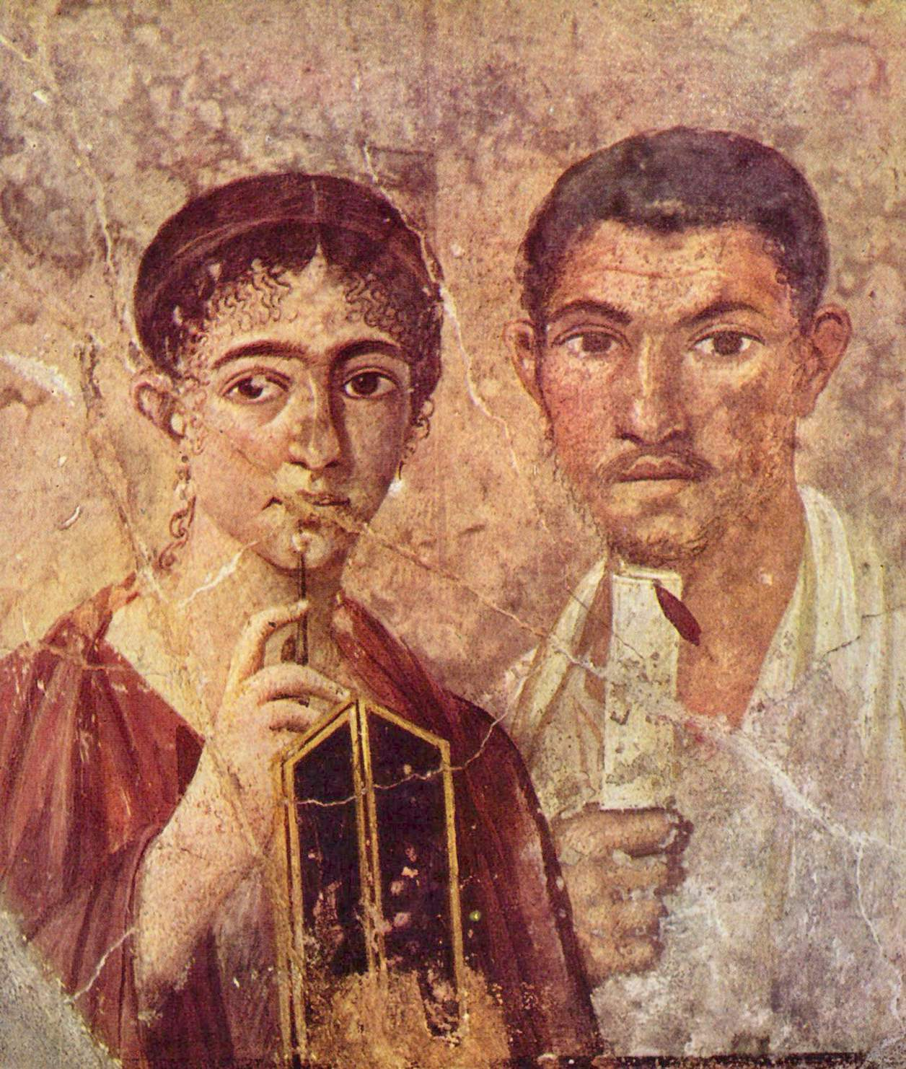
Portrait of a Married Couple, Pompeii, Mid 1st Century CE

Slide 26
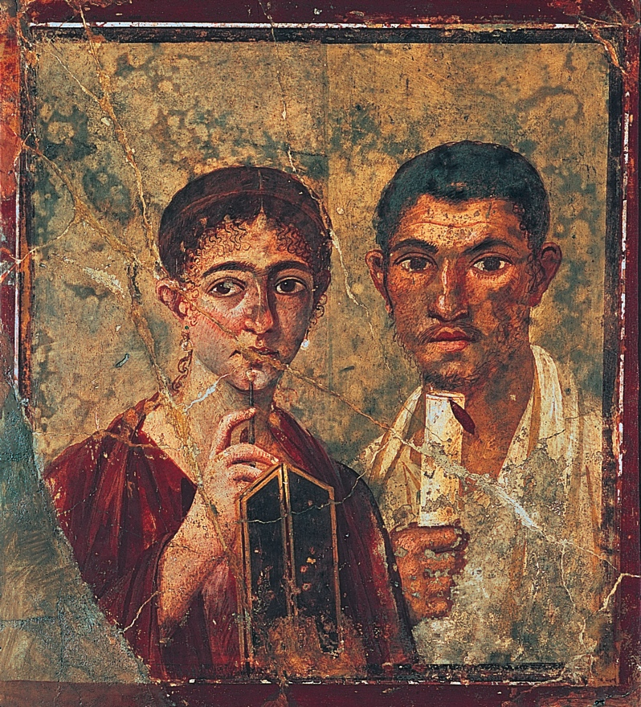
Portrait of a Married Couple, Pompeii, Mid 1st Century CE

