Slide 1
Prehistoric Art continued

Slide 2
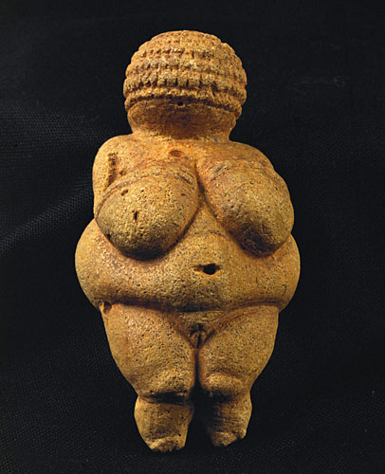
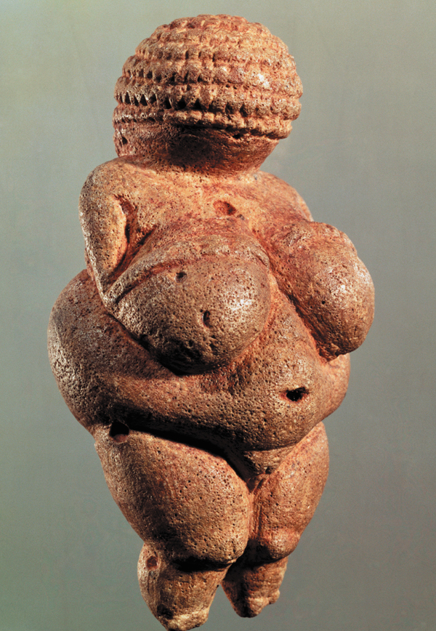
Woman From Willendorf, Austria,
C.24,000 BCE, 4” Limestone

Slide 3
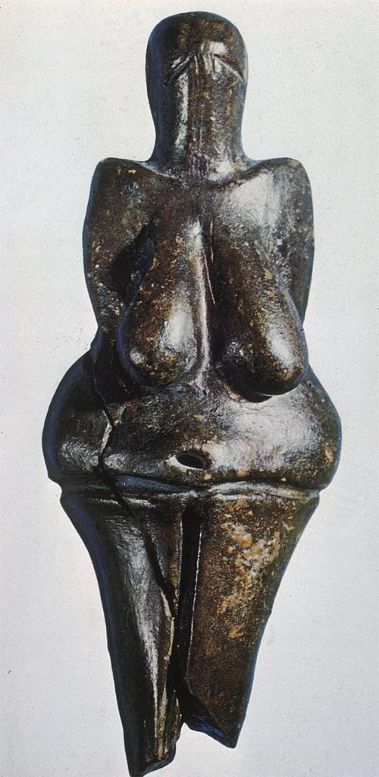
Woman from Dolni Vestonice,
Czech Republic, 23,000BC
Woman From Willendorf. From Austria.

Slide 4
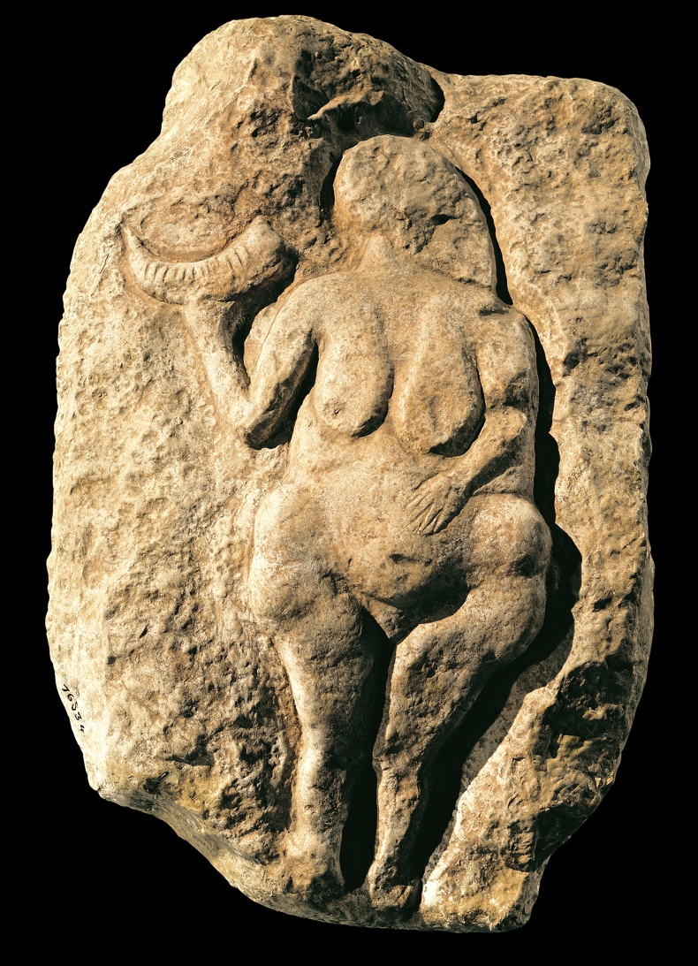
Woman Holding a Bison Horn, from Laussel, France, ca. 25,000–20,000 BCE. Painted limestone, approx. 1’ 6” high.

Slide 5
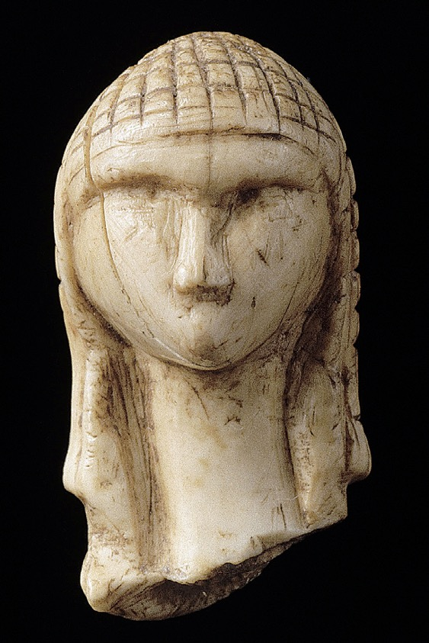
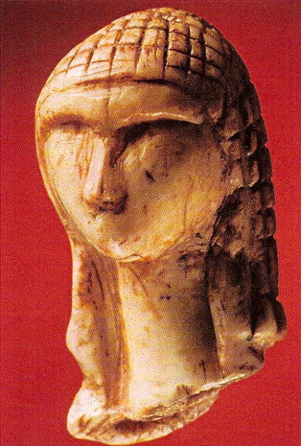
Woman from Brassempouy,
From Grotte du Pape, France
ca 30,000 BCE, Ivory, height approx. 1”

Slide 6
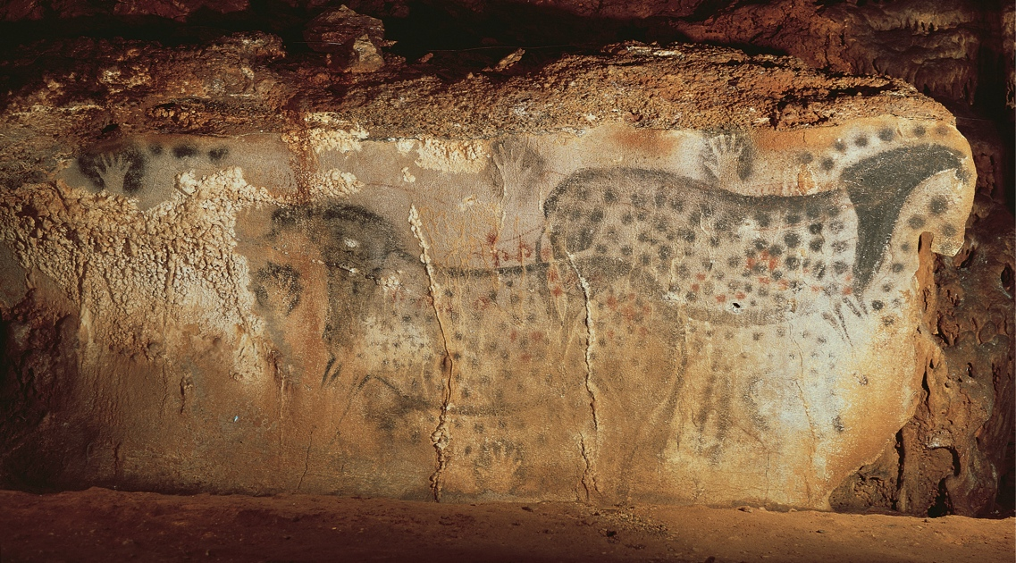
Spotted Horses and Human Hands. Peche Merle cave, Dordogne, France. Horses 25,000-24,000 BCE; hands c. 15,000 BCE. Paint on limestone, individual horses over 5’ in length
PALEOLITHIC

Slide 8
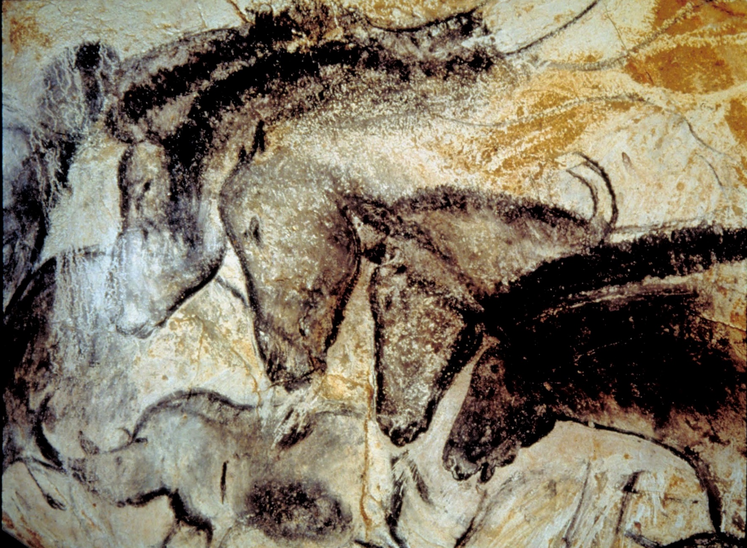
Wall Painting with Horses, Rhinoceroses and Aurochs, Chauvet Cave, France. c. 32,000-30,000 BC Paint on Limestone

Slide 9
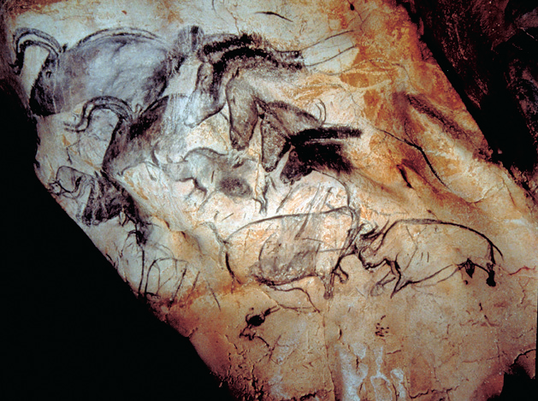
Wall Painting with Horses, Rhinoceroses and Aurochs. Chauvet Cave.

