Slide 1
Asian and Southeast Asian Art
Hinduism, Buddhism, Confucianism, Taoism

Slide 2
Hinduism

Slide 3
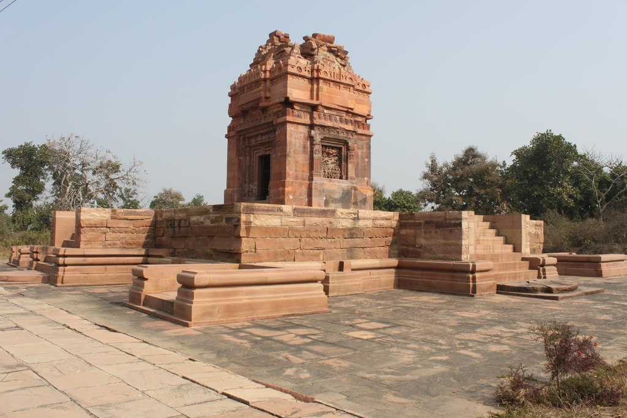
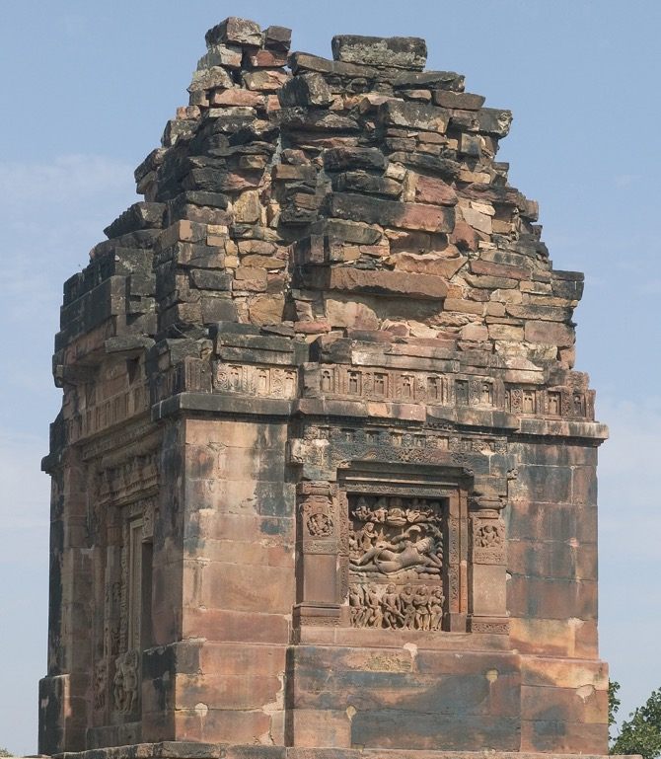
Hindu
Vishnu Temple, Deogarh, Uttar Pradesh, India, Gupta Dynasty, c. 530 CE

Slide 4
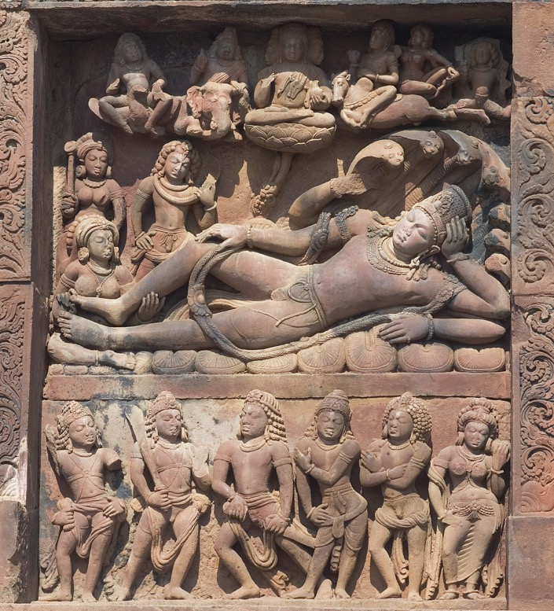
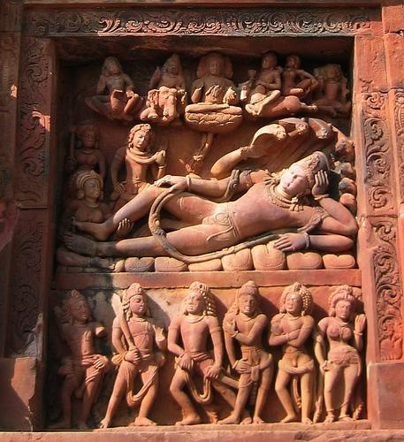
Vishnu on the Cosmic Waters (Asleep on the Serpent Atlanta), Relief panel Vishnu Temple, 530 CE

Slide 5
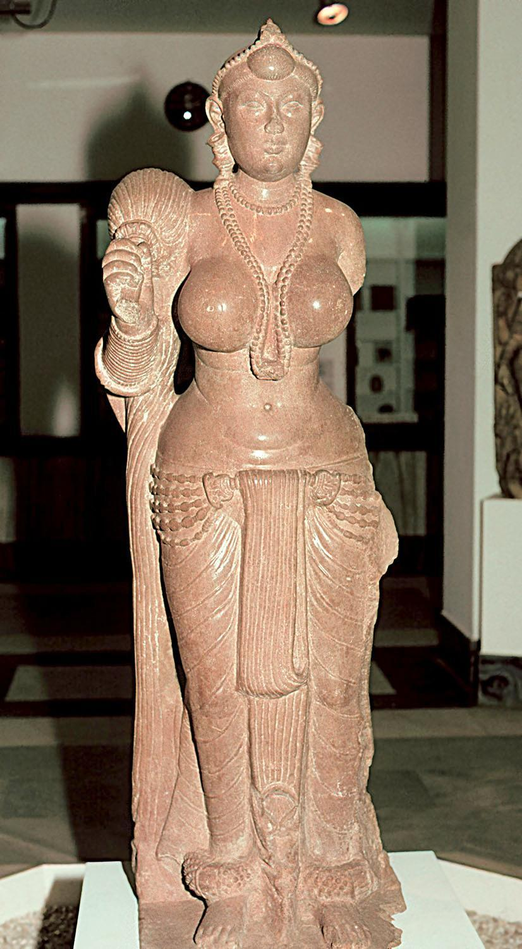
Yakshi Holding a Fly-Whisk,
Didarganj, Patna, India 250 BCE

Slide 6
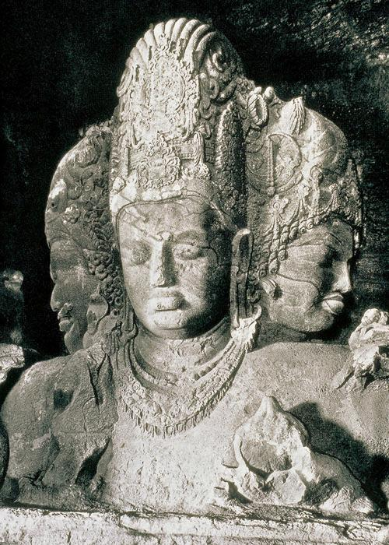
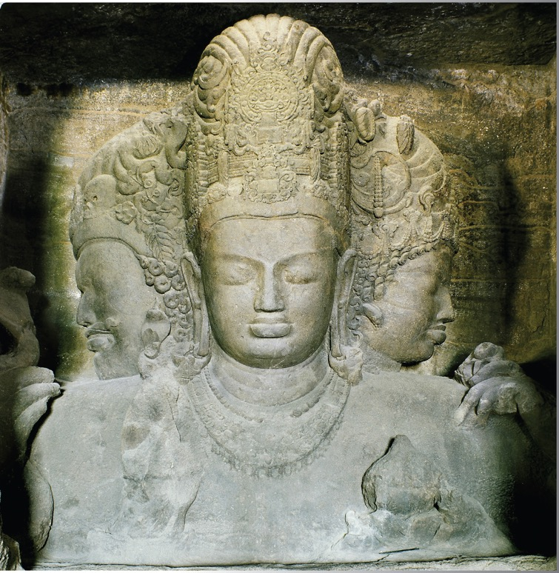
Shiva as Mahadeva (Eternal Shiva),
Cave Temples of Shiva, Elephanta,
6th Century, 17’10”

Slide 7
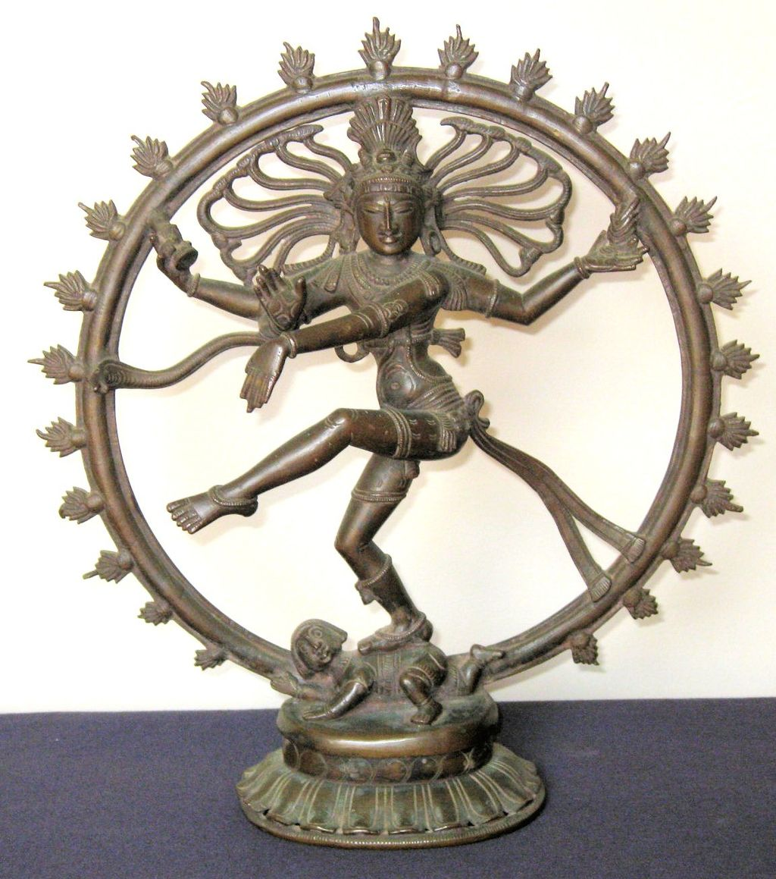
Shiva Nataraja, Chola Dynasty, 12th century CE, New Delhi

Slide 8
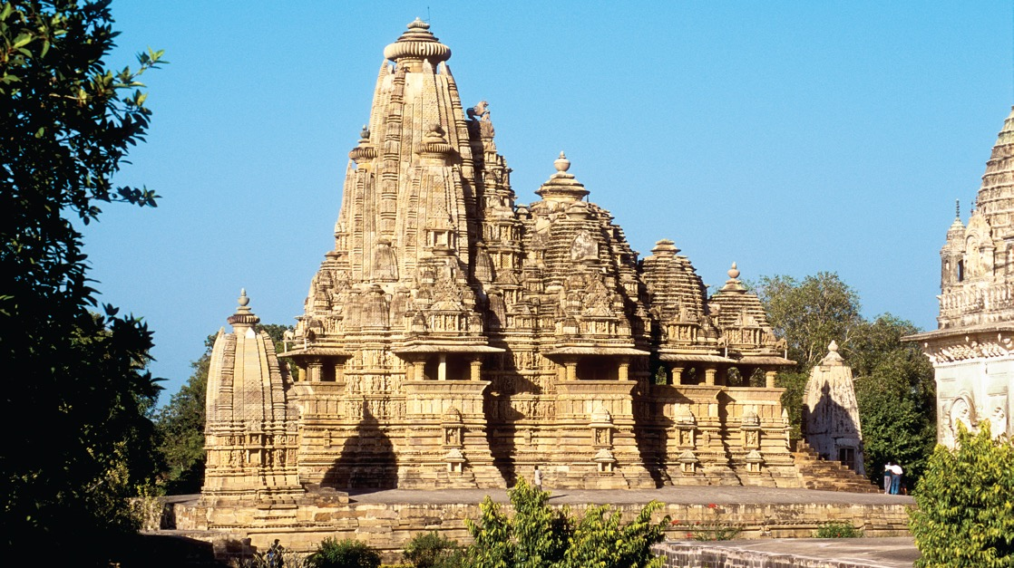
Kandariya Mahadeva Temple, Khajuraho, India, c. 1000 CE

Slide 9
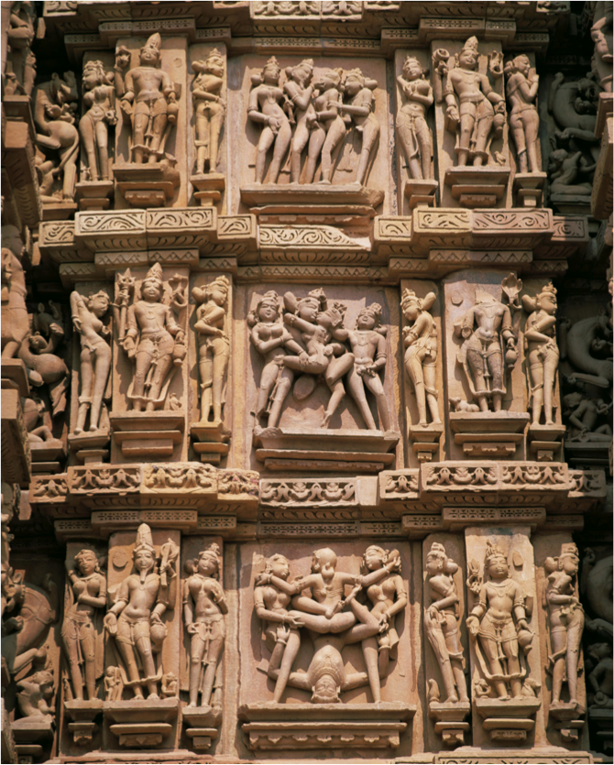
Erotic Couples,
on Wall of Kandariya Mahadeva
Temple, Khajurado, India

Slide 10
Buddhism and Art

Slide 11
The Four Noble Truths
1. Life is suffering (Suffering exists, both physical and psychological)
2. Suffering has a cause~~Ignorance (attachment to desires)
3. Ignorance can be overcome (Suffering ceases when attachment to desires ceases~~Nirvana is attained)
4. The way to overcome ignorance, or freedom from suffering, is by following the Eight Fold Path

Slide 12
Eight Fold Path
Right View
Right Intention
Right Speech
Right Action
Right Livelihood
Right Effort
Right Mindfulness
Right Concentration

Slide 13
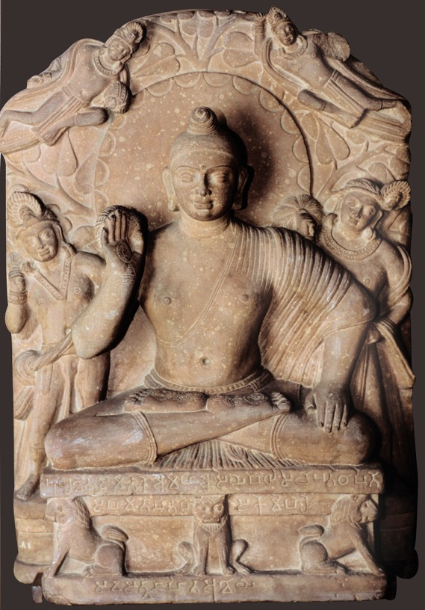
Mudras
Urna
Ushnisha
Chakra
Buddha on Lion Throne with Attendants,
Mathura, India,
2nd century ce
Red sandstone, 2' 3 1/2" high.

Slide 14
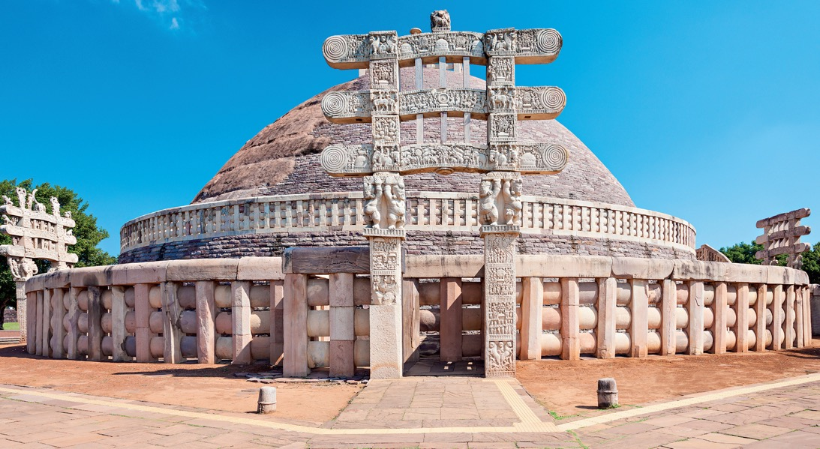
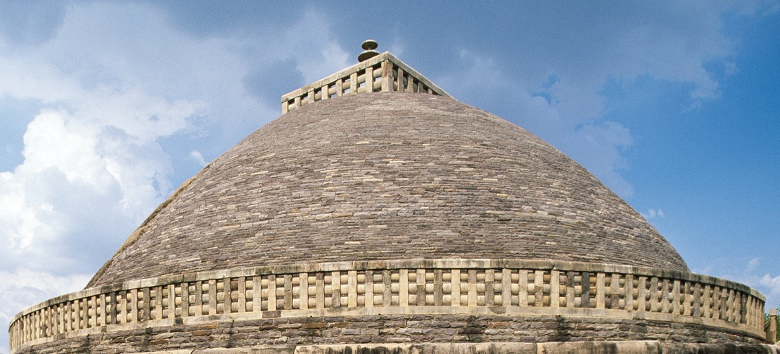
Great Stupa, Sanchi, India,
3rd century bce to 1st century ce

Slide 15
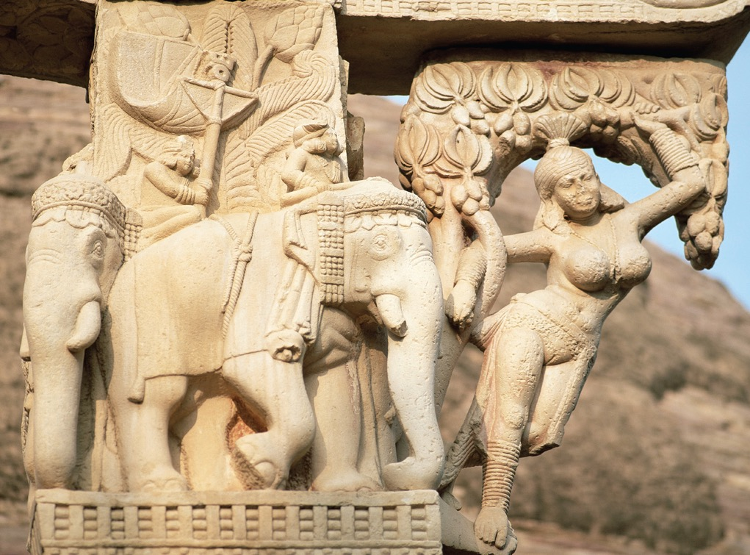
Yakshi , Great Stupa

Slide 16
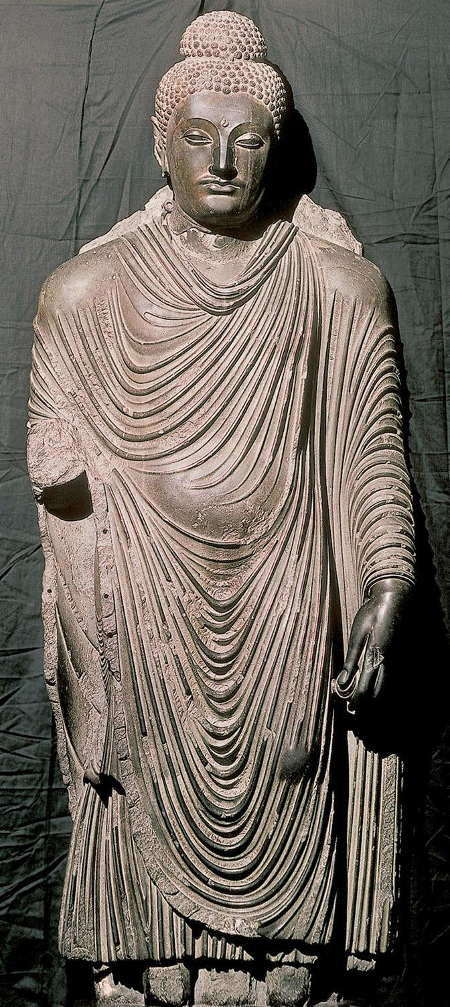
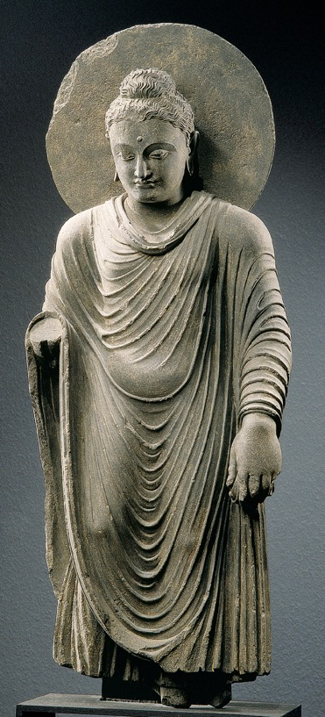
Standing Buddha, From Gandhara, Pakistan, Kushan Period C. 2nd -3rd century CE

Slide 17
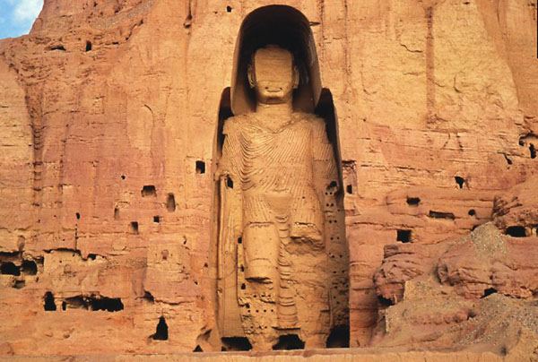
Standing Buddha, Afghanistan, c. 5th century BCE

Slide 18
