Slide 1
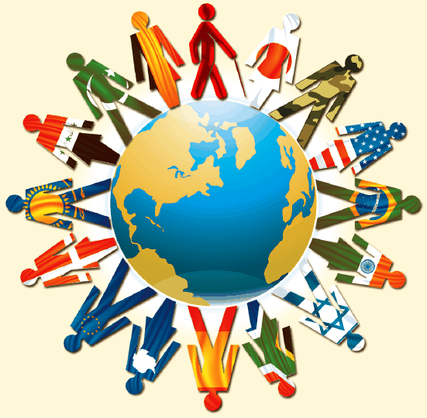
Diversity
Career Orientation

Slide 2
Where are we diverse?
Racial
Ethnic
Cultural
Gender
Sexual Orientation
Disabilities
Socio Economic
Age
Others?

Slide 3
What does it mean to celebrate diversity?
“…a system of beliefs and behaviors that recognizes and respects the presence of all diverse groups in an organization or society, acknowledges and values their differences, and encourages and enables their continued contribution within an inclusive context which empowers all within the organization or society.
  recognition of the abundant diversity of cultures
  respect for the differences
  acknowledging the validity of different expressions and contributions
  valuing what others have to offer
  encouraging the contribution of diverse groups
  empowering people to strengthen themselves and others to achieve their maximum potential by being critical of their own biases
  celebrating rather than just tolerating the differences in order to bring about unity through diversity.

Slide 4
Benefits All
Diversity is important because our country, workplaces, and schools increasingly consist of various groups. We can learn from one another, but first we must have a level of understanding about each other in order to facilitate collaboration and cooperation.

Slide 5
How can we as individuals support diversity?
Increase level of understanding about other cultures by interacting with people outside of our own culture—meaningful relationships may never develop simply due to a lack of understanding.
Avoid imposing values on others that may conflict/ be inconsistent with cultures other than ours.
Recognize and understand that concepts within the helping profession, such as family, gender roles, spirituality, and emotional well-being, vary significantly among cultures and influence behavior.
Within the workplace, educational setting, and/or clinical setting, advocate for the use of materials that are representative of the various groups within the local community and the society in general.
Intervene in an appropriate manner when you observe others engaging in behaviors that show insensitivity, bias, or prejudice.
Be proactive in listening, accepting, and welcoming people and ideas that are different from your own.

Slide 6
Advantages in the workplace
An organization’s success and competitiveness often depend upon its ability to embrace diversity and realize its benefits
Organizations should actively assess their handling of workplace diversity issues
Organizations must work to overcome perceptual, cultural, and language barriers for their diversity programs to succeed
Workers with diverse cultural backgrounds have unique experiences and perceptions that strengthen productivity
Properly managed diversity makes it possible to leverage the strengths of employees and complement their weaknesses
Diversity can strengthen relationships with customers by making communication more effective
More diverse companies win in innovation and outperform their competitors
Diverse teams are more creative and are better at solving problems
More:

Slide 7
How Employers Balance Diversity
A diverse workplace does not simply hire workers from various groups and balance its ratio; rather, diverse workplaces includes people with different experiences, varying personalities, and different levels of experience to foster creativity and offer a range of viewpoints and ideas
Workers from diverse backgrounds offer a selection of different talents and skills that benefit the organization and improve their work performance
Hiring workers who speak different languages helps companies work on a global basis and interact with a broader customer base

Slide 8
How Employers Balance Diversity cont.
Companies that manage diversity well incorporate cross-cultural diversity and inclusion training to ensure everyone feels validated and important regardless of his differences
Proactive companies manage and promote diversity, which improves morale and promotes positivity in the workplace
Culturally-diverse workplaces empower companies to expand into worldwide markets and better mimic the communities they serve
Strong workplaces have a variety of ideology to connect with customers better and avoid an environment in which everyone thinks the same way
Diversity becomes a powerful tool for business growth when you take a genuine approach to it and don’t view it as something you need to do in order to comply with laws and regulations
Diverse workplaces featuring employees with a broad range of inherent and acquired diversity benefit from a larger pool of different ideas and perspectives with which to work

Slide 9
Take a moment to reflect and upload to mycourses:
What does diversity mean to you?
What are 3 groups that come to mind when you think of diversity?
How does diversity improve society?
How can diversity improve an organization?

